Slide 1

DA 322 DEEP LEARNING Course Project

Slide 2
Agenda
Introduction
Motivation
Application / Use Cases
Literature Review
Objectives
Methodology
Dataset
Results
Summary

Slide 3

Introduction
In today's digital age, the rapid advancement of artificial intelligence has revolutionized the way we interact with and consume media. However, alongside these innovations comes the proliferation of deepfakes, AI-generated content that raises concerns about the authenticity and integrity of visual information.
In response to these challenges, our project endeavors to develop an AI image classifier capable of discerning between authentic and AI-generated images using CNNs.

Slide 4

Motivation
The motivation behind this project is to combat the proliferation of deepfakes, which threaten to erode trust in visual media and facilitate the spread of misinformation. By developing an AI image classifier capable of distinguishing between authentic and AI-generated images, we aim to empower individuals to critically evaluate digital content and uphold the integrity of online information.

Slide 5
Applications
Media Verification: News organizations, journalists, and fact-checkers can use the classifier to verify the authenticity of images and videos before publishing or reporting on them.
Social Media Platforms: Social media platforms can integrate the classifier into their content moderation systems to detect and flag potentially deceptive or manipulated content.
Forensic Analysis: Law enforcement agencies and forensic experts can leverage the classifier in forensic investigations to authenticate digital evidence, such as surveillance footage or images submitted as legal documentation.
Content Creation: Content creators, photographers, and artists can use the classifier to ensure the integrity of their work and protect against unauthorized alterations or misuse of their images.

Slide 6

Literature Review

Slide 7
Literature Review
Carlini, Nicholas, and Hany Farid. "Evading deepfake-image detectors with white-and black-box attacks." In Proceedings of the IEEE/CVF conference on computer vision and pattern recognition workshops, pp. 658-659. 2020.
Khoo, Brandon, Raphaël C‐W. Phan, and Chern‐Hong Lim. "Deepfake attribution: On the source identification of artificially generated images." Wiley Interdisciplinary Reviews: Data Mining and Knowledge Discovery 12, no. 3 (2022): e1438.
Cao, Xiaoyu, and Neil Zhenqiang Gong. "Understanding the security of deepfake detection." In International Conference on Digital Forensics and Cyber Crime, pp. 360-378. Cham: Springer International Publishing, 2021.

Slide 8

Our Model
An AI Image Classifier

Slide 9
Objective
The objective of the project is to develop an AI image classifier capable of accurately distinguishing between AI-generated and real images. This classifier aims to mitigate the spread of misinformation by providing a tool to authenticate visual content in the digital realm.
Additionally, the project seeks to promote media integrity and transparency by empowering individuals to make informed decisions about the authenticity of images they encounter online. Through the application of advanced machine learning techniques and rigorous evaluation, the project strives to contribute to a more trustworthy and reliable digital landscape.

Slide 10
Data Collection & Preprocessing
We employed Selenium, a web automation tool, along with Beautiful Soup, a Python library for web scraping, to systematically gather images from search engine results pages.
Additionally, PyImage was utilized to craft search queries specifically targeting AI-generated and real images, ensuring the collection of relevant and diverse samples.
Following data collection, rigorous preprocessing techniques were applied to standardize the images to a uniform size, facilitating seamless integration into the neural network model.
By combining these methods, we curated a high-quality dataset primed for training an accurate and robust image classifier capable of discerning between AI-generated and real images effectively.

Slide 11
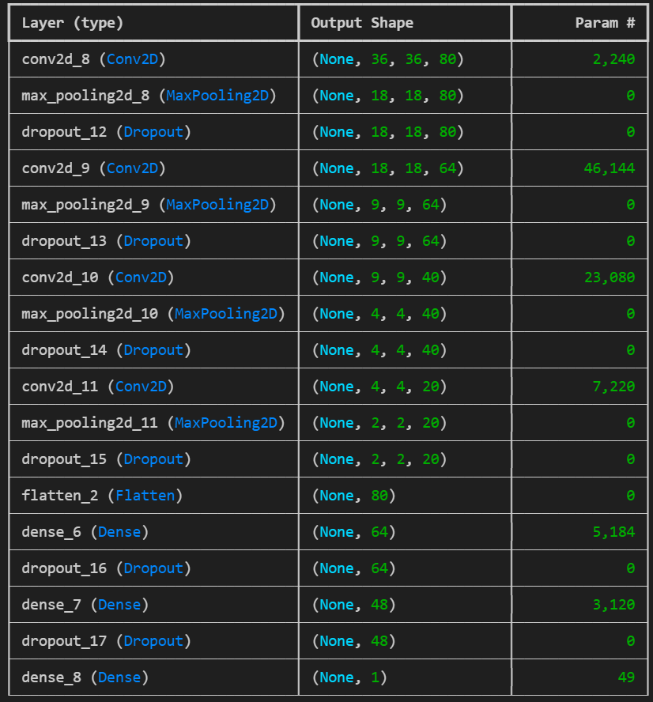
Methodology
Our method created an 18 layered CNN architecture, suitable for image colorization tasks. It involved 87,037 trainable parameters.
The model architecture employs convolutional layers, max-pooling layers, and dropout regularization to facilitate image classification. ReLU activation functions are utilized within both convolutional and dense layers to introduce non-linearity and enable complex pattern learning.
The model was trained for 10 epochs.
Adam was used as the optimizer and Sparse Categorical Cross-entropy was used as the loss function.

Slide 12
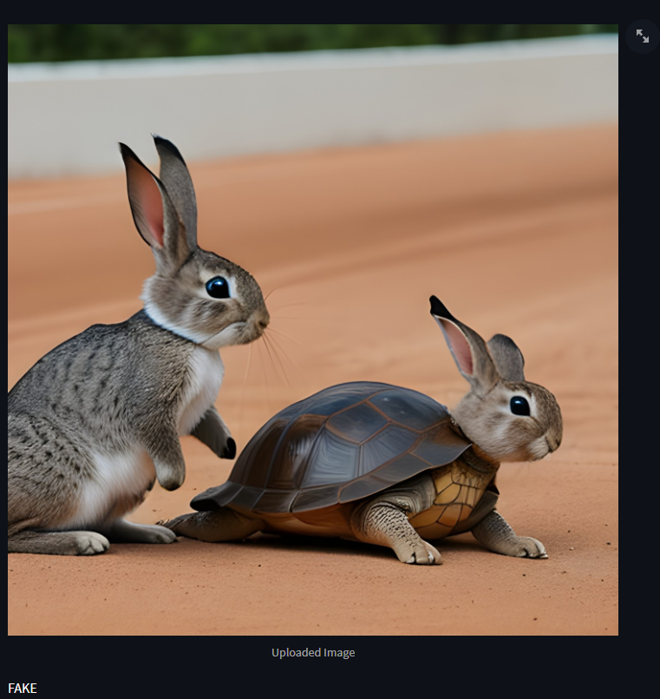
Results
Precision
Our model had a precision of 0.96 and 0.92 for classes 0 and 1 respectively.
Recall
Our model had a precision of 0.92 and 0.96 for classes 0 and 1 respectively.
F1-score
The F1 score of out model was 0.95
Class | Precision | Recall | F1 Score
0 | 0.96 | 0.92 | 0.94
1 | 0.92 | 0.96 | 0.94
Accuracy |  |  | 0.94
Macro Avg | 0.94 | 0.94 | 0.94
Weighted Avg | 0.94 | 0.94 | 0.94

Slide 13
Summary
The project aimed to develop an AI image classifier capable of distinguishing between AI-generated and real images to address concerns surrounding the spread of misinformation and the authenticity of visual content in the digital realm.
Using web scraping techniques and publicly available datasets, a comprehensive dataset of images was collected and preprocessed to ensure uniformity and quality.
The model architecture, comprising convolutional layers, max-pooling layers, and dropout regularization, was designed to effectively process and classify visual data. Through rigorous training and evaluation, the model learned to accurately differentiate between AI-generated and real images. In future, we aim to deploy this project as a user-friendly application facilitates its accessibility and usability, empowering individuals to verify the authenticity of images and combat the proliferation of manipulated media.

Slide 14

Thank you
Sahil Danayak
Roll No. 210101092
Aasneh Prasad
Roll No. 210101001

