Slide 1
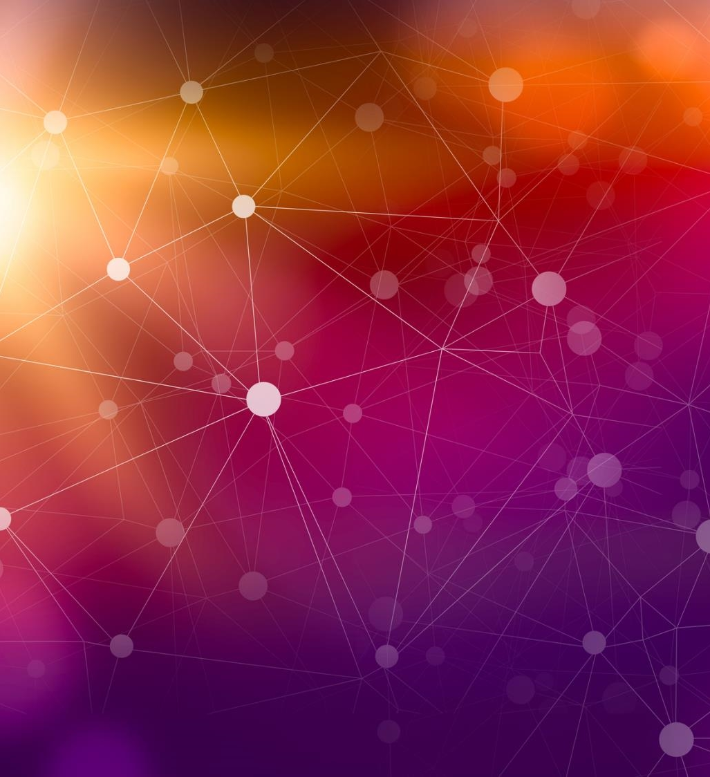
DA 322 DEEP LEARNING Course Project

Slide 2
Agenda
Introduction
Motivation
Application / Use Cases
Literature Review
Objectives
Methodology
Dataset
Results
Summary

Slide 3

Introduction
In today's digital age, the rapid advancement of artificial intelligence has revolutionized the way we interact with and consume media. However, alongside these innovations comes the proliferation of deepfakes, AI-generated content that raises concerns about the authenticity and integrity of visual information.
In response to these challenges, our project endeavors to develop an AI image classifier capable of discerning between authentic and AI-generated images using CNNs.

Slide 4

Motivation
The motivation behind this project is to combat the proliferation of deepfakes, which threaten to erode trust in visual media and facilitate the spread of misinformation. By developing an AI image classifier capable of distinguishing between authentic and AI-generated images, we aim to empower individuals to critically evaluate digital content and uphold the integrity of online information.

Slide 5
Applications
Media Verification: News organizations, journalists, and fact-checkers can use the classifier to verify the authenticity of images and videos before publishing or reporting on them.
Social Media Platforms: Social media platforms can integrate the classifier into their content moderation systems to detect and flag potentially deceptive or manipulated content.
Forensic Analysis: Law enforcement agencies and forensic experts can leverage the classifier in forensic investigations to authenticate digital evidence, such as surveillance footage or images submitted as legal documentation.
Content Creation: Content creators, photographers, and artists can use the classifier to ensure the integrity of their work and protect against unauthorized alterations or misuse of their images.

Slide 6

Literature Review

Slide 7
Literature Review

Slide 8
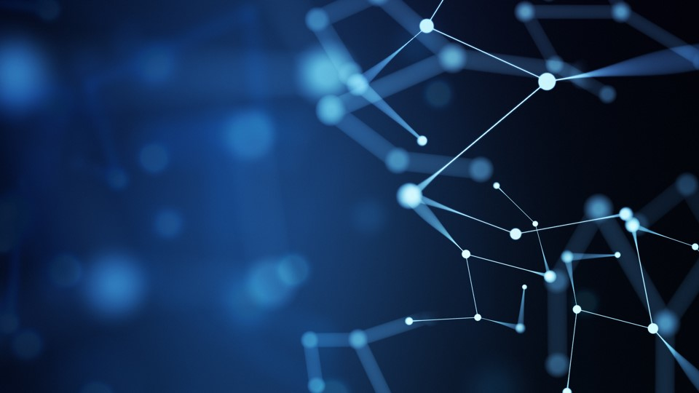
Our Model
An AI Image Classifier

Slide 9
Objective

Slide 10
Data Collection & Preprocessing
We employed Selenium, a web automation tool, along with Beautiful Soup, a Python library for web scraping, to systematically gather images from search engine results pages.
Additionally, PyImage was utilized to craft search queries specifically targeting AI-generated and real images, ensuring the collection of relevant and diverse samples.
Following data collection, rigorous preprocessing techniques were applied to standardize the images to a uniform size, facilitating seamless integration into the neural network model.
By combining these methods, we curated a high-quality dataset primed for training an accurate and robust image classifier capable of discerning between AI-generated and real images effectively.

Slide 11
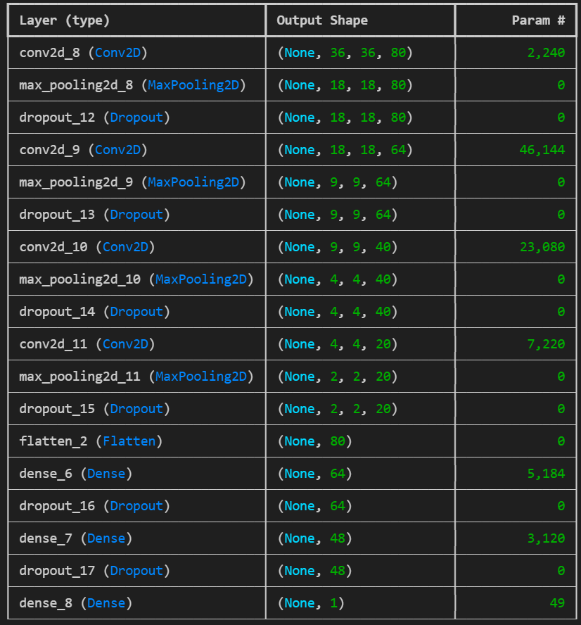
Methodology
Our method created an 18 layered CNN architecture, suitable for image colorization tasks. It involved 87,037 trainable parameters.
The model architecture employs convolutional layers, max-pooling layers, and dropout regularization to facilitate image classification. ReLU activation functions are utilized within both convolutional and dense layers to introduce non-linearity and enable complex pattern learning.
The model was trained for 10 epochs.
Adam was used as the optimizer and Sparse Categorical Cross-entropy was used as the loss function.

Slide 12
Results
Precision
Our model had a precision of 0.96 and 0.92 for classes 0 and 1 respectively.
Recall
Our model had a precision of 0.92 and 0.96 for classes 0 and 1 respectively.
F1-score
The F1 score of out model was 0.95
Class | Precision | Recall | F1 Score
0 | 0.96 | 0.92 | 0.94
1 | 0.92 | 0.96 | 0.94
Accuracy |  |  | 0.94
Macro Avg | 0.94 | 0.94 | 0.94
Weighted Avg | 0.94 | 0.94 | 0.94

Slide 13
Summary

Slide 14
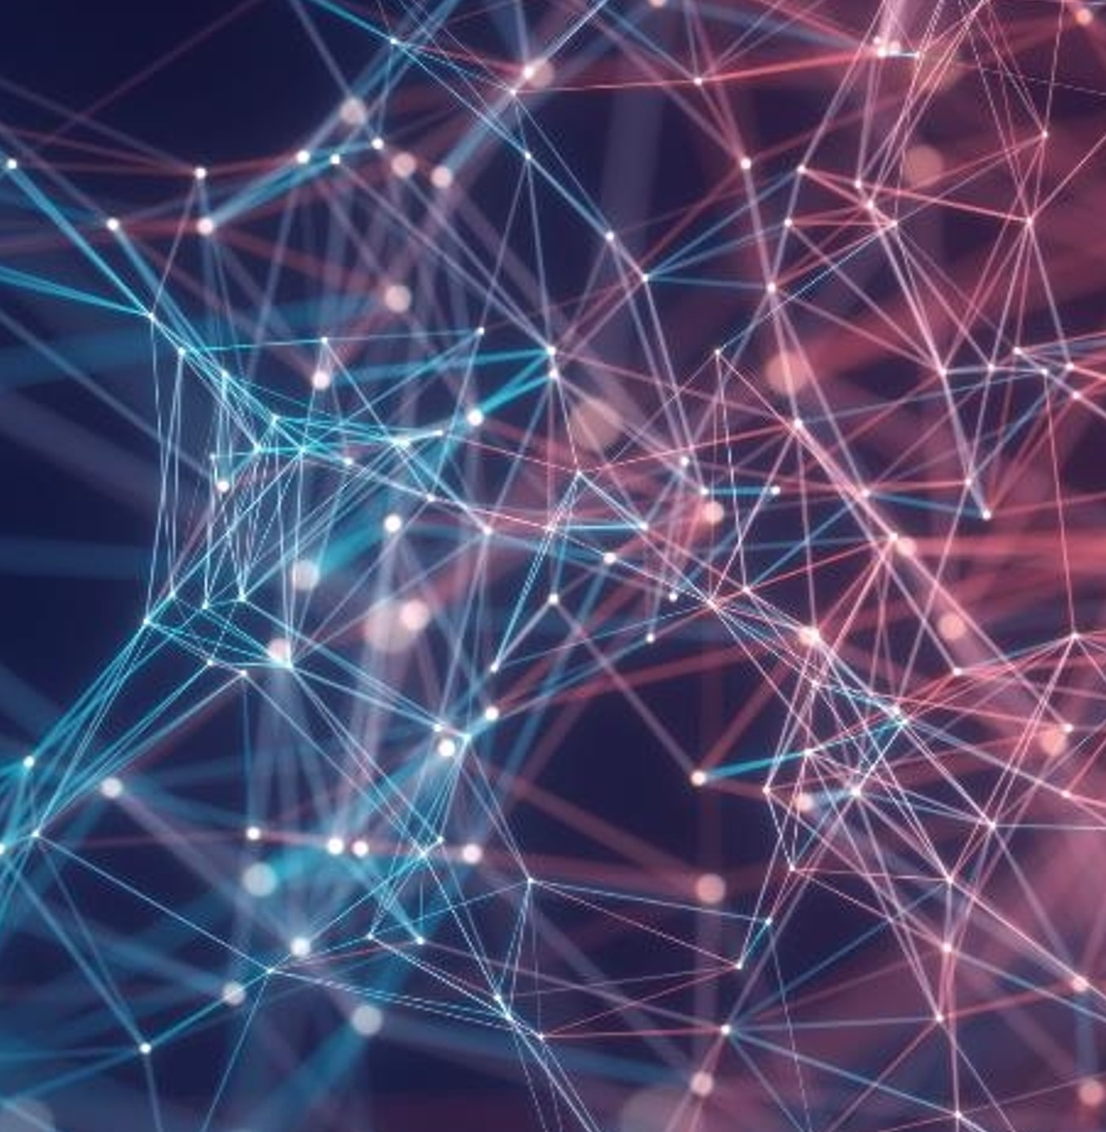
Thank you
Sahil Danayak
Roll No. 210101092
Aasneh Prasad
Roll No. 210101001

