Slide 1
DAMG 6210 Database Design
Nik Bear Brown
@NikBearBrown
Python for MySQL

Slide 2
Topics
Introduction to Python

Slide 3
Python
Scripting Language
Object-Oriented
Portable
Powerful
Easy to learn and use
Widely used for API’s
Lots of scientific libraries

Slide 4
Python
Python is a high-level programming language
Open source and community driven
“Batteries Included”
a standard distribution includes many modules
Dynamically typed
Source can be compiled or run just-in-time
Scripting language
Many mathematical and scientific libraries

Slide 5
Hello World
Hello World
print “hello world”
Prints hello world to standard out

Slide 6
Built-in Object Types
Numbers - 3.1415, 1234, 999L, 3+4j
Strings - 'spam', "guido's"
Lists - [1, [2, 'three'], 4]
Dictionaries - {'food':'spam', 'taste':'yum'}
Tuples - (1, 'spam', 4, 'U')
Files - text = open ('eggs', 'r'). read()

Slide 7
Variables
No need to declare data type
Need to assign (initialize)
use of uninitialized variable raises exception
Not typed
if friendly: greeting = "hello world"
else: greeting = 12**2
print greeting
Everything is a "variable":
Even functions, classes, modules

Slide 8
Numbers
The usual suspects
12, 3.14, 0xFF, 0377, (-1+2)*3/4**5, abs(x), 0<x<=5
C-style shifting & masking
1<<16, x&0xff, x|1, ~x, x^y
Integer division truncates :-(
1/2 -> 0 # 1./2. -> 0.5, float(1)/2 -> 0.5
Will be fixed in the future
Long (arbitrary precision), complex
2L**100 -> 1267650600228229401496703205376L
In Python 2.2 and beyond, 2**100 does the same thing
1j**2 -> (-1+0j)

Slide 9
Indentation and Blocks
Python uses whitespace and indents to denote blocks of code
Lines of code that begin a block end in a colon:
Lines within the code block are indented at the same level
To end a code block, remove the indentation
You'll want blocks of code that run only when certain conditions are met

Slide 10
Grouping Indentation
0
Bingo!
---
---
---
3
---
---
---
6
---
---
---
9
---
---
---
12
---
---
---
15
Bingo!
---
---
---
18
---
---
In C:
for (i = 0; i < 20; i++)
{
if (i%3 == 0) {
printf("%d\n", i);
if (i%5 == 0) {
printf("Bingo!\n"); }
}
printf("---\n");
}
In Python:
for i in range(20):
if i%3 == 0:
print i
if i%5 == 0:
print "Bingo!"
print "---"

Slide 11
Conditional Branching
if and else
if variable == condition: #do something based on v == c
else:
#do something based on v != c
elif allows for additional branching
if condition:
elif another condition:
…
else: #none of the above

Slide 12
Control Structures
if condition:
statements
[elif condition:
statements] ...
else:
statements
while condition:
statements
for var in sequence:
statements
break
continue

Slide 13
Looping with for
For allows you to loop over a block of code a set number of times
For is great for manipulating lists:
a = ['cat', 'window', 'defenestrate'] for x in a: print x, len(x)
Results:
cat 3
window 6
defenestrate 12

Slide 14
Looping with while
while <boolean>:
statement 1
statement 2
statement 3

Slide 15
break, continue
Checking 3
The square is 9
Checking 1
Ignoring
Checking 4
The square is 16
Checking 1
Ignoring
Checking 5
The square is 25
Checking 9
Exiting for loop
>>>
>>> for value in [3, 1, 4, 1, 5, 9, 2]:
... print "Checking", value
... if value > 8:
... print "Exiting for loop"
... break
... elif value < 3:
... print "Ignoring"
... continue
... print "The square is", value**2
...
Use “break” to stop
the for loop
Use “continue” to stop
processing the current item

Slide 16
Range()
“range” creates a list of numbers in a specified range
range([start,] stop[, step]) -> list of integers
When step is given, it specifies the increment (or decrement).
>>> range(5)
[0, 1, 2, 3, 4]
>>> range(5, 10)
[5, 6, 7, 8, 9]
>>> range(0, 10, 2)
[0, 2, 4, 6, 8]
How to get every second element in a list?
for i in range(0, len(data), 2):
print data[i]

Slide 17
Modules/Libraries
Modules are additional pieces of code that further extend Python’s functionality
A module typically has a specific function
additional math functions, databases, network…
Python comes with many useful modules

Slide 18
Operators
Booleans: and or not < <= >= > == != <>
Identity: is, is not
Membership: in, not in
Bitwise: | ^ & ~
No ++ -- +=, etc.

Slide 19
String Operators
Concatenation: +
Repeat: *
Index: str[i]
Slice: str[i:j]
Length: len( str )
String Formatting: "a %s parrot" % 'dead‘
Iteration: for char in str
Membership: ‘m’ in str

Slide 20
String Methods
Assign a string to a variable
hi = “hello world”
In this case “hw”
hi.title()
hi.upper()
hi[0].isdigit()
hi[0].islower()

Slide 21
Strings
"hello"+"world" "helloworld" # concatenation
"hello"*3 "hellohellohello" # repetition
"hello"[0] "h" # indexing
"hello"[-1] "o" # (from end)
"hello"[1:4] "ell" # slicing
len("hello") 5 # size
"hello" < "jello" 1 # comparison
"e" in "hello" 1 # search
"escapes: \n etc, \033 etc, \if etc"
'single quotes' """triple quotes""" r"raw strings"

Slide 22
String Methods
The string held in your variable remains the same
The method returns an altered string
Changing the variable requires reassignment
hi = hi.upper()
hi now equals “HELLO WORLD”

Slide 23
Common Statements
Assignment - curly, moe, larry = 'good', 'bad', 'ugly'
Calls - stdout.write("spam, ham, toast\n")
Print - print 'The Killer', joke
If/elif/else - if "python" in text: print text
For/else - for X in mylist: print X
While/else - while 1: print 'hello'
Break, Continue - while 1: if not line: break
Try/except/finally - try: action() except: print 'action error'

Slide 24
Common Statements
Raise - raise endSearch, location
Import, From - import sys; from sys import stdin
Def, Return - def f(a, b, c=1, d): return a+b+c+d
Class - class subclass: staticData = []
Global - function(): global X, Y; X = 'new'
Del - del data[k]; del data [i:j]; del obj.attr
Exec - yexec "import" + modName in gdict, ldict
Assert - assert X > Y

Slide 25
Interactive “Shell”
Great for learning the language
Great for experimenting with the library
Great for testing your own modules
Two variations: IDLE (GUI), python (command line)
Type statements or expressions at prompt:
>>> print "Hello, world"
Hello, world
>>> x = 12**2
>>> x/2
72
>>> # this is a comment

Slide 26
Reference Semantics
Assignment manipulates references
x = y does not make a copy of y
x = y makes x reference the object y references
Very useful; but beware!
Example:
>>> a = [1, 2, 3]
>>> b = a
>>> a.append(4)
>>> print b
[1, 2, 3, 4]

Slide 27
Functions, Procedures
def name(arg1, arg2, ...):
"""documentation""" # optional doc string
statements
return # from procedure
return expression # from function

Slide 28
Example Function
def gcd(a, b):
"greatest common divisor"
while a != 0:
a, b = b%a, a # parallel assignment
return b
>>> gcd.__doc__
'greatest common divisor'
>>> gcd(12, 20)
4

Slide 29
Using Functions
We use the def statement to start a block of code that will only be run when our function is called
We want our functions to return values we can use in our geoprocessing
The last statement in our function should be return.

Slide 30
Basic Function
A simple function that adds 1 to value passed
def addone(x): return x + 1
print addone(2) >>> 3
var = addone(3) print var >>> 4

Slide 31
Python Data Structures
Lists (mutable sets of strings)
var = [] # create list
var = [‘one’, 2, ‘three’, ‘banana’]
Tuples (immutable sets)
var = (‘one’, 2, ‘three’, ‘banana’)
Dictionaries (associative arrays or ‘hashes’)
var = {} # create dictionary
var = {‘lat’: 40.20547, ‘lon’: -74.76322}
var[‘lat’] = 40.2054
Each has its own set of methods

Slide 32
Lists
Flexible arrays, not Lisp-like linked lists
a = [99, "bottles of beer", ["on", "the", "wall"]]
Same operators as for strings
a+b, a*3, a[0], a[-1], a[1:], len(a)
Item and slice assignment
a[0] = 98
a[1:2] = ["bottles", "of", "beer"]
-> [98, "bottles", "of", "beer", ["on", "the", "wall"]]
del a[-1] # -> [98, "bottles", "of", "beer"]

Slide 33
More Dictionary Ops
Keys, values, items:
d.keys() -> ["duck", "back"]
d.values() -> ["duik", "rug"]
d.items() -> [("duck","duik"), ("back","rug")]
Presence check:
d.has_key("duck") -> 1; d.has_key("spam") -> 0
Values of any type; keys almost any
{"name":"Guido", "age":43, ("hello","world"):1, 42:"yes", "flag": ["red","white","blue"]}

Slide 34
More List Operations
>>> a = range(5) # [0,1,2,3,4]
>>> a.append(5) # [0,1,2,3,4,5]
>>> a.pop() # [0,1,2,3,4]
5
>>> a.insert(0, 42) # [42,0,1,2,3,4]
>>> a.pop(0) # [0,1,2,3,4]
5.5
>>> a.reverse() # [4,3,2,1,0]
>>> a.sort() # [0,1,2,3,4]

Slide 35
Dictionaries
Hash tables, "associative arrays"
d = {"duck": "eend", "water": "water"}
Lookup:
d["duck"] -> "eend"
d["back"] # raises KeyError exception
Delete, insert, overwrite:
del d["water"] # {"duck": "eend", "back": "rug"}
d["back"] = "rug" # {"duck": "eend", "back": "rug"}
d["duck"] = "duik" # {"duck": "duik", "back": "rug"}

Slide 36
Lists
Think of a list as a stack of cards, on which your information is written
The information stays in the order you place it in until you modify that order
Methods return a string or subset of the list or modify the list to add or remove components
Written as var[index], index refers to order within set (think card number, starting at 0)
You can step through lists as part of a loop

Slide 37
List Methods
Adding to the List
var[n] = object
replaces n with object
var.append(object)
adds object to the end of the list
Removing from the List
var[n] = []
empties contents of card, but preserves order
var.remove(n)
removes card at n
var.pop(n)
removes n and returns its value

Slide 38
Tuples
Like a list, tuples are iterable arrays of objects
Tuples are immutable – once created, unchangeable
To add or remove items, you must redeclare
Example uses of tuples
County Names
Land Use Codes
Ordered set of functions

Slide 39
Dictionaries
Dictionaries are sets of key & value pairs
Allows you to identify values by a descriptive name instead of order in a list
Keys are unordered unless explicitly sorted
Keys are unique:
var[‘item’] = “apple”
var[‘item’] = “banana”
print var[‘item’] prints just banana

Slide 40
Dictionary Details
Keys must be immutable:
numbers, strings, tuples of immutables
these cannot be changed after creation
reason is hashing (fast lookup technique)
not lists or other dictionaries
these types of objects can be changed "in place"
no restrictions on values
Keys will be listed in arbitrary order
again, because of hashing

Slide 41
Tuples
key = (lastname, firstname)
point = x, y, z # parentheses optional
x, y, z = point # unpack
lastname = key[0]
singleton = (1,) # trailing comma!!!
empty = () # parentheses!
tuples vs. lists; tuples immutable

Slide 42
Modules
Collection of stuff in foo.py file
functions, classes, variables
Importing modules:
import re; print re.match("[a-z]+", s)
from re import match; print match("[a-z]+", s)
Import with rename:
import re as regex
from re import match as m
Before Python 2.0:
import re; regex = re; del re

Slide 43
Packages
Collection of modules in directory
Must have __init__.py file
May contain subpackages
Import syntax:
from P.Q.M import foo; print foo()
from P.Q import M; print M.foo()
import P.Q.M; print P.Q.M.foo()
import P.Q.M as M; print M.foo() # new

Slide 44
Catching Exceptions
def foo(x):
return 1/x
def bar(x):
try:
print foo(x)
except ZeroDivisionError, message:
print "Can’t divide by zero:", message
bar(0)

Slide 45
Try-finally: Cleanup
f = open(file)
try:
process_file(f)
finally:
f.close() # always executed
print "OK" # executed on success only

Slide 46
Raising Exceptions
raise IndexError
raise IndexError("k out of range")
raise IndexError, "k out of range"
try: something except: # catch everything print "Oops" raise # reraise

Slide 47
More on Exceptions
User-defined exceptions
subclass Exception or any other standard exception
Old Python: exceptions can be strings
WATCH OUT: compared by object identity, not ==
Last caught exception info:
sys.exc_info() == (exc_type, exc_value, exc_traceback)
Last uncaught exception (traceback printed):
sys.last_type, sys.last_value, sys.last_traceback
Printing exceptions: traceback module

Slide 48
File Objects
f = open(filename[, mode[, buffersize])
mode can be "r", "w", "a" (like C stdio); default "r"
append "b" for text translation mode
append "+" for read/write open
buffersize: 0=unbuffered; 1=line-buffered; buffered
methods:
read([nbytes]), readline(), readlines()
write(string), writelines(list)
seek(pos[, how]), tell()
flush(), close()
fileno()

Slide 49
Standard Library
Core:
os, sys, string, getopt, StringIO, struct, pickle, ...
Regular expressions:
re module; Perl-5 style patterns and matching rules
Internet:
socket, rfc822, httplib, htmllib, ftplib, smtplib, ...
Miscellaneous:
pdb (debugger), profile+pstats
Tkinter (Tcl/Tk interface), audio, *dbm, ...

Slide 50
Standard Library
https://docs.python.org/2/library/index.html
The Python Standard Library
While The Python Language Reference describes the exact syntax and semantics of the Python language, this library reference manual describes the standard library that is distributed with Python. It also describes some of the optional components that are commonly included in Python distributions

Slide 51
Classes
class name:
"documentation"
statements
-or-
class name(base1, base2, ...):
...
Most, statements are method definitions:
def name(self, arg1, arg2, ...):
...
May also be class variable assignments

Slide 52
Example Class
class Stack:
"A well-known data structure…"
def __init__(self): # constructor
self.items = []
def push(self, x):
self.items.append(x) # the sky is the limit
def pop(self):
x = self.items[-1] # what happens if it’s empty?
del self.items[-1]
return x
def empty(self):
return len(self.items) == 0 # Boolean result

Slide 53
Using Classes
To create an instance, simply call the class object:
x = Stack() # no 'new' operator!
To use methods of the instance, call using dot notation:
x.empty() # -> 1
x.push(1) # [1]
x.empty() # -> 0
x.push("hello") # [1, "hello"]
x.pop() # -> "hello" # [1]
To inspect instance variables, use dot notation:
x.items # -> [1]

Slide 54
Subclassing
class FancyStack(Stack):
"stack with added ability to inspect inferior stack items"
def peek(self, n):
"peek(0) returns top; peek(-1) returns item below that; etc."
size = len(self.items)
assert 0 <= n < size # test precondition
return self.items[size-1-n]

Slide 55
Subclassing (2)
class LimitedStack(FancyStack):
"fancy stack with limit on stack size"
def __init__(self, limit):
self.limit = limit
FancyStack.__init__(self) # base class constructor
def push(self, x):
assert len(self.items) < self.limit
FancyStack.push(self, x) # "super" method call

Slide 56
Class / Instance Variables
class Connection:
verbose = 0 # class variable
def __init__(self, host):
self.host = host # instance variable
def debug(self, v):
self.verbose = v # make instance variable!
def connect(self):
if self.verbose: # class or instance variable?
print "connecting to", self.host

Slide 57
Instance Variable Rules
On use via instance (self.x), search order:
(1) instance, (2) class, (3) base classes
this also works for method lookup
On assignment via instance (self.x = ...):
always makes an instance variable
Class variables "default" for instance variables
But...!
mutable class variable: one copy shared by all
mutable instance variable: each instance its own

Slide 58
Python 2.6 or 2.7
Python 2.6 or 2.7
Not 3+

Slide 59
NumPy
NumPy is the fundamental package for scientific computing with Python. It is a Python library that provides a multidimensional array object, various derived objects (such as masked arrays and matrices), and an assortment of routines for fast operations on arrays, including mathematical, logical, shape manipulation, sorting, selecting, I/O, discrete Fourier transforms, basic linear algebra, basic statistical operations, random simulation and much more.

Slide 60
SciPy
SciPy (pronounced “Sigh Pie”) is a computing environment and open source ecosystem of software for the Python programming language used by scientists, analysts and engineers doing scientific computing and technical computing. SciPy also refers to a specific open source library / Python package of algorithms and mathematical tools that form a core element of the SciPy environment for technical computing. The SciPy environment includes the NumPy and SciPy libraries, along with an expanding set of additional scientific computing libraries like IPython, Matplotlib, pandas and SymPy. It has similar users to other applications such as MATLAB, GNU Octave, and Scilab.

Slide 61
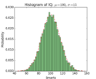
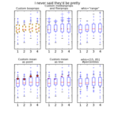
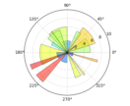
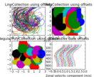
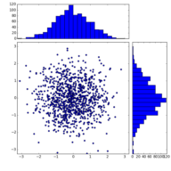
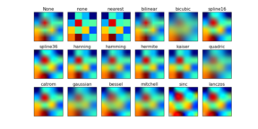
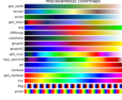
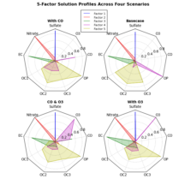
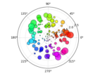
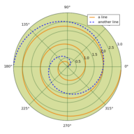
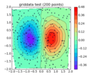
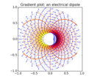
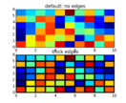
matplotlib

Slide 62
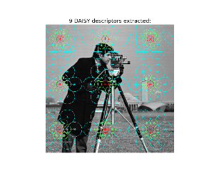
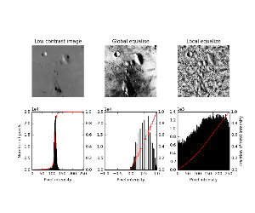
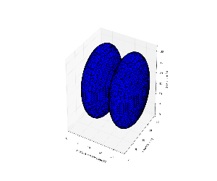
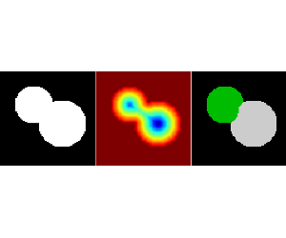
scikit-image
scikit-image is a collection of algorithms for image processing. http://scikit-image.org/docs/dev/auto_examples/

Slide 63
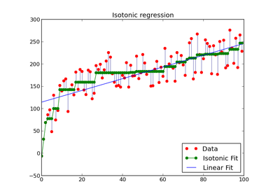
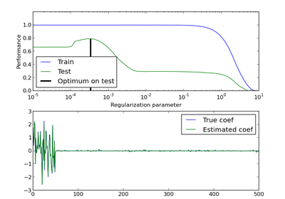
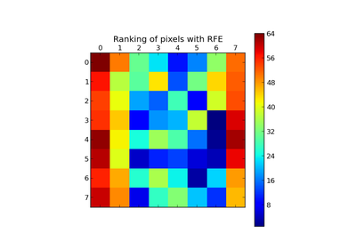
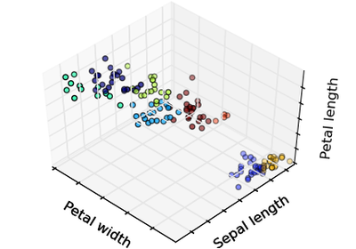
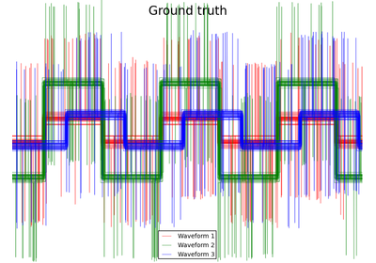
scikit-learn
scikit-learn Machine Learning in Python. Simple and efficient tools for data mining and data analysis. http://scikit-learn.org/stable/auto_examples/

Slide 64
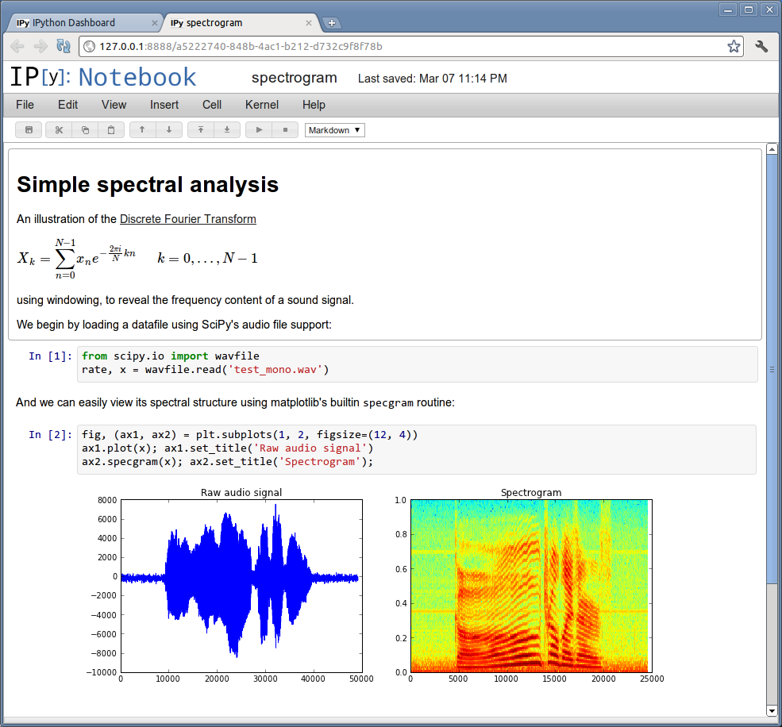
IPython
The IPython Notebook is a web-based interactive computational environment where you can combine code execution, text, mathematics, plots and rich media into a single document:

Slide 65
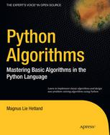
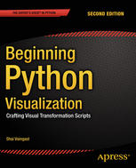
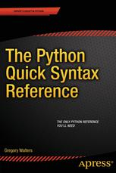
Python Books (http://link.springer.com/)
Python Algorithms: Mastering Basic Algorithms in the Python Language
Magnus Lie Hetland (2010)
http://link.springer.com/book/10.1007/978-1-4302-3238-4
Beginning Python Visualization
Crafting Visual Transformation Scripts
Shai Vaingast (2014)
http://link.springer.com/book/10.1007/978-1-4842-0052-0
The Python Quick Syntax Reference
Gregory Walters (2014)
http://link.springer.com/book/10.1007/978-1-4302-6479-8

Slide 66
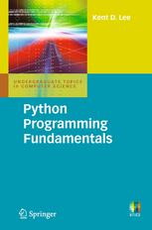
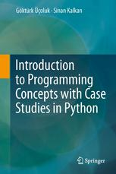
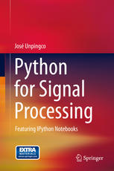
Python Books (http://link.springer.com/)
Python Programming Fundamentals
Kent D. Lee in Undergraduate Topics in Computer Science (2011)
http://link.springer.com/book/10.1007/978-1-84996-537-8
Introduction to Programming Concepts with Case Studies in Python
Göktürk Üçoluk, Sinan Kalkan (2012)
http://link.springer.com/book/10.1007/978-3-7091-1343-1
Python for Signal Processing
Featuring IPython Notebooks
José Unpingco (2014)
http://link.springer.com/book/10.1007/978-3-319-01342-8

Slide 67
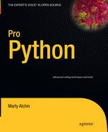
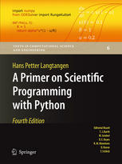
Python Books (http://link.springer.com/)
Pro Python
Clay Andres, Steve Anglin, Mark Beckner, Ewan Buckingham… (2010)
A Primer on Scientific Programming with Python
Hans Petter Langtangen in Texts in Computational Science and Engineering (2014)

Slide 68
Python Tutorials
Things to read through
“Dive into Python” (Chapters 2 to 4) http://diveintopython.org/
Python 101 – Beginning Python http://www.rexx.com/~dkuhlman/python_101/python_101.html
Things to refer to
The Official Python Tutorial http://www.python.org/doc/current/tut/tut.html
The Python Quick Reference http://rgruet.free.fr/PQR2.3.html

Slide 69
YouTube Python Tutorials
Python Fundamentals Training – Classes http://www.youtube.com/watch?v=rKzZEtxIX14
Python 2.7 Tutorial Derek Banas· http://www.youtube.com/watch?v=UQi-L-_chcc
Python Programming Tutorial - thenewboston
http://www.youtube.com/watch?v=4Mf0h3HphEA
Google Python Class http://www.youtube.com/watch?v=tKTZoB2Vjuk

Slide 70
codecademy.com python
codecademy.com
http://www.codecademy.com/tracks/python

Slide 71
YouTube Python Tutorials
Image analysis in python with scipy and scikit image tutorials
Part 1 http://www.youtube.com/watch?v=MP-MTiCETYg
Part 2 http://www.youtube.com/watch?v=SE7h0IWD93Y
Part 3 http://www.youtube.com/watch?v=Yxpnvc4RHy4

Slide 72
Scientific Python distributions
Python 2.6 or 2.7 https://www.python.org/download/releases/2.7.6/
NumPy http://www.numpy.org/
SciPy http://www.scipy.org/
matplotlib http://matplotlib.org/
scikit-learn http://scikit-learn.org
scikit-image http://scikit-image.org

Slide 73
Scientific Python distributions
For most users, especially on Windows and Mac, the easiest way to install the packages of the SciPy stack is to download one of these Python distributions, which includes all the key packages:
Anaconda: A free distribution for the SciPy stack. Supports Linux, Windows and Mac.
Enthought Canopy: The free and commercial versions include the core SciPy stack packages. Supports Linux, Windows and Mac.
Python(x,y): A free distribution including the SciPy stack, based around the Spyder IDE. Windows only.
WinPython: A free distribution including the SciPy stack. Windows only.
Pyzo: A free distribution based on Python 3 (see Note on Python 3) with the IEP editor. Supports Linux and Windows.
Algorete Loopy: A free, community oriented distribution for the SciPy stack maintained by researches at Dartmouth College. Loopy supports both Python 2 and 3 on Linux, Windows and Mac OSX. The distribution is derived from Anaconda with additional packages (e.g. Space Physics, BioInformatics).

