Slide 1

AgentIQ FinTech
UPI Fraud Ring & Merchant Risk Intelligence
Enterprise payment surveillance, merchant-risk analytics, graph intelligence, and AI-assisted investigation
TRANSORG AGENTIQ DATATHON
TRACK 1: FINTECH & BFSI
RISK INTELLIGENCE PLATFORM
Notes:
1. Introduce AgentIQ as a payment-risk intelligence platform built for investigation support.
2. Frame the scope across payment surveillance, merchant analytics, graph intelligence, and governed AI.
3. Clarify that the system surfaces risk indicators and suspicious patterns rather than confirmed fraud.
4. Set the expectation for an eight-to-ten-minute walkthrough focused on evidence and auditability.

Slide 2
Payment risk spans the full transaction lifecycle
02
Customer
›
UPI transaction
›
Merchant
›
Settlement
›
Dispute
›
RISK
VIEW
identity + behavior
amount + UTR + status
profile + category
payment outcome
reason + delay
VELOCITY
MERCHANT
DISPUTE
UTR
High-velocity anomalies
Rogue or compromised merchants
Chargeback concentration
Missing or inconsistent UTR records
IDENTITY
DELAY
NETWORK
DATA
Synthetic or high-risk identities
Delayed dispute reporting
Connected suspicious payment networks
Fragmented or corrupted sources
Row-level monitoring can miss coordinated patterns across transactions, merchants, identities, and reported disputes.
AGENTIQ FINTECH
Notes:
1. Walk through the payment lifecycle from customer action to reported dispute.
2. Explain that each stage contributes a different risk signal and a different data-quality challenge.
3. Emphasize the limitation of monitoring each row or table in isolation.
4. Use 'suspicious pattern' and 'risk indicator' consistently; avoid declaring confirmed fraud.

Slide 3
Five pillars create investigation-ready intelligence
03
01
02
03
04
05
Data rescue
Governed warehouse
Risk metrics
Pattern detection
Investigation workspace
+
+
+
+
Standardize corrupted financial datasets
Build an auditable analytical foundation
Calculate transaction, merchant, KYC, and dispute indicators
Surface suspicious networks and velocity anomalies
Combine dashboards with AI-assisted analysis
“Transform fragmented payment records into an explainable, auditable, and investigation-ready risk intelligence platform.”
AGENTIQ FINTECH
Notes:
1. Present the five pillars as one connected operating model, not five isolated features.
2. The sequence starts with reliable data because every downstream indicator depends on traceable inputs.
3. Explainability and auditability remain explicit design goals across metrics, graphs, and AI outputs.
4. The platform supports analyst judgment and investigation prioritization.

Slide 4
Four datasets form the governed risk evidence base
04
Dataset | Core fields | Analytical role
UPI Transactions | Transaction ID Timestamp User and merchant IDs Amount, UTR, MCC Transaction status | Payment activity Outcome monitoring Velocity analysis
KYC Records | Customer profile PAN and Aadhaar format indicators Income and occupation KYC status Risk segment | Identity context Segment analysis Privacy-aware risk review
Merchant Master | Merchant profile Category and MCC Business type and location Merchant status Declared average ticket size | Merchant benchmarking Category comparison Declared vs observed behavior
Chargebacks | Complaint and transaction IDs Disputed amount and reason Severity Reporting timestamps Resolution status | Reported dispute exposure Delay analysis Loss concentration
65,894
TOTAL RAW RECORDS
56,063
TOTAL CLEANED RECORDS
9,831
DUPLICATES REMOVED
0
UNJUSTIFIED ROW DROPS
AGENTIQ FINTECH
Notes:
1. Introduce the four source datasets and the role each one plays in the analytical model.
2. Call out that the clean record count reflects duplicate removal, not unjustified row deletion.
3. Keep Aadhaar and PAN references limited to format indicators; the system does not claim identity verification.
4. The fields shown are the supplied schema elements used for analysis and audit evidence.

Slide 5
Data rescue preserves every unique record and documents each transformation
05
CLEANING CONTROLS
Dataset | Raw | Clean | Duplicates removed
UPI Transactions | 20,400 | 20,000 | 400
KYC Records | 36,400 | 28,920 | 7,480
Merchant Master | 6,210 | 4,343 | 1,867
Chargebacks | 2,884 | 2,800 | 84
Standardize user, merchant, transaction, UTR, and MCC identifiers
Parse Unix epoch, ISO, AM/PM, and slashed timestamps
Normalize INR symbols, commas, negatives, and k multipliers
Harmonize transaction, merchant, KYC, severity, and resolution statuses
Impute income and ticket size with occupation or category medians
Reconcile disputed amounts and backfill MCC through governed lookups
Preserve missing-value indicators instead of dropping records
AGGREGATE RETENTION
UNIQUE RECORD RETENTION
85.08%
100%
Audit position: duplicate removal explains the difference between raw and clean counts; unique records remain retained.
AGENTIQ FINTECH
Notes:
1. Explain that the rescue pipeline standardizes formats before calculating any risk indicator.
2. Use the audit table to reconcile raw, clean, and duplicate counts by dataset.
3. Highlight the distinction between aggregate retention and retention of unique records.
4. Missing-value indicators remain available so analysts can assess data quality alongside risk.

Slide 6
Governed architecture connects data and controlled AI
06
CORE ANALYTICAL PATH
Raw files
›
Data rescue
›
Clean datasets
›
Warehouse
›
Network engine
›
Risk dashboard
CSV + JSON
Pandas + NumPy
Parquet + CSV
DuckDB
NetworkX
Streamlit + Plotly
CONTROLLED AI BRANCH
Question
›
Domain gate
›
SQL generation
›
Safety validation
›
Execution
›
Output
natural language
local validation
Groq
SQLGlot
in-memory DuckDB
Plotly + findings
TECHNOLOGY STACK
Python
Pandas
NumPy
PyArrow
DuckDB
NetworkX
Streamlit
Plotly
Groq
SQLGlot
External access stays disabled during query execution; approved in-memory datasets remain the analytical boundary.
AGENTIQ FINTECH
Notes:
1. Follow the top row from raw files through the dashboard to show the reproducible analytical path.
2. Then explain the AI branch as a controlled query workflow with validation before execution.
3. DuckDB provides the common analytical boundary for dashboard metrics and generated SQL.
4. The architecture keeps human review, transparent SQL, and approved data access visible.

Slide 7
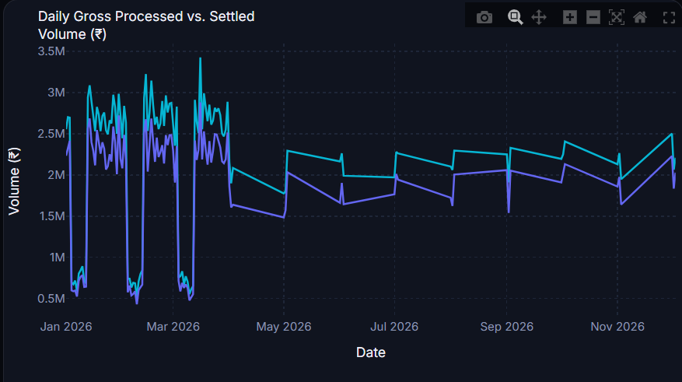
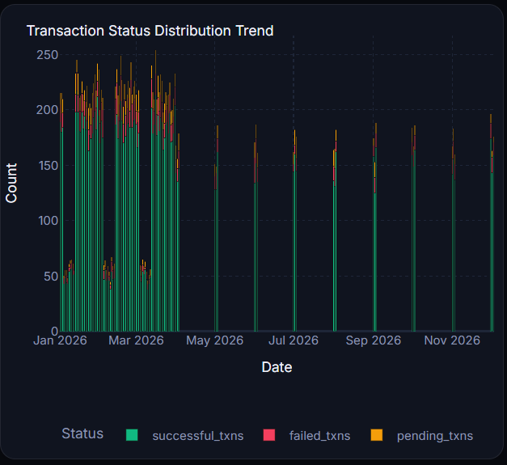
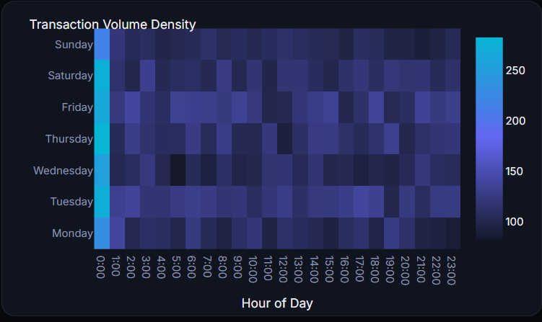
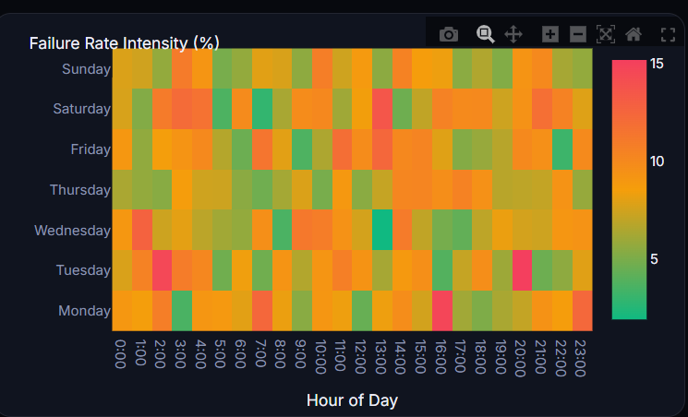
Executive payment health combines scale, quality, and reported dispute exposure
07
TOTAL TRANSACTION VOLUME
AVERAGE TICKET SIZE
FAILURE RATE
DISPUTED VOLUME
CHARGEBACK LOSS RATIO
₹25.00 Cr
₹12,500
8.05%
₹88.9 Lakh
3.56%
20,000
cleaned transactions
2,800
chargeback complaints
5.0%
missing UTR rate
23.5 days
average reporting delay
Daily gross vs successful volume
Transaction-status distribution
Hour-by-day transaction heatmap
Hour-by-day failure-rate heatmap
Thresholds surface investigation priorities; they do not establish confirmed fraud.
AGENTIQ FINTECH
Notes:
1. Anchor the discussion in the five supplied executive KPIs and preserve their stated units.
2. Use the supporting metrics to add record volume, UTR completeness, and reporting-delay context.
3. The four placeholders indicate where verified dashboard captures should be inserted before a live presentation.
4. Clarify that dashboard thresholds rank priorities for review rather than prove fraudulent activity.

Slide 8
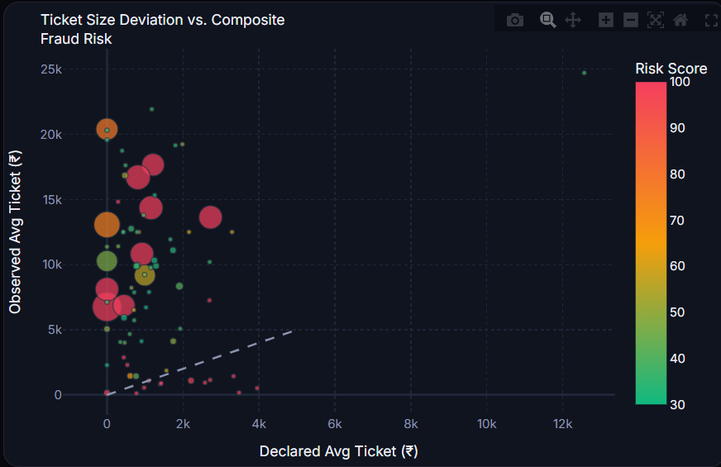
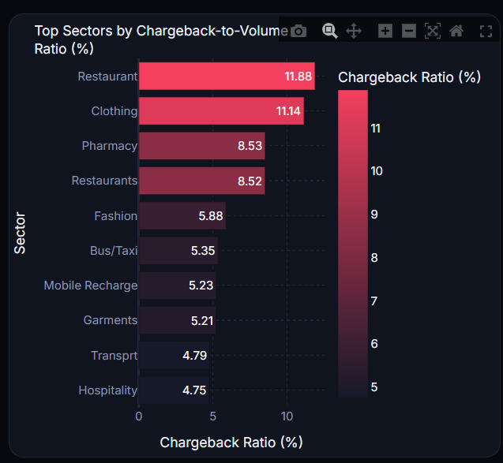
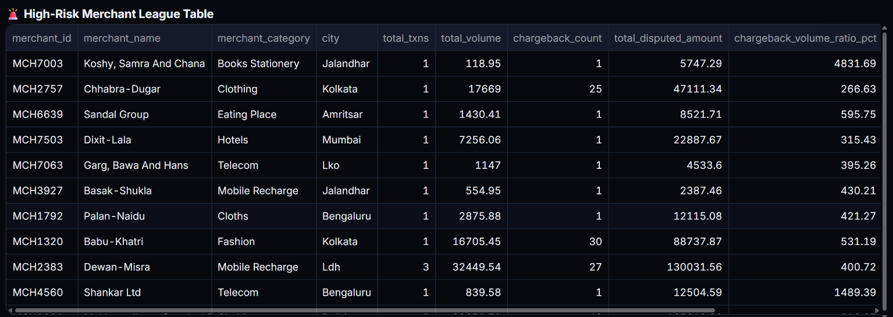
Merchant Risk Center creates an explainable investigation queue
08
Compare declared and observed ticket sizes
Calculate transaction and reported disputed volume
Measure failure rates and chargeback exposure
Produce a composite merchant-risk score
Filter by category and rank merchants in a league table
Declared vs observed ticket scatter
Category chargeback-ratio bar chart
COMPOSITE RISK SCORE
min(100,
0.4 × chargeback-volume ratio
+ 0.3 × failure rate
+ 0.3 × min(dispute count, 50))
High-risk merchant league table
INVESTIGATION PRINCIPLE
The score prioritizes review. It does not independently prove fraud.
AGENTIQ FINTECH
Notes:
1. Explain the Merchant Risk Center as a ranking and comparison workspace.
2. Read the formula components as separate signals: dispute exposure, failures, and dispute frequency.
3. The cap at 100 keeps the composite score interpretable within a bounded scale.
4. Reinforce that the score prioritizes investigation and does not determine guilt or confirmed fraud.

Slide 9
Velocity anomalies expose departures from user baselines
09
Aggregate transaction activity by user and hour
Establish each user’s normal hourly activity
Calculate deviation from expected behavior
Flag unusually high payment velocity for review
SCHEMATIC USER-HOUR VELOCITY VIEW
CRITICAL > 3
Z-score
HIGH > 2
PRACTICAL USE CASES
Automated transaction bursts
Account takeover behavior
Mule-account activity
Sudden deviation from established patterns
MEDIUM > 1.5
User-hour observation
SCHEMATIC • NOT DATASET RESULTS
AGENTIQ FINTECH
Notes:
1. Describe the engine as a per-user hourly baseline rather than a single global threshold.
2. The displayed points are a schematic illustration; they do not represent measured users or fabricated results.
3. Explain the supplied severity bands at Z-scores above 1.5, 2, and 3.
4. Each alert remains a risk signal that requires contextual review.

Slide 10
Graph intelligence reveals risk hubs and suspicious clusters
10
SUCCESSFUL TRANSACTION FLOW GRAPH
Standard user
M
Disputed user
Merchant
M
Disputed merchant (large)
ANALYTICAL SIGNALS
M
Degree centrality identifies high-connectivity hubs
Connected components reveal suspicious clusters
Deterministic spring layout supports reproducible views
The graph supports investigation. It does not declare an entity fraudulent.
Edge width represents transaction amount
AGENTIQ FINTECH
Notes:
1. Explain nodes as users and merchants, with directed edges for successful transaction flows.
2. Reported disputes change node highlighting so investigators can see concentration and connectivity together.
3. Degree centrality and connected components help identify hubs and clusters worth reviewing.
4. The network diagram represents the model structure; it does not claim a specific fraud ring count.

Slide 11
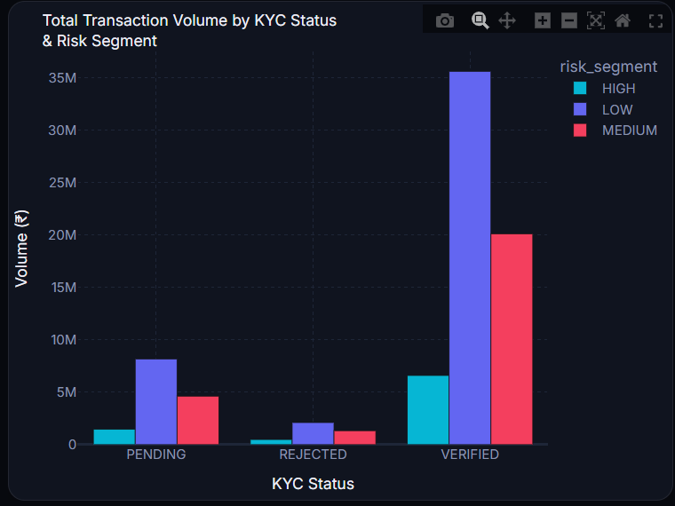
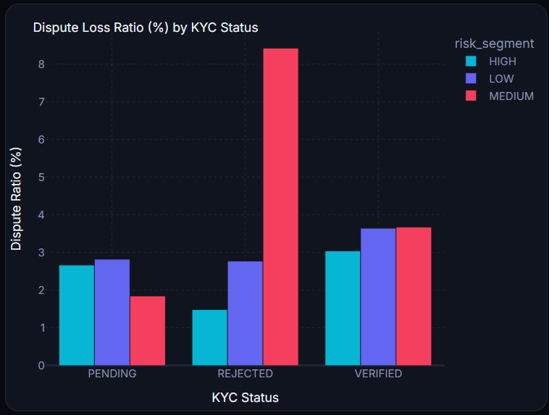
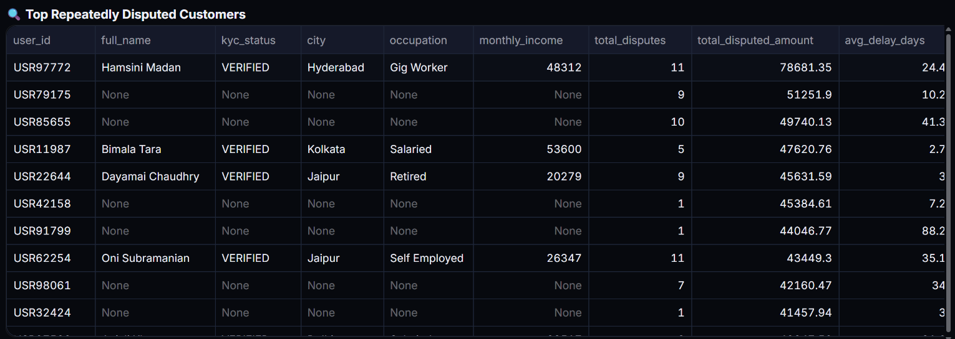
KYC context supports privacy-aware identity-risk review
11
Compare transaction volume across KYC statuses
Cross-tabulate KYC status and customer risk segment
Measure reported dispute exposure
Identify repeatedly disputed customer IDs
Exclude sensitive identity fields from AI outputs
Treat Aadhaar checks as format validation only
Transaction volume by KYC status
Dispute ratio by KYC status
PRIVACY BOUNDARY
Repeatedly disputed customer table
Analytical narratives use risk context while keeping sensitive identity fields outside prompt content.
Aadhaar validation checks format consistency; it does not verify a person’s identity.
AGENTIQ FINTECH
Notes:
1. Position KYC status and customer risk segment as context for payment behavior and reported disputes.
2. Repeatedly disputed IDs indicate review priority, not a fraud determination.
3. Sensitive identity fields stay out of AI narrative prompts to reduce privacy exposure.
4. State explicitly that Aadhaar validation covers format only and does not perform identity verification.

Slide 12
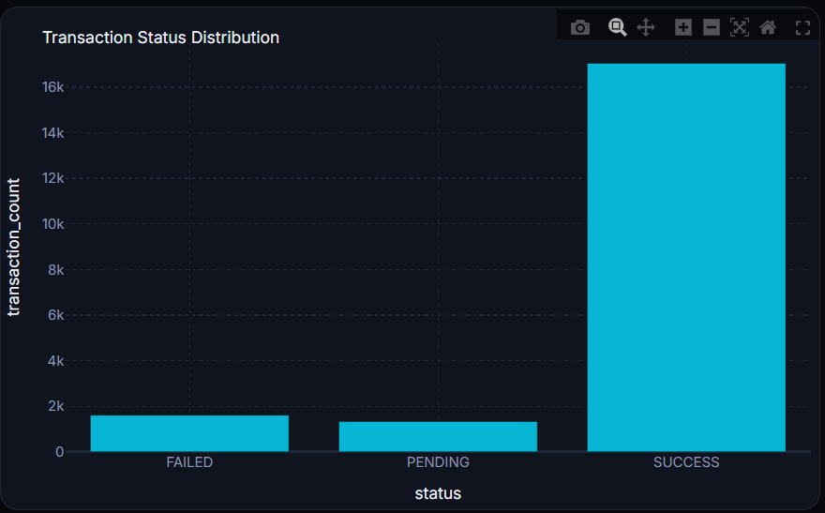
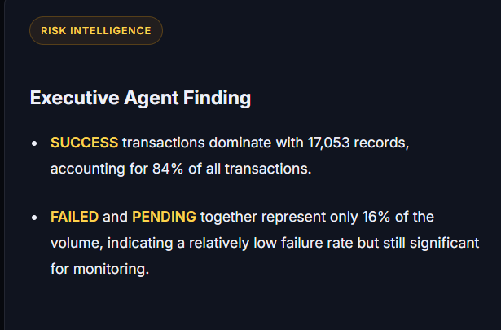
AI Strategist enforces a transparent, read-only boundary
12
1
12 presets / question
›
2
Local domain gate
›
3
Local overview answer
›
4
Groq SQL generation
›
5
SQLGlot + DuckDB validation
›
6
Approved in-memory data
›
7
Chart selection
›
8
Two findings
›
9
Executed SQL visible
Chart
Executive Agent Finding
SECURITY + RELIABILITY
Read-only SELECT queries
Approved tables and functions
External access disabled
No recursive or multi-statement SQL
1,000-row result limit
512 MB memory limit
15-second execution timeout
Sensitive identity fields excluded
SUPPORTED OUTPUTS
Bar
Line
Scatter
Donut
Metric
Table
Every analytical response retains the exact executed SQL so evaluators can inspect the evidence path.
AGENTIQ FINTECH
Notes:
1. Walk through the nine-step flow from a preset or question to a chart, findings, and visible SQL.
2. Overview questions can be answered locally; analytical questions use Groq for SQL generation.
3. SQLGlot and DuckDB validate the statement before it reaches the approved in-memory datasets.
4. Highlight the explicit limits on query type, rows, memory, execution time, and sensitive fields.
5. The AI produces evidence-based findings but keeps the analyst in control through transparent SQL.

Slide 13
Every project step is reproducible and verifiable
13
INSTALLATION
EVIDENCE FILES
python -m pip install -r requirements.txt
README.md
GROQ CONFIGURATION
GROQ_API_KEY=your-groq-api-key
DATA_DICTIONARY.md
AUDIT_PROOF.md
FINAL APPLICATION
python app.py
pipeline/clean_pipeline.py
data/processed/audit_proof.json
CLEANING-ONLY VERIFICATION
python pipeline/clean_pipeline.py
AUTOMATED VALIDATION
python -m unittest test_ai_strategist test_enterprise_ui -v
python verify_dashboard.py
DATA DICTIONARY COVERAGE
Every generated dataset column documents its type, meaning, key role, and cleaning transformation.
AGENTIQ FINTECH
Notes:
1. Show evaluators that the project can be installed, configured, run, and tested from documented commands.
2. Separate application execution from cleaning-only verification so data rescue can be checked independently.
3. Point to the evidence files that document the pipeline, data dictionary, and audit proof.
4. The data dictionary provides column-level lineage through type, meaning, key role, and transformation.

Slide 14
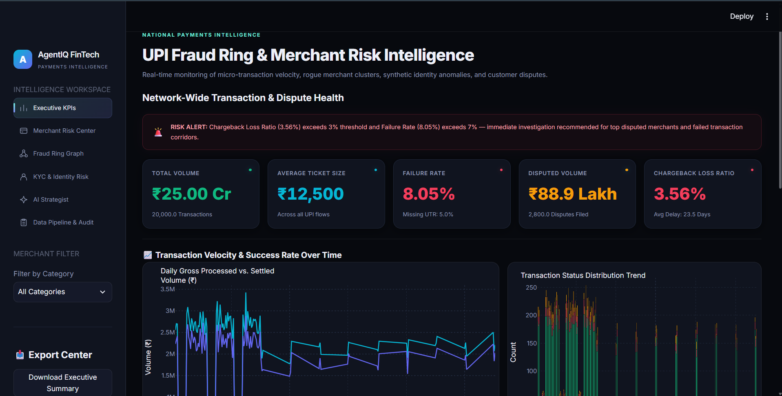
AgentIQ delivers governed payment-risk intelligence
14
01
Faster identification of payment-risk concentrations
Final dashboard overview
02
Explainable merchant and identity-risk prioritization
03
Network-level investigation beyond isolated transactions
04
Auditable AI-assisted analytics with transparent SQL
“AgentIQ converts corrupted payment data into governed intelligence—combining reproducible data engineering, statistical anomaly detection, graph analytics, and controlled generative AI in one investigation workspace.”
From raw payment records to investigation-ready intelligence.
AGENTIQ FINTECH
Notes:
1. Close on the four outcomes: faster prioritization, explainability, network context, and transparent AI.
2. Connect the conclusion back to the governed pipeline rather than presenting isolated analytical features.
3. Remind the audience that risk indicators support investigation and do not declare confirmed fraud.
4. End with the final line and pause for questions.

