Slide 1
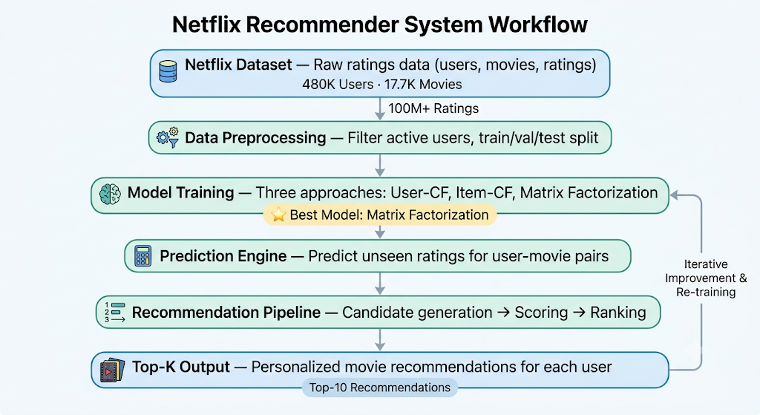
Recommendation Systems for Personalized Content Discovery
TEAM MEMBERS
Sahil Hussain (23124031)
Rayyan Khan (23117114)
[ Insert Netflix logo or workflow diagram ]
OBJECTIVE
Learn user preferences from historical ratings.
Predict unseen movie ratings.
Generate personalized Top-K recommendations.
Compare collaborative filtering and matrix factorization methods.
DATASET
Netflix Prize Dataset
100.48M ratings | 480K users | 17.7K movies

Slide 2
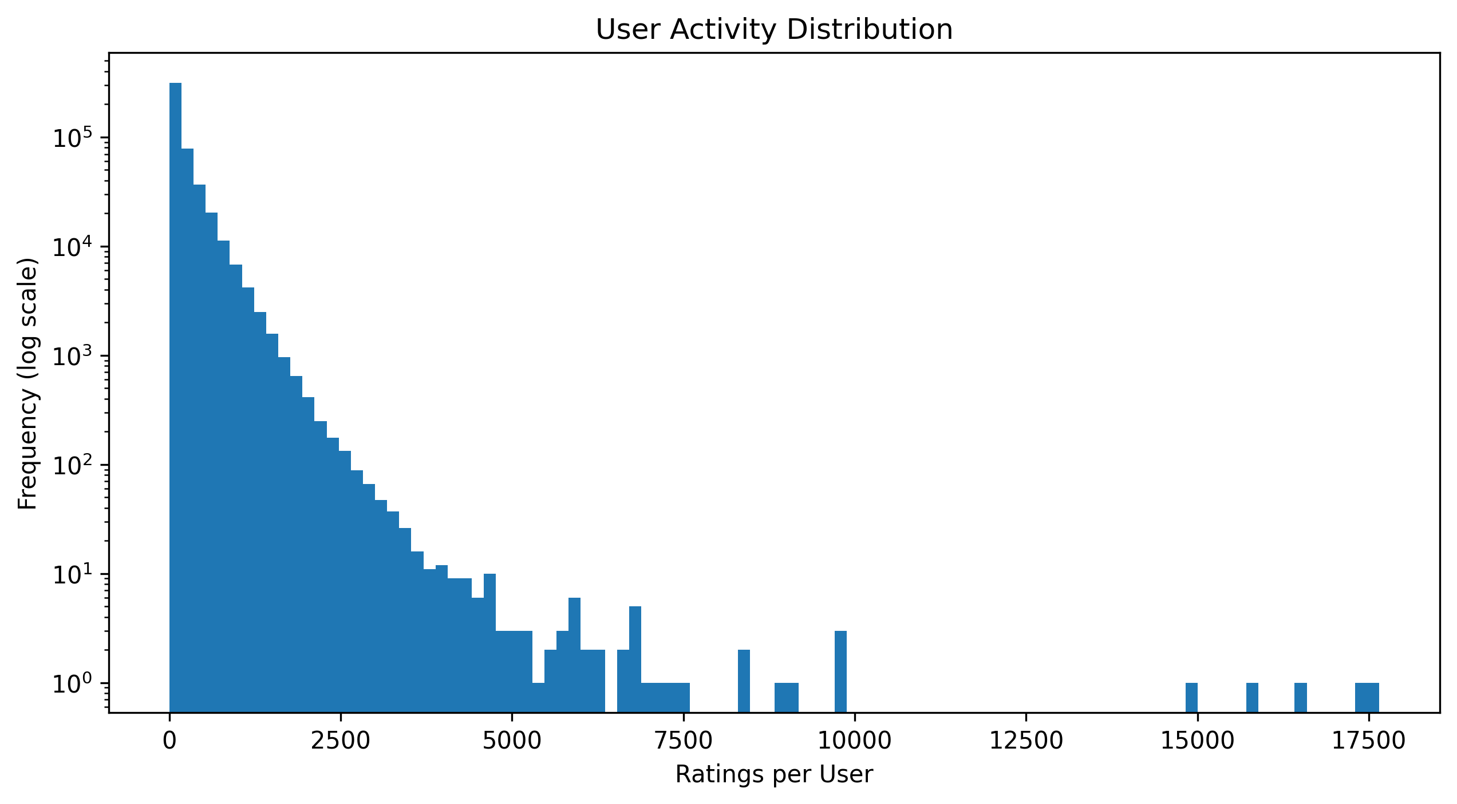
OVERVIEW
DATASET & EDA
APPROACH
MODEL
EVALUATION
RESULTS
CONCLUSIONS
Dataset & EDA Insights
DATASET CHARACTERISTICS
Metric | Value
Users | 480,189
Movies | 17,770
Ratings | 100,480,507
Sparsity | 98.82%
KEY INSIGHTS
[ Insert plots here ]
User Activity Distribution | Rating Distribution
User activity is highly skewed.
Movie popularity follows a long-tail distribution.
Ratings are concentrated around 3–5 stars.
Extremely sparse user-item matrix.
Takeaway: The dataset is large, sparse, and highly imbalanced, making recommendation generation challenging.
2 / 8

Slide 3
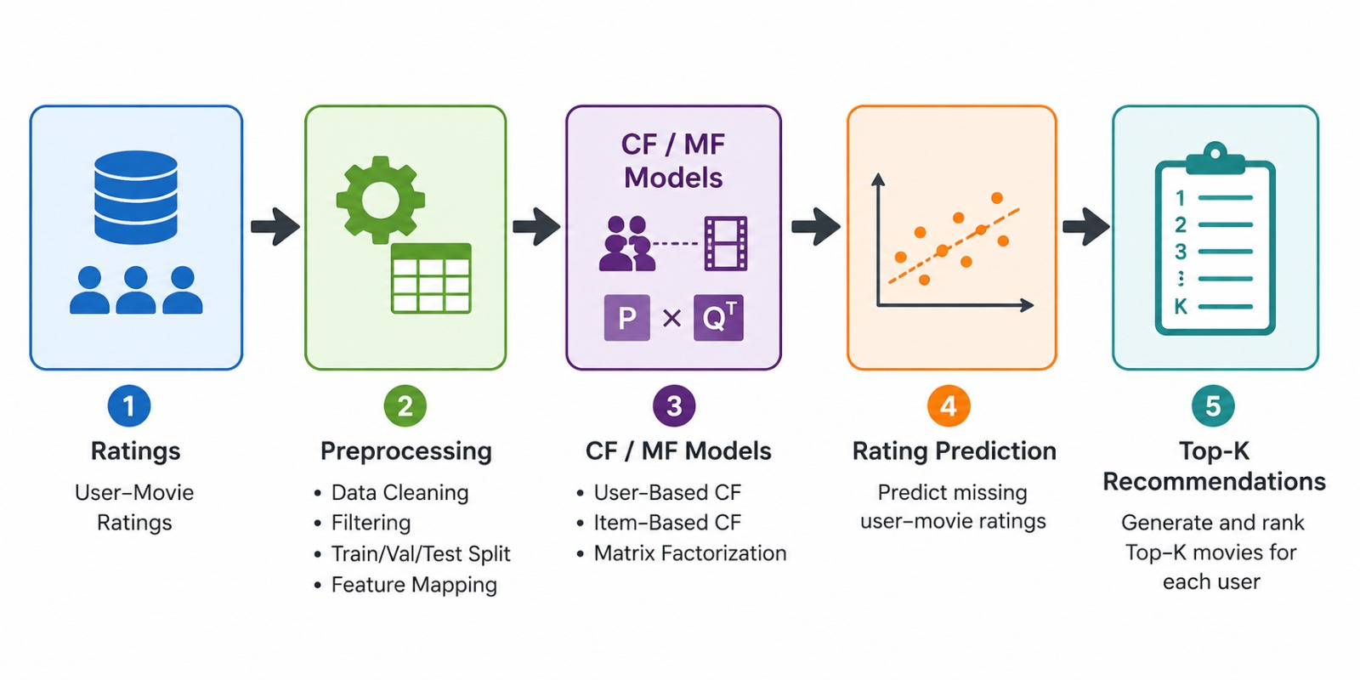
OVERVIEW
DATASET & EDA
APPROACH
MODEL
EVALUATION
RESULTS
CONCLUSIONS
Approach Overview
Baselines
Collaborative Filtering
Matrix Factorization
Global Mean
User Mean
Movie Mean
User-Based CF
Item-Based CF
Latent-factor recommendation model
GPU accelerated PyTorch implementation
WORKFLOW
[ Insert workflow diagram here ]
Ratings → Preprocessing → CF/MF Models → Rating Prediction → Top-K Recommendations
Takeaway: Matrix Factorization was selected as the primary model due to its ability to learn latent preferences.
3 / 8

Slide 4
OVERVIEW
DATASET & EDA
APPROACH
MODEL
EVALUATION
RESULTS
CONCLUSIONS
Matrix Factorization Model
PREDICTION FORMULA
TRAINING CONFIGURATION
$${\overset{^}{r}}_{ui}=μ+b_{u}+b_{i}+p_{u}^{T}q_{i}$$
Parameter | Value
Latent Factors | 64
Optimizer | Adam
Batch Size | 262,144
Epochs | 15
Device | GPU
WHERE
• μ = global mean rating
• b_{u} = user bias term
• b_{i} = movie bias term
• p_{u} = user latent factor embedding
• q_{i} = movie latent factor embedding
Takeaway: Latent factors capture hidden relationships between users and movies.
4 / 8

Slide 5
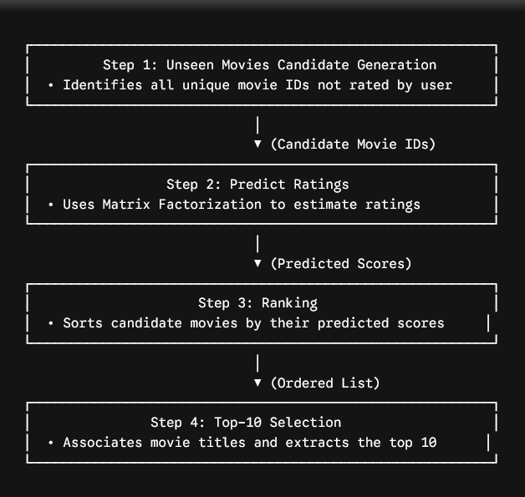
OVERVIEW
DATASET & EDA
APPROACH
MODEL
EVALUATION
RESULTS
CONCLUSIONS
Evaluation Setup
TRAIN / VALIDATION / TEST SPLIT
Split | Ratio | Purpose
Train | 80% | Model training
Validation | 10% | Hyperparameter tuning
Test | 10% | Final evaluation
METRICS
RMSE — Measures rating prediction accuracy.
MAP@10 — Measures recommendation ranking quality.
Relevant movie: Rating ≥ 4
[ Insert recommendation pipeline diagram ]
Unseen Movies → Predict → Rank → Top-10
Takeaway: Both prediction accuracy and recommendation quality were evaluated.
5 / 8

Slide 6
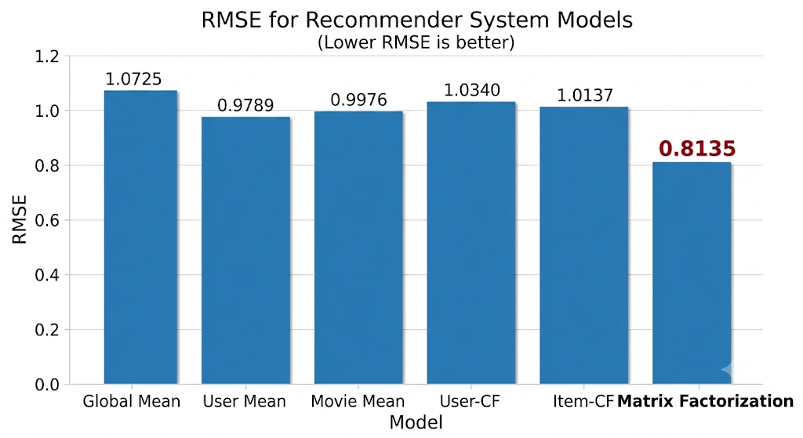
OVERVIEW
DATASET & EDA
APPROACH
MODEL
EVALUATION
RESULTS
CONCLUSIONS
Model Comparison Results
RMSE PERFORMANCE
Model | RMSE
Global Mean | 1.0725
User Mean | 0.9789
Movie Mean | 0.9976
User-CF | 1.0340
Item-CF | 1.0137
Matrix Factorization | 0.8135
[ Insert bar chart of RMSE values ]
ADDITIONAL METRICS
Metric | Value
MAP@10 | 0.04965
Coverage | 9.45%
Takeaway: Matrix Factorization achieved the best overall performance.
6 / 8

Slide 7
OVERVIEW
DATASET & EDA
APPROACH
MODEL
EVALUATION
RESULTS
CONCLUSIONS
Recommendation Examples
EXAMPLE USER
Previously Liked Movies
Recommended Movies
Streets of Fire
Amadeus
Dangerous Liaisons
Moonlighting: The Pilot
The Ninth Gate
Independence Day
The Silence of the Lambs
Pretty Woman
The Lord of the Rings: Fellowship of the Ring
The Green Mile
OBSERVATION
Recommendations align with the user's historical interests.
The model successfully captures latent movie preferences.
[ Space reserved for visual table layout: Liked Movies | Recommended Movies ]
7 / 8

Slide 8
OVERVIEW
DATASET & EDA
APPROACH
MODEL
EVALUATION
RESULTS
CONCLUSIONS
Conclusions & Future Work
CONCLUSIONS
FUTURE IMPROVEMENTS
Implemented and compared User-CF, Item-CF, and Matrix Factorization.
Matrix Factorization achieved the best RMSE and recommendation quality.
Successfully generated personalized movie recommendations.
Demonstrated effectiveness of latent-factor models on large-scale sparse data.
Hybrid recommendation systems.
Cold-start handling.
Content-based features.
Ranking-aware loss functions.
Diversity-aware recommendations.
KEY RESULTS
0.8135
0.04965
9.45%
RMSE
MAP@10
Coverage
FINAL TAKEAWAY
Matrix Factorization significantly outperformed neighborhood-based methods and proved most effective for personalized content discovery on the Netflix dataset.
8 / 8

