Slide 1


Summer Internship at AICW, Edunet Foundation
Department of Computer Science and Engineering
S.N. Patel Institute of Technology (SNPIT), Bardoli
Guided by Presented by
Prof. Hemangini A. Patel Dhruti Vipulbhai Soni
Internal Guide (230490131112)

Slide 2

Outline:
Introduction
Company’s Introduction
Objectives of Internship’s Project
Project Overview & Problem Statement
System Architecture & Workflow
Data Collection & Preprocessing
Student Performance & Learning Progress Analysis
AI-Based Insights & Personalized Recommendations
Data Visualization & Interactive Dashboard
Challenges & Learnings
Future Scope
Conclusion
References

Slide 3
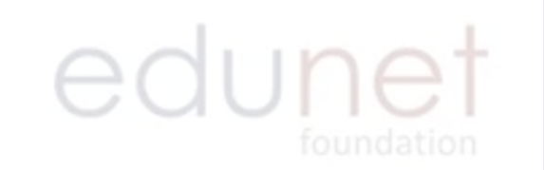

Company’s Introduction:
Edunet Foundation is a non-profit organization working in the areas of skilling, livelihood enhancement, and STEM education.
AICW is a national initiative by Edunet Foundation that empowers Non-STEM women with future-ready AI skills, mentorship, and certification, delivered in collaboration with Microsoft, SAP and LinkedIn, with support from the Ministry of Skill Development & Entrepreneurship.
Official designation: AI Intern
Duration: 4 weeks (06-07-2026 to 31-07-2026)
Mode: Offline

Slide 4
Objectives of Internship’s Project:
Collect & manage student academic data.
Clean & validate dataset
Analyze student perfromance
Identify student needs of improvement
Generate personalized AI feedback

Slide 5
Technology Stack:
Data Processing
Pandas
NumPy
CSV
Python
Data Processing
Pandas
NumPy
CSV
Visualization
Matplotlib
Seaborn
Plotly
Application
Streamlit

Slide 6
Project Overview & Problem Statement:
Project Overview
Problem Statement
Project The AI Student Performance & Learning Progress Tracker is a Python-based data analytics and AI application developed to monitor and analyze students' academic performance and learning activities. The system processes student data, performs performance and progress analysis, generates personalized AI-based feedback, and presents the results through an interactive dashboard.
The project uses Python, Pandas, NumPy, Matplotlib, Seaborn, Plotly, Streamlit, and Google Gemini API. It combines rule-based analysis with Gemini-powered feedback to provide meaningful insights into students' strengths and areas for improvement.
Traditional student performance evaluation mainly focuses on examination marks and may not provide a complete picture of a student's learning progress. Factors such as attendance, quiz performance, study hours, and previous academic performance also need to be considered.
Manually analyzing these parameters for a large number of students can be time-consuming and makes it difficult to identify students who require additional support. There is also a need for personalized and easily understandable feedback rather than only numerical results.

Slide 7
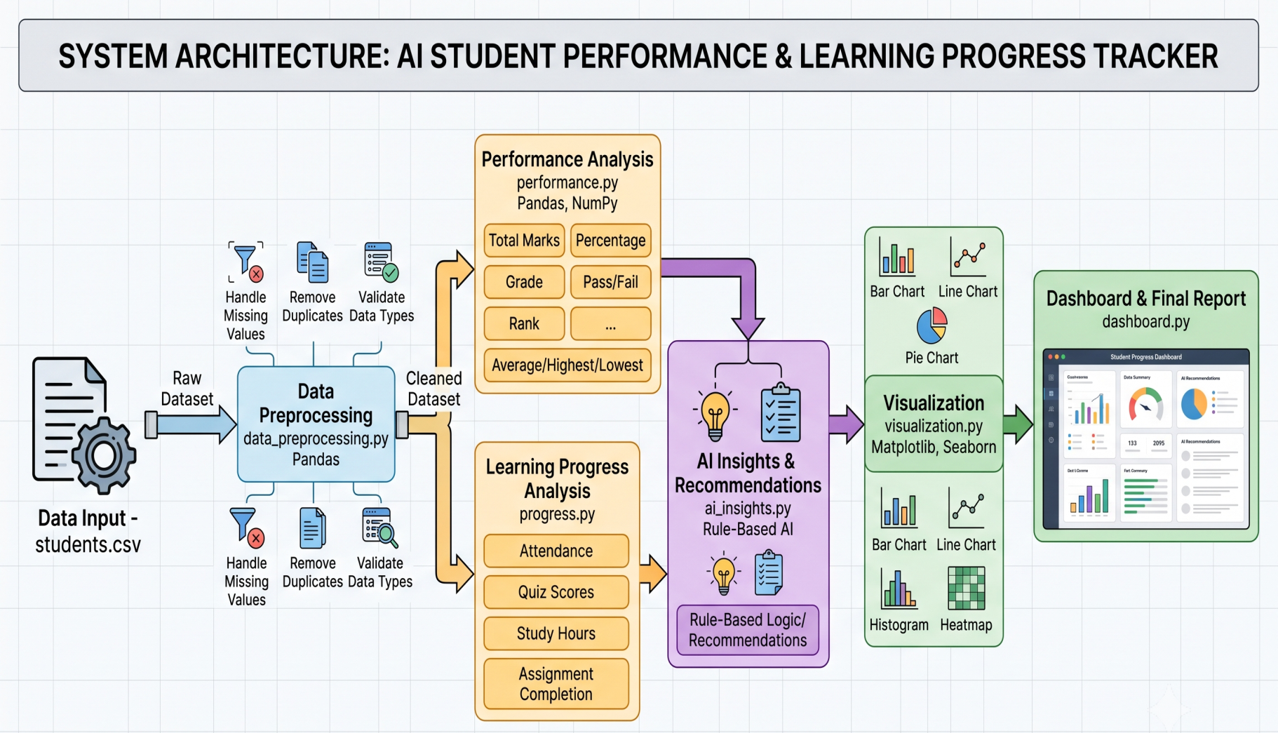
System Architecture & Workflow:

Slide 8
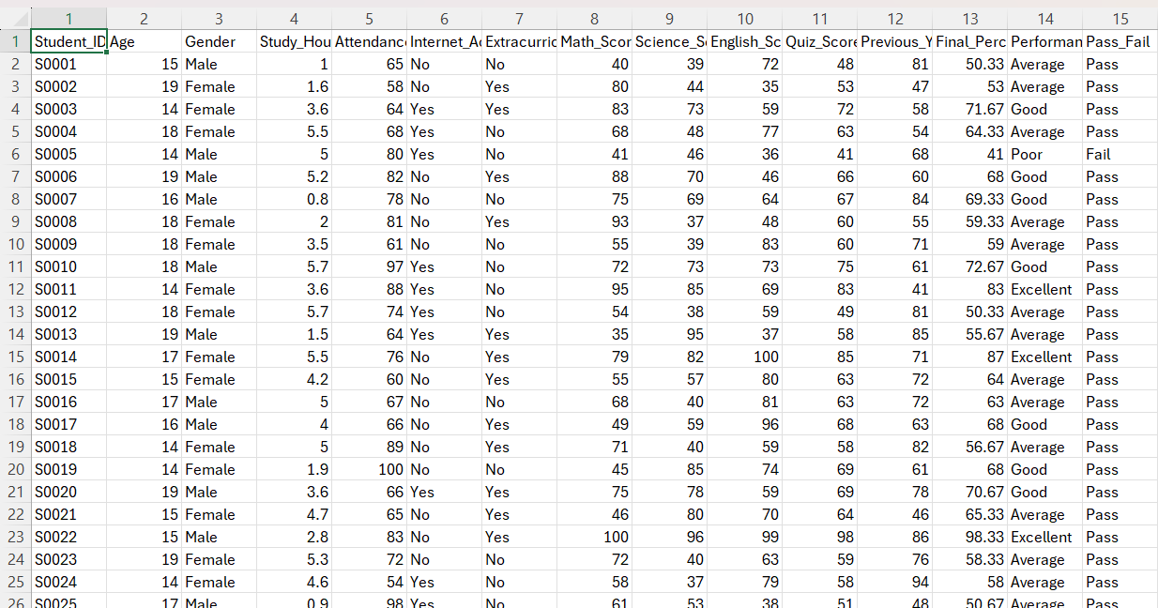
Dataset & Data Preprocessing:
Dataset contains 5,000 student records.
Loaded student dataset using Pandas.
Inspected dataset structure using info(), shape(), and describe().
Validated score ranges between 0 and 100.

Slide 9
Student Performance & Learning Progress Analysis:
Performance Parameters
Subject Scores
Method Used | Calculations
mean() | Average Percentage
max() | Highest Percentage
min() | Lowest Percentage
value_counts() | Pass/Fail & Performance Distribution
idxmax() | Top Student
Quiz Scores
Previous Year Scores
Final Prercentage
Performance Level
Pass / Fail Status

Slide 10
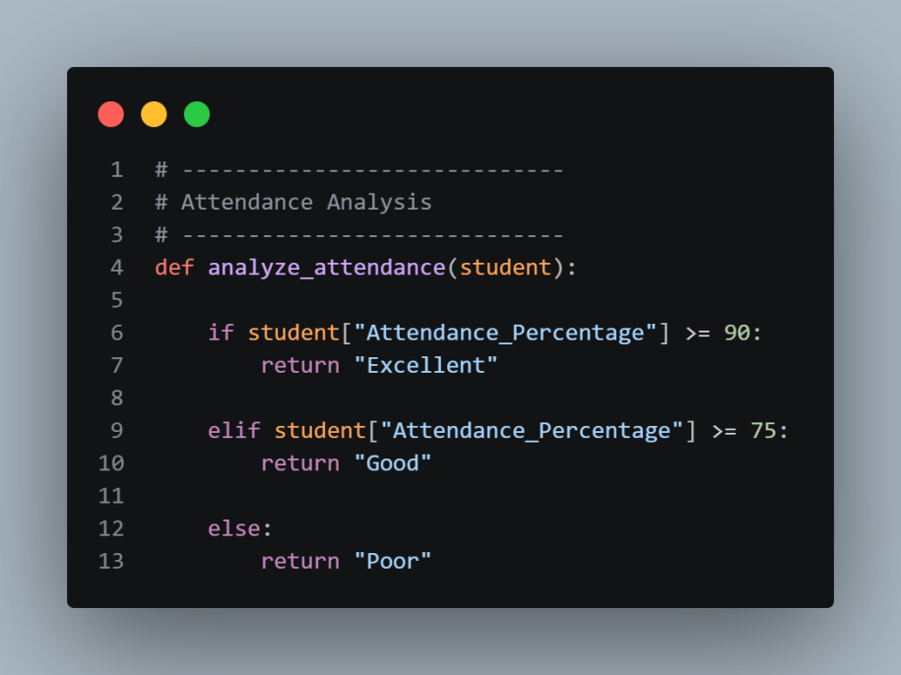
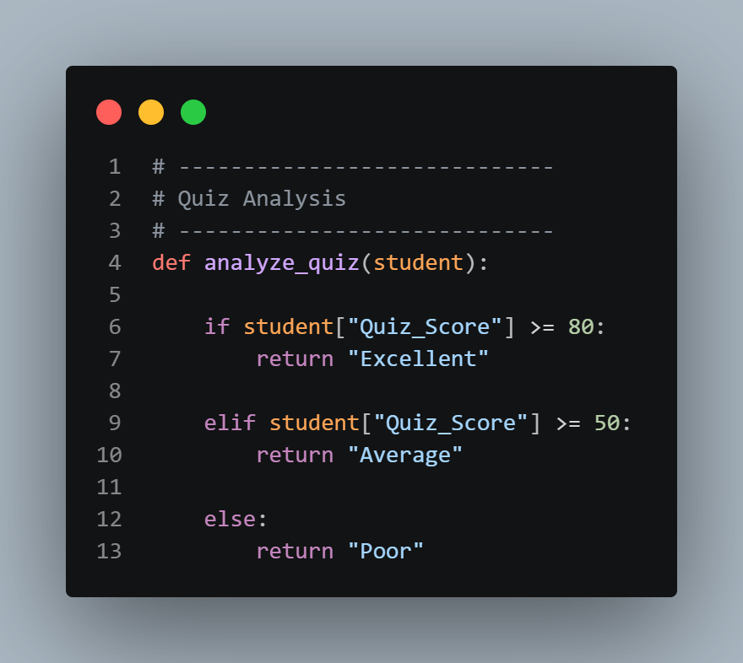
Student Performance & Learning Progress Analysis (Conti..):
Quiz Analysis
Attendance Count
The system classifies attendance, quiz scores, and study hours and combines these results to determine the student's overall progress.

Slide 11
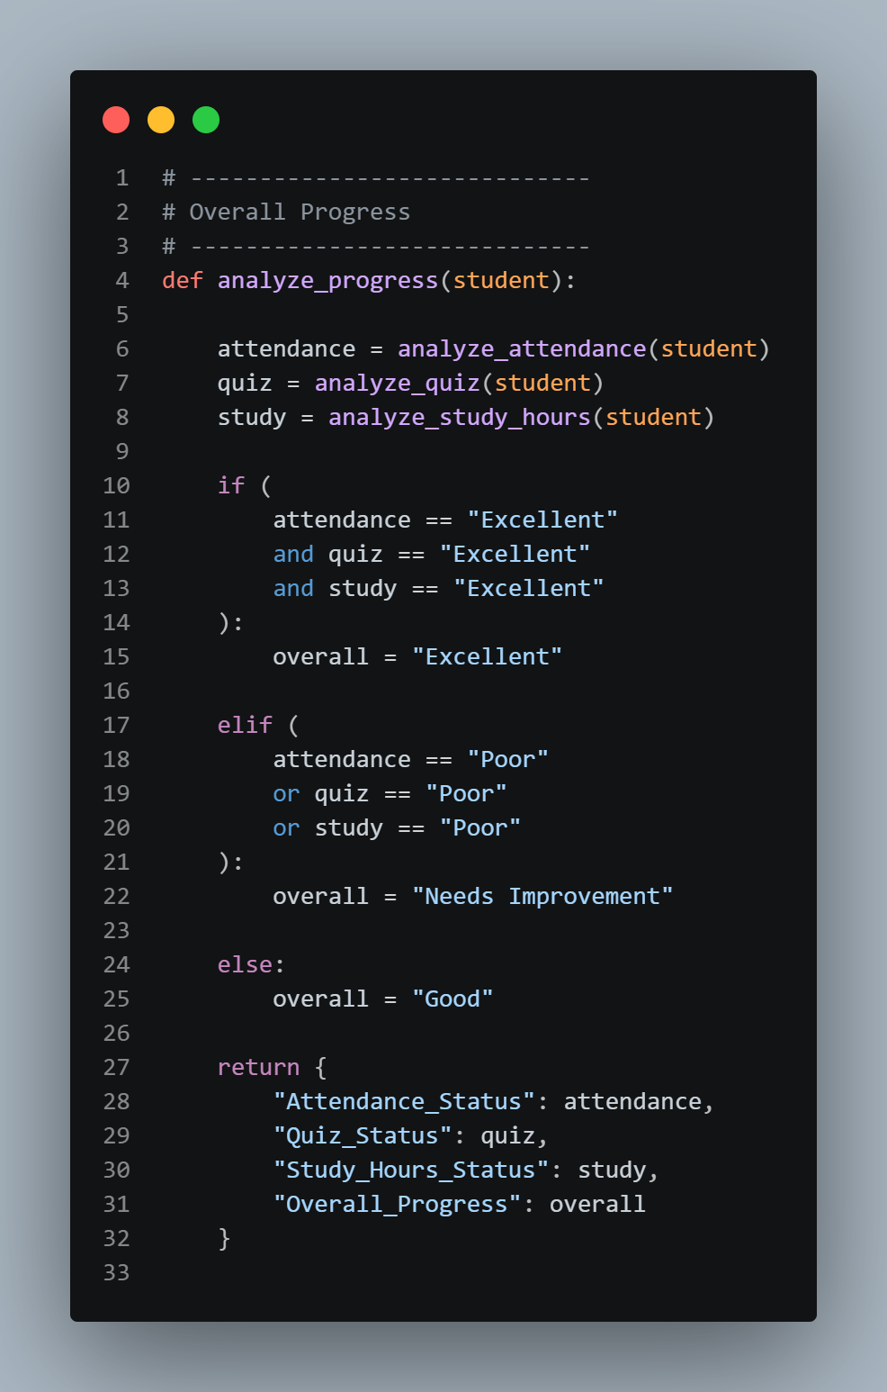
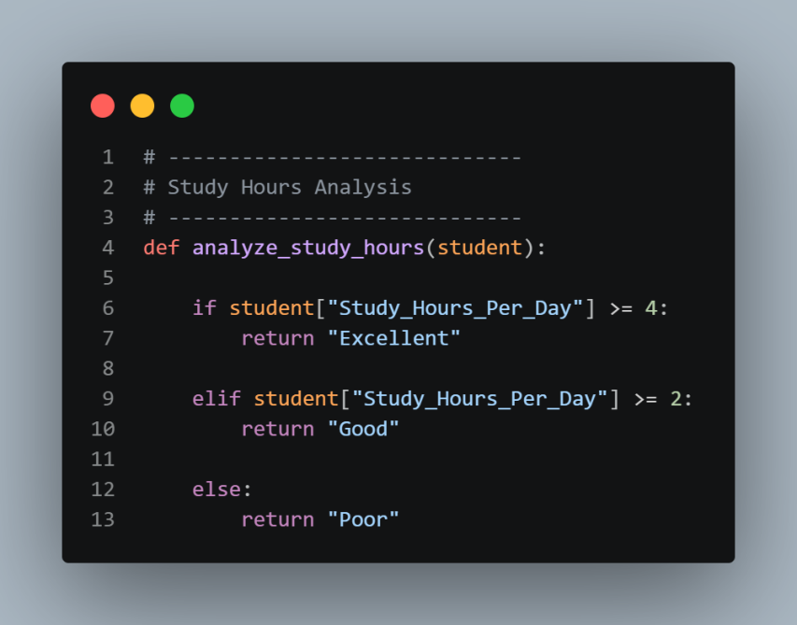
Student Performance & Learning Progress Analysis (Conti..):
Overall Progress
Study Hours

Slide 12
AI-Based Insights & Personalized Recommendations:
Student Data
Progress Analysis
Student Status
AI Academic Feedback
Gemini API
Prompt Construction
The rule-based module first converts raw values into meaningful statuses. These results are then provided to Gemini through a structured prompt. Gemini acts as an academic mentor and generates simple, practical, and personalized feedback.

Slide 13
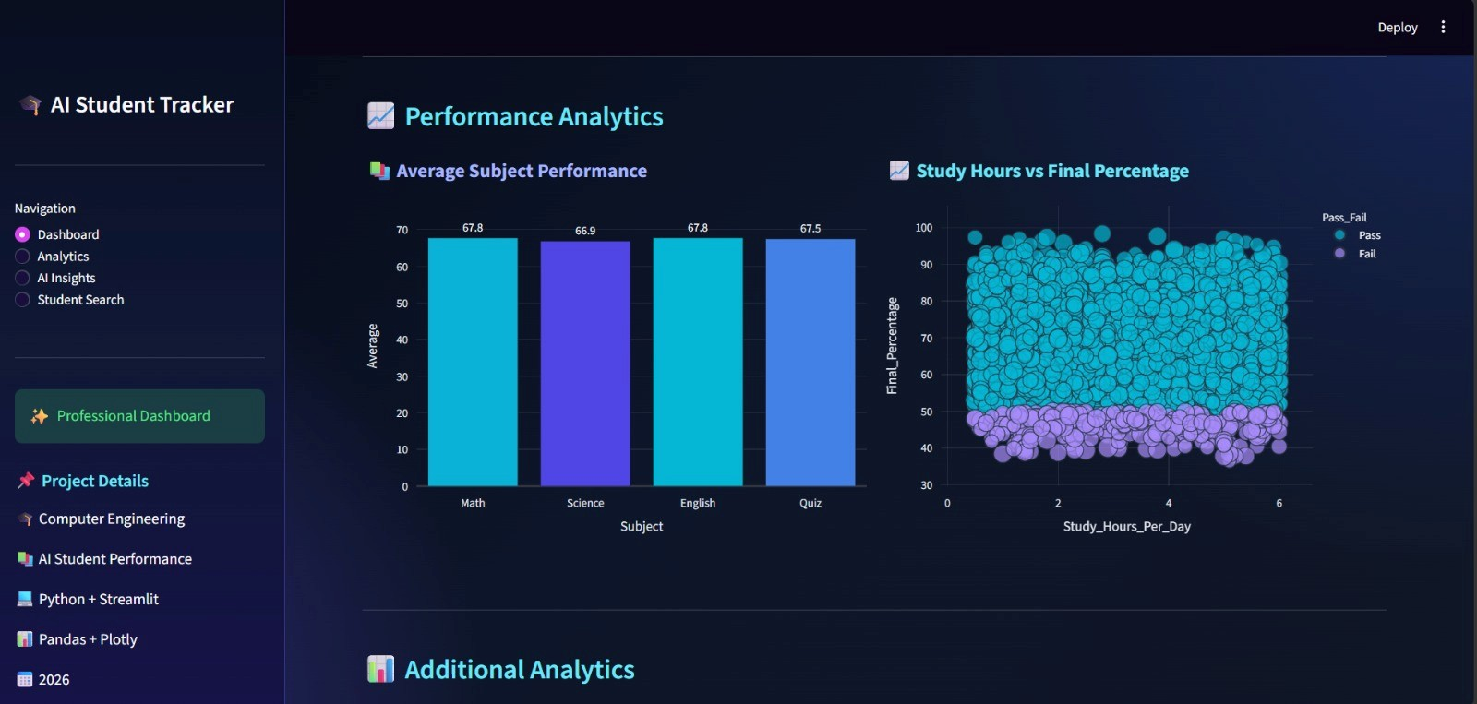
Data Visualization & Interactive Dashboard:
Figure 1: Dashboard showing comparison of Study hrs. vs final % using line scatter analysis & average student performance using bar graph.

Slide 14
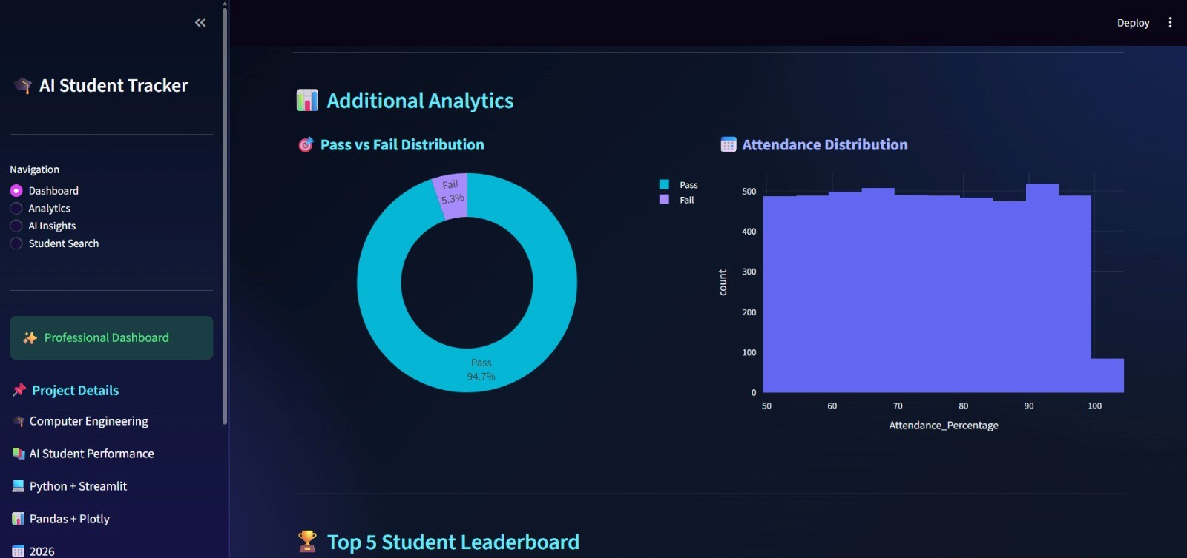
Data Visualization & Interactive Dashboard (Conti..):
Figure 2: Dashboard showing Pass / Fail distribution using pie chart & attendance distribution using historgram.

Slide 15
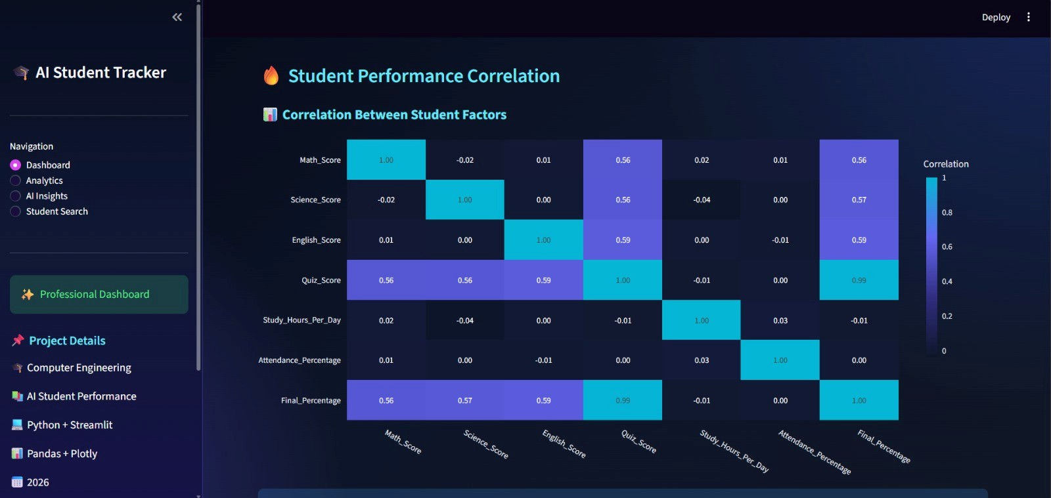
Data Visualization & Interactive Dashboard (Conti..):
Figure 3: Dashboard showing Student performance correlation using heatmap.

Slide 16
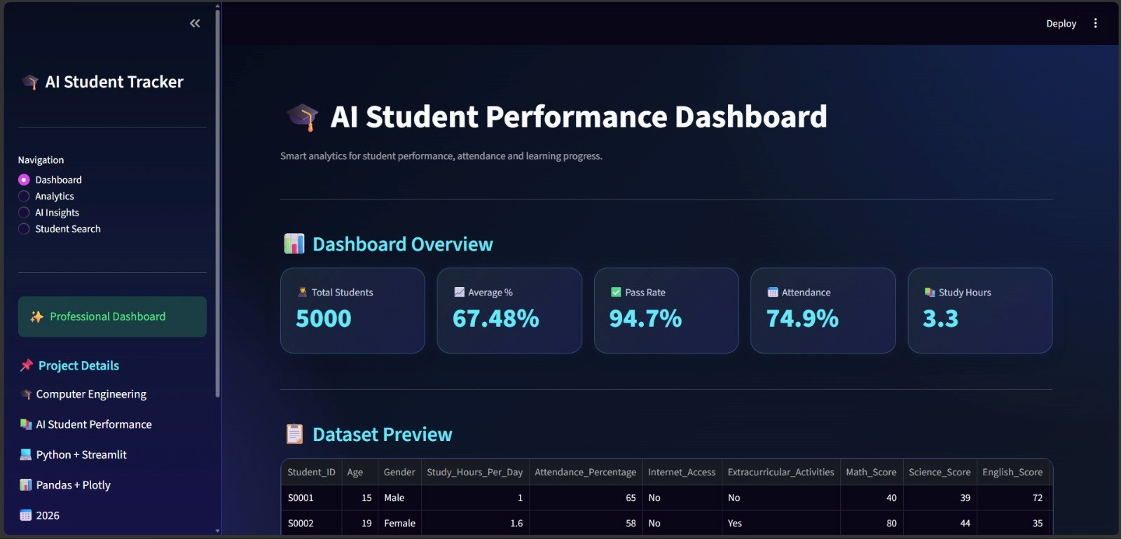
Data Visualization & Interactive Dashboard (Conti..):
Figure 4: Student dashboard.

Slide 17
Challenges and Learnings:
Challenges:
Learnings:
Raw dataset required validation.
Large dataset difficult to analyze manually.
Academic scores alone were insufficient.
Rule-based output was limited.
Static analysis was difficult to explore.
Large amount of information.
Python programming.
Automated Calculations using python.
API Integration.
Using of charts & KPIs.
Data processing.
Data visualization.

Slide 18
Future Scope:
Machine Learning-based performance prediction
Student login system
Advanced Streamlit dashboard
PDF report generation Email notifications
Database integration
More detailed student progress tracking
Historical progress comparison

Slide 19
Conclusion:
The project successfully combines data preprocessing, academic performance analysis, learning-progress tracking, AI-generated feedback, and data visualization into a single application. Through this project, we gained practical experience in Python, data analytics, visualization, API integration, and Streamlit application development. The system demonstrates how student data can be converted into meaningful insights and personalized learning recommendations.

Slide 20
References:
[1] Python Official Documentation. Available: https://docs.python.org/3/
[2] Pandas Official Documentation. Available: https://pandas.pydata.org/docs/
[3] NumPy Official Documentation. Available: https://numpy.org/doc/
[4] Matplot Lib Official Documentation. Available: https://matplotlib.org/stable/
[5] Seaborn Official Documentation. Available: https://seaborn.pydata.org/
[6] Kaggle Official Documentation. Available: https://www.kaggle.com/

Slide 21
THANK YOU
*****

