Slide 1


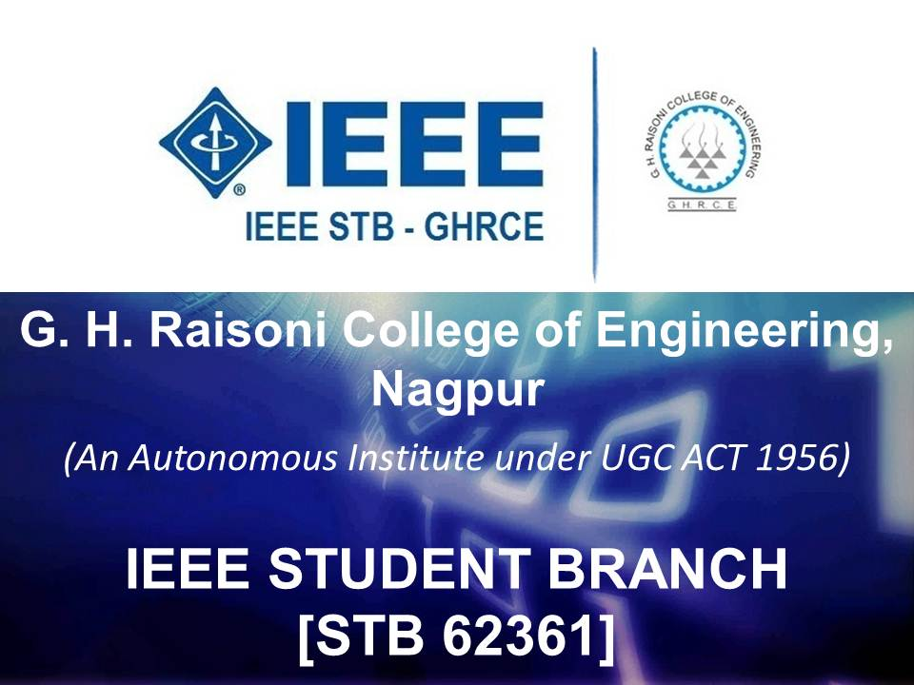

G. H. Raisoni College of Engineering, Nagpur
(An Autonomous Institute Under UGC Act 1956)
Highest IEEE Members (1889) in R10

Slide 2
IEEE
G. H. Raisoni College of Engineering, Nagpur
(An Autonomous Institute Under UGC Act 1956)
IEEE is the world’s largest international, non-profit technical organization.
    Over 365,000 members.(68,000 students)
    Present in 175 countries.
Promotes the advancement and study of electrical, electronics, communications and computer engineering.
    Power generation.
    Microelectronics.
    Electromagnetic.
    Biotechnology.
    Aerospace and so on.

Slide 3
What does the IEEE do ?
G. H. Raisoni College of Engineering, Nagpur
(An Autonomous Institute Under UGC Act 1956)
Major publisher of scientific journals.
    30% of the world’s ECE literature.
Develops industrial standards (over 900 active, with 700 in development!)
    802.11 (WiFi)
    1284 (Parallel port comms)
    1394 (FireWire)
Helps accredit educational programs.
Contains 39 societies, organized around specialized technical fields.
    Computer society.
    Communications.
    Microwave theory.
    Nuclear and plasmas sciences.
    Aerospace and many more……

Slide 4
Who can be a member ?
G. H. Raisoni College of Engineering, Nagpur
(An Autonomous Institute Under UGC Act 1956)
Any person in a field related to one of IEEE’s technical areas.
    Basically, all engineers and scientists.
Must be a full time student to qualify as a student member.
    Greatly reduced membership cost.($30)
    Free magazines.
    Online career networking.
    Exclusive scholarships.
    Local events.
    Student paper contests.
    Reduced society membership costs.

Slide 5
What are the benefits ?
G. H. Raisoni College of Engineering, Nagpur
(An Autonomous Institute Under UGC Act 1956)
Keeps you up to date in your field.
Shows employers/interviewers that you care about your work.
Free email account.
Exclusive employment listings.
Exclusive discounts.
    Insurance.(health, dental, life, car, house)
    Investments.
    Computer hardware/software.
    Travel services.
    Hotels and entertainment.
IEEE Spectrum magazine subscription.(Monthly Edition)
Discount on DELL products up to 15%.(ONLINE)
Free License of 60 Microsoft Products.
IEEE Job fair.(EXCLUSIVE)
myIEEE member portal access.
IEEE Xplore Digital Library access to online technical publications.
IEEE Mentoring Connection.

Slide 6
Membership Fees
G. H. Raisoni College of Engineering, Nagpur
(An Autonomous Institute Under UGC Act 1956)
Residence | Member Full Year | Member Half Year | Student Full Year | Student Half Year
Asia, Pacific | $150.00 | $75.00 | $27.00 | $13.50
( Pricing is effective 16 August 2014 through 15 August 2015 )
All dues pricing is listed in US dollars.
IEEE membership year runs from 1 January through 31 December.
NEW applications received between 16 August 2014 and 28 February 2015 will automatically be processed at the full-year dues rates. Services begin immediately.
NEW applications received between 1 March and 15 August 2015 will automatically be processed for half-year membership ending 31 December 2015 at the half-year dues rates.

Slide 7
GHRCE IEEE Membership
G. H. Raisoni College of Engineering, Nagpur
(An Autonomous Institute Under UGC Act 1956)
YEAR | STUDENT | FACULTY
2010 | 42 | 53
2011 | 42 | 54
2012 | 40 | 68
2013 | 25 | 65
2014 | 1321 | 98
2015 | 1812 | 77

Slide 8
GRAPHICAL STATUS
G. H. Raisoni College of Engineering, Nagpur
(An Autonomous Institute Under UGC Act 1956)

Slide 9
Workshops/Seminars/Guest Lecture conducted under IEEE SB
(2014 – 2015)
Name of Workshop | Date | Conducted for | Resource Person | No.of Benificieries
CSR Activity under IEEE IEEE SB G.H.R.C.E Nagpur at ‘ Zilla Parishad Primary School Kanhan ’ | 26/07/14 | -- | Prof.L.P.Thakare & IEEE Execom Team | --
An IEEE Student Awareness Activity for B.E First Year | 06/08/14 to 09/08/14 | B.E First Year | Prof.L.P.Thakare & IEEE Execom Team | ALL FY
Celebration of IEEE Day | 7 October 2014 | -- | Dept of Electronics Engineering & IEEE Execom Team | --
IEEE INSTALLATION | 04/09/2014 | -- | Dept of Electronics Engineering & IEEE Execom Team | --
Technical Workshop on AVR Microcontroller By “ Tecxtra Technologies Pvt.Ltd ” | 21/9/14 | UG | Prof.L.P.Thakare & IEEE Execom Team | 125
Motivational Talk on Entrepreneurship | 24 JAN 2015 | UG | Mr.Saket Salpekar, CEO Technobizz Nagpur. | 135
Seminar on Application to Mophological processing in Digital image processing Using ‘ Matlab ’ | 31 JAN 2015 | UG | Prof. Chetan Dhule | 55
Guest Lecture on ‘ Design Aspects using Embedded Systems ’ | 9th February 2015 | UG | Mr. Charudatta Bhure, R&D consultant from Bharat Forge Ltd | 120

Slide 10
Workshop/ Guest Lecture under IEEE SB
Name of Workshop | Date | Conducted for | No.of Benificieries
Motivational Talk on Entrepreneurship by Mr.Saket Salpekar, CEO Technobizz Nagpur. | 24 JAN 2015 | UG | 135
Technical presentation on Microwave Engineering for VI B semester students. | 13 JAN 2015 | VI B semester | 67
Guest lecture on Recent Trends in Optical Devices and Fiber Optics for II sem M Tech ETRX/ VLSI | 16 JAN 2015 | II sem M Tech ETRX/ VLSI | 36
Technical presentation for Switching Theory & Automata for VI semester ETRX-B students | 17 JAN 2015 | VI semester ETRX-B | 67
A Technical Presentation on Digital System Design. | 17 JAN 2015 | M.Tech.VLSI & M.Tech.Electronics II | 36
Department of electronics Engineering organizes one-day workshop “Android App Design and Development” | 20 JAN 2015 | 4th sem a sec | 65
Technical presentation on Application to Mophological processing in Digital image processing Using Matlab | 31 JAN 2015 | UG | 55
Guest Lecture for IVth semester B.E.Students on “Static Controllable Switches & Its Application | 4 FEB 2015 | VIII sem ETRX | 70
Guest Lecture for IVth semester B.E.Students on “Static Controllable Switches & Its Application | 4 FEB 2015 | IV SEM | 140
IEEE PAPER PRESENTTAION | 2 FEB 2015 | VI SEM | 10
Department of Electronics Engineering Organized “IEEE PAPER PRESENTTAION” for 8st semester B.E Electronics students under IEEE | 4 FEB 2015 | VIII SEM | 10
Guest Lecture on “Design Aspects using Embedded Systems” | 6 FEB 2015 | VIII SEM A & B | 150
Technical presentation on Micro-Electro-Mechanical Systems(MEMS) | 6 FEB 2015 | VIII SEM A & B | 155
Guest Lecture on “Semi Automatic Copper Foil Surface Roughness Detection from PCB Micro-section images” | 13 FEB 2015 | IIndSem M.Tech.(ETRX) and .Tech.(VLSI)
Presentation on High Speed Devices & Circuits | 2nd feb 2015 | II SEM M Tech VLSI | 18
Activity base learning on Verilog HDL” | 3rd MAR 2015. | VI SEM ETRX | 5
- presentation on Low Power VLSI Design for IInd semester M Tech. | 11th FEB 2015 | M.Tech.(ETRX) and .Tech.(VLSI) | 35
- presentation on High Speed Devices & Circuits for 2nd semester M Tech VLSI | .2ND FEB 2015 | 2nd semester M Tech VLSI | 18

Slide 11
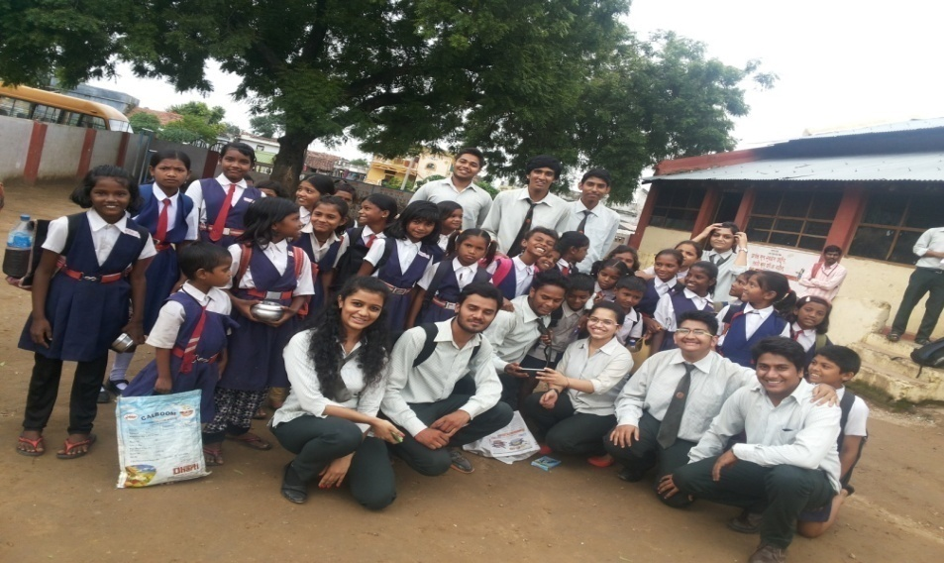
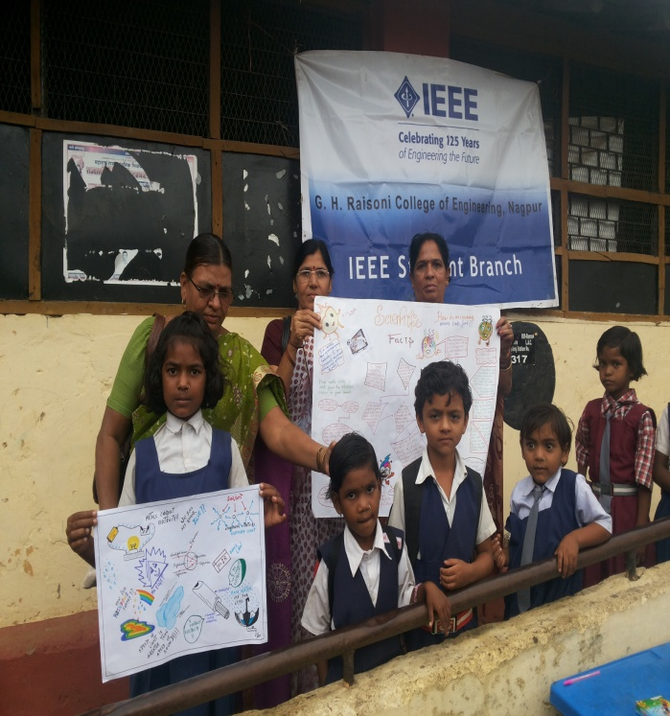
CSR Activity in Zilla Parishad School,Kanhan
Technology Awareness to the less deprived.

Slide 12
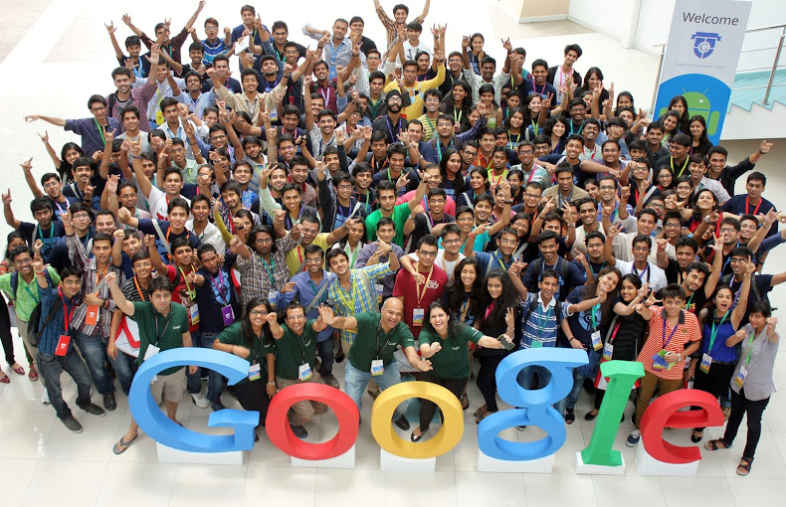
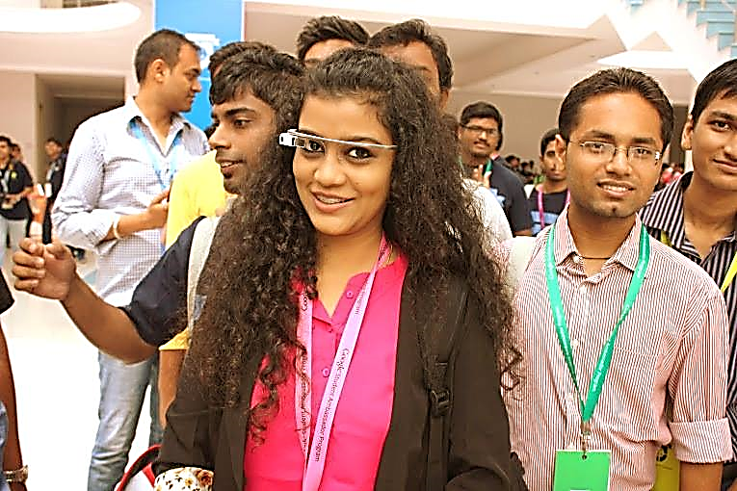
Ms. Apoorva Sonavani
“Google Student Ambassador
2014-15
&
Team Lead,Networking,IEEE India Council Student Coordinators Team”

Slide 13
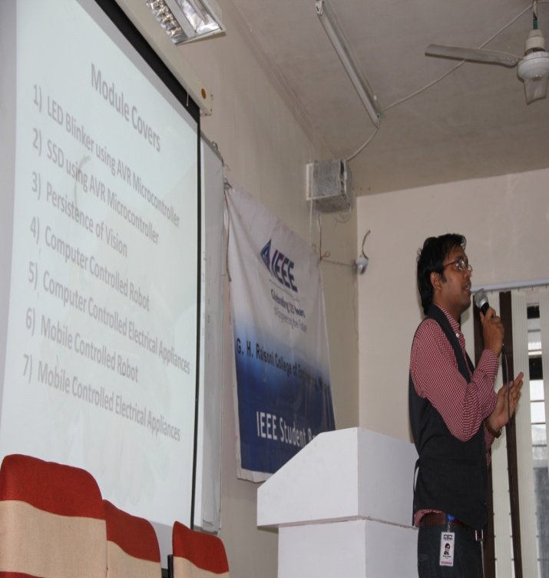
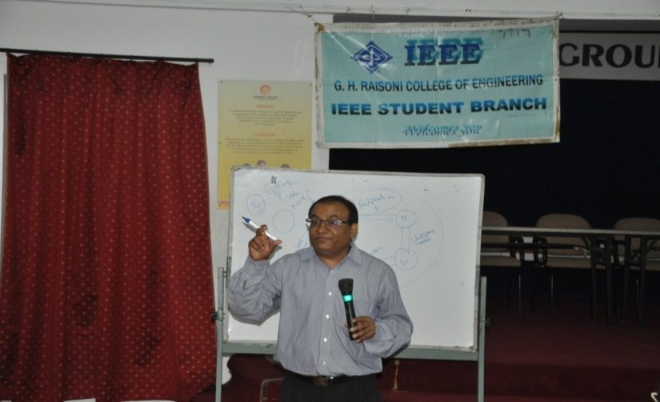
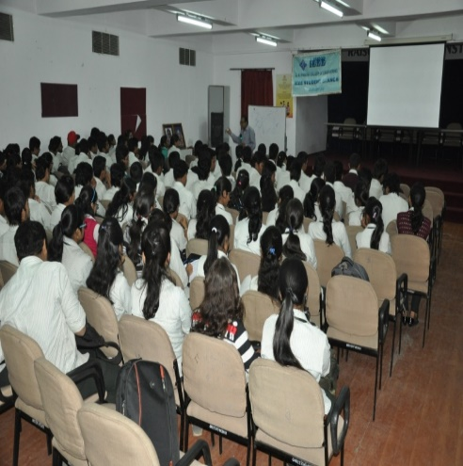
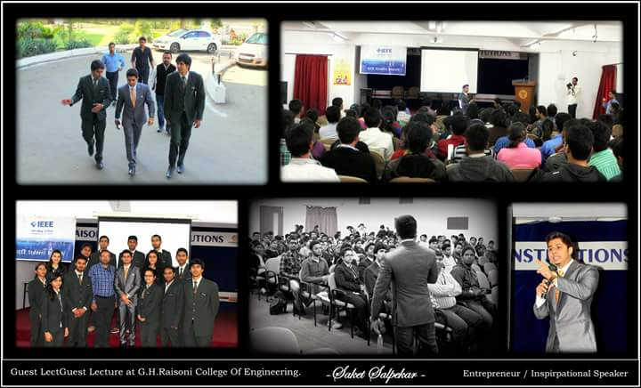
Workshop / Guest Lecture conducted under IEEE 2014-15
Workshop on “AVR Microcontroller ” By Tecxtra Technologies Pvt.Ltd.
Guest Lecture on “Design Aspects using Embedded Systems”
Mr. Charudatta Bhure, R&D
consultant from Bharat Forge Ltd
“Seminar on Entrepreneurship by Mr.Salpekar”

Slide 14
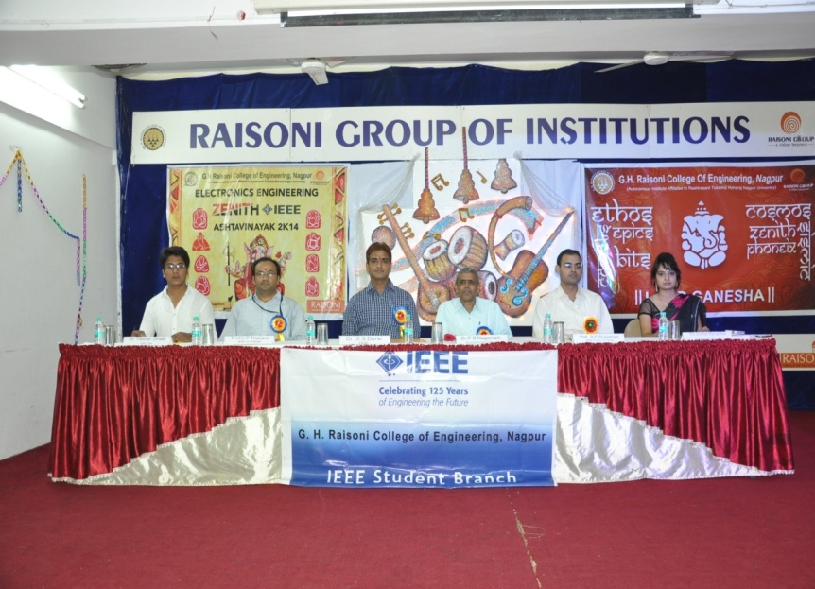
IEEE Execom Installation 2014-15

Slide 15
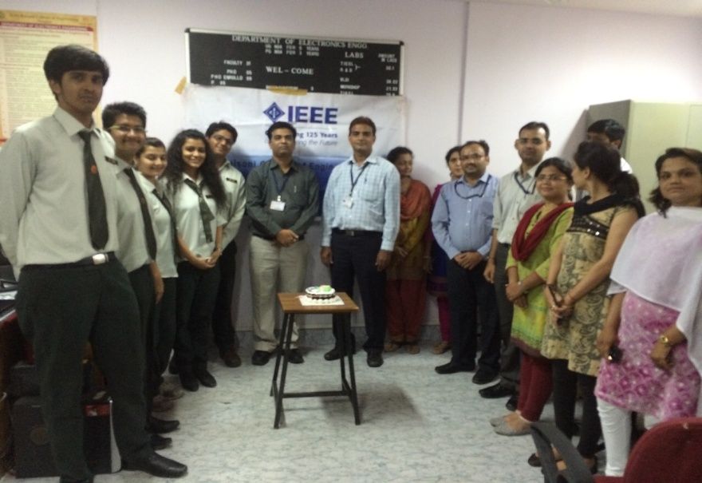
‘IEEE DAY’ Celebrations

Slide 16
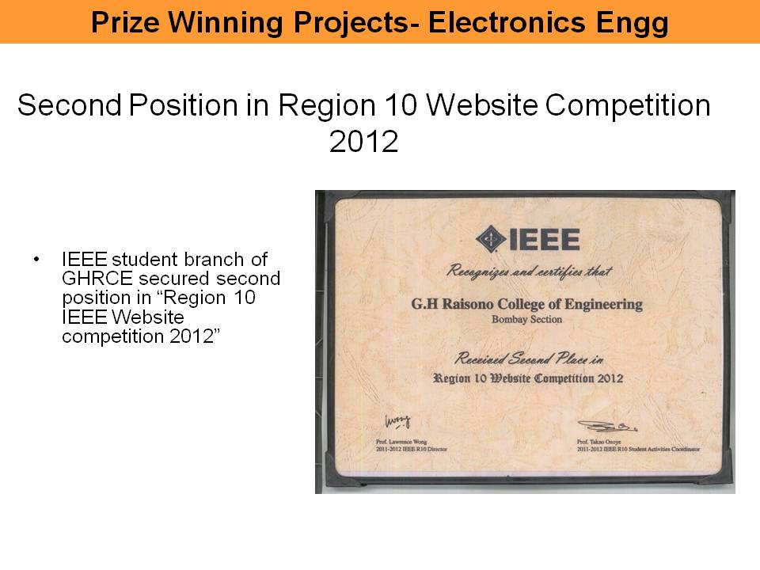
IEEE Awards

Slide 17
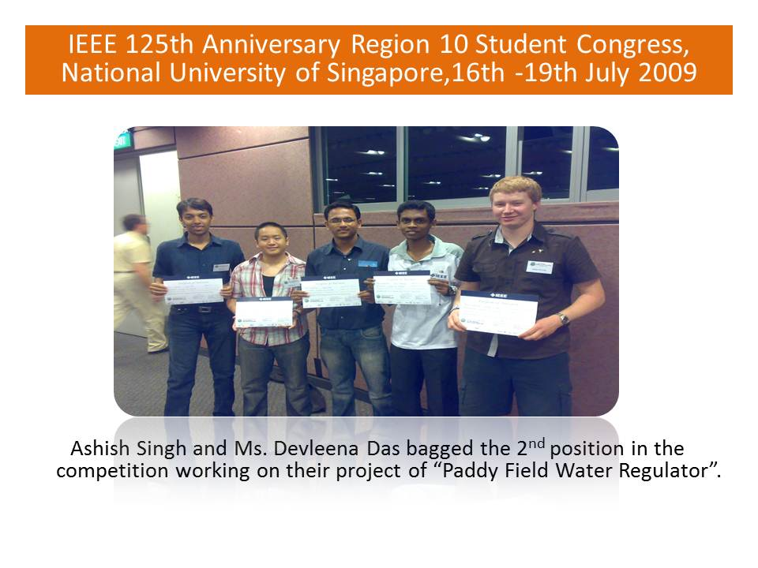

Slide 18
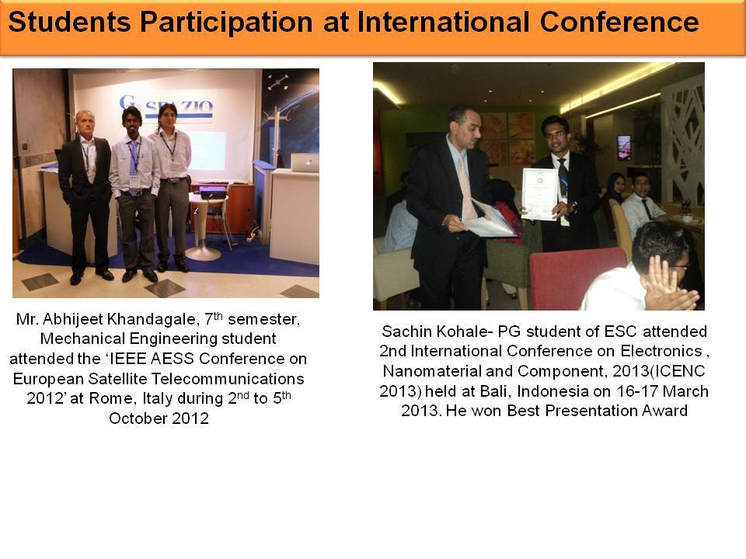

Slide 19
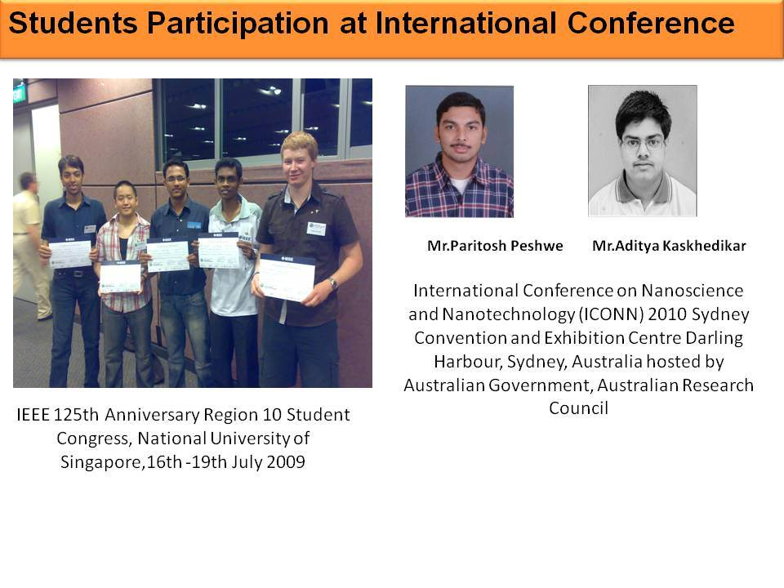

Slide 20
What do you gain ?

Slide 21
1st
Professional step towards grooming yourself!

Slide 22
*THE CORRECT* exposure

Slide 23
And of course…..

Slide 24
A family you can count on and a place where the more you give,the more you get for your betterment!

Slide 25
Thank You

