Slide 1
LingUaLearN
Meher Amir (22i-1973) | Sahil Kumar (22i-2048) | Raiha Adnan (22i-1875)

Slide 2
Translation app
An innovative language learning application that offers a multitude of features to facilitate and enhance the language learning experience. Whether you're a beginner or an advanced learner, this app provides a versatile platform to engage with and master a new language.

Slide 3
PROBLEM
MARKET GAP
COSTS
Few, if any, products on the market help customers like we do
Loss of productivity costing consumers thousands of dollars
CUSTOMERS
USABILITY
66% of consumers spend money on multiple products that only partially resolves their issue
Customers want something easy to use that helps make their life easier

Slide 4
SOLUTION
CLOSE THE GAP
COST SAVINGS
Our product makes consumer lives easier, and no other product on the market offers the same features
Reduce expenses for replacement products
EASY TO USE
Simple design that gives customers the targeted information they need

Slide 5
Advantages and constraints
Advantages
constraints
Versatile platform for learners of all levels.
Interactive features like quizzes, games, and chatbots to enhance learning experience.
Flexible schedule and self-paced learning options.
Access to a wide range of languages and dialects.
Reliance on technology and internet connectivity.
Limited opportunity for in-person interaction and practice.
May not be suitable for learners who require more structured or guided learning.
Limited availability of resources and content for certain languages, which may limit the app's usefulness for users who want to learn a specific language.

Slide 6
Lingualearn

Slide 7



Features
Language Selection
Interactive AI Conversations
Speech Recognition
User-friendly interface
Interactions in the target language
To evaluate the pronunciation

Slide 8



Features
Offline Mode
Vocabulary Builder
Translation Services
Users download lessons and practice materials for offline use
Introduce new words and phrases in context
Allowing users to translate text

Slide 9

Features
progress Tracking
For tracking users' progress that keeps track of their language development and learning achievements

Slide 10
NFR Requirements
Usability
Language selection interface is user-friendly
Reliability
Persist across app sessions
Scalability
Able to support a wide range of supported languages
Personalization
To personalize the learning experience, based on their skill level
Security
To minimize risks

Slide 11
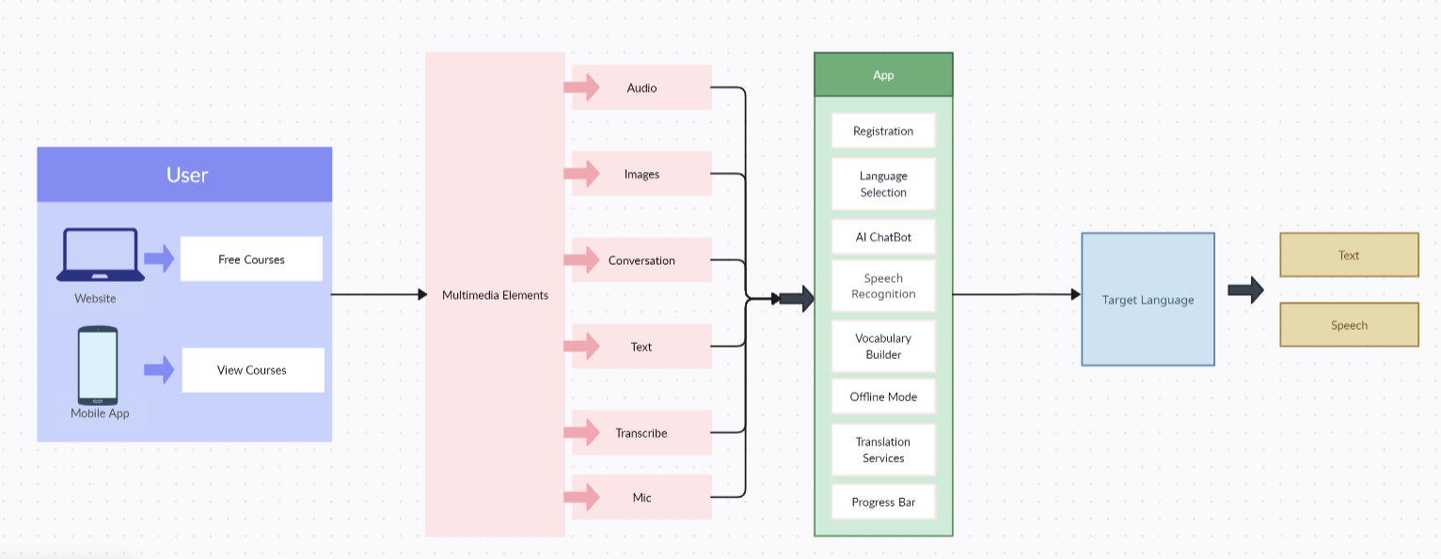
Architecture
Our language learning app is built to offer a seamless and personalized learning

Slide 12
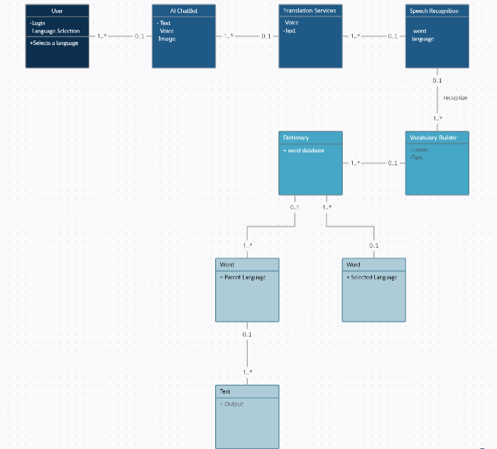
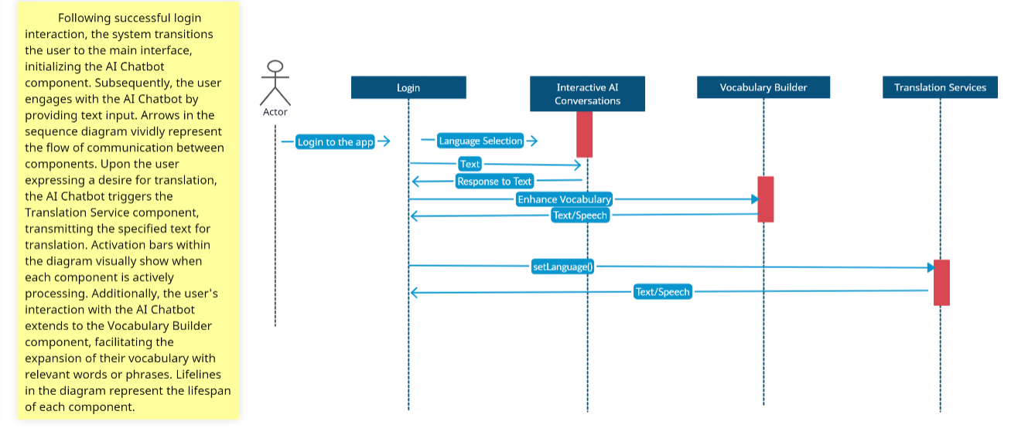
Design of the Language Learning App Our language learning app is designed to provide a versatile platform for learners of all levels.
Class diagram
Sequence diagram

Slide 13
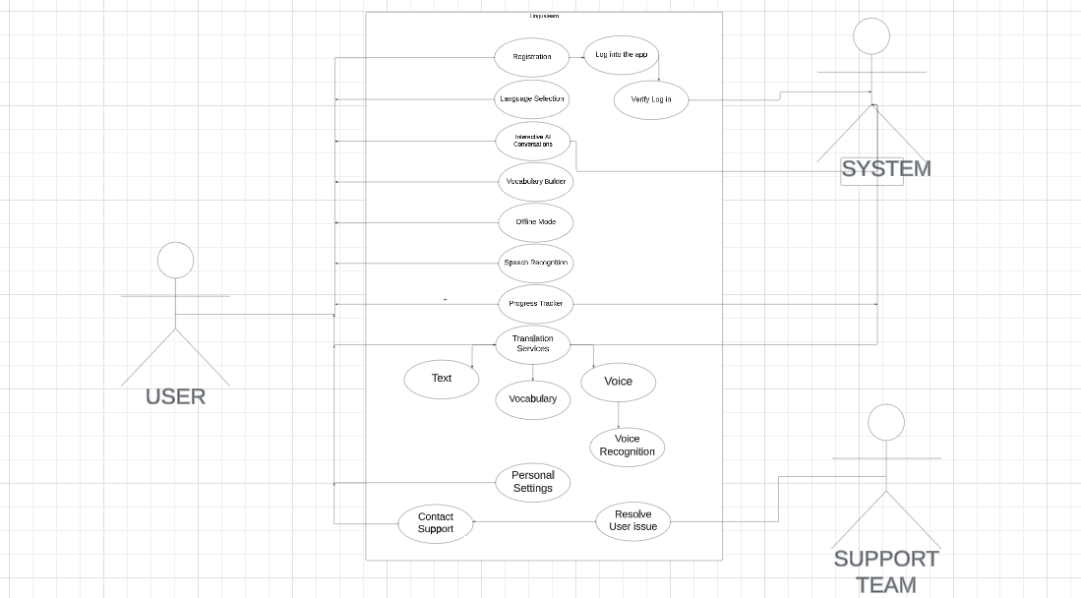
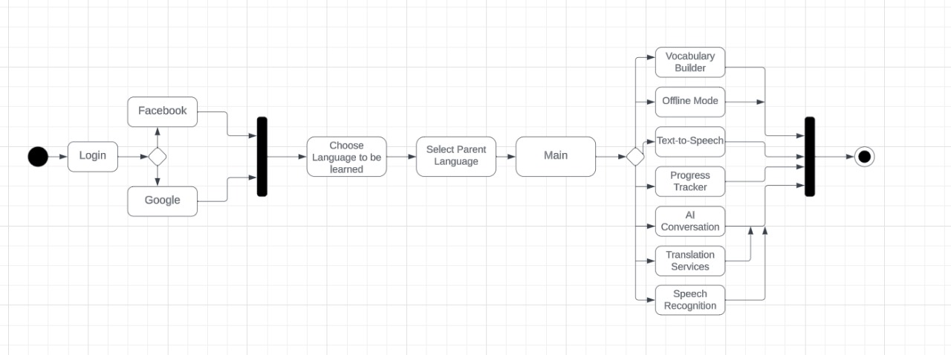
Design of the Language Learning App
Use case diagram
activity diagram

Slide 14
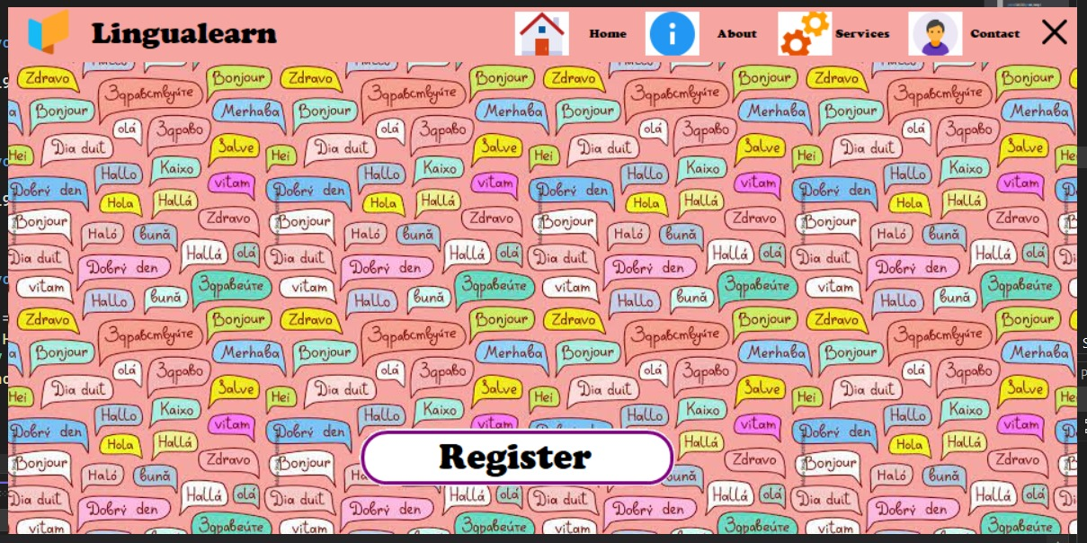
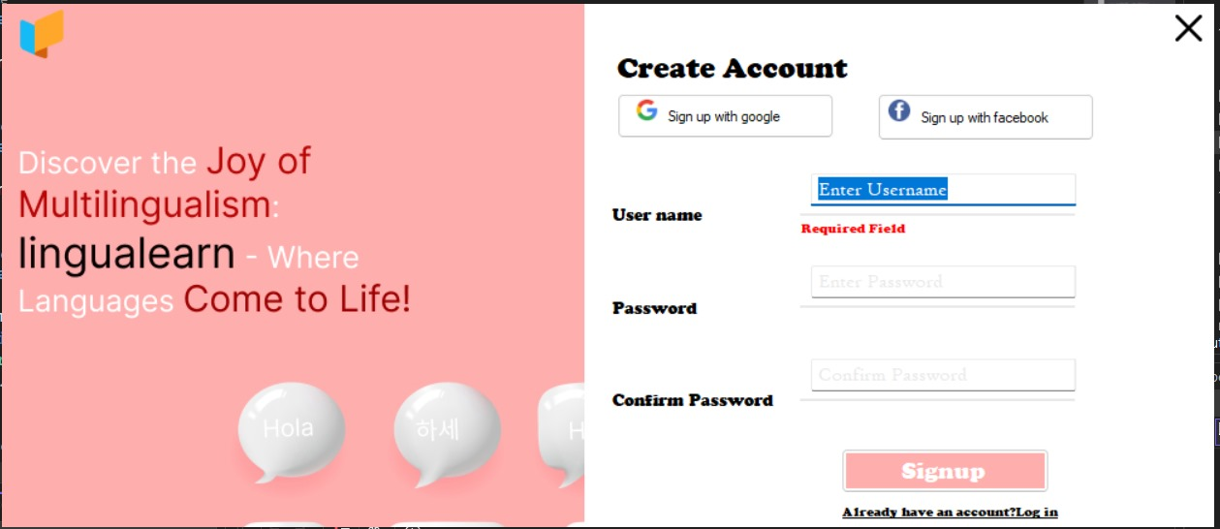
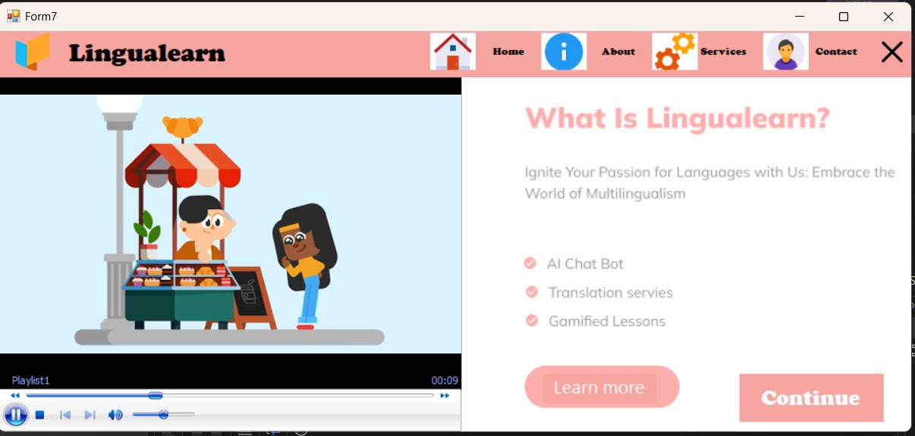
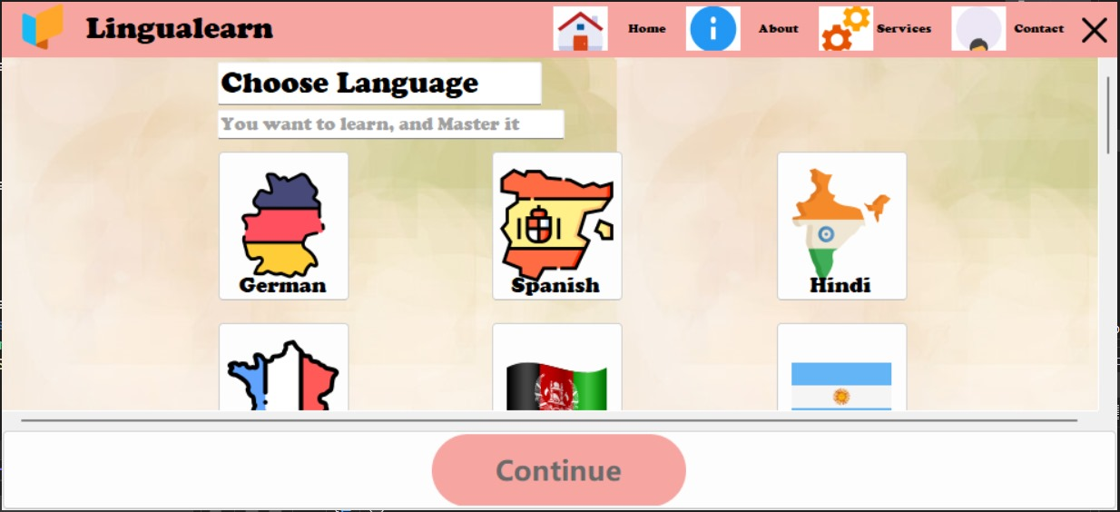
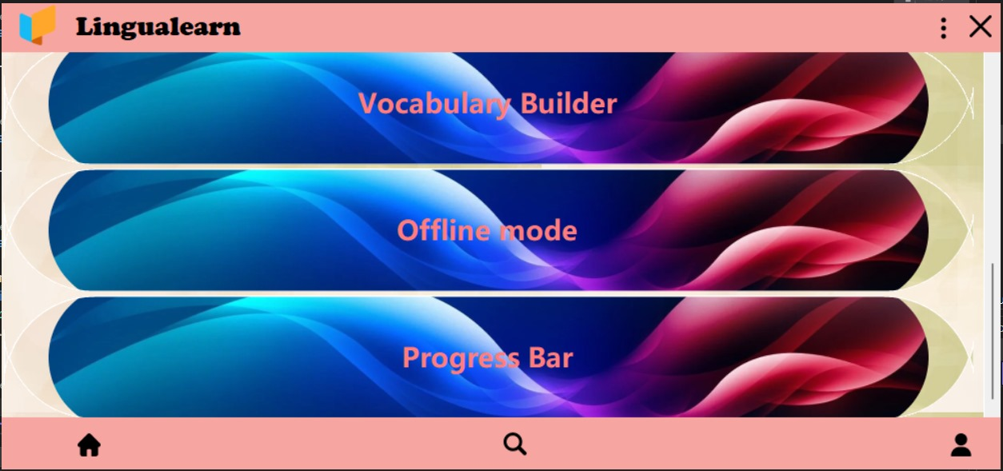
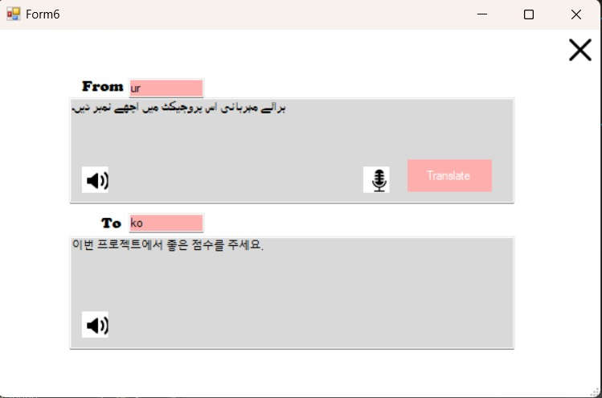
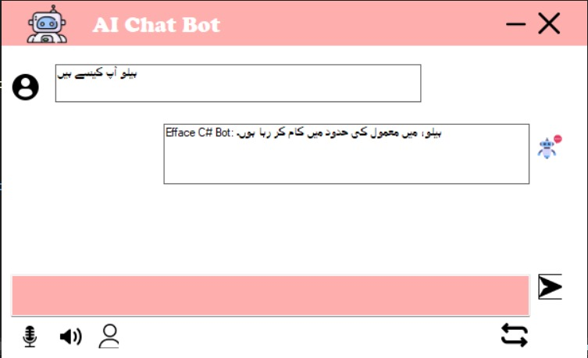
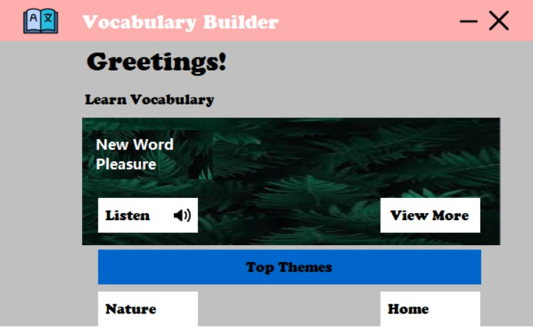
Actual Implementation Screenshots Below are some screenshots of the actual implementation of our language learning app.

Slide 15
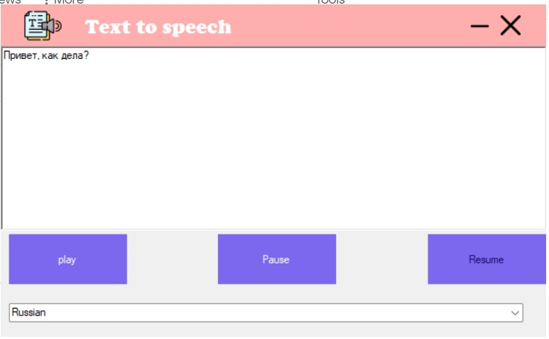
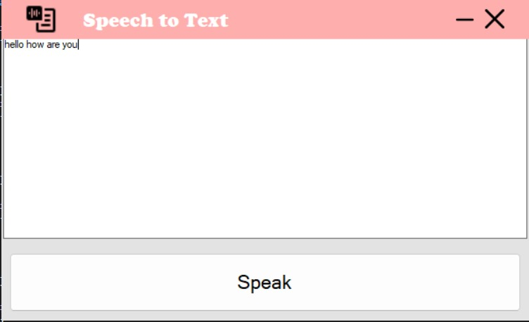
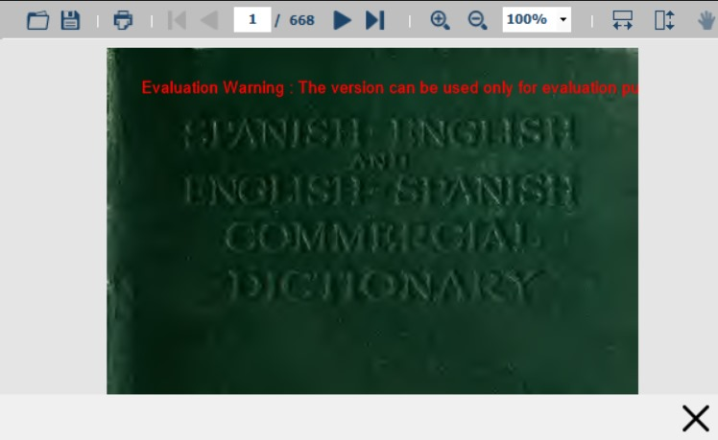
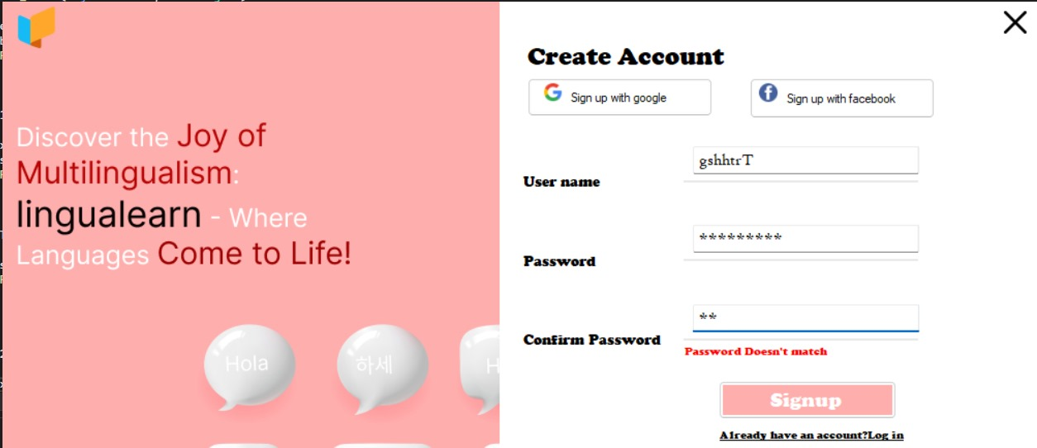
Actual Implementation Screenshots

Slide 16
Boundary Value Anlayis
Boundary Testing
Testing the upper and lower boundaries of the character limits for both username and password.
Checking the behavior when the fields are filled with the maximum allowed characters.
Validating the response when the form is submitted with inputs just at the edge of the allowed range.
Edge Case Testing
Testing with the smallest possible input (minimum length, valid characters).
Testing with the largest possible input (maximum length, valid characters).
Concurrency Testing
Simultaneous sign-up attempts with the same username or email.
Multiple login attempts with the same or different credentials.
Performance Testing
Evaluating the response time under normal and peak loads.

Slide 17
MEET THE TEAM
Sahil Kumar
Meher Amir
Raiha Adnan
Team Lead
Team Designer
Product Manager
Back-End Development
Database design and implementation.
Server-side programming and API integration
Front-End Development
Design and layout of user interface.
Implementation of front-end design and user interaction.
overall vision and strategy
The driving force of LinguaLearn, Raiha plays a crucial role in defining the product roadmap, prioritizing features, and ensuring that LinguaLearn aligns with the needs and expectations of its users.

Slide 18
SUMMARY
LinguaLearn leverages cutting-edge AI technologies to enhance every aspect of language learning and translation. services, empowering users to break down language barriers, enrich their cultural understanding, and make language acquisition an engaging and enjoyable experience. What sets this app apart from existing solutions is its commitment to a dynamic learning experience, seamless translation integration, cultural enrichment, user-centric design, continuous improvement, versatility, community and support, accessibility, real-world application, and engaging content.

Slide 19
Lesson Learnt
Focus on User Experience
One of the biggest lessons we learned was to prioritize user experience throughout the design and development process.
Iterate and Test Frequently
Another important lesson we learned was the value of iterating and testing frequently.
Collaboration is Key
Finally, we learned that collaboration is key to the success of any project. By working closely with our team members, we were able to create a platform that truly meets the needs of language learners of all levels.

Slide 20
THANK YOU

