Slide 1
Road Damage Detection from UAV Images
IPCV PROJECT · MNNIT ALLAHABAD
Using DA-YOLO11n on the UAVROAD dataset
Sahil Kumar Singh - 20233239
Sashwat Barthwal – 20233558
Sakaray Varsha – 20233241
Sathammai Sathappan - 20233559
Dr. Abhimanyu Sahu
Computer Science and Engineering, MNNIT Allahabad
Notes:
Welcome. This project detects road damage in drone images. We built DA-YOLO11n by adding a deformable-attention block to YOLO11n and trained it on the UAVROAD dataset.

Slide 2




Roads need checking, and checking by foot is slow
PROBLEM
Manual survey
UAV images
Object detection
Walking inspections for cracks, potholes and other damage take a long time.
Drones capture many pictures quickly, but someone still has to review every one.
For each image, draw a box around every damage and give its class name.
Many damages are thin and long, like cracks, or very small. This is harder than normal object detection.
DA-YOLO11n · Road damage detection from UAV images
2
Notes:
Motivation. Checking roads by walking is slow. Drones help collect images, but reviewing them by hand is still work. We treat it as object detection. Cracks are thin and long and many damages are tiny, which makes it difficult.

Slide 3
UAVROAD: drone images with 14 damage classes
DATASET
5,002
Cracks
Transverse · Longitudinal · Alligator · Oblique
image and label pairs
Pavement
Repair · Pothole · Damaged marking
14
6.6 GB
classes
from Kaggle
Roadside
Greenbelt encroachment · Damaged sign · Damaged guardrail · Damaged drainage · Damaged curb
JPEG images with Pascal VOC XML labels. All 5,002 had a matching XML file. No boxes were found for Damaged sign.
On the surface
Trash · Water
3
Notes:
UAVROAD has about 6.6 GB of images with Pascal VOC XML labels. All 5,002 images had a matching XML. Similar raw names are merged into 14 classes, but the class audit finds no boxes for damaged sign, so 13 classes have data.

Slide 4
From VOC labels to an 8:1:1 YOLO split
DATA PREPARATION
1
2
3
4
Pair
Map classes
Convert
Split
Match each JPEG with its XML file
Join similar names into 14 classes; unknown names stop the run
Boxes become class, x-centre, y-centre, width, height in 0 to 1
Shuffle with seed 56, then split 8:1:1
Split | Images | Used for
Train | 4,001 | Model training
Validation | 500 | Checkpoint selection during training
Test | 501 | Final reported metrics, never tuned on
4
Notes:
Each XML box is converted to YOLO format and normalised; 136 malformed boxes were skipped. The data is shuffled with seed 56 and split 8:1:1 into 4,001 training, 500 validation and 501 test images. The final metrics in this deck come from the 501-image test split.

Slide 5


DA-YOLO11n is YOLO11n with one custom block
MODEL
BASE MODEL
CHANGES WRITTEN IN PYTORCH
YOLO11n
One custom module
About 2.6 million parameters
C3k2_DAttention replaces one C3k2 block at layer 8; the standard Detect head is kept
Goal: follow thin, bent cracks and small damages better than the standard C3k2 block.
5
Notes:
The base is YOLO11n with pretrained weights, a small model of about 2.6 million parameters. We wrote one custom module in PyTorch and swapped it in at layer 8; the new block starts from fresh weights and the Detect head is unchanged.

Slide 6
One block changes, the head stays
CUSTOM MODULE
BACKBONE, LAYER 8
INSIDE THE BLOCK
HEAD, LAYER 23
C3k2_DAttention
Deformable conv
Detect (unchanged)
A C3k2-style block with two bottlenecks. Each is a 1x1 conv, then a deformable 3x3 conv, with a shortcut.
Uses torchvision deform_conv2d. One conv predicts the x and y offsets and a mask, and the mask goes through a sigmoid.
The standard YOLO11n Detect head is kept and set to 14 classes.
A small, testable change.
The filter can follow thin and bent cracks.
Offsets start at zero.
6
Notes:
C3k2_DAttention uses torchvision deform_conv2d through a DeformableConvBlock, so the sampling points can move to fit the crack shape. Offsets and mask are initialised to zero. The Detect head at layer 23 is the standard YOLO11n head, kept on purpose so the effect of the one change can be tested. LSCBNHead and DASI from the DAL-YOLO idea are not part of this model.

Slide 7
300 epochs on a single Colab T4 GPU
TRAINING
300
640
16
100
epochs
image size
batch size
early-stop patience
Optimizer
Augmentation
SGD, learning rate 0.01
Momentum 0.937, weight decay 0.0005
3 warm-up epochs, mixed precision
Mosaic, off for the last 10 epochs
Horizontal flip 0.5, HSV colour change
Translate 0.1, scale 0.5, erasing 0.4
7
Notes:
Training used the Ultralytics trainer on a Tesla T4 in Google Colab with default YOLO augmentation. Checkpoints and logs were saved to Google Drive so training could continue across sessions.

Slide 8
The best model reaches mAP@50 of 0.593
RESULTS
0.593
0.684
0.623
Precision
F1-score
mAP@50
0.573
501
0.354 at mAP@50-95
Recall
test images
8
Notes:
These are the held-out test numbers for the best checkpoint on 501 images: precision 0.684, recall 0.573, F1 0.623, mAP@50 0.593 and mAP@50-95 0.354. F1 is computed from the mean precision and recall.

Slide 9
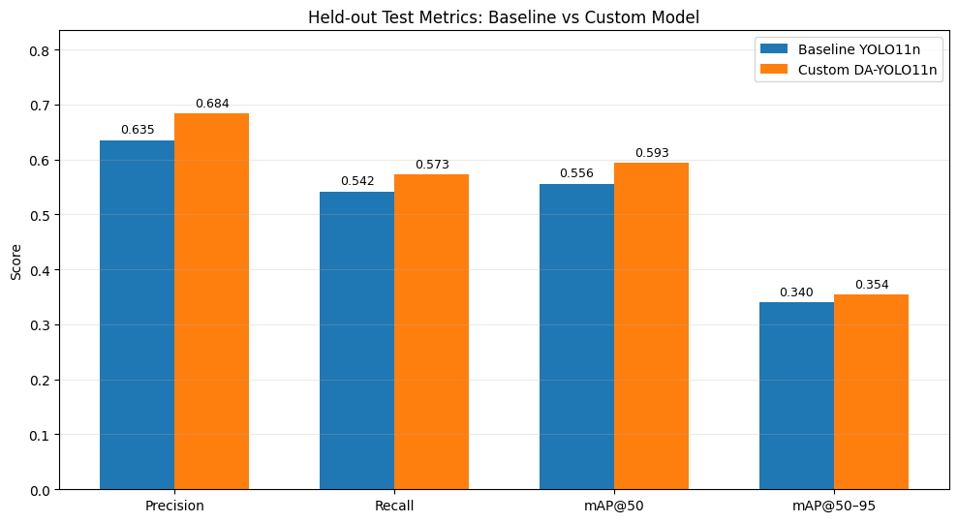
DA-YOLO11n against the fine-tuned YOLO11n baseline
COMPARISON
Metric | Baseline | DA-YOLO11n | Gain
Precision | 0.6353 | 0.6841 | +0.0488
Recall | 0.5419 | 0.5726 | +0.0307
F1-score | 0.5849 | 0.6234 | +0.0385
mAP@50 | 0.5559 | 0.5931 | +0.0372
mAP@50-95 | 0.3395 | 0.3537 | +0.0142
Both models are YOLO11n trained on UAVROAD and scored on the same 501 test images at 640 px. The gains are small and come from one run.
9
Notes:
Both models are YOLO11n trained on UAVROAD and evaluated on the same held-out test split at the same image size. DA-YOLO11n is ahead on every overall metric, by about 0.03 to 0.05 on precision, recall and mAP@50 and 0.014 on mAP@50-95. This is one run, so treat the gain as modest. Per class it is mixed: guardrail, pothole and water improve, while repair, drainage and oblique crack drop.

Slide 10
Drainage, potholes and repair work; curbs get missed
CLASS-WISE BEHAVIOUR
Detected well · mAP@50
Often missed · recall
Class | mAP@50
Damaged drainage | 0.928
Pothole | 0.826
Repair | 0.825
Damaged guardrail | 0.733
Transverse crack | 0.730
Class | Recall
Damaged curb (227 boxes) | 0.237
Greenbelt encroachment | 0.250
Trash | 0.302
Water | 0.375
Damaged curb has the most boxes of any class, yet most are missed. Many classes have under 60 boxes in the test data, so their scores can shift with a different split.
10
Notes:
These are DA-YOLO11n test results. Damaged drainage reaches 0.928 mAP@50, pothole 0.826 and repair 0.825; transverse crack is 0.730. Curbs are the biggest problem: recall is only 0.237 even though there are 227 curb boxes in the test split. Greenbelt encroachment, trash and water also have low recall. Damaged sign has no labelled boxes, so it is not scored.

Slide 11
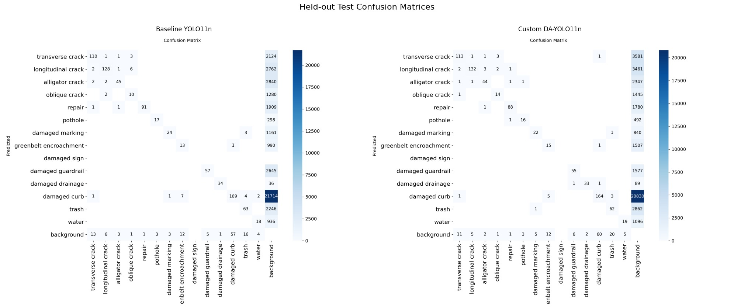
Baseline on the left, DA-YOLO11n on the right
CONFUSION MATRICES
11
Notes:
These are held-out test matrices. Left is the baseline YOLO11n, right is DA-YOLO11n. The diagonal of each matrix shows where classes are predicted correctly.

Slide 12
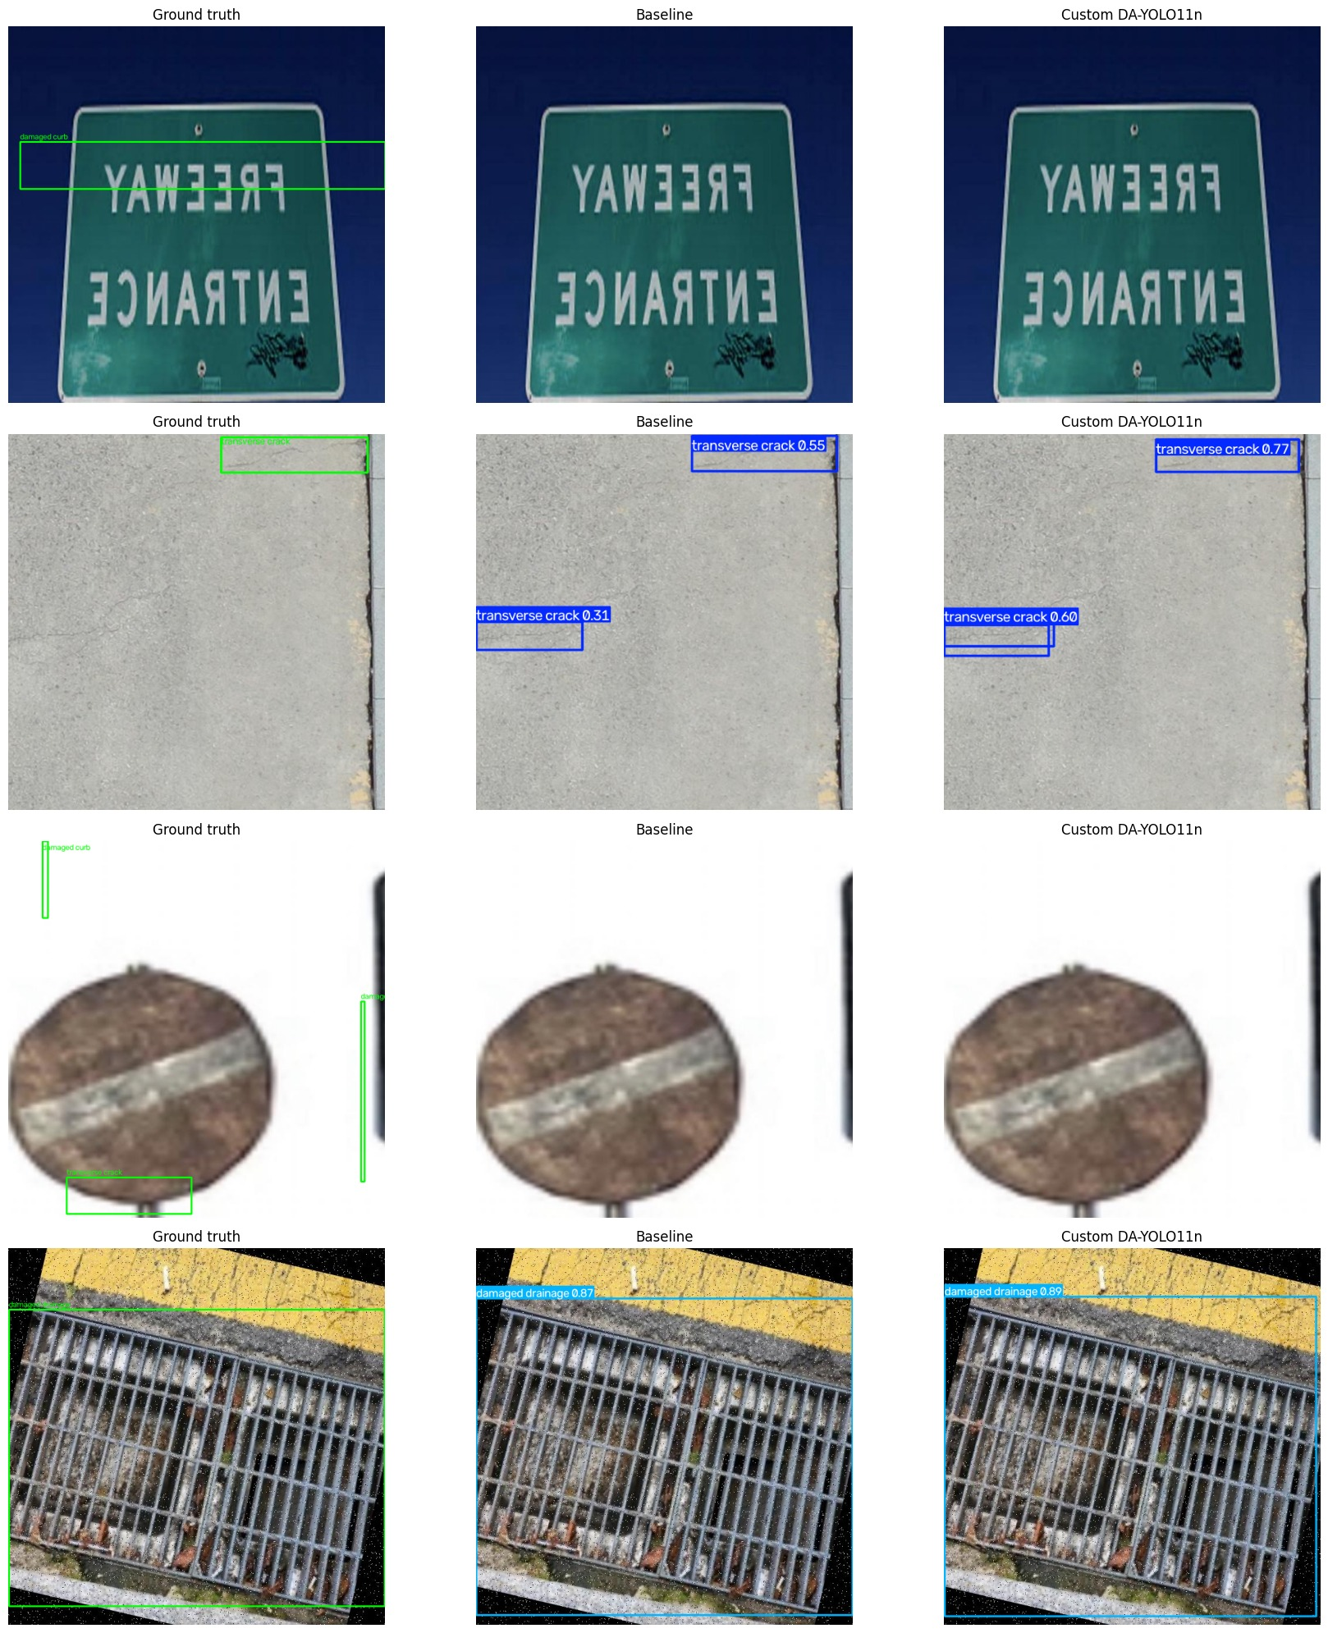
Four random test images
EXAMPLES
Columns: ground truth, baseline YOLO11n, DA-YOLO11n.
Both models find the transverse crack and the drain.
Both miss the damaged curbs.
12
Notes:
The four test images were picked at random with seed 56. Ground truth is on the left, the baseline in the middle and DA-YOLO11n on the right. Both models detect the transverse crack and the drain grate; both miss the damaged curb boxes in the first and third rows, which matches the low curb recall.

Slide 13
A full pipeline with clear strengths and gaps
CONCLUSION
What we built
What we found
Next steps
UAVROAD download, YOLO label conversion and 8:1:1 split
Deformable block added to YOLO11n (layer 8)
Training and held-out test evaluation
Test mAP@50 0.593 (baseline 0.556), mAP@50-95 0.354 (0.340)
Drainage, potholes and repair detected well
Curbs, greenbelt, trash and water often missed
More examples of the low-recall classes
Repeat with more seeds to confirm the small gain
Try the LSCBNHead and DASI modules
Scope: box detection on still images only, from one training run. Small classes make some per-class scores sensitive to the split.
13
Notes:
To close: we have a complete pipeline from raw dataset to a model scored on the held-out test split. DA-YOLO11n beats the fine-tuned baseline modestly. The next steps are suggestions from our results, not completed work.

