Slide 1

Project on
Symbiosis Skill & Professional University of (SPPU) Kiwale, Pune.
“Hospital Management System”
SUBMITTED BY
Dhruvi Thakkar
Deepak Tiwari
Renuka Kalkar
Sahil Mali
Shivam Kshatriya
For Academic Year
2024-2025
Under the Project Guidance of
Prof. Vinaya Kulkarni
Department of Engineering
MET Institute of Engineering
Bhujbal Knowledge City
Adgaon, Nashik.

Slide 2
Symbiosis Skill & Professional (SPPU) Kiwale, Pune.
CERTIFICATE
This is to certify that project entitled
“Hospital Management System”
Has been satisfactorily
completed by
Dhruvi Thakkar
Deepak Tiwari
Renuka Kalkar
Sahil Mali
Shivam Kshatriya
In partial fulfilment of training
Application Under the Faculty of Engineering.
For the Academic Year 2024-2025

Slide 3
Contents:
Introduction
Objectives
Scope of Project
Requirements Gathering and Analysis
Feasibility Study
Design

Slide 4
Introduction :
Scalability: Easily scalable to accommodate the growing needs of the hospital.
The Hospital Management System (HMS) is a comprehensive, web-based application developed using ASP.NET. It is designed to streamline and automate the administrative, clinical, and financial operations within a healthcare facility.
Key Objectives:
Efficient Management: Streamlines patient management, appointments, billing, and medical records.
Data Security: Ensures secure handling of sensitive patient information with robust security measures.
User-Friendly Interface: Provides a simple, intuitive interface for healthcare professionals and administrative staff.
Why ASP.NET?
Scalability: Easy scalable to accommodate the Growing Needs of the Hospital
Security: Built-in security features like authentication and role-based access control.
Performance: High-performance framework suitable for complex, real-time applications.

Slide 5
Objectives :
Ensure accurate and timely access to patient records and medical history.
Enhance Operational Efficiency:
Streamline administrative tasks such as patient registration, appointment scheduling, and billing
Improve Patient Care:
Ensure accurate and timely to patient and medical history.
Ensure Data Security:
Protect sensitive patient information through robust security measures and role-based access control
Facilitate Better Decision-Making:
Provide health. Care professionals with real time data and analytics for informed decision making.
Reduce Operational Cost:
Automate routing process to minimize manual work and reduce errors.

Slide 6
Scope of Project :
Patient Management:
Registration, admission, and discharge processes.
Patient appointment scheduling and follow-ups.
Electronic Medical Records (EMR) management.
Billing and Invoicing:
Automated billing for services rendered.
Insurance claim processing and management.
Payment tracking and reporting.
Inventory Management:
Management of medical supplies, drugs, and equipment.
Stock monitoring, reorder alerts, and inventory audits.

Slide 7
Staff and Resource Management:
Scheduling and tracking of doctors, nurse and other stuff.
Assignments of resources such as roots equipment and facilities.
Reporting and Analytics.
Generation of reports on patient care, financials and resource utilization.
Data analytics for performance monitoring and decision making.
User management and security.
Rule test access control for different user types (Administrators, doctors, nurse, etc)
Secure login and data encryption.

Slide 8
Requirements Gathering and Analysis :
1. Stakeholder Identification:
Identify key stakeholders (hospital administrators, doctors, nurses, patients) to understand their needs and expectations.
2. Functional Requirements:
Patient Management: Requirements related to patient registration, appointment scheduling, medical records, and discharge processes.
Billing and Payments: Requirements for handling billing, invoicing, insurance processing, and payment tracking.
Inventory Management: Requirements for tracking medical supplies, equipment, and stock levels.
Staff Management: Requirements for managing staff schedules, resource allocation, and duty rosters.

Slide 9
3. Non-Functional Requirements:
Security: Data protection, user authentication, and role-based access control.
Performance: System responsiveness, load handling, and uptime requirements.
Usability: User interface design, ease of use, and accessibility.
Scalability: Ability to handle growing data and user loads as the hospital expands.
4. Requirement Validation:
Review and Sign-off:
Validate the gathered requirements with stakeholders to ensure they meet their needs and expectations.
Prototype Development:
Create prototypes or wireframes to visualize the system and gather further feedback.

Slide 10
Requirement For System
1. Software Requirements:
Operating System:
Windows 10 or later
Windows Server 2016 or later (for deployment)
Development Environment:
Microsoft Visual Studio 2019 or later
ASP.NET Core 3.1 or later
Database:
Microsoft SQL Server 2016 or later
MySQL or PostgreSQL (optional)
Web Server:
IIS 10.0 or later
Apache (optional)
Frameworks & Libraries:
.NET Core/ASP.NET Core
Entity Framework Core
Bootstrap (for frontend)
jQuery/JavaScrip
2. Hardware Requirements:
Development Machine:
Processor: Intel i5 or higher
RAM: 8GB or more
Hard Disk: 250GB SSD or higher
Server (for deployment):
Processor: Intel Xeon or equivalent
RAM: 16GB or more
Storage: 500GB SSD or higher
Network: High-speed internet connection

Slide 11
Feasibility study
1. Technical Feasibility:
Technology Availability:
The required technologies (ASP.NET, SQL Server, etc.) are readily available and well-supported.
Technical Expertise:
The development team possesses the necessary skills in ASP.NET, database management, and web development.
Scalability:
The system can be designed to scale as the hospital grows, accommodating more users and data.
2. Economic Feasibility:
Cost Estimation:
Initial development costs, including hardware, software, and personnel, are within the hospital’s budget.
Long-term Financial Viability:
The cost of maintaining and updating the system is sustainable over the long term.
Funding Sources:
Potential for government grants, private funding, or hospital budget allocation to cover the project costs.

Slide 12
3. Operational Feasibility:
Stakeholder Acceptance:
Hospital staff, including doctors, nurses, and administrators, are likely to accept and use the system.
Training and Support:
Adequate training programs can be provided to ensure all users are comfortable with the new system.
Impact on Hospital Operations:
The system will streamline operations, improve patient care, and enhance overall efficiency without causing major disruptions.
Change Management:
A plan is in place to manage the transition from the current system to the new Hospital Management System.
4. Legal and Ethical Feasibility:
Compliance with Regulations:
The system will adhere to healthcare regulations, such as HIPAA, ensuring patient data privacy and security.
Ethical Considerations:
The system will ensure the ethical use of patient data and respect patient confidentiality.
Contractual Obligations:
Any third-party contracts for software or services will be reviewed for compliance and legal obligations.

Slide 13
Modules:
Doctor:-
1. Doctor Module:
Patient Management:
Access to patient medical records, history, and treatment plans.
Appointment Management:
View and manage daily appointments, reschedule or cancel as needed.
Prescription Management:
Create, edit, and track prescriptions for patients.
Communication:
Communicate with patients and other healthcare staff via secure messaging.
Reporting:
Generate reports on patient progress, treatment outcomes, and other relevant data.

Slide 14
2. Patient Module:
Registration and Profile Management:
Patients can register, create a profile, and update personal details.
Appointment Booking:
Book, view, and manage appointments with doctors.
Access to Medical Records:
View personal medical history, treatment plans, and lab results.
Prescription Access:
Access prescribed medications and instructions.
Billing and Payments:
View billing history, make payments, and manage insurance details.
Feedback and Communication:
Provide feedback on services and communicate with healthcare providers.

Slide 15
3. Admin Module:
User Management:
Manage users (doctors, patients, staff), including creating, updating, and deleting accounts.
Role-Based Access Control:
Assign roles and permissions to different users to ensure secure access to system functionalities.
Appointment and Scheduling Management:
Oversee and manage the scheduling of appointments and resource allocation.
Billing and Financial Management:
Manage hospital billing, invoicing, and financial reporting.
Inventory Management:
Track and manage hospital inventory, including medical supplies, drugs, and equipment.
Reporting and Analytics:
Generate comprehensive reports on hospital operations, patient care, and financial performance.

Slide 16
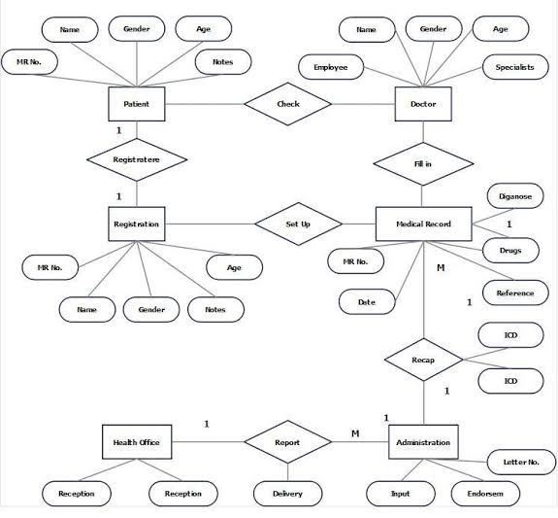
ER Diagram:

Slide 17
Thank You …

