Slide 1
My Wallet Investing for Tomorrow

Slide 2
INTRODUCTION
Understanding your cash flow is a major part of successfully managing your finance.
Track and manage your personal finance using My Wallet.
My Wallet helps you to manage your expenses and plan budgets wisely to save more money for your future.
Easily record your day to day financial transaction.
Generates income/expense graph.
Review your daily , weekly and monthly financial data.

Slide 3
Abstract
This project is developing under Dart programming language in flutter sdk.
A ”My Wallet” app helps you decide between short-term and long-term spending.
Our aim is to develop expense manager app with high functionalities.
When people don’t keep a watch on their spending, they will be short of money . With “My Wallet”, they will be able to cut down unnecessary spending.
Many people are unaware about their money , so there is high need of app like “My Wallet”.

Slide 4

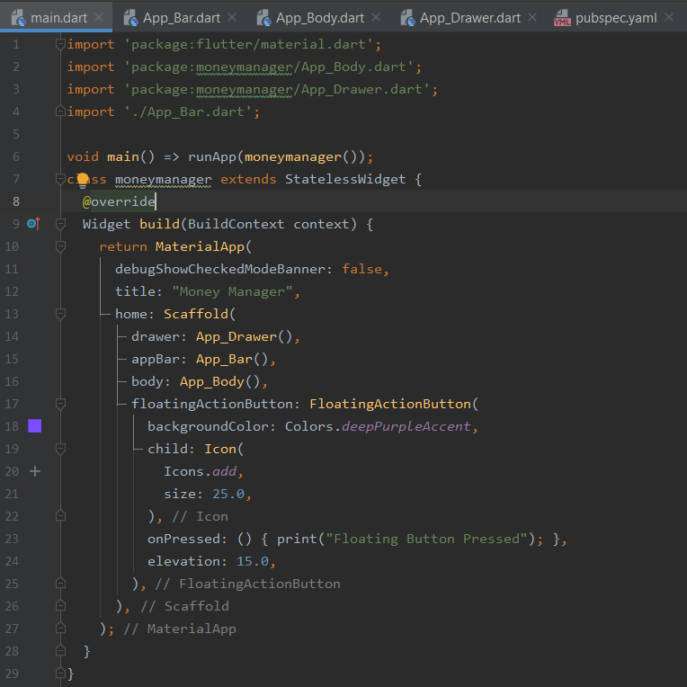
Process
Main Function
App Bar
App Body
App Drawer
Floating Icon
Action Widget

Slide 5
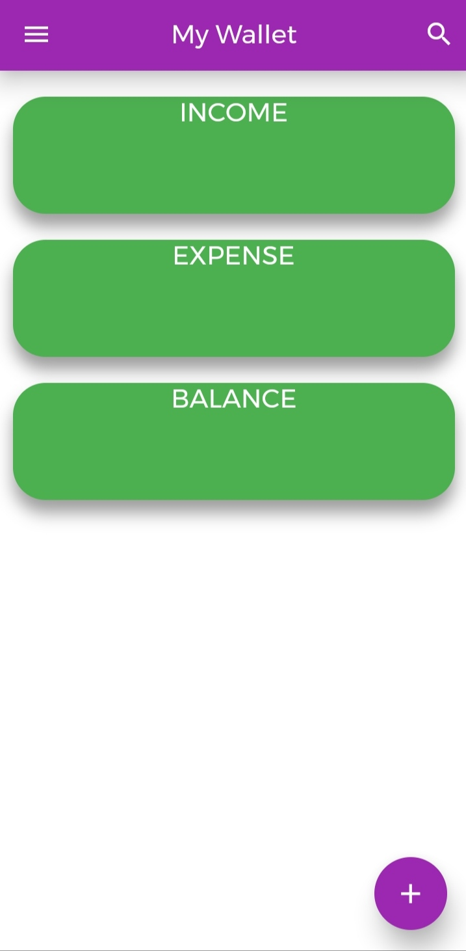
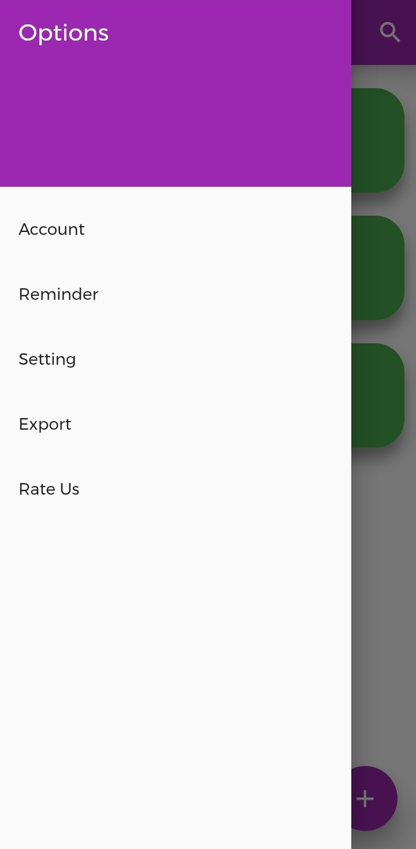
Place your screenshot here
H
O
M
E
P
A
G
E
D
R
A
W
E
R

Slide 6
Features
Record your expense.
Financial Graph.
Export PDF of expenses.
Auto Task.
Overspending Alert.
Make custom category.
Smart Reminder.

Slide 7
Benefits
Can manage your finances efficiently.
Can save money for your future goals.
Easier to save expenses.
Easier to stick to good spending habits.
Can access your finances anywhere at anytime.
Increase financial confidence.

Slide 8
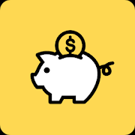
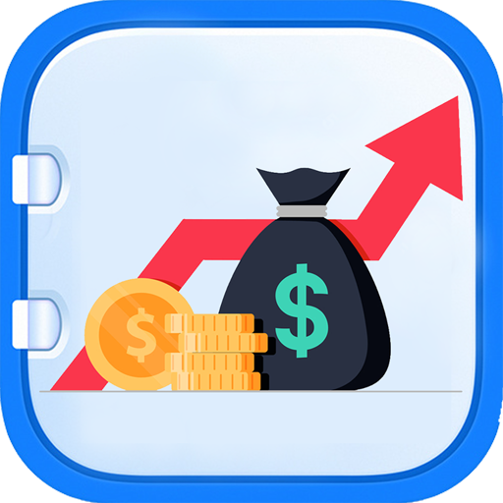
Reference
Reference from ‘Money Manager’ and ‘Expense Manager’ apps that are available on playstore.

Slide 9
Conclusion
We did survey of many apps available on playstore and we will add new features in our “My Wallet” app to make a complete app for user.
We make money work in
Your favor.

Slide 10

THANKS! Any Question?
Prepared By,
19IT068 - Mihir Modi
19IT071 - Sahil Nasariwala

