Slide 1
Traffic Modelling System
Team: Ekathra
Team
Ashwini Cherukuri
Roopanandha Moori
Sahil Nokhwal
Rama Naveen Kommuri
Laxmi Sai Teja Naraharisetty
Vamsi chowdary Bobba
Manikanta Nomula

Slide 2
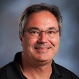
Client and Mentor
Client & Mentor: Dr. Michael Oudshroon
Associate professor in the School of Computer Science and Information System

Slide 3
Outline
Project Overview
Requirements
Project Prototypes
Tools and Technologies
Endterm Project Development Plan

Slide 4
Project Overview
Now-A-days traffic is a main problem. This is caused due to different reasons.
One of the reasons may be deploying the wrong setup of roads.
So making a traffic study and choosing the correct type of road at a particular situation will help to reduce the traffic issues.

Slide 5
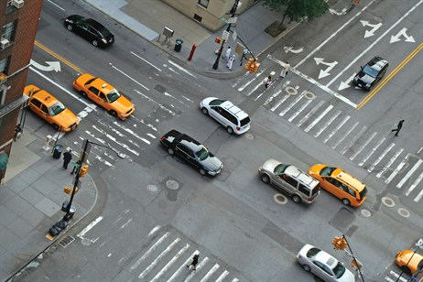
Project Overview (Contd..)
One of the basic goals of studying traffic is to understand traffic congestion and look for ways to prevent it.
The goal is to provide efficient movement of traffic while minimizing congestion problems.

Slide 6
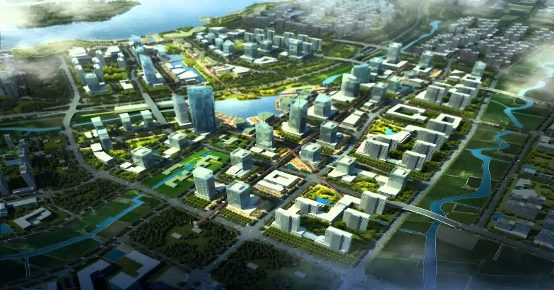
Project Overview (Contd..)
Developing a traffic modelling system can also be used in city planning.
It also help to improve environment by preventing unwanted traffic which will reduce both release of CO2 and chances of vehicle collision
A model of city planning

Slide 7
Requirements
The user should be able to simulate different types of roads which include 2-ways, 4-ways, roundabouts, traffic signals and T-junction.
The user can be able to drag any kind of above mentioned intersection methods and create a path.
The user should provide the below details regarding
Arrival rate.
Speed limit of the road, which will be a range. Ex- 60-65 mph.
Distance of the roads.
Distance between the vehicles.

Slide 8
Requirements (Contd..)
The roads should be one-way.
Only 4-weelers should be simulated and they must stop at stop-signs and follow the traffic signals.
The cars should maintain some threshold distance among them.
The cars should come in all directions and in different speeds.
The cars should avoid accidents.

Slide 9
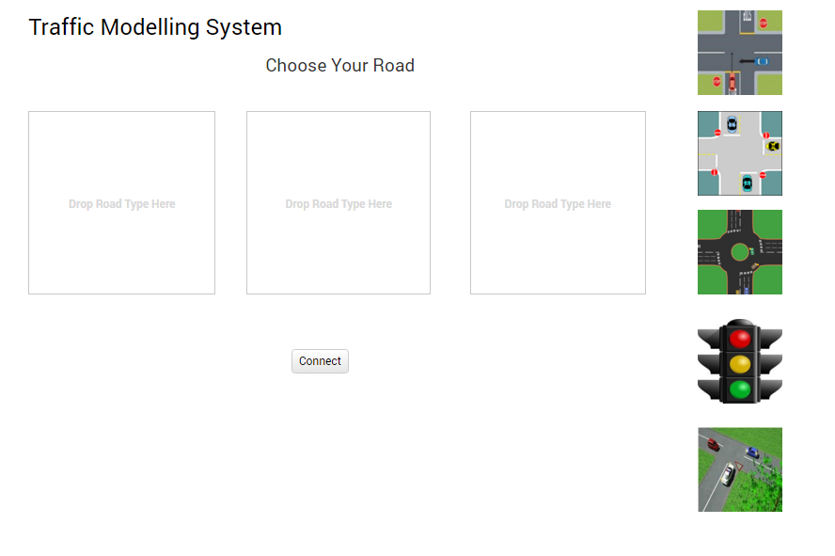
Project Prototypes
The user can simulate different scenarios by choosing different roads.
He just need to drag different roads into the boxes shown.
He will press “Connect” button and then the simulation starts.

Slide 10
Project Prototypes(Contd..)
After the user select the roads he want to simulate, he should enter the inputs which are mentioned in previous slides.
As of now we are trying to develop the remaining prototypes.
As they are very crucial to the project we decided to go through requirements thoroughly and also do some research.

Slide 11
Tools and Technologies
Eclipse
GitHub

Slide 12
Endterm Project Development Plan
Still need some clarifications on requirements.
Will be working on creating new prototypes which suits the updated requirements.
Will be deciding which tools and technologies to use.
Will be completing all the required documents and be ready to start coding.
Will Improve our knowledge on topics related to discrete event simulation and more on traffic modelling systems.

