Slide 1
Text Mining in Social Networks
Prasad Sahil(205124069)

Slide 2
Agenda
01
02
03
04
05
06
Why this matters?
What is Text Mining?
How it Works?
Code Demonstration
Real World Applications
Challenges

Slide 3
01
Why this matters

Slide 4
The Social Media Data Explosion
Every minute online
  500,000 tweets posted on X/Twitter
  5.7 million Google searches conducted
  2.1 million Snapchat snaps created
  69 million WhatsApp messages sent
  2.4 million Facebook posts published

Slide 5
02
What is Text Mining?

Slide 6
"Deriving high-quality INFORMATION from unstructured TEXT"

Slide 7
Why Social Networks are Perfect for Mining
The 5 V's of Social Data:
  • Volume - Massive scale (billions of posts daily)
  • Velocity - Real-time generation
  • Variety - Text, emojis, images, videos
  • Veracity - Authentic but noisy opinions
  • Value - Direct insight into public sentiment
Result: Unprecedented window into human behavior and opinions

Slide 8
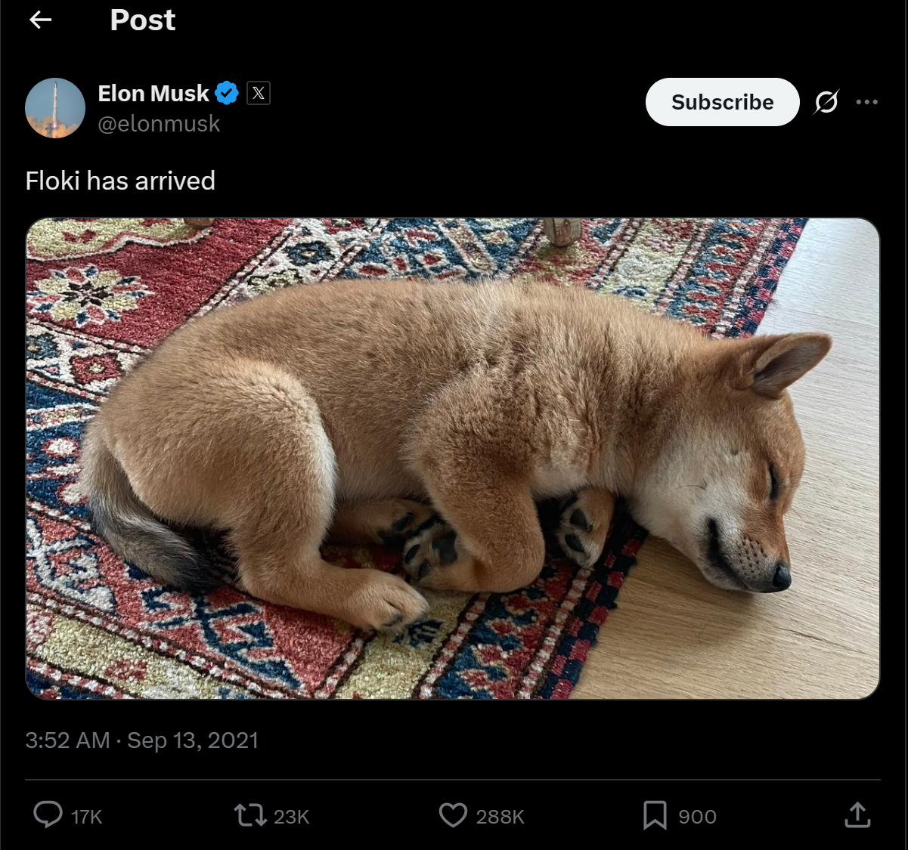
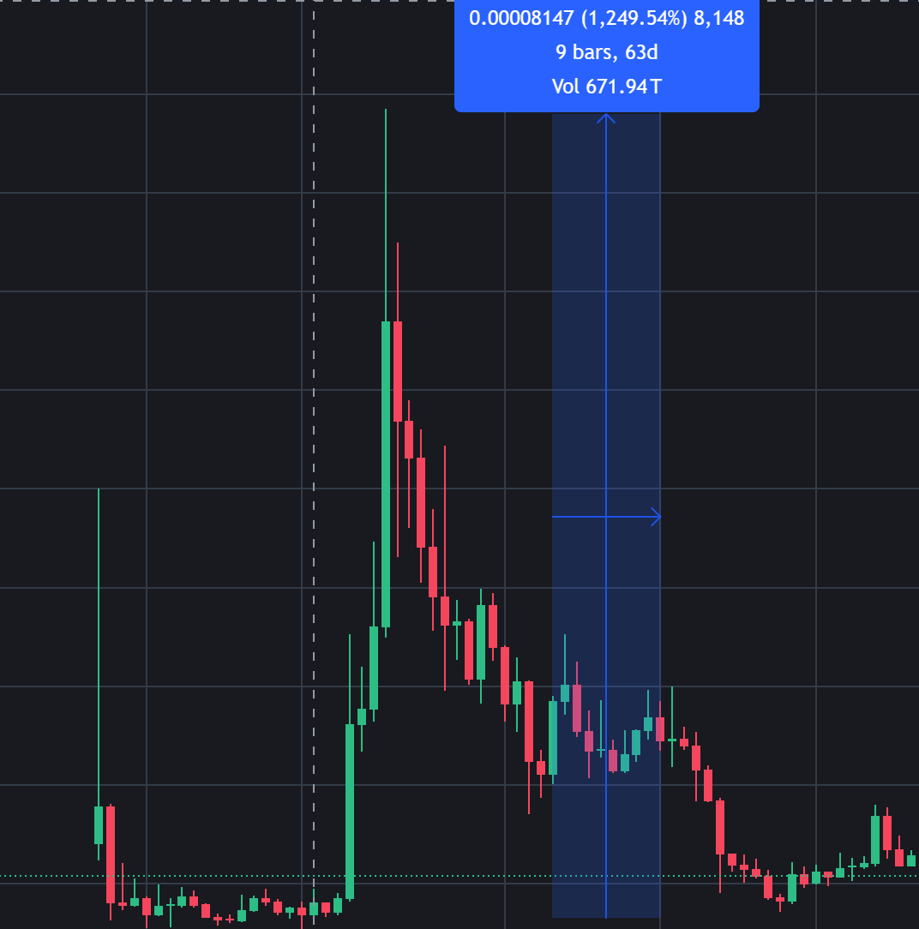
Example

Slide 9
03
How this Works?

Slide 10
The Text Mining Pipeline
Step-by-Step Process:
  1. Data Collection - Gathering raw social media data
  2. Pre-processing - Cleaning and organizing text
  3. Analysis - Applying mining algorithms
  4. Visualization - Making insights understandable
  5. Interpretation - Driving business decisions

Slide 11
Step 1: Data Collection
Sources & Methods:
• Twitter/X API - Public tweets and conversations
• Reddit API - Forum discussions and communities
• Facebook/Instagram - Limited but valuable public data
• Web Scraping - Public forums and comment sections
• Public data only
• Respect privacy settings
• Follow platform terms of service
• Anonymize sensitive information
Ethical Considerations:

Slide 12
Step 2: Data Pre-processing
Cleaning Steps:
• Remove noise - URLs, special characters, punctuation
• Tokenization - Split text into individual words
• Stop words removal - Filter out 'the', 'and', 'is’
• Stemming - 'running' → 'run', 'better' → 'good’
• Lowercasing - Standardize all text
  Before: 'I LOVE my new iPhone! It's absolutely amazing 😍 https://apple.com'
  After: 'love new iphone absolutely amazing'
Example:

Slide 13
Step 3: Analysis Techniques
Key Text Mining Methods:
Sentiment Analysis - Measure emotion (Positive/Negative/Neutral)
Topic Modelling - Find themes ('Technology', 'Politics', 'Sports')
Entity Recognition - Identify key terms (People, Organizations, Locations)
Trend Detection - Spot patterns (Emerging topics, Viral content)
Network Analysis - Map relationships (Influencers, Communities)

Slide 14
04. Code Demonstration

Slide 15
THANKS

