Slide 1

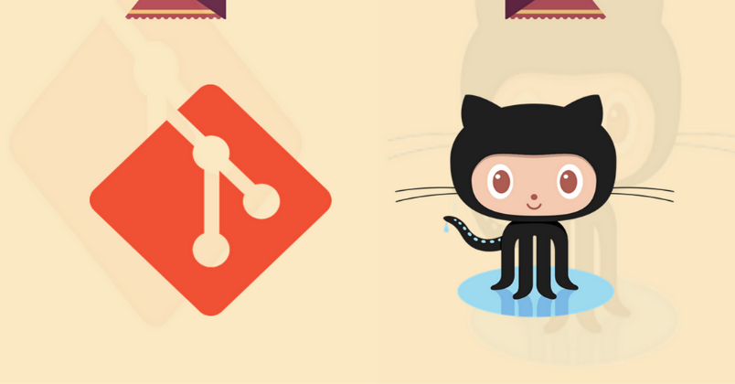
Git and GitHub
Qasir Hassan
MCA 2nd Sem
Roll No: 040
Github.com/sahilqaiser
http://bit.ly/Git_ppt

Slide 2
Todays Contents
What a VCS is?
Why use VCS?
What is GIT?
Why Git is becoming, if not already, the standard choice for developers worldwide?
Why should U care?

Slide 3
Todays Contents
GiT Basics…
init, clone, add, commit, push, checkout
What is GitHub?
GitHub Basics : Fork, Issues and Bugs, Repos…
Conclusion

Slide 4
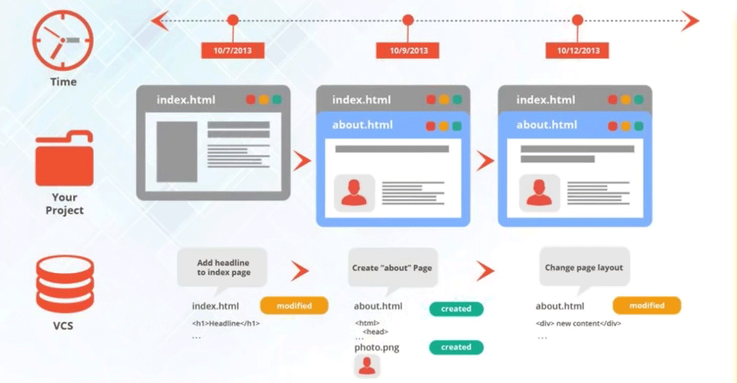
What is a VCS?

Slide 5
What is a VCS?
A VCS is a System with following Properties :
1 : Keep Data (Project Files) Safe in Cloud
2 : Allow Multiple Authors, Keep Track of WHO changed WHAT
3 : Keep Track of Changes to Files (& Folders)
4 : RollBack any and every change that u want

Slide 6
What is a VCS?
TWO types of VCS :
Centralized VCS
Decentralized VCS
One True Source
Every Clone is a Source
Very Complex Branching… ☹
Very Easy Branching and Merging

Slide 7
Git

