Slide 1

Online Code Snippet Sharing Tool
SAHIL RAJESH (1NH24MC112)
Guide: A. Kalaivani (Sr. Assistant Professor)
Department of MCA, NHCE

Slide 2
Introduction
Developers and learners frequently share short pieces of code, such as utility functions, configuration snippets.
Consists of Guest, User and Admin dashboard.
The tool allows users to create, save, and share code snippets in a matter of seconds, complete with syntax highlighting and persistent storage.
Notes:
Start with high level description on what this application offers.

Slide 3
Problem Statements
Objectives :
1. Unique code access
2. User independent snippets
01
Goals:
1. User Friendly Interface
2. Easy to use
3. Persistent Storage
02
Expected Outcomes:
1. Efficient code with Syntax highlighting
2. Multi-purpose tool
03

Slide 4
Literature Survey
Researchers like Brad Green and Shyam Seshadri (2019) have appreciated AngularJS for its fantastic templating, routing, and data-binding features/outlying functionalities.
A comparative study by Craig Walls (2016) emphasized the foundation of frameworks like Spring Boot which provides autoconfiguration, embedded servers, and production features for development on-the-fly.

Slide 5
Existing System Limitations
Paste tools provide speed but ignore identity, permissions, and persistence.
Repository platforms are powerful but overkill for short-lived fragments and informal learning.
No lightweight middle ground between ephemeral paste bins and full repository platforms.
Ctxt.io, Pastebin, GitHub gists, etc.

Slide 6
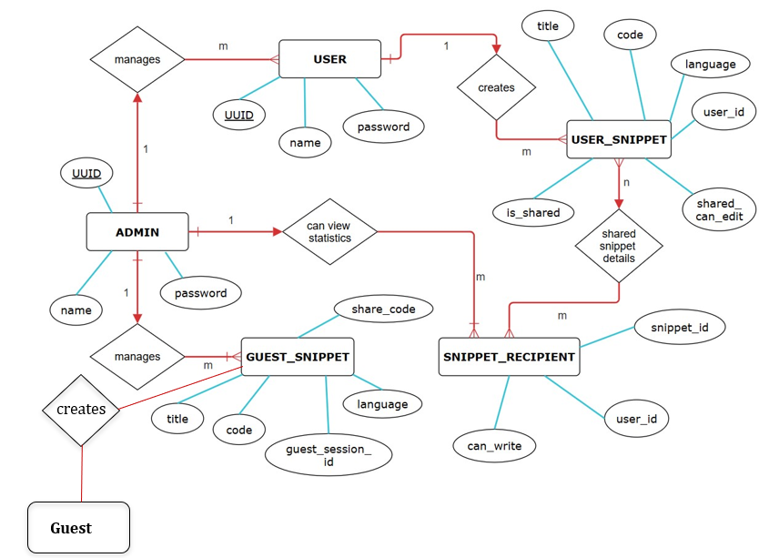
Proposed System / Methodology

Slide 7
System Modules
Admin
Guest
User
- View user statistics
Search snippets
View user, guest snippets
Delete snippets, user
- Create snippets
Share snippets
Modify snippets
- Create/Modify snippets
- Share snippets (Read/write)
- Download/Copy snippets

Slide 8
Technical Requirements
Hardware
Software
Type : Mobile / Laptop / Desktop
Screen Size : 6.1 inch or higher
Network : Stable
- Browser : Edge, Chrome, Firefox
- Technology : AngularJS, Spring Boot
- Database : PostgreSQL (Clever Cloud)
- Tools used : Visual Studio Code, Docker Desktop, Clever Cloud, Render

Slide 9
Implementation
Scaffold entities, repositories, and controllers, establish migration scripts.
Implement snippet CRUD, guest scoping and add syntax highlighting.
Integrate Docker Compose for database provisioning and deployment.
Deployed Docker hub image on Render.

Slide 10
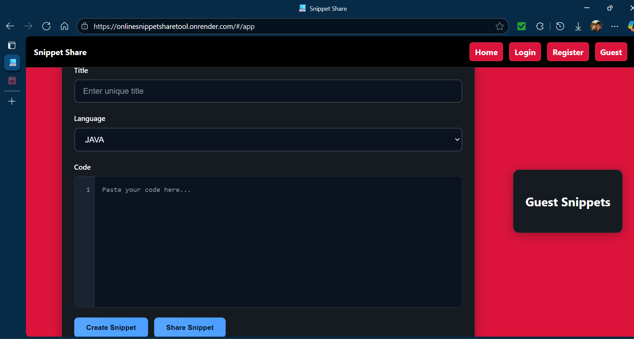
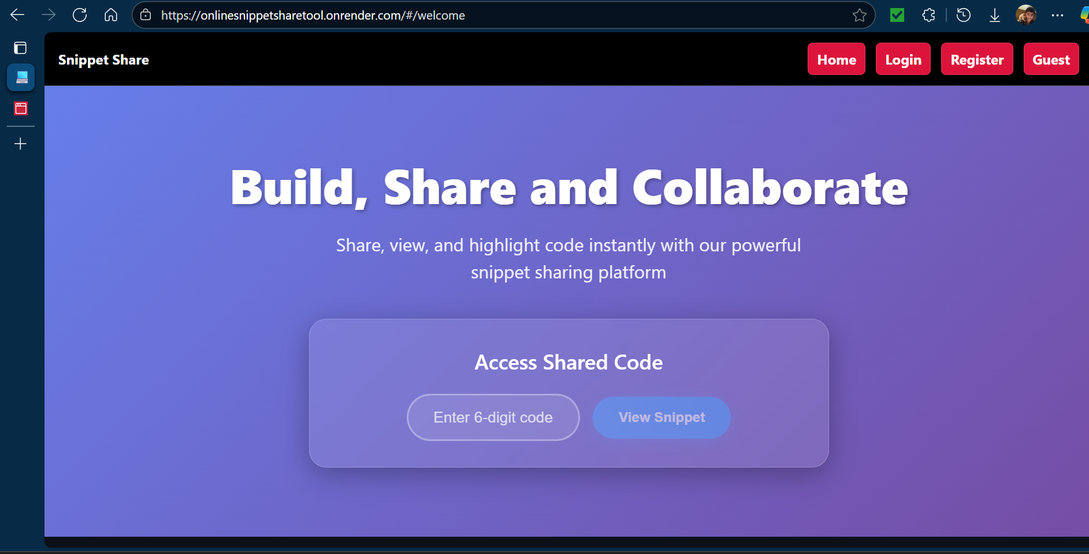
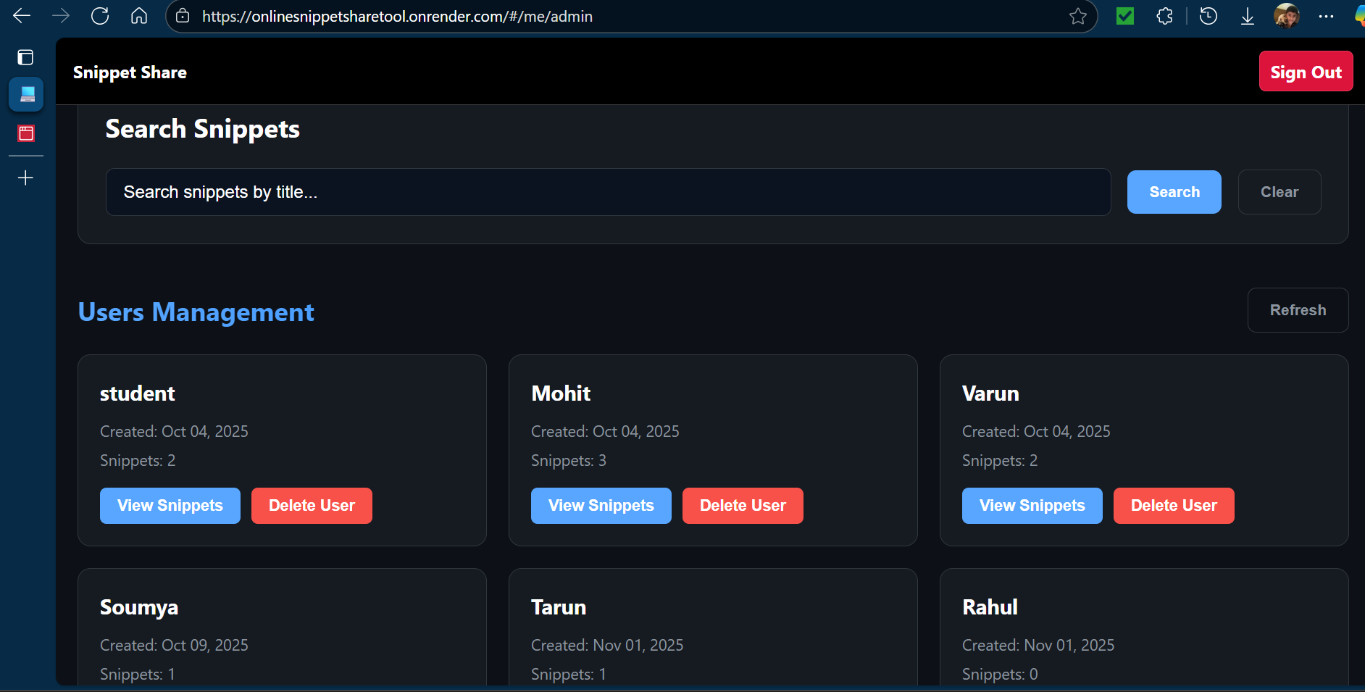
Screenshots of the project

Slide 11
Results & analysis
Efficient sharing of short code snippets.
Ensure smooth and transparent experience for users.
Efficient in data organization and management of users and code snippets.
Real-time updates are a principal benefit of this application.

Slide 12
Conclusion
Online Code snippet sharing tool helps combine both functionality from paste bins and full repository platforms.
This application is much suited for small scale enterprises or educational institutions.
Core features include user management, snippet creation & sharing, admin control.

Slide 13
Future enhancements
Make application more scalable.
Add user profile enhancements.
Update authorization to Oauth 2.0
Transition towards ReactJS.
Notes:
Ai integration, Multlingual

Slide 14
References
-> Text References:
[1] ng-book: The Complete Book On AngularJS by Ari Lerner
[2] Spring Boot 3.0 Cookbook by Packt Publishing
-> Web References:
Spring Boot Project – https://spring.io/projects/spring-boot
Docker - https://hub.docker.com

Slide 15
Q & A

Slide 16
THANK YOU
SAHIL RAJESH (1NH24MC112)
Guide: A. Kalaivani (Sr. Assistant Professor)
Department of MCA, NHCE

