Slide 1

Simple Calendar Application
Capgemini Java Developer Programming Assignment
JAVA 8+
MAVEN
JUNIT 5
JSON STORAGE
Sahil Raorane

Slide 2

Project Overview
A command-line appointment management system with event scheduling, conflict detection, and persistent JSON storage.
Create Events
Overlap Prevention
Daily Event Listing
Schedule appointments with title, start time, and end time.
Automatically prevents conflicting appointments from being created.
View all events for today or any selected date.
Available Slot Finder
Event Management
Data Persistence
Find the next available time slot based on a specified duration.
Search, update, and delete existing events.
Store event data in JSON and automatically restore it on application startup.
Extended Functionality: Search, Update, Delete, and Remaining Events View

Slide 3

System Architecture
events.json
Persistent event storage
Event.java
Domain model for events
CalendarService.java
Business logic and validation
CalendarApp.java
Application layer handling UI
User CLI
Command-line input and navigation
CalendarApp
CalendarService
Handles menu navigation and user input
Validation, overlap detection, and slot finding
Event
JSON Storage
Event model containing title, date, start, and end time
Persists events between application runs

Slide 4
Project Structure
Folder Tree
Component Roles
Event.java - Represents calendar events with title, date, start time, and end time.
CalendarService.java - Handles event validation, overlap detection, scheduling logic, and available slot calculation.
FileStorage.java - Reads and writes event data to JSON for persistence.
CalendarApp.java - Command-line interface and application entry point.
CalendarServiceTest.java - JUnit 5 tests for validating business logic and application behavior.
events.json - Stores event data between application runs.
Project
├── data/
│ └── events.json
│
├── src/
│ ├── main/java/com/calendar/
│ │ ├── model/
│ │ │ └── Event.java
│ │ ├── service/
│ │ │ └── CalendarService.java
│ │ ├── storage/
│ │ │ └── FileStorage.java
│ │ └── CalendarApp.java
│ │
│ └── test/java/com/calendar/
│ └── CalendarServiceTest.java
│
├── pom.xml
├── run.bat
└── run-tests.bat

Slide 5
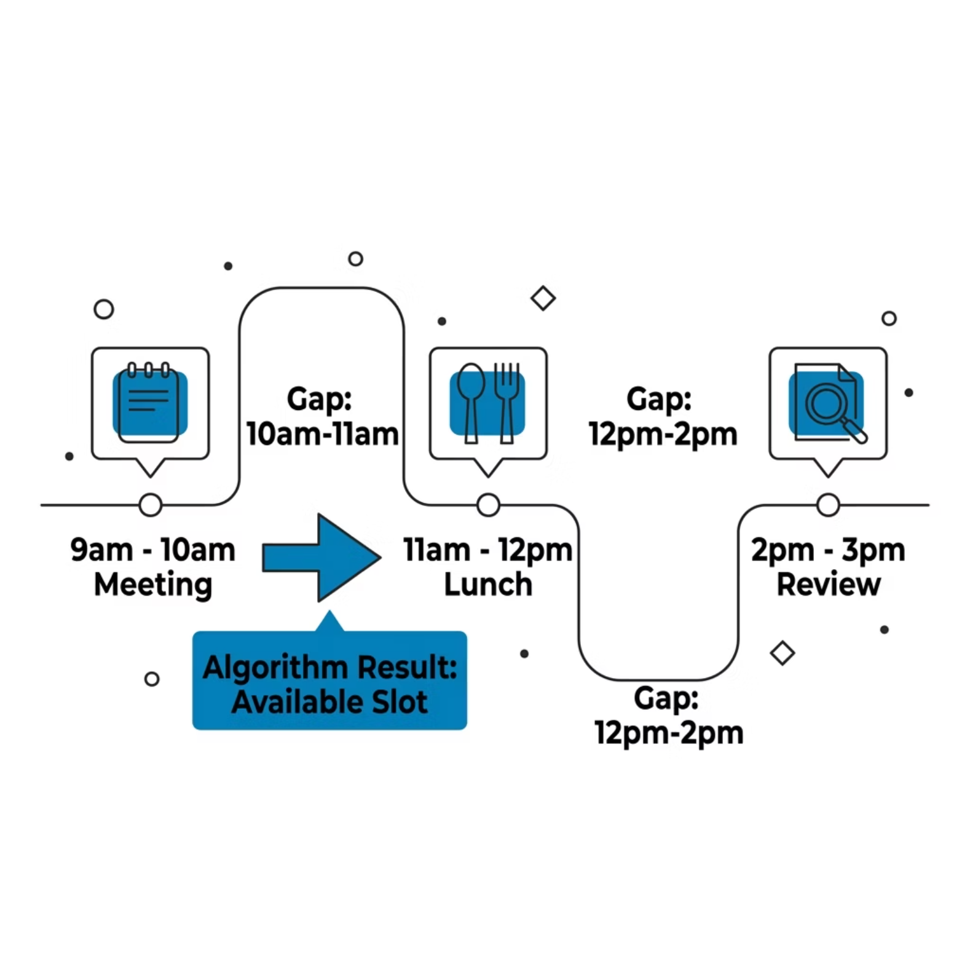


Core Algorithms
Overlap Detection
A new event is rejected when it conflicts with any existing appointment.
Two events overlap when:
A.Start Time < B.End Time
AND
B.Start Time < A.End Time
Next Available Slot
Sort events by start time
Scan for gaps between consecutive events
Return the first slot matching the requested duration
Time Complexity: O(n)

Slide 6
Run, Test & Verify
Build & Run
Verification Checklist
Create a new event
Run run.bat
Alternative (Maven):
mvn clean package
java -jar target/calendar-app.jar
Prevent overlapping appointments
Run Tests
List events
Run run-tests.bat
Find the next available slot
Alternative (Maven):
mvn test
Search, update, and delete events
For more information on how to run the code on different software, please refer to the readme.md file.
Seed Data
Sample events are stored in events.json and loaded automatically when the application starts.
Note: Seed data is pre-loaded for 06/10/2026, 06/11/2026, and 06/12/2026. If you are running this application after these dates,
please update data/events.json with future dates accordingly.

