Slide 1

Session 2023-24
Defining & Progress Seminar
Group ID – GA-09
“Smart Health Prediction & Consultation” - PharmaFlex
Name of the Students :
Prathmesh Mathankar (134)
Rhutwik Gaidhani (137)
Sahil Lokhande (140)
Sanket Gulhane (141)
Sanket Bhute (167)
Under the Guidance of
Mr. M. G. Panjwani
Assistant Professor
Department of Computer Technology

Slide 2
Contents
Introduction
Literature Review
Problem Statement
Objective
Working Principle and Methodology
Hardware and software requirements
Construction Design
Expected Result and Discussion
Conclusion
References

Slide 3
Introduction
Now a days we witness a phase transition of buying pattern of any goods, cloths, electronics and etc. with advent of technology, offline shopping switches to online mode.
Online pharmacy and specialist doctors support is going to be the next big evolution that will impact billions of lives and bring a healthy behaviour change to safer and more convenient tomorrow.
Reason for selection of this project: To merge and provide user with medical services (Pharmacy & doctor consultancy) at one place
Health Prediction is a system which helps a user to find their health status. It might have happened so many times that you or someone yours need access of doctor immediately, but they are not available due to some reason. The Health Prediction system is an end user support and online consultation project.
Also if some patient have some personal contact of doctor but what about other patient. Always doctors are not comfortable to give there personal contact to everyone so having a proper platform filling this gap for both side convince is necessary.
Here we propose a system that allows users to get instant guidance on their health issues through an intelligent health care system online. The system is fed with various symptoms and the disease/illness associated with those systems. The system allows a user to share their symptoms and issues

Slide 4

INTERCONECTION :
Pharmacy and doctor consultation
Health
prediction

Slide 5
Literature Review
Sr.no. | Research | Location | Website | Target
1 | HealthKart | India | www.healthkart.com | Online store for health
2. | 1mg | India | www.1mg.com | Online pharmacy marketplace
3. | Medlife | India | www.medlife.com | App for purchasing medicine
4. | PharmEasy | India | www.pharmeasy.com | Medical ordering and diagnostic test
5. | Netmeds | India | www.netmeds.com | Platform for selling prescription, OTC(Over the counter)
6. | EMEDIX | India | www.emedix.com | Better delivery and excellent service

Slide 6
Problem Statement
Problem :
Many people face challenges in accessing timely healthcare services and predicting potential health issues. Visiting a doctor many people avoid till it become major problem also there is a lack of tools for individuals to monitor their health proactively. This leads to delayed diagnosis and treatment, impacting overall health and well-being. Also sometime there is requirement of online access of pharmacy.
Solution :
To address this issue, we propose the development of a Smart Health Prediction and Online Doctor Consultation platform.This platform will incorporate the following key features:
AI-Driven Health Prediction, Electronic Health Records (EHR), Online Doctor Consultation, Health and Wellness Resources, Online medicine delivery (Online pharmacy)

Slide 7
Objective
To create a highly accurate diseases prediction model using a machine learning algorithm.
Identify the closest disease they might affect.
It will remove the confusion to find doctors and disease.
Provides live consultation with a specific doctor by live video or chat.
Smart health prediction helps in the diagnosis of multiple diseases by analyzing patient symptoms using a perfect fitting Machine Learning Algorithm technique.
Provide easy service and access to users to make life easier.

Slide 8
Working Principle and Methodology
HTML, CSS, JS and Bootstrap will be used as front end language while python as backend knowledge.
For database storage at large level SQL will also play important role in future which might get more effective using Django
One of the following algorithm will be selected in future depending on accuracy rate in future:
K-means Clustering Algorithm
Naïve Bayes Algorithm

Slide 9
Hardware and Software Requirements
Operating System: Windows 10 or higher version
RAM: 4GB or higher
Storage: 5 GB or higher
Browser: Any updated browser
Tools and Technology
Programming Languages: Python, Django Framework, Pandas, Numpy, Matplotlib, HTML5, CSS3, Bootstrap, JS
Database: SQL
Code Editor: VS Code
Payment gateway: Razor Pay
Web APIs
WebRTC

Slide 10
Expected Features
Login/ Register / Change password (Admin, Doctor, Patient)
Search nearby hospitals and doctors by fetching live location
Health or disease prediction and analysis
Online Pharmacy
Book Appointment with Doctor
Live doctor support (Video or Chat)
Prescription Upload
Health Related Blogs
Payment Gateway
Contact Us
Security
Appointment activity logs
Tracking order
AI bot
EHR (Electronic Health Records)
Online blood bank donation

Slide 11
Construction Design
Input
Features
Feature tupple
Python
Django
ML Model
Front end
Output
Prediction
Prediction
User Space
Server Space

Slide 12
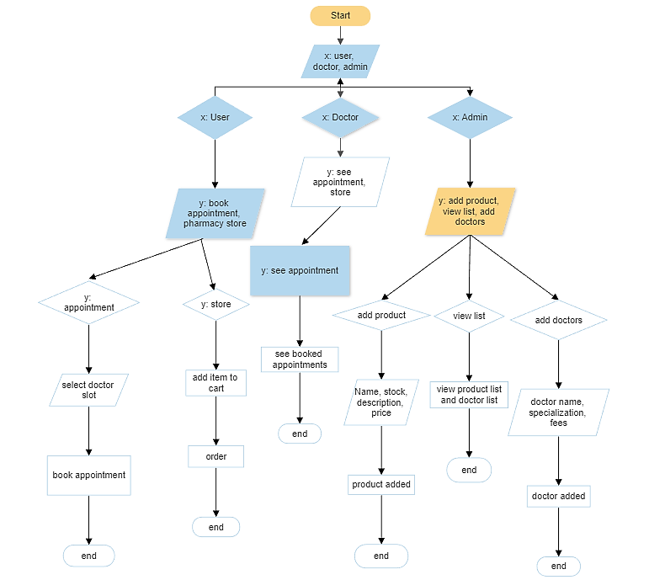

Slide 13
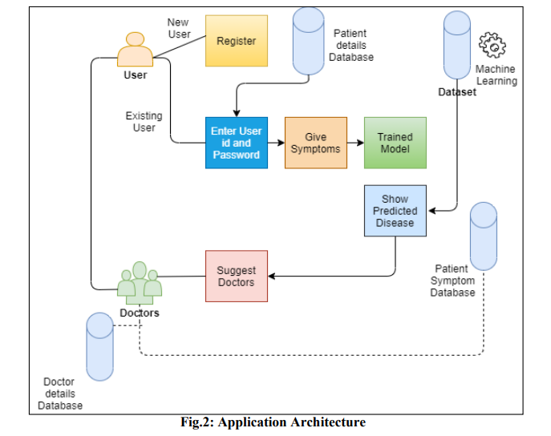

Slide 14
Timeline & Stages of the Projects
Month 1: Working on dataset. (Phase 1)
Week 1: Define project scope, objectives, and success criteria.
Week 2: Research and decide the attributes which may needed in projects.
Week 3: Set up the development environment and tools.
Week 4: Designing of work plan.
Month 2: Dividing Dataset and Training. (Phase 2)
Week 1-2: Collecting the and scanning the dataset from possible way.
Week 3: Developing basic prototype.
Week 4: Conduct initial testing and predict possible accuracy for future improvements by making necessary changes in work plan if required depending on response of trained dataset.
Month 3: Development and Testing (Phase 3)
Week 1-4: Develop the prototype and increase its speed with accuracy as decided. Also keeping testing of prototype of backend at regular intervals of time.
Month 4: Testing and Deployment (Phase 4)
Week 1: Improve UI interface according to sample users feedback.
Week 2-3: Fixing bugs and other problems with regular testing and feedback
Week 4: Finalize document for submission of project
It is basic overview of project progress over 4 month period. Actual timeline may vary due to unknown complexities which may arrive during project and unforeseen challenges. Still regular communication and teamwork will make it possible to complete the project
.

Slide 15
Conclusion
An e-Pharmacy aligns very well with the national development objectives and has clear and tangible benefits to the consumers as well as the industry.
Online doctor consultations are a useful complement to traditional in-person medical care, but should not completely replace it.

Slide 16
References
NICOLA J GRAY: “THE EVOLUTION OF ONLINE PHARMACIES”, https://selfcarejournal.com/wp-content/uploads/2015/09/Gray-2.376-86.pdf
Dhinesh Babu L.D, Mohan Sai Kumar P, Manish G: “Health Care Analysis using Data Mining”
Alison C. Dcruz, Vinay N. Mokashi, Sreedhar Ranganath Pai, and Dharmagadda Sreedhar : The rise of E-pharmacy in India, https://www.ncbi.nlm.nih.gov/pmc/articles/PMC9804119/

Slide 17
THANK YOU !

