Slide 1

GDP
PREDICTION USING MACHINE LEARNING
SAHIL SAKLANI
2016979
MENTOR – MR. VIKAS TOMER

Slide 2
INTRODUCTION
GDP(Gross Domestic Product)
GDP measures the monetary value of final goods and services—that is, those that are bought by the final user—produced in a country in a given period of time

Slide 3

MACHINE LEARNING ALGORITHMS USED
Linear Regression - Linear regression analysis is used to predict the value of a variable based on the value of another variable.
Random Forest - Random forest is a commonly-used machine learning algorithm, which combines the output of multiple decision trees to reach a single result.
Gradient Boosting - Gradient boosting is a machine learning technique used in regression and classification tasks, among others. It gives a prediction model in the form of an ensemble of weak prediction models, which are typically decision trees.[1][2] When a decision tree is the weak learner, the resulting algorithm is called gradient-boosted trees; it usually outperforms random forest.

Slide 4
Methodology
I have done this project in two main parts :
Testing 2 machine learning algorithms on the data and selecting the best performer.
On the basis of performance I have created a web app using streamlit python lib where we can predict the gdp of the country by giving the values of some of the attributes such as population etc.

Slide 5
Import Data and Data Cleaning
For collecting the data of the countries of the world for gdp prediction we have used Kaggle.com.
As we are using EDA here which means:
Exploratory Data Analysis (EDA) is an approach to analyze the data using visual techniques. It is used to discover trends, patterns, or to check assumptions with the help of statistical summary and graphical representations.
For this we will perform following tasks on our dataset:
Getting insights about the dataset
Handling missing values
Data Visualization

Slide 6
CHECKING THE CORRELATION’S
BY CHECKING THE CORRELATIONS BETWEEN THE GDP AND OTHER ATTRIBUTES WE CONCLUDED THAT THE FOLLOWING ARE THE MOST RELATED ATTRIBUTES TO THE GDP OF THE COUNTRY ARE-:
NET MIGRATION
LITERACY
PHONES
INFANT MORTALITY
BIRTH RATE
AGRICULTURE
SERVICE

Slide 7
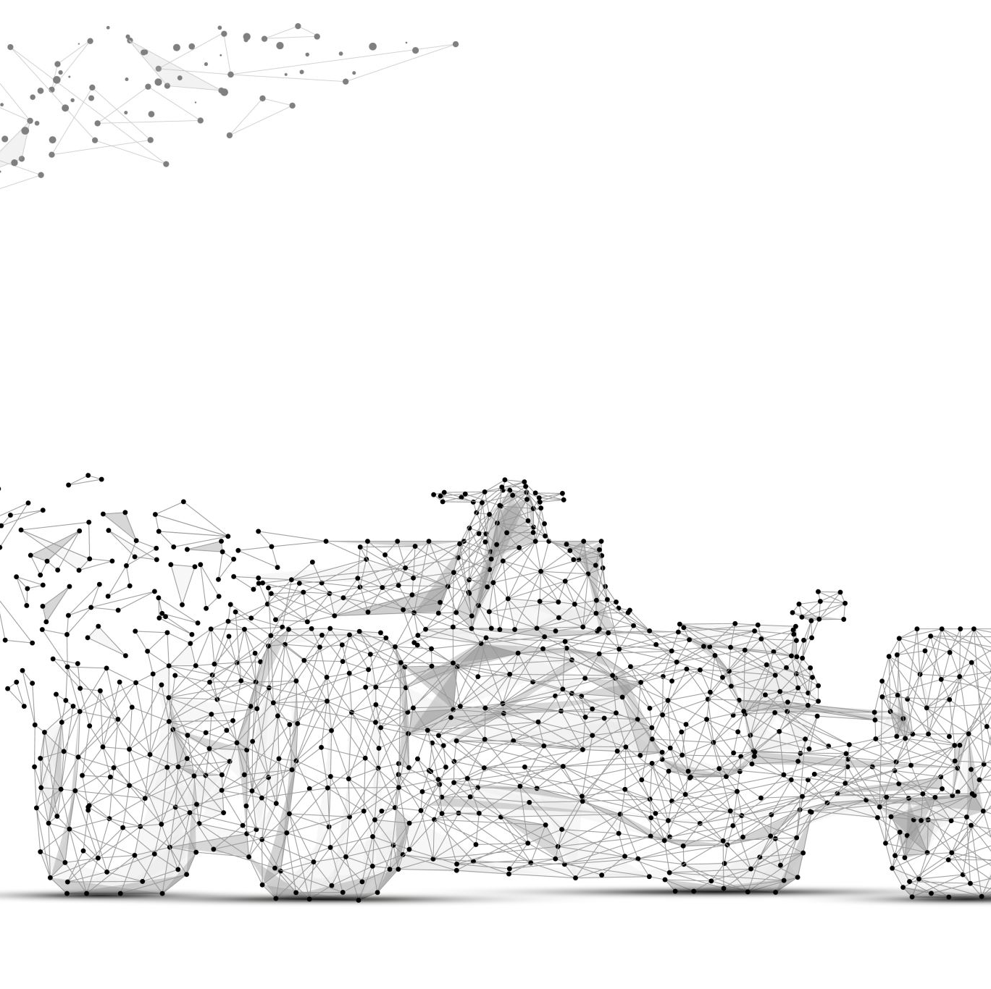
PREPROCESS DATA
NOW WE WILL PREPARE DATA FOR MODEL TRAINING
WE WILL DIVIDE THE DATA SET INTO TWO PARTS-:
TRAIN SET- 80%
TEST SET- 20%
NOW WE WILL PREPARE 4 SETS
1. CONTAINS WHOLE FEATURES WITHOUT SCALING
2.CONTAINS WHOLE FEATURES WITH SCALING
3.SELECTED FEATURES WITHOUT SCALING
4.SELECTED FEATURES WITH SCALING

Slide 8
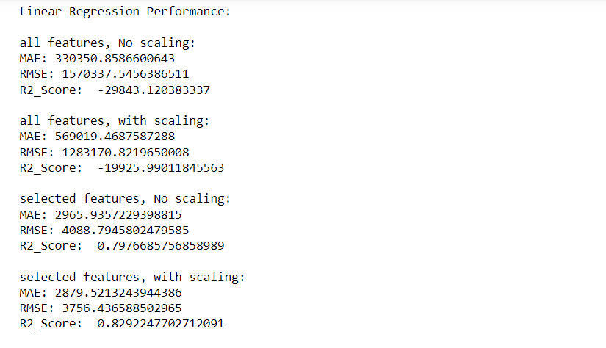
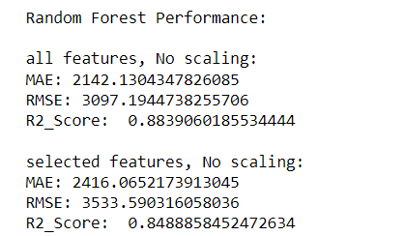
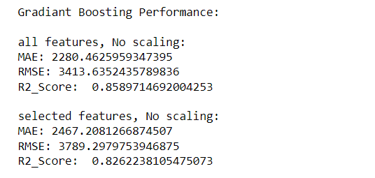
FIT DATA SETS IN 3 DIFFERENT MODELS
LINEAR REGRESSION RESULTS
RANDOM FORESTS RESULTS
GRADIENT BOOSTING RESULTS

Slide 9
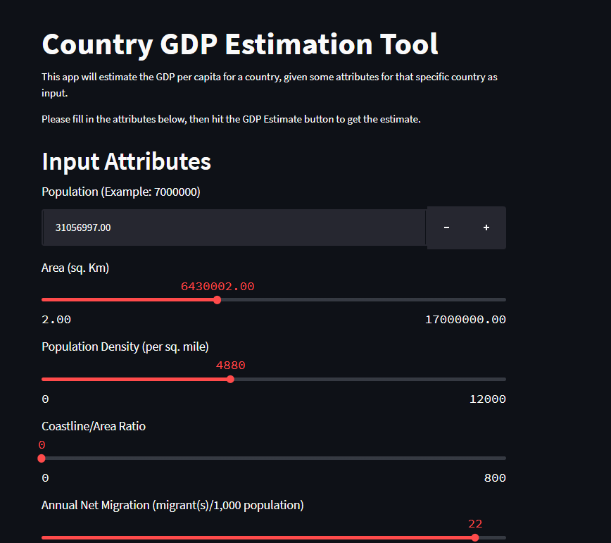
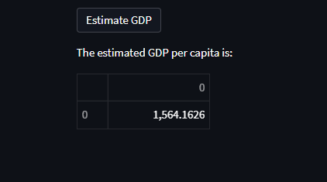
CREATING A WEB APP
WE HAVE USED STREAMLIT IN PYTHON TO CREATE A WEB APP TO ESTIMATE THE GDP OF THE COUNTRY
TAKE THE VALUES OF THE ATTRIBUTES FROM USER AND USING THIS SET WE GIVE TO TRAINED MODEL
AND WE PREDICT THE COUNTRY’S GDP

Slide 10
CONCLUSION
&
FUTURE WORK
3 different learning regressors (Linear Regression, Random Forest, and Gradiant Boosting) were tested.The best prediction performance was acheived using Gradient Boosting regressor, using all features in the dataset, and resulted in the following metrics:
Mean Absolute Error (MAE): 2280.46
Root mean squared error (RMSE): 3413.63
R-squared Score (R2_Score): 0.85
AT ACCURACY- 85% GDP IS PREDICTED
If we get more of the resources we can try extending the ranges of grid for gradient boosting and random forest machine learning algorithms.

