Slide 1

ColumbiaAsia Hospital Analysis
PresentedbySahil Kadam

Slide 2

Introduction
Columbia Asia Hospital is a well-known healthcare provider serving a diverse patient base.
This project analyzes hospital visit data using Power BI to gain insights into patient demographics, doctor performance, and financial trends.
The analysis is based on two datasets containing:
Patient details: age, gender, race, satisfaction scores, wait times, department referrals.
Doctor details: name, department, appointment fees, total bill amounts.
By leveraging data visualization and analytics, this project helps hospital management make informed decisions to improve patient experience and optimize financial performance.

Slide 3

ProblemStatement
Hospitals handle a large volume of patient data, but lack actionable insights to improve efficiency.
Understanding patient demographics, visit patterns, and satisfaction levels is crucial for better service delivery.
Doctor referrals and performance evaluation are not easily measurable without data-driven analysis.
There is a need to analyze appointment fees and total bill trends to optimize hospital revenue.

Slide 4

Objectives
Analyze patient demographics (age, gender, race) to understand hospital visit patterns.
Evaluate doctor performance and referrals to identify top-performing departments.
Assess appointment fees and total bill trends to optimize financial management.
Examine patient wait times and satisfaction scores to enhance the patient experience.
Identify areas for operational improvement using data-driven insights.

Slide 5
DataOverview
Dataset: Two tables containing patient and doctor details.
Table 1: Patient & Doctor Info
patient_id, Doctor Name, Doctor ID, department_referral Appointment Fees, Total Bill
Table 2: Patient Visit Details
date, patient_id, patient_gender, patient_age, patient_race
patient_sat_score, patient_waittime, patient_admin_flag, department_referral Purpose: Enables analysis of patient trends, doctor performance, financials, and efficiency using Power BI.

Slide 6
ANALYSIS AND INSIGHTS

Slide 7
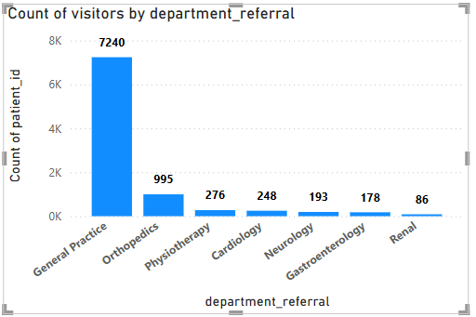
TotalVisitsbyDepartment
General Practice dominates with 7,240 visitors, far higher than any other department.
Orthopedics is the second most visited department with 995 patients.
Specialized departments have significantly lower patient counts
Renal department has the least visitors (86), indicating fewer kidney-related cases.
The data suggests that most patients first visit General Practice before being referred to specialists.

Slide 8
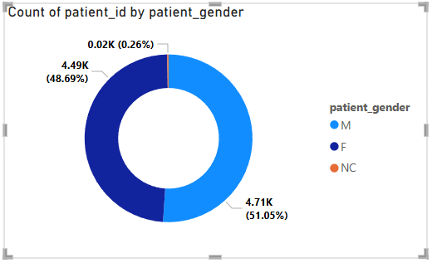
TotalVisitsbyGender
Majority Male Patients – The highest proportion of patients (51.05%) are male (M), accounting for 4.71K patients.
Nearly Equal Female Representation – Female
(F) patients make up 48.69%, slightly lower than males, with 4.49K patients.
Negligible NC Patients – Patients categorized as NC (possibly Non-Conforming) are very few, only 0.26% (0.02K or ~20 patients).
Balanced Gender Distribution – The number of male and female patients is almost equal,
with a small patients).
classification, minimal.
difference of 0.36% (220
though the count remains

Slide 9
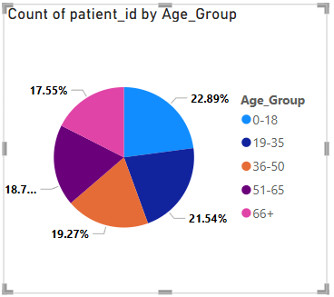
TotalVisitsby AgeGroup
Highest Representation – 0-18 Age Group
The 0-18 age group has the highest number of patients, making up 22.89% of the total.
This could indicate a high number of pediatric visits or a significant focus on child healthcare.
19-35 Age Group is Second Highest
The 19-35 age group follows closely with 21.54%, showing a strong presence of young adults seeking medical attention.
Gradual Decline in Older Age Groups
36-50 (19.27%), 51-65 (18.75%), and 66+ (17.55%)
show a gradual decrease in representation.
This might suggest either fewer hospital visits by older individuals or demographic differences in patient populations.

Slide 10
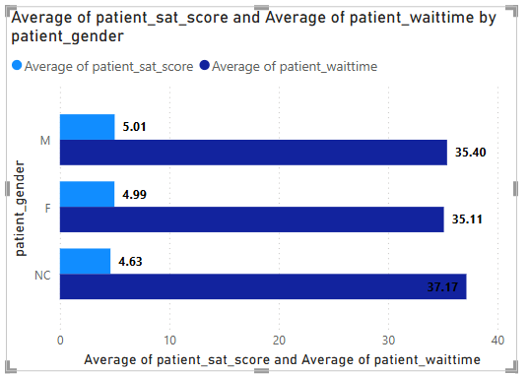
Patient_Sat_Score by Gender
Patient Satisfaction Score: M (5.01), F (4.99), NC (4.63).
Average Patient Wait Time: M (35.40 min), F (35.11 min), NC (37.17 min).
NC patients have the longest wait time and lowest satisfaction.
Male and Female patients have similar satisfaction and wait times.
Higher wait time appears linked to lower satisfaction.
Reducing patient wait time can improve satisfaction.
Special attention needed for NC patients to enhance experience.

Slide 11
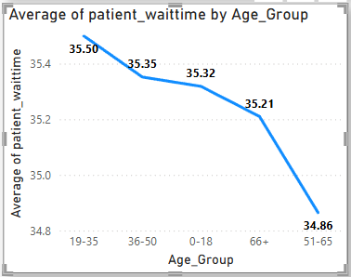
Patient_Waittime by AgeGroup
Highest average wait time: 19-35 (35.50 min). Gradual decrease in wait time across age groups.
51-65 age group has the lowest wait time (34.86 min).
Older patients (66+ and 51-65) experience shorter wait times.
Younger patients (19-35, 36-50) have higher wait times.
Potential trend: older patients may receive faster service.

Slide 12
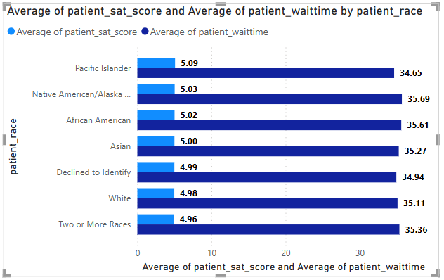
Patient_Sat_Score by Race
Highest satisfaction score: Pacific Islander (5.09).
Lowest satisfaction score: Two or More Races (4.96).
Shortest wait time: Pacific Islander (34.65 min).
Longest wait time: Native American/Alaska (35.69 min).
Satisfaction scores show a small variation across groups.
Wait times remain fairly consistent with slight differences.

Slide 13
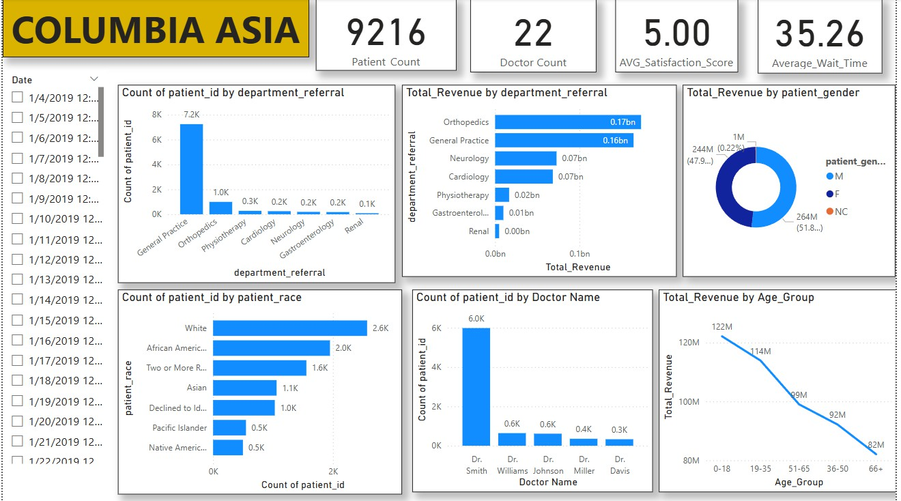
Dashboard

Slide 14
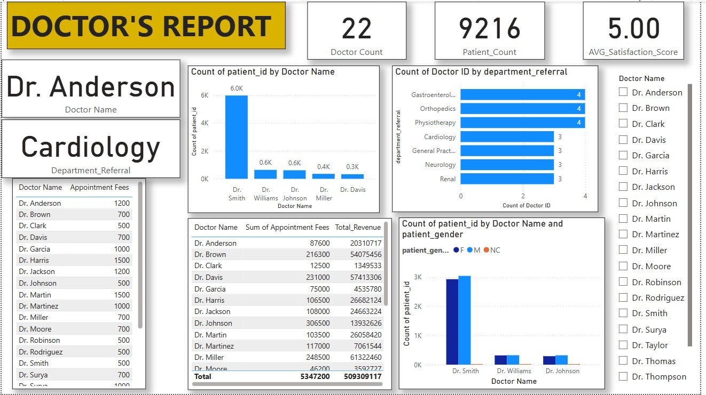

Slide 15
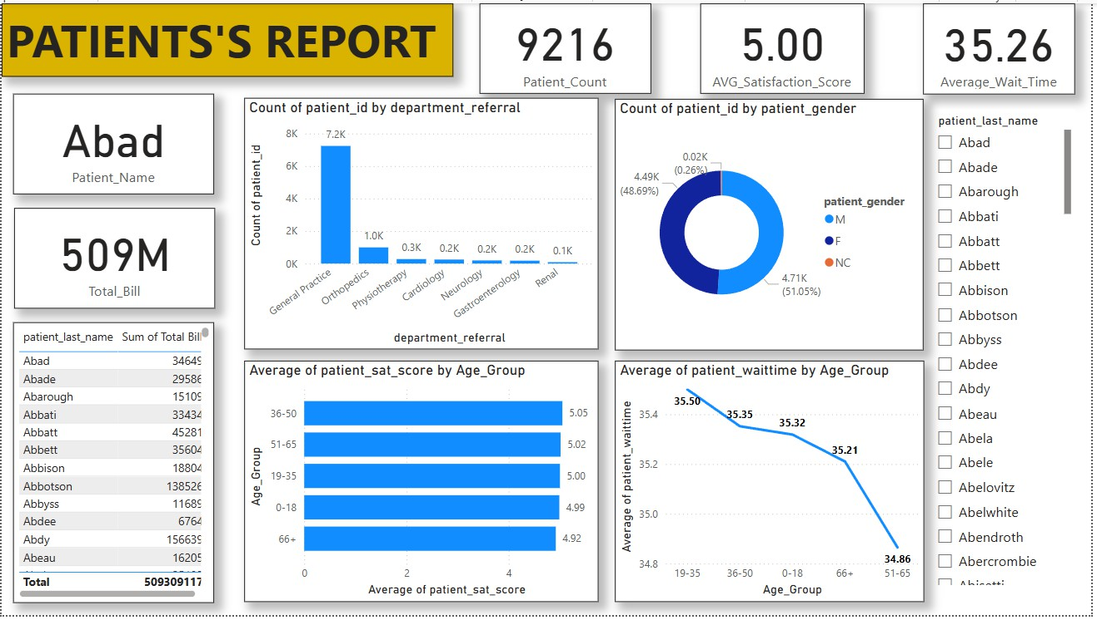

Slide 16
Conclusion
This analysis provides valuable insights into patient demographics, doctor performance, hospital revenue, and operational efficiency.
It helps identify high-performing doctors and departments, enabling better resource allocation and hospital management.
Understanding patient satisfaction scores and wait time trends allows for improvements in hospital services and patient experience.
Analyzing appointment fees and total bill trends supports financial planning and revenue optimization.
By leveraging Power BI dashboards and reports, the hospital can make data-driven decisions to enhance overall efficiency and service quality.

Slide 17


Presented by Sahil Kadam
Thank you very much!

