Slide 1


Presented by Sahil Kadam
IPL Data Analysis
Trends and challenges

Slide 2
Introduction
The IPL mega auction in 2017 was a crucial event for teams to rebuild their squads.
RCB aimed to address past performance issues and strengthen their team balance.
The project focuses on identifying high-performing players suited for RCB.
Key analysis areas include batting, bowling, and all-rounder performance metrics.
The objective is to recommend players who align with RCB's strategy and auction goals.

Slide 3
Problem Statement
▰RCB team is looking for top-performing and reliable players to win tournaments, considering both on-field performance and value for money in mega player auction of 2017.
▰So we have to come up with strategies/suggestions regarding selecting the best-performing players and optimizing player auction investments.

Slide 4
Objective
To analyze IPL player performance data and derive actionable insights.
To identify high-performing and cost-effective players suitable for RCB in the 2017 mega auction.
To address RCB's historical weaknesses by selecting players who can strengthen batting depth, bowling attack, and all-round capabilities.
To create a data-driven framework for strategic player selection to enhance RCB’s chances in the IPL 2017 season.

Slide 5
Data Overview
Database Structure:
The database consists of 20 tables capturing various aspects of IPL matches and player performance.
Key tables include:
Player: Details about players (name, batting and bowling style, country).
Matches: Match-specific details (teams, venue, date, winner, and toss decisions).
Ball_by_Ball: Detailed ball-by-ball records (runs scored, wickets taken, extras).
Player_Match: Player roles and participation in matches.

Slide 6
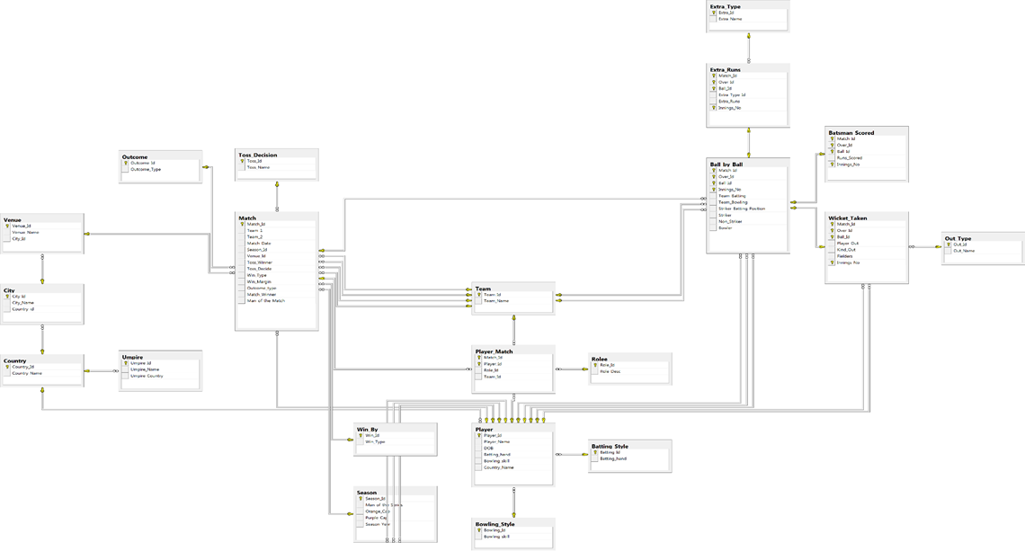
Database Schema

Slide 7

ANALYSIS AND INSIGHTS

Slide 8
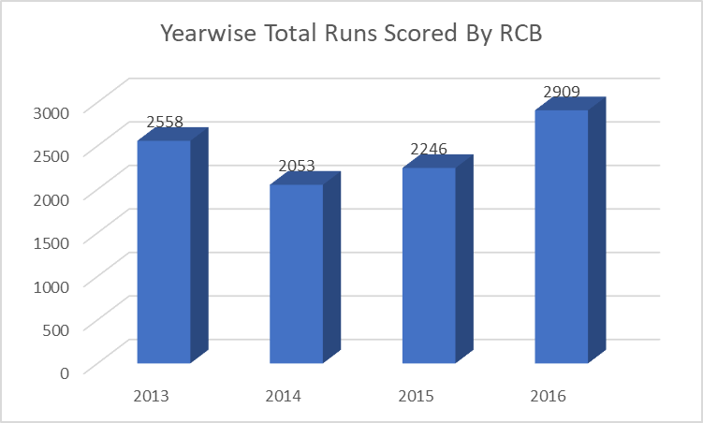
RCB Yearwise Runs Scored
Performance Growth:
The total runs scored by RCB increased significantly from 2015 (2246 runs) to 2016 (2909 runs), showing a marked improvement in their batting performance.
Decline in 2014:
A drop in runs scored from 2013 (2558 runs) to 2014 (2053 runs) suggests a potential struggle in the batting lineup or challenging playing conditions that year.
2016 Peak:
The 2016 season was the best in terms of runs scored (2909 runs), indicating a strong batting performance

Slide 9
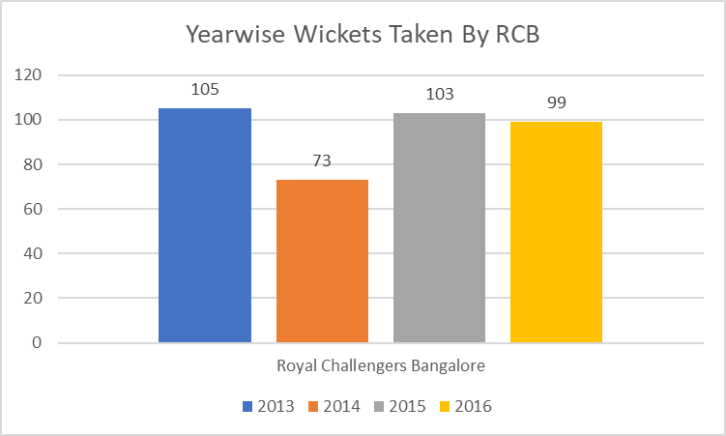
RCB Yearwise Wickets Taken
2013 Season:
RCB took 105 wickets, marking one of their stronger years in terms of bowling performance.
2014 Season:
A noticeable dip occurred as RCB managed only 73 wickets. This might indicate weaker bowling or fewer matches played due to an early exit in the tournament.
2015 Season:
RCB bounced back with 103 wickets, a significant improvement compared to 2014. This could reflect better team form or impactful performances by bowlers.
2016 Season:
RCB's wicket tally slightly declined to 99. However, this was still higher than in 2014 and close to their performance in 2015.

Slide 10
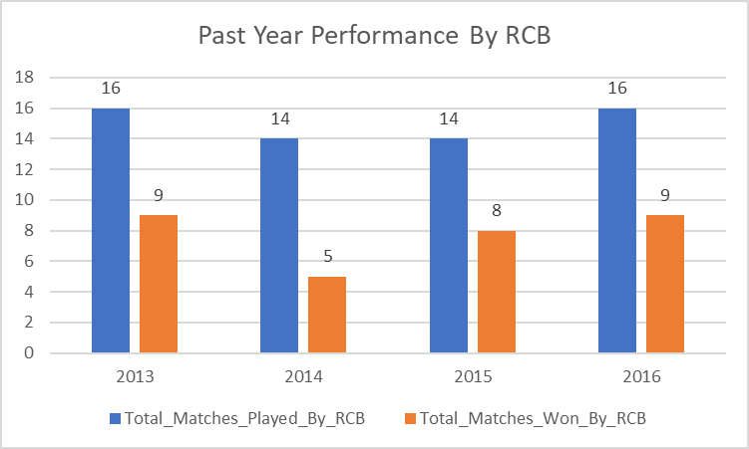
RCB Past Year Performance
RCB's performance in 2014 stands out as a poor season compared to the other years, with the lowest win percentage and fewest matches won.
Both 2015 and 2016 demonstrated a positive turnaround, with consistent winning percentages above 56%, highlighting their competitiveness.
The correlation between wickets taken and matches won is evident, as 2014 had both the lowest wickets (73) and fewest wins (5).

Slide 11
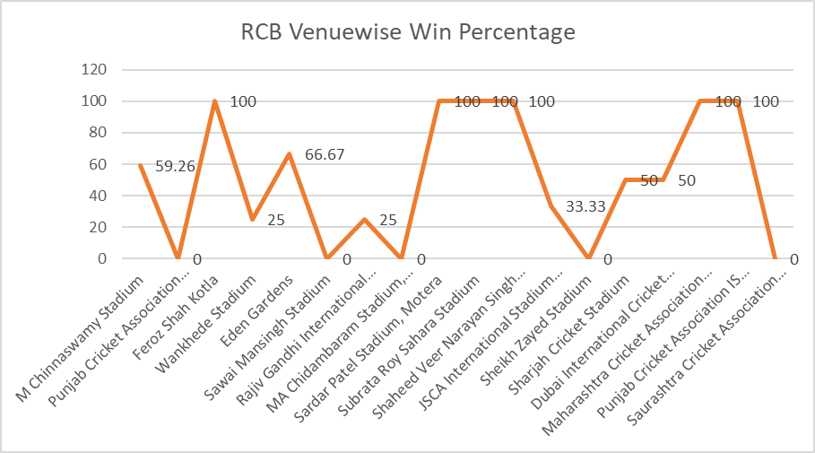
RCB Venuewise Performance
RCB is highly successful at certain neutral venues, such as Feroz Shah Kotla, and has struggled at a few iconic venues like Wankhede and Chepauk.
Their performance at home (M Chinnaswamy) is good but not dominant, which might point to inconsistency in leveraging home advantage.
The team struggles in Mohali (Punjab Cricket Association Stadium) despite success in another Punjab venue (IS Bindra Stadium).

Slide 12
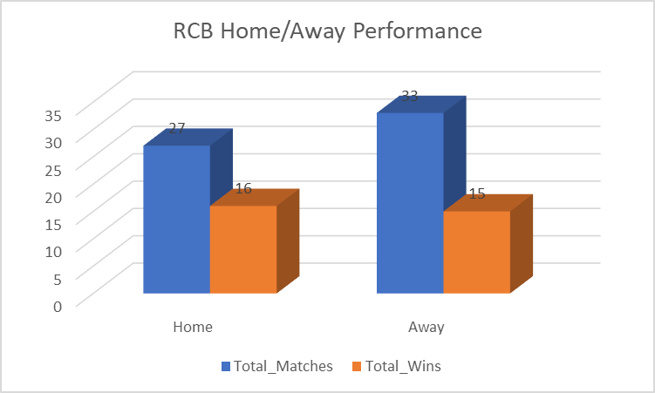
RCB Home/Away Performance
Home vs. Away Performance Gap:
RCB's win percentage drops by nearly 14% when they play away (59.26% at home vs. 45.45% away).
This shows that RCB is more comfortable at home and needs to improve adaptability for better away performances.
Reliance on Home Success:
RCB's playoff chances are heavily dependent on their home performances. With a strong improvement at home, they could convert marginal wins into dominant victories.

Slide 13
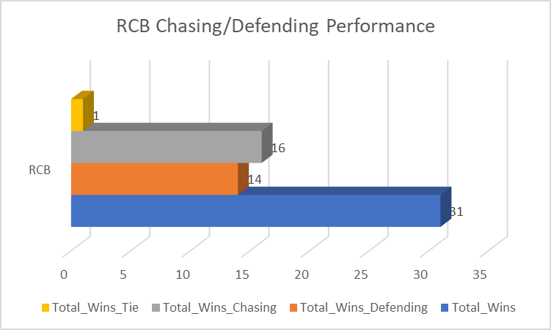
RCB Chasing/Defending Performance
Balance Between Defending and Chasing:
RCB's almost equal success in defending and chasing suggests versatility. However, their bowling (defending) has room for improvement, especially on batting-friendly pitches.
Chasing Strength:
Slightly better performance in chasing indicates the team relies on its batting strength to win games. A focus on strengthening the middle and lower order for chasing scenarios could pay dividends.
Bowling Under Pressure:
Their lower win count while defending shows potential gaps in closing out games, especially in the death overs.

Slide 14
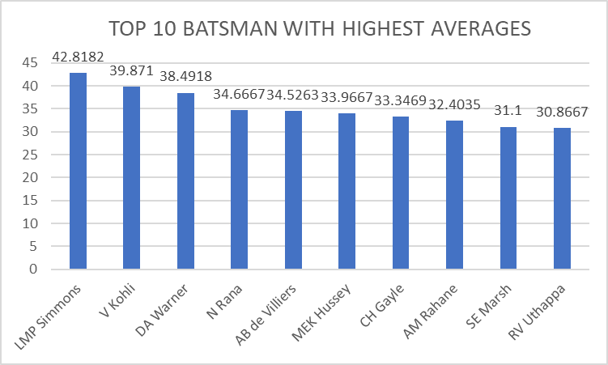
Top 10 Batsman With Highest Averages
LMP Simmons (42.82) has the highest batting average among the top 10, showcasing exceptional consistency.
Virat Kohli (39.87) ranks second and is the highest-placed RCB player, emphasizing his critical role in the team's batting lineup.
David Warner (38.49) closely follows Kohli, highlighting his dominance as a top-order batter.
AB de Villiers (34.53) and Chris Gayle (33.35) also feature on the list, further reflecting RCB's historically strong batting lineup.
Players like N Rana (34.67) and MEK Hussey (33.97) add diversity to the list with their consistency across teams.

Slide 15
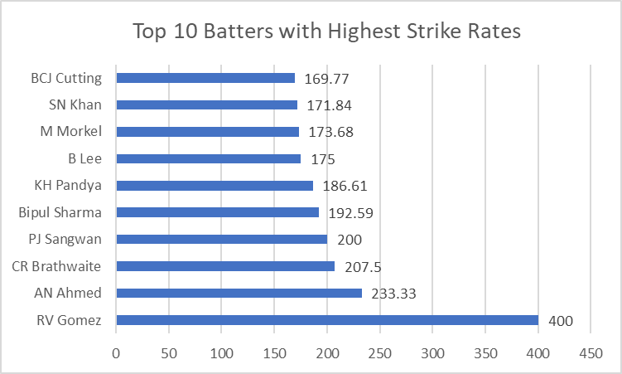
Top 10 Power Hitters
RV Gomez leads the list with an incredible strike rate of 400, indicating he likely played a small number of explosive innings.
AN Ahmed (233.33) and CR Brathwaite (207.5) follow, showing their ability to score quickly and change the game's momentum.
PJ Sangwan (200), traditionally a bowler, makes an appearance, hinting at a rare impactful innings.
The presence of all-rounders like Bipul Sharma (192.59), KH Pandya (186.61), and BCJ Cutting (169.77) highlights the importance of players who can finish games with aggressive batting.

Slide 16
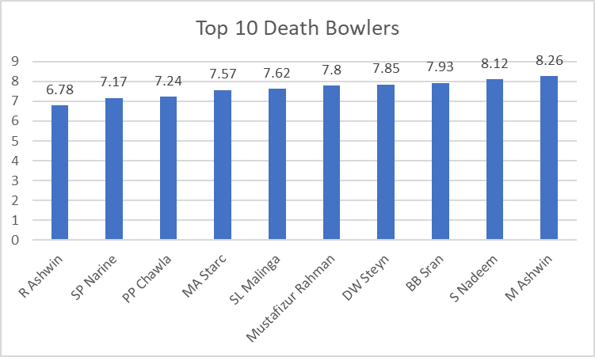
Top 10 Death Bowlers
R Ashwin (6.78) has the best economy rate, showcasing exceptional control and effectiveness in the death overs.
SP Narine (7.17) and PP Chawla (7.24) highlight the role of spinners in limiting runs, even in pressure situations.
MA Starc (7.57) and SL Malinga (7.62), known for their lethal yorkers, emphasize the importance of pace bowlers in death-over bowling.
The list features a mix of spinners (R Ashwin, Narine, Chawla) and pacers (Starc, Malinga, Steyn), indicating that both types of bowlers can be effective with the right skills.

Slide 17
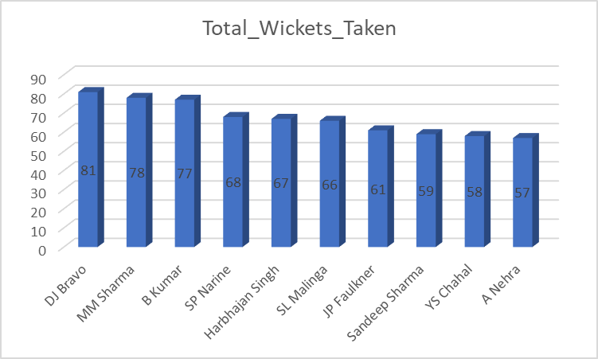
Top 10 Bowlers With the Most Wickets
Dwayne Bravo (81 wickets) leads the list with his ability to bowl in different phases, particularly excelling at the death.
Mohit Sharma (78 wickets) and Bhuvneshwar Kumar (77 wickets) demonstrate the value of medium-pace bowlers in T20 cricket with control over line and length.
SP Narine (68 wickets) and Harbhajan Singh (67 wickets) highlight the impact of spinners, especially in containing runs and breaking partnerships.
Lasith Malinga (66 wickets), known for his pinpoint yorkers and slower deliveries, has been a game-changer in death overs.

Slide 18
Recommondation to RCB for Auction
1.Target Death-Over Specialists:
Bowlers like Lasith Malinga, Dwayne Bravo, or Mitchell Starc (if available) can solve RCB's issues in the death overs. RCB should prioritize bowlers who can bowl accurate yorkers and slower deliveries under pressure.
Emerging death-over specialists like Mustafizur Rahman or experienced campaigners like Ashish Nehra should also be considered.
Powerplay Wicket-Takers:
Bowlers like Bhuvneshwar Kumar or Mohit Sharma are proven performers in the powerplay and can restrict runs while taking early wickets.
Spin Bowling Options:
RCB’s home ground (Chinnaswamy Stadium) is a small venue, which makes spin an essential weapon to control runs. Spinners like Sunil Narine, Imran Tahir, or even retaining Yuzvendra Chahal would be critical for middle overs.

Slide 19
Recommondation to RCB for Auction
2. Build a Balanced All-Rounder Core
All-rounders add depth to both batting and bowling. In T20s, they play a crucial role in closing games or turning the tide in tight situations:
Target All-Rounders:
Players like Andre Russell, Dwayne Bravo, Ben Stokes, or even a utility player like Chris Morris can significantly improve RCB’s balance.
Reliable Indian All-Rounders:
Players like Hardik Pandya, Krunal Pandya, or Axar Patel can provide finishing ability with the bat and deliver economical bowling spells.
3. Focus on Middle-Order Stability
RCB’s top-heavy batting lineup (reliant on Kohli, AB de Villiers, and Chris Gayle) has often crumbled when early wickets fall. Adding middle-order finishers and reliable batters is critical:
Experienced Finishers:
Target players like MS Dhoni, David Miller, or Jos Buttler who can play impactful innings in the lower-middle order.

Slide 20
Conclusion
RCB should strengthen its bowling by targeting economical death-over specialists and top wicket-takers like R Ashwin and DJ Bravo.
Reinforce the batting lineup with consistent performers like LMP Simmons and DA Warner to complement Kohli and AB de Villiers.
Focus on improving performance while defending totals and adapting strategies for challenging away venues.
Prioritize versatile all-rounders like JP Faulkner to fill gaps in both batting and bowling.
Utilize players with high strike rates for finishing roles to capitalize on the death overs.
Leverage home-ground advantage at M Chinnaswamy Stadium (59.26% win rate) to secure more wins at home.

Slide 21

Presented by Sahil Kadam
Thank you very much!

