Slide 1
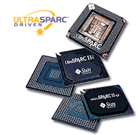
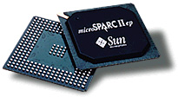
Scalable Processor Architecture
(SPARC)

Slide 2
Overview
Designed to optimize compilers and pipelined hardware implementations
Offers fast execution rates
Engineered at Sun Microsystems in 1985
  Based on RISC I & II which were developed at Univ of Cal at Berkeley
SPARC “register window” architecture

Slide 3
Features
Performance and Economy
  Simplified instruction set
  Higher number of instructions with fewer transistors
Scalability
  Flexible integration of cache, memory and FPUs
Open Architecture
  Compatible technology to multiple vendors
  Now allow access to CPU component techniques
  Complete set of development tool available for h/w & s/w

Slide 4
Architecture
RISC machine
64-bit addressing and 64-bit data
Increased bandwidth
Fault tolerance
Nine stage pipeline; can do up to 4 instructions per cycle
On-chip 16Kb data and instruct. Caches
  With 2Mb external cache

Slide 5
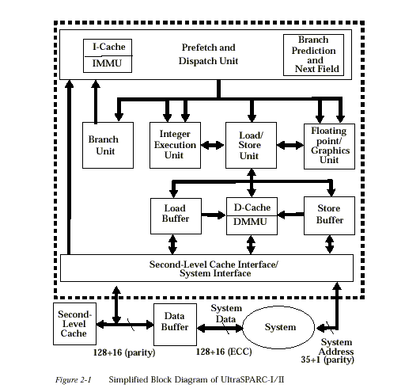

Slide 6
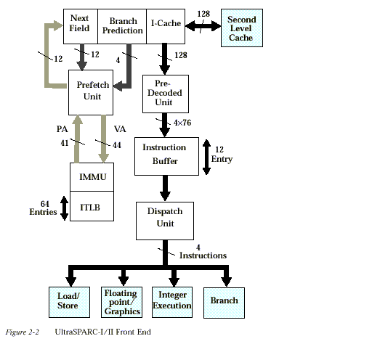

Slide 7
Registers
General purpose/ working data registers
  IU’s ‘r’ registers
  FPU’s ‘f’ registers
Control status registers
  IU control/status registers
  FPU control/status registers
  Coprocessor (CP) control/status registers

Slide 8
Registers
Window Overlapping
Each window shares its ins and outs with two adjacent windows
  Incremented by a RESTORE instruction decremented by a SAVE instruction
  Due to windowing the number available to software is 1 less than number implemented
  When a register is full the outs of the newest window are the ins of the oldest, which still contain valid program data

Slide 9
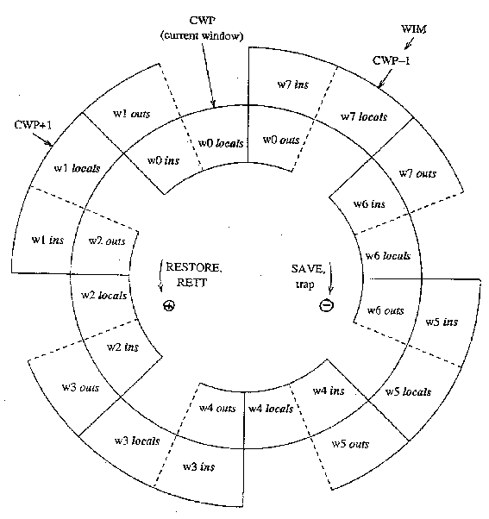

Slide 10
IU Control/Status Registers
Processor State Register (PSR)
Window Invalid Mask (WIM)
Multiply/Divide (Y)
Program Counters (PC, nPC)
Ancillary State Registers (ASR)
Deferred-Trap Queue
Trap Base Register (TBR)

Slide 11
IU Control/Status Registers
Processor State Register (PSR)
  Contains various fields that control and hold status information
Window Invalid Mask (WIM)
  To determine a window overflow or underflow
Impl | Ver | Icc | Reserved | EC | EF | PIL | S | PS | ET | CWP
31:28 27:24 23:20 19:14 13 12 11:8 7 6 5 4:0
W31 | W30 | W29 | ----------------------- | W1 | W0

Slide 12
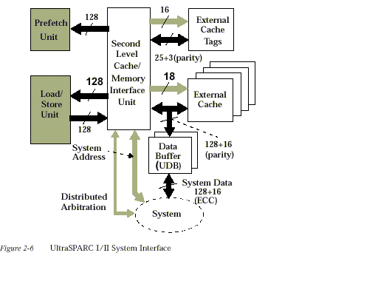
Memory
Each location identified by
  Address Space Identifier (ASI)
  64-bit address
Real memory
  No side effects
I/O locations
  Side effects
Notes:
Weaver - pg 117 -119

Slide 13

Snoop

Slide 14
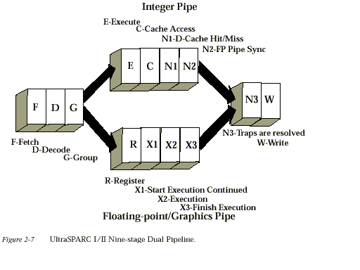
Pipelining

Slide 15
Instruction Formats
VIS – Visual Instruction Set
  Visualization built into chip
Examples of formats

Slide 16
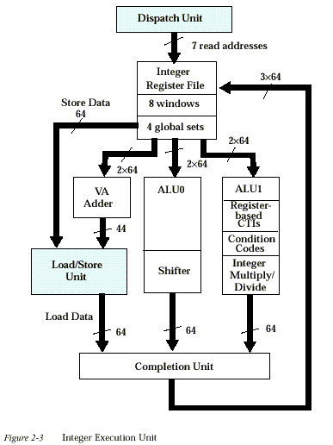
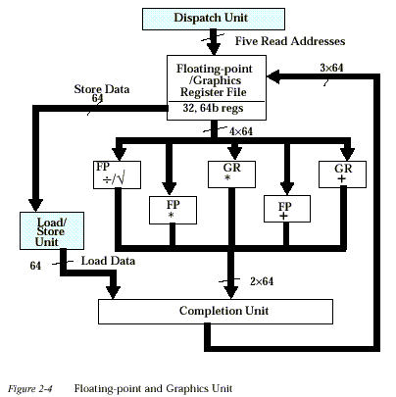

Slide 17
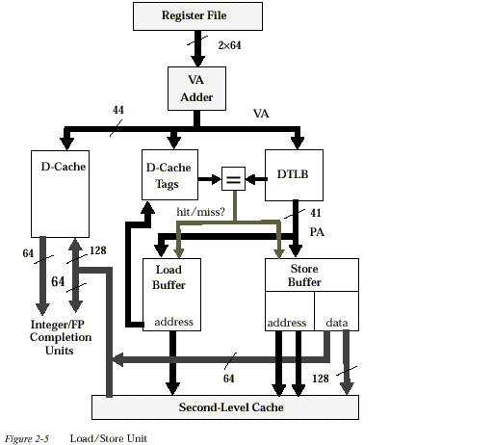

Slide 18
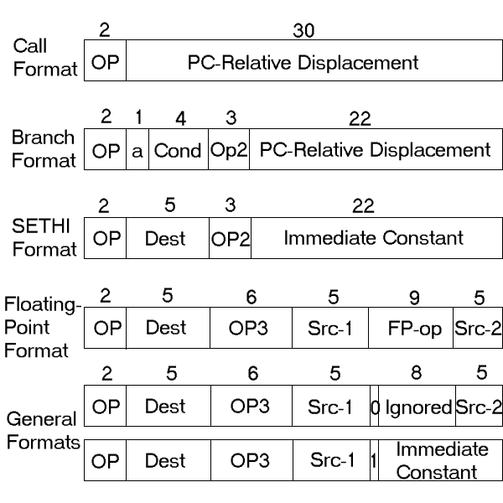

Slide 19
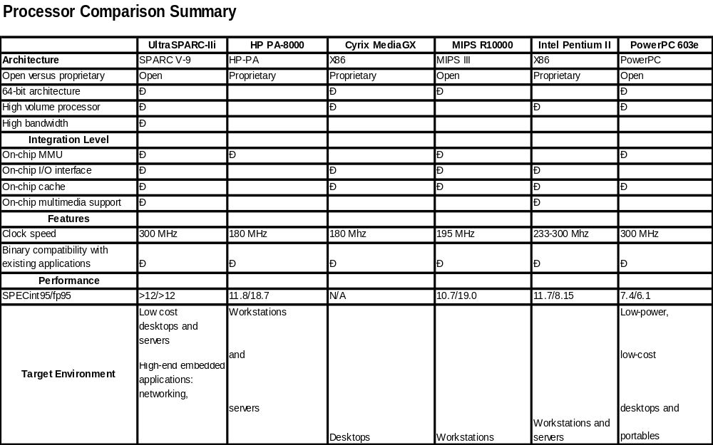

Slide 20
What makes the CISC lock-up?
Elegant forward looking branch instruction set
  Compiler can go to different branches
More complete testing of SPARC
Simpler compiler design
Better integration of OS interrupts to H/W interrupts
Solaris has a tighter source code
  Less devices to support

