Slide 1
Lecture 4

Slide 2
Arrays 1D
Arrays are used to store multiple values in a single variable, instead of declaring separate variables for each value.
An array is a group of contiguous or related data items that share a common name.
To declare an array, define the variable type with square brackets:
int a[];
The elements in the array allocated by new will automatically be initialized to zero (for numeric types), false (for boolean), or null (for reference types).

Slide 3
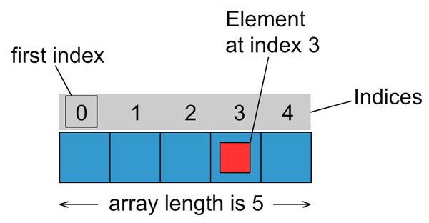
Arrays
int a[];
int a[]= {12,7,6,9,4};

Slide 4
Arrays
Creating an Array:
Declaring the array.
type arrayname[];
or
type[] arrayname;
Creating memory locations
arrayname=new type[size];
e.g. int a[]=new int[5];
int a[]=new int[n];
Putting values into the memory locations
arrayname[subscript]=value;

Slide 5
Arrays
Access the Elements of an Array:
You access an array element by referring to the index number.
String[] cars = {"Volvo", "BMW", "Ford", "Mazda"}; System.out.println(cars[0]);
Change an Array Element:
To change the value of a specific element, refer to the index number:
String[] cars = {"Volvo", "BMW", "Ford", "Mazda"}; cars[0] = "Opel"; System.out.println(cars[0]);

Slide 6
Arrays
Array Length:
To find out how many elements an array has, use the length property:
String[] cars = {"Volvo", "BMW", "Ford", "Mazda"}; System.out.println(cars.length);
Loop Through an Array
You can loop through the array elements with the for loop, and use the length property to specify how many times the loop should run.
String[] cars = {"Volvo", "BMW", "Ford", "Mazda"}; for (int i = 0; i < cars.length; i++) { System.out.println(cars[i]); }

Slide 7
Arrays
Loop Through an Array with For-Each:
There is also a "for-each" loop, which is used exclusively to loop through elements in arrays:
for (type variable : arrayname) { ... }
String[] cars = {"Volvo", "BMW", "Ford", "Mazda"}; for (String i : cars)
{ System.out.println(i); }

Slide 8
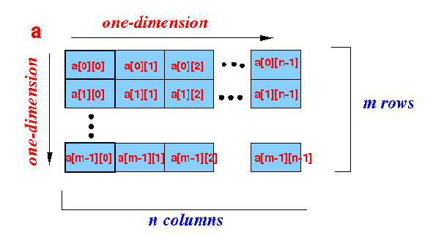
2D-Arrays
In 2D array we have rows and columns.
int a[][]= new int [m][n];

Slide 9
Variable size arrays/Jagged array
Variable length columns:
int x[][]=new int[n][ ];
x[0]= new int[7];
x[1]= new int[2];
x[2]= new int[5];
.
.
x[n-1]=new int[3];

Slide 10
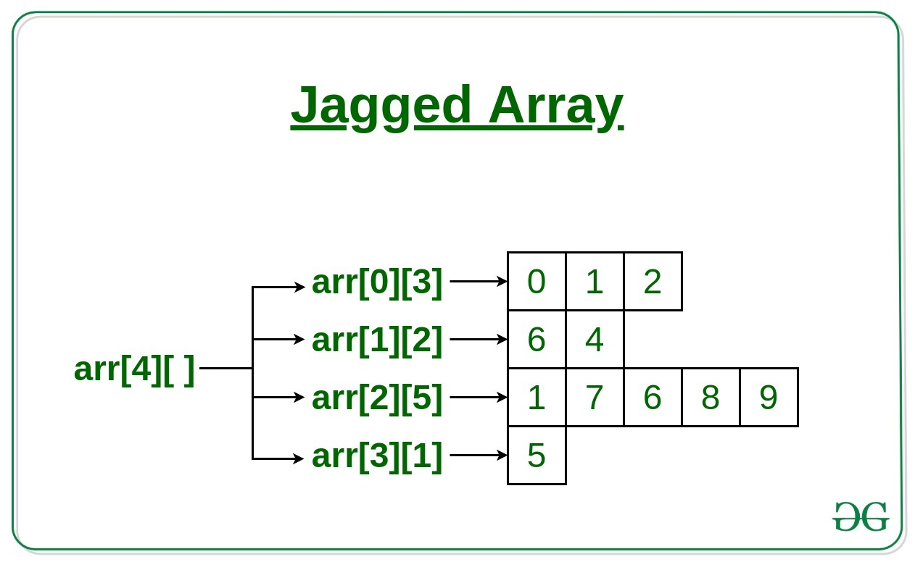
Variable size arrays/Jagged array
Variable length columns:

Slide 11
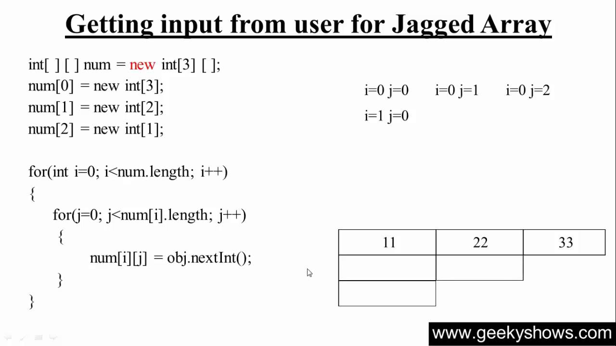
Variable size arrays/Jagged array
Variable length columns:

Slide 12
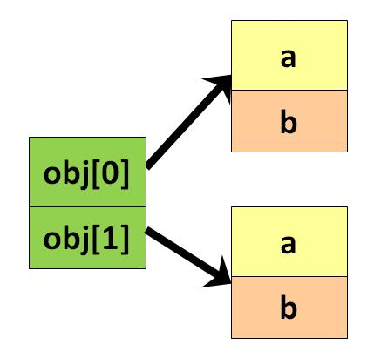
An Array of objects
Unlike traditional array which store values like string, integer, Boolean, etc. array of objects stores objects.
The array elements store the location of reference variables of the object.

Slide 13
An Array of objects
You can declare and instantiate the array of objects as shown below:
syntax: Class obj[]= new Class[array_length];
Employee emp[] = new Employee[2];
2. Once an array of objects is instantiated like above, the individual elements of the array of objects need to be created using new.
One way to initialize the array of objects is by using the constructors.
When you create actual objects, you can assign initial values to each of the objects by passing values to the constructor.
You can also have a separate member method in a class that will assign data to the objects.

