Slide 1
Object Oriented Programming METHODOLOGY
Ruchika Patil
ruchika.rp@somaiya.edu

Slide 2
AGENDA
What is Class?
Overview of Objects
Working with Objects
Ways to Initialize objects
Structure of a Class
Variable Types, Methods
Constructors

Slide 3
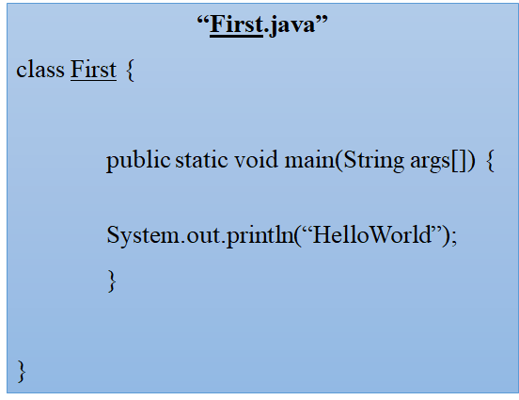
Your First java program

Slide 4
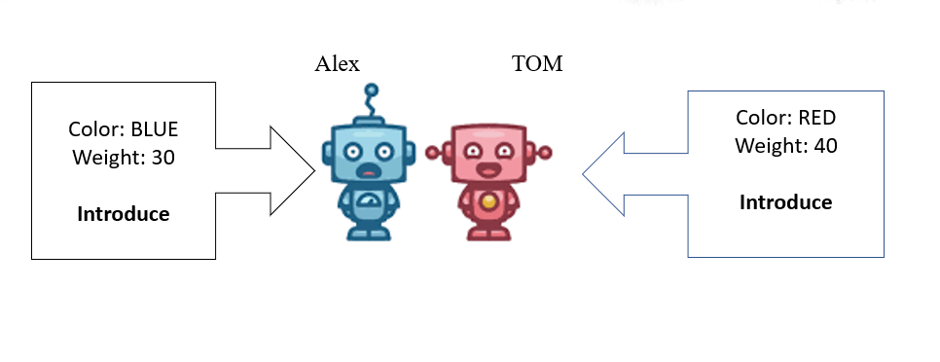
OBJECTS AND CLASSES: A REAL WORLD EXAMPLE

Slide 5
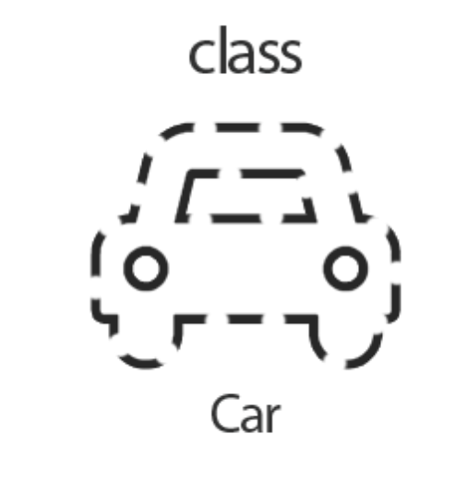
Class
Class is a template or blueprint from which objects are created.
A class is a group of objects – describes state and behaviour.
All actions in Java program takes inside class.
Syntax to declare a class:
class Class_name{ field or variable ; method like main() and others ; }

Slide 6
SYNTAX:
Public class Car{
Color
Model
Price
Accelerate();
GearChange();
}
Class Name
Variables
Methods

Slide 7
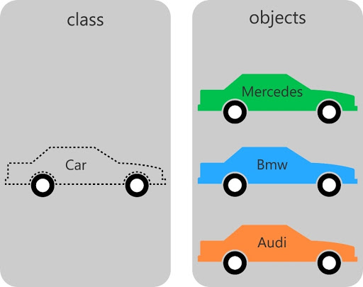
OBJECTS
An object is created from a class.
Instance of class which can access data.
An object has:
State: represents the data (value) of an object.
Behavior: represents the behavior (functionality) of an object.
Identity

Slide 8
Working with objects
How can you create an Object?
1) Declaration
-- Variable name
2) Instantiation
-- "New" keyword creates an object
3) Initialization
-- Call to constructor, initializes new object

Slide 9
how we can create objects in Java?
className object = new className();
New allocates memory for the object

Slide 10
Creating an object
public class MyClass { int x = 5; public static void main(String[] args) { MyClass myObj = new MyClass(); System.out.println(myObj.x); } }

Slide 11
Program 1: Basic
Write a program to illustrate 'student class'
-- Having different fields (RollNo, Name, Age)
-- Create an object of the student class
-- Print Object value

Slide 12
class Student{
int id;//field or data member or instance variable
String name;
public static void main(String args[]){
Student s1=new Student();//creating an object of Student
System.out.println(s1.id);//accessing member through reference variable
System.out.println(s1.name);
}
}
Object and Class Example:
main within the class

Slide 13
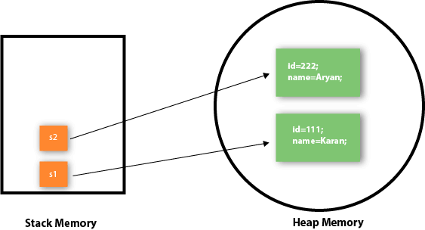

Slide 14
initialize objects?
There are 3 ways to initialize object in Java.
By reference variable
By method
By constructor

Slide 15
1) objects: initialization through reference
class Student{
int id;
String name;
}
class TestStudent3{
public static void main(String args[]){
//Creating objects
Student s1=new Student();
Student s2=new Student();
//Initializing objects
s1.id=101;
s1.name="Sonoo";
s2.id=102;
s2.name="Amit";
//Printing data
System.out.println(s1.id+" "+s1.name);
System.out.println(s2.id+" "+s2.name);
}
}

Slide 16
2) objects: Initialization through method
class Student{
int rollno;
String name;
void insertRecord(int r, String n){
rollno=r;
name=n;
}
void displayInformation(){
System.out.println(rollno+" "+name);
}
}
class TestStudent4{
public static void main(String args[]){
Student s1=new Student();
Student s2=new Student();
s1.insertRecord(111,"Karan");
s2.insertRecord(222,"Aryan");
s1.displayInformation();
s2.displayInformation();
}
}

Slide 17
3) Object : Initialization through a constructor
class Student{ String name;
int rollNo;
Student(String s, int r) // constructor { name = s; rollNo = r; }
void methodforDisplay() { System.out.println(name+"'s Roll No: "+rollNo); } public static void main(String args[]){ Student obj1=new Student("Ramboo",21); obj1.methodforDisplay(); } }

Slide 18
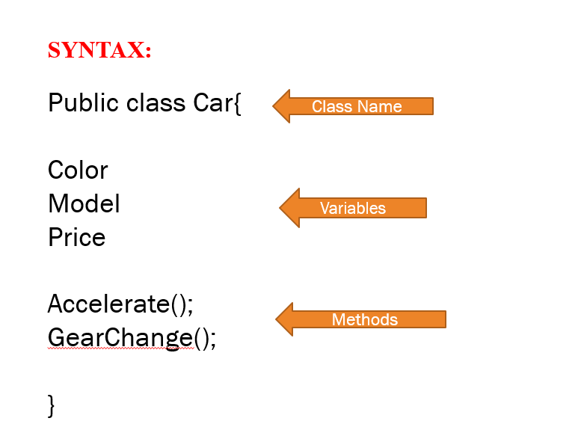
Let's go back:
Structure of a Class​

Slide 19
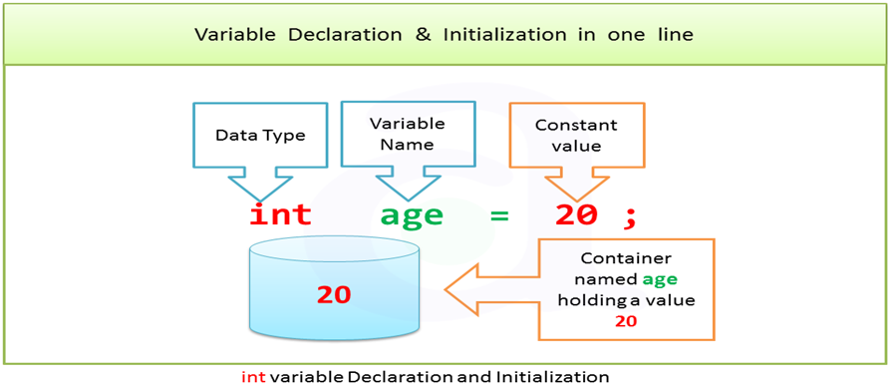
Variables
•Variables are named memory locations used to store values of specific data type.
Member Variables

Slide 20
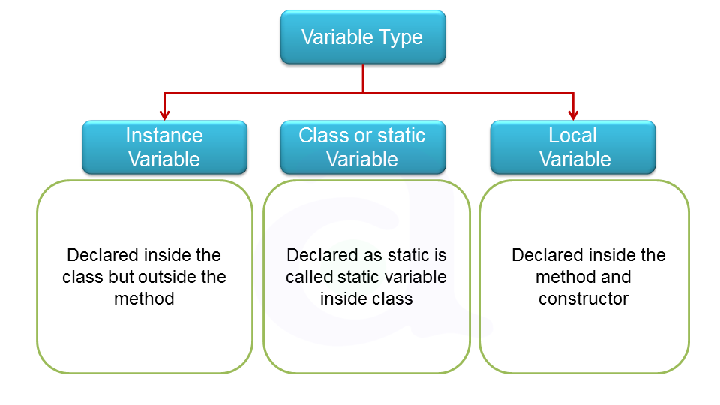
VARIABLE TYPES
https://www.atnyla.com/library

Slide 21
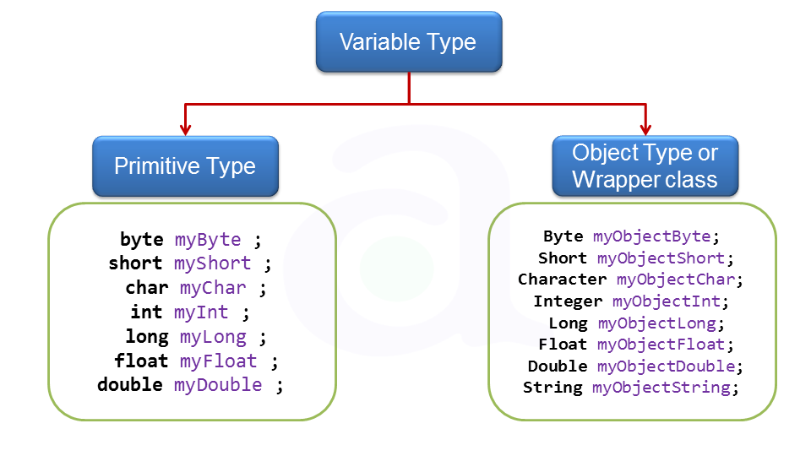

Slide 22
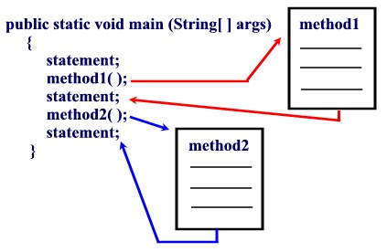
Methods
A method is a set of code which is referred to by name and can be called (invoked) at any point in a program simply by utilizing the method's name.
You can pass data, known as parameters, into a method.

Slide 23
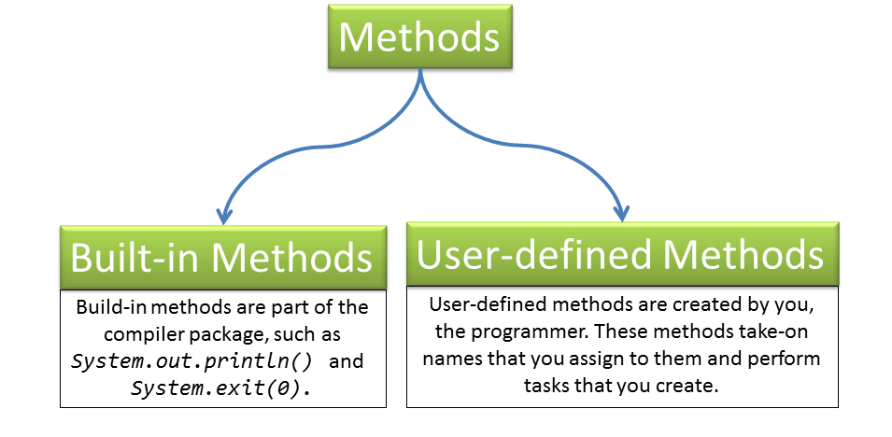
TYPES OF METHODS

Slide 24
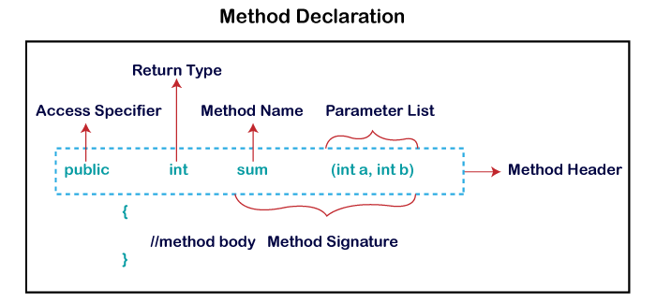
Method Declaration

Slide 25
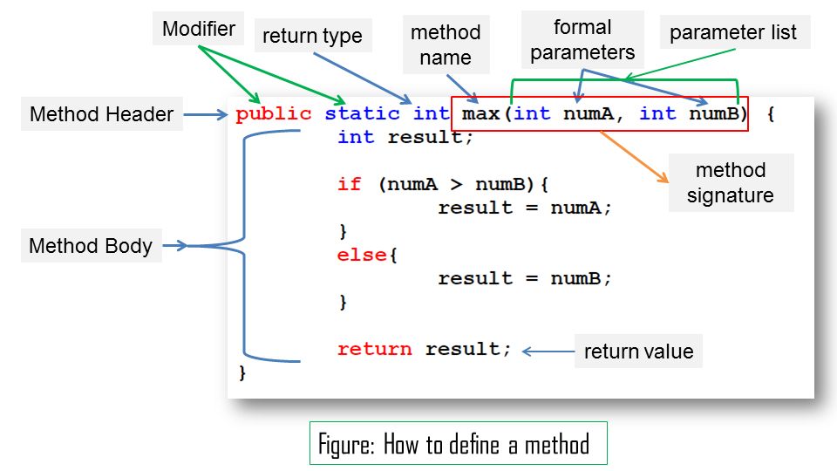
METHODS- syntax

Slide 26
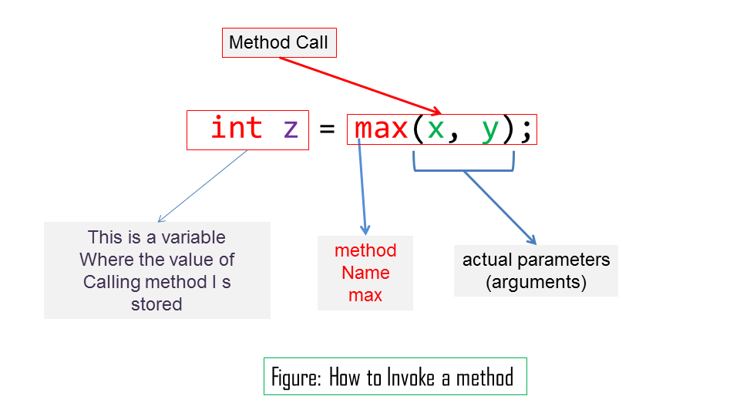

Slide 27
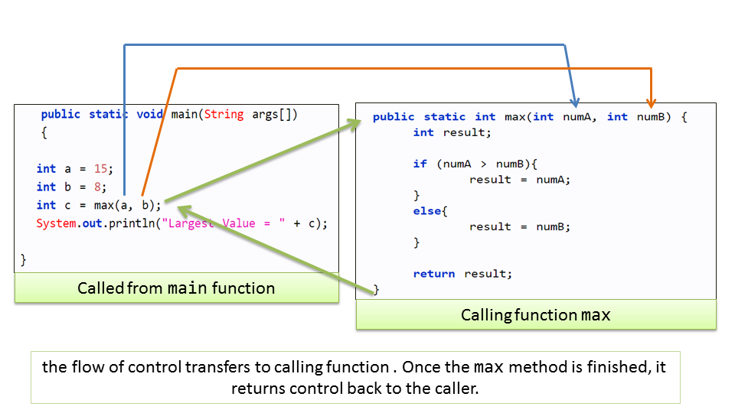
METHODS

Slide 28
PROBLEM STATEMENT (1)
Write a program to add two numbers using Method in Java

Slide 29
PROBLEM STATEMENT (2)
Write a program to check whether a number entered by user is even or odd

Slide 30
CONSTRUCTORS
Special method that is used to initialize objects.
The constructor is called when an object of a class is created.
At the time of calling constructor, memory for the object is allocated in the memory.
RULES:
1) Constructor name must be same as its class name
2) No return type
3) cannot be abstract, static, final, and synchronized

Slide 31
Types of Java constructors
There are two types of constructors:
1) Default constructor (no-arg constructor)
Default constructor provides the default values to the object like 0, null etc. depending on the type.
Eg. Constructors ()
{
System.out.println("This is default constructor");
}
2) Parameterized constructor

Slide 32
EXAMPLE OF Default Constructor
//Java Program to create and call a default constructor
class Bike1{
//creating a default constructor
Bike1(){
System.out.println("Bike is created");
}
//main method
public static void main(String args[]){
//calling a default constructor
Bike1 b=new Bike1();
}
}

Slide 33
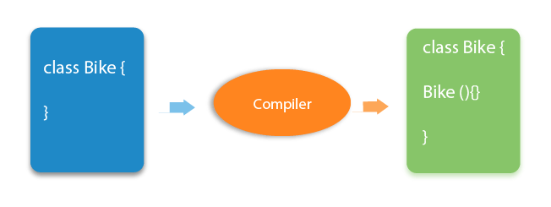
Rule: If there is no constructor in a class, compiler automatically creates a default constructor.

Slide 34
Parameterized Constructor
A constructor that have parameters.
Parameterized constructor is used to provide different values to the distinct objects.

Slide 35
EXAMPLE OF PARAMETRIZED CONSTRUCTOR
class Student{ String name; int rollNo;
//Parametrized Constructor Student(String n, int i){ name = n; rollNo = i; }
void display(){ System.out.println(rollNo+" "+name); } public static void main(String args[]){ Student s1=new Student("RUCHIKA", 1); Student s2=new Student(" MANJU",2); s1.display(); s2.display(); } }

Slide 36
Constructor vs Method
SR no | Constructor | Method
1 | Constructor is used to initialize the state of an object. | Method is used to expose behaviour of an object.
2 | Constructor must not have return type | Method must have return type.
3 | Constructor is invoked implicitly. | Method is invoked explicitly.
4 | The java compiler provides a default constructor if you don't have any constructor. | Method is not provided by compiler in any case.
5 | Constructor name must be same as the class name | Method name may or may not be same as class name.
6 | called only once at the time of Object creation | can be called any numbers of time.

Slide 37
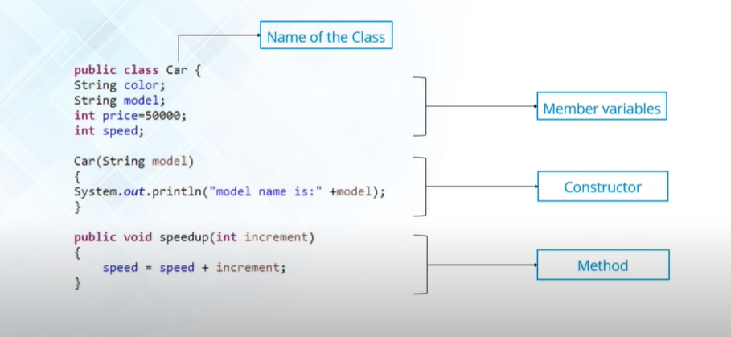
Structure of a class

Slide 38
THANKS!

