Slide 1
Inheritance
Reusability
Deriving a new class from an old one
Inheritance allows subclasses to inherit all the variables and methods of their parent classes.
Forms:
Single inheritance(only one super class)
Multiple inheritance(several super classes)
Hierarchical inheritance(one super class many subclasses)
Multilevel inheritance(derived from a derived class)

Slide 2
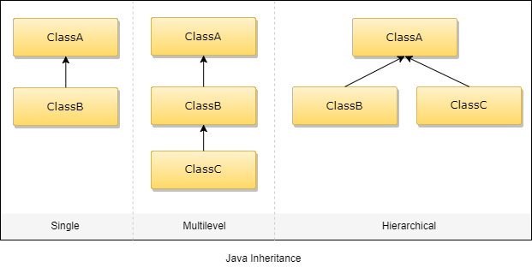
Inheritance

Slide 3
Defining a subclass
class subclassname extends superclassname
{
variable declaration;
methods declaration;
}
The keyword extends signifies that the properties of the superclassname are extended to subclassname.
The subclass will now contain its own variables and methods as well those of the superclass.

Slide 4
Subclass Constructor
A subclass constructor is used to construct the instance variables of both the subclass and the superclass .
The subclass constructor uses the keyword super to invoke the constructor method of the superclass.
The keyword super is used provided:
Super may only be used within a subclass constructor method.
The call to superclass constructor must appear as the first statement within the subclass constructor.
The parameters in the super class must match the order and type of the instance variable declared in the superclass.

Slide 5
Multilevel Inheritance
Class A
{
-----
------
}
Class B extends A
{
------
------
}
Class C extends B
{
-----
------
}

Slide 6
Overriding Methods
A method defined in a super class is inherited by its subclass and is used by the objects created by the subclass.
If we want an object to respond to the same method but have different behaviour when that method is called. We override the method defined in the superclass.
This is possible by defining a method in the subclass that has the same name, same arguments and same return type as a method in the superclass.
When that method is called, the method defined in the subclass is invoked and executed instead of the one in the superclass.
This is known as method overriding.

Slide 7
Final variables and methods
All methods and variables can be overridden by default in subclasses.
If we wish to prevent the subclasses from overriding the members of the superclass, we can declare them as final using the keyword final as a modifier.
final int SIZE=100;
final void showstatus();

Slide 8
Final classes
Sometimes we may like to prevent a class being further subclasses for security reasons.
A class that cannot be subclassed is called a final class.
final class abc{………}
final class pqr extends someclass{……..}
Any attempt to inherit these classes will cause an error and the compiler will not allow it.

Slide 9
Abstract methods and classes
To indicate that a method must always be redefined in a subclass, thus making overriding compulsory.
This is done using the modifier keyword abstract in the method definition.
abstract class shape
{
………
abstract void draw();
………
}
When a class contains one or more abstract methods ,it should be declared abstract

Slide 10
Dynamic Method Dispatch
Method overriding is one of the ways in which Java supports Runtime Polymorphism.
Dynamic method dispatch is the mechanism by which a call to an overridden method is resolved at run time, rather than compile time.
When an overridden method is called through a superclass reference, Java determines which version(superclass/subclasses) of that method is to be executed based upon the type of the object being referred to at the time the call occurs. Thus, this determination is made at run time.

Slide 11
Dynamic Method Dispatch
At run-time, it depends on the type of the object being referred to (not the type of the reference variable) that determines which version of an overridden method will be executed
A superclass reference variable can refer to a subclass object. This is also known as upcasting. Java uses this fact to resolve calls to overridden methods at run time.

Slide 12
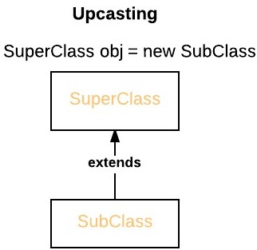
Dynamic Method Dispatch
Therefore, if a superclass contains a method that is overridden by a subclass, then when different types of objects are referred to through a superclass reference variable, different versions of the method are executed.

