Slide 1
Packages: Putting Classes Together

Slide 2
Introduction
The main feature of OOP is its ability to support the reuse of code:
  Extending the classes (via inheritance)
  Extending interfaces
The features in basic form limited to reusing the classes within a program.
What if we need to use classes from other programs without physically copying them into the program under development ?
In Java, this is achieved by using what is known as “packages”, a concept similar to “class libraries” in other languages.

Slide 3
Packages
Packages are Java’s way of grouping a number of related classes and/or interfaces together into a single unit. That means, packages act as “containers” for classes.
The benefits of organising classes into packages are:
  The classes contained in the packages of other programs/applications can be reused.
  In packages classes can be unique compared with classes in other packages. That two classes in two different packages can have the same name. If there is a naming clash, then classes can be accessed with their fully qualified name.
  Classes in packages can be hidden if we don’t want other packages to access them.
  Packages also provide a way for separating “design” from coding.

Slide 4
Java Foundation Packages
Java provides a large number of classes groped into different packages based on their functionality.
The six foundation Java packages are:
  java.lang
    Contains classes for primitive types, strings, math functions, threads, and exception
  java.util
    Contains classes such as vectors, hash tables, scanner,date etc.
  java.io
    Stream classes for I/O
  java.awt
    Classes for implementing GUI – windows, buttons, menus etc.
  java.net
    Classes for networking
  java.applet
    Classes for creating and implementing applets

Slide 5
Using System Packages
The packages are organised in a hierarchical structure. For example, a package named “java” contains the package “awt”, which in turn contains various classes required for implementing GUI (graphical user interface).
java
lang
“java” Package containing
“lang”, “awt”,.. packages;
Can also contain classes.
awt
Graphics
awt Package containing
classes
Font
Classes containing
methods
Image
…

Slide 6
Accessing Classes from Packages
There are two ways of accessing the classes stored in packages:
  Using fully qualified class name
    java.lang.Math.sqrt(x);
  Import package and use class name directly.
    import java.lang.Math
    Math.sqrt(x);
Selected or all classes in packages can be imported:
Implicit in all programs: import java.lang.*;
package statement(s) must appear first
import package.class;
import package.*;

Slide 7
Creating Packages
Java supports a keyword called “package” for creating user-defined packages. The package statement must be the first statement in a Java source file (except comments and white spaces) followed by one or more classes.
Package name is “myPackage” and classes are considred as part of this package; The code is saved in a file called “ClassA.java” and located in a directory called “myPackage”.
  package myPackage;
  public class ClassA {
    // class body
  }
  class ClassB {
  // class body
  }

Slide 8
Creating Sub Packages
Classes in one ore more source files can be part of the same packages.
As packages in Java are organised hierarchically, sub-packages can be created as follows:
  package myPackage.Math
  package myPackage.secondPakage.thirdPackage
Store “thirdPackage” in a subdirectory named “myPackage\secondPackage”. Store “secondPackage” and “Math” class in a subdirectory “myPackage”.

Slide 9
Accessing a Package
As indicated earlier, classes in packages can be accessed using a fully qualified name or using a short-cut as long as we import a corresponding package.
The general form of importing package is:
  import package1[.package2][…].classname
  Example:
    import myPackage.ClassA;
    import myPackage.secondPackage
  All classes/packages from higher-level package can be imported as follows:
    import myPackage.*;

Slide 10
Using a Package
Let us store the code listing below in a file named “ClassA.java” within subdirectory named “myPackage” within the current directory (say “abc”).
  package myPackage;
  public class ClassA {
  // class body
  public void display()
  {
  System.out.println("Hello, I am ClassA");
  }
  }
  class ClassB {
  // class body
}

Slide 11
Using a Package
Within the current directory (“abc”) store the following code in a file named “ClassX.java”
  import myPackage.ClassA;
  public class ClassX
  {
  public static void main(String args[])
  {
  ClassA objA = new ClassA();
  objA.display();
  }
  }

Slide 12
Compiling and Running
When ClassX.java is compiled, the compiler compiles it and places .class file in current directly. If .class of ClassA in subdirectory “myPackage” is not found, it comples ClassA also.
Note: It does not include code of ClassA into ClassX
When the program ClassX is run, java loader looks for ClassA.class file in a package called “myPackage” and loads it.

Slide 13
Using a Package
Let us store the code listing below in a file named “ClassA.java” within subdirectory named “secondPackage” within the current directory (say “abc”).
  package secondPackage;
  public class ClassC {
  // class body
  public void display()
  {
  System.out.println("Hello, I am ClassC");
  }
  }

Slide 14
Using a Package
Within the current directory (“abc”) store the following code in a file named “ClassX.java”
  import myPackage.ClassA;
  import secondPackage.ClassC;
  public class ClassY
  {
  public static void main(String args[])
  {
  ClassA objA = new ClassA();
  ClassC objC = new ClassC();
  objA.display();
  objC.display();
  }
  }

Slide 15
Output
[raj@mundroo] package % java ClassY
  Hello, I am ClassA
  Hello, I am ClassC
[raj@mundroo] package %

Slide 16
Protection and Packages
All classes (or interfaces) accessible to all others in the same package.
Class declared public in one package is accessible within another. Non-public class is not
Members of a class are accessible from a difference class, as long as they are not private
protected members of a class in a package are accessible to subclasses in a different class

Slide 17
Visibility - Revisited
Public keyword applied to a class, makes it available/visible everywhere. Applied to a method or variable, completely visible.
Private fields or methods for a class only visible within that class. Private members are not visible within subclasses, and are not inherited.
Protected members of a class are visible within the class, subclasses and also within all classes that are in the same package as that class.

Slide 18
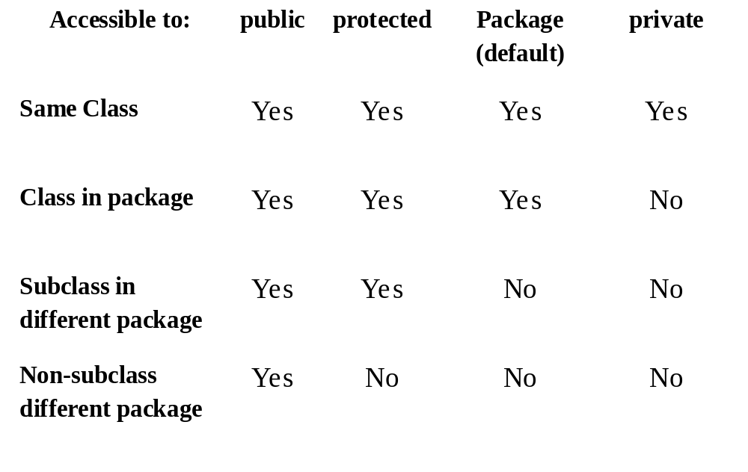
Visibility Modifiers

Slide 19
Adding a Class to a Package
Consider an existing package that contains a class called “Teacher”:
This class is stored in “Teacher.java” file within a directory called “pack1”.
How do we a new public class called “Student” to this package.
package pack1;
public class Teacher
{
// class body
}

Slide 20
Adding a Class to a Package
package pack1;
class Teacher
class Student
Define the public class “Student” and place the package statement before the class definition as follows:
Store this in “Student.java” file under the directory “pack1”.
When the “Student.java” file is compiled, the class file will be created and stored in the directory “pack1”. Now, the package “pack1” will contain both the classes “Teacher” and “Student”.
package pack1;
public class Student
{
// class body
}

Slide 21
Packages and Name Clashing
When packages are developed by different organizations, it is possible that multiple packages will have classes with the same name, leading to name classing.
We can import and use these packages like:
  import pack1.*;
  import pack2.*;
  Student student1; // Generates compilation error
package pack1;
package pack2;
class Teacher
class Student
class Student
class Courses

Slide 22
Handling Name Clashing
In Java, name clashing is resolved by accessing classes with the same name in multiple packages by their fully qualified name.
Example:
  import pack1.*;
  import pack2.*;
  pack1.Student student1;
  pack2.Student student2;
  Teacher teacher1;
  Courses course1;

Slide 23
Extending a Class from Package
A new class called “Professor” can be created by extending the “Teacher” class defined the package “pack1” as follows:
import pack1.Teacher;
public class Professor extends Teacher
{
// body of Professor class
// It is able to inherit public and protected members,
// but not private or default members of Teacher class.
}

Slide 24
Summary
Packages allow grouping of related classes into a single united.
Packages are organised in hierarchical structure.
Packages handle name classing issues.
Packages can be accessed or inherited without actual copy of code to each program.

Slide 25
Problem Statement
Create a Package myMath which has 2 classes factorial and power which has methods fact() and cal_pow() respectively.
Create a main class which will use package and calculate
cos (x) = 1 – (x2/2!) + (x4/4!) – (x6/6!) + … upto n terms (n given by user).
sin (x) = x-x3/3!+x5/5!-x7/7!+........ upto n terms (n given by user).

Slide 26
Write a program to create a package ‘myPack’ which contains a class Trigonometry. The
class contains following static methods.
i) sine() –accepts degree (0,30,60,90)
ii) cos() - accepts degree (0,30,60,90)
iii)tan()- accepts degree (0,30,60,90)
iv)cot()-- accepts degree (0,30,60,90)
v)cosec()-- accepts degree (0,30,60,90)
vi)sec()-- accepts degree (0,30,60,90)
(Do not make use of inbuilt functions. Use the functions of user defined class Trigonometry by
importing mypack.)

