Slide 1

FUNCTIONAL INTERFACE AND LAMBDA EXPRESSION

Slide 2


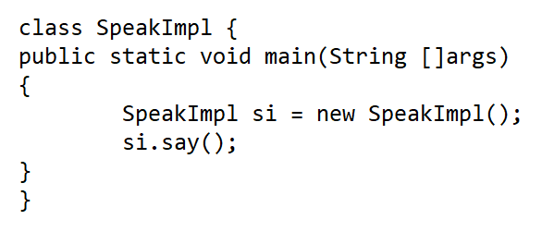
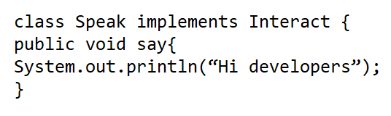
How To Decrease code???

Slide 3
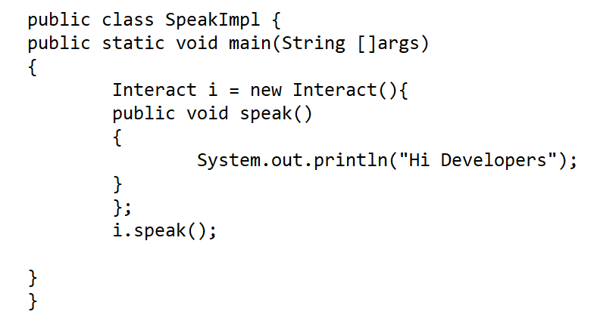

Is it the most optimised way possible

Slide 4
For Implementation of a method what we need??
1.Method Name
2.Method Parameters
3.Return Type

Slide 5
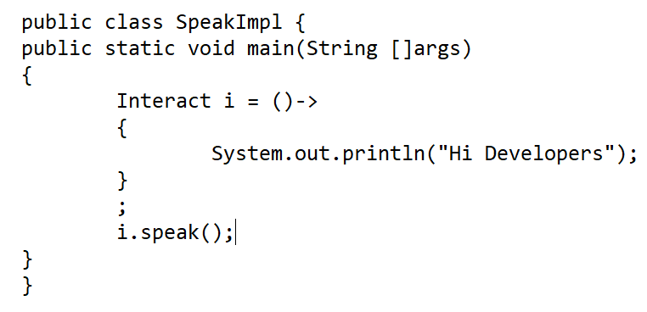

Removing Boiler Plate Code

Slide 6

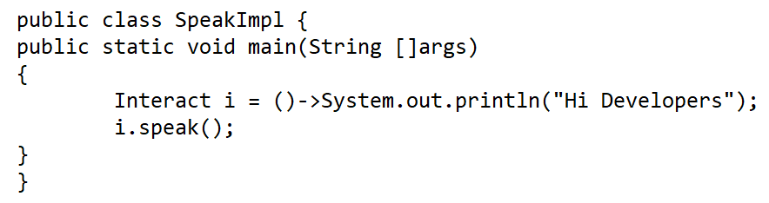
Can I avoid writing Interface???

Slide 7
Built in java functional interfaces
Java provides us with 43 built in functional interfaces all of which are included under package java.util.function
All functional interfaces are categorised into 4 categories
Supplier
Consumer
Predicate
Function

Slide 8

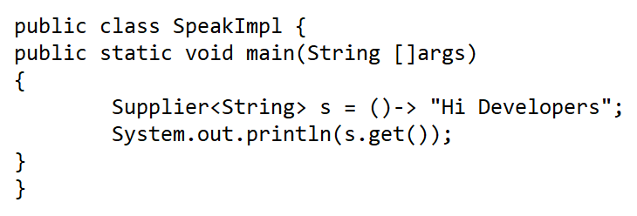
SUPPLIER
A Supplier represents a function that doesn’t take something but return something
It’s only abstract method is get()

Slide 9

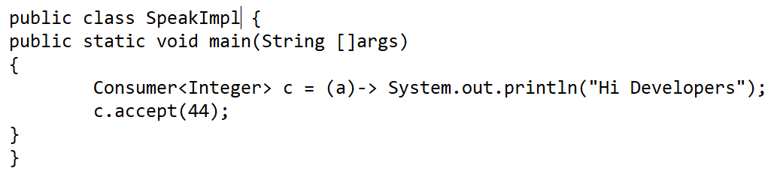
CONSUMER
A Consumer represents a function that takes a argument and return nothing
It’s only abstract method is accept()

Slide 10

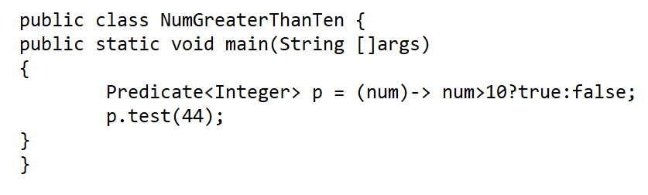
PREDICATE
A Predicate represents a function that takes an argument and return true or false
It’s only abstract method is test()

Slide 11

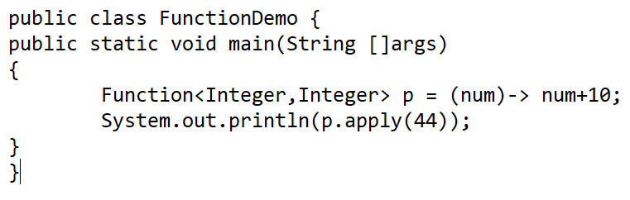
FUNCTION
A Function represents a function that takes an argument and returns another object
It’s only abstract method is apply()

