Slide 1

Supply Chain Management Analytics for XYZ Company
“Data-Driven Insights for Optimizing Supply Chain Operations”
By Sahil Surve

Slide 2
Challenges in the Supply Chain
XYZ company faces challenges in optimizing shipping costs, reducing lead times, and improving profitability.
Inefficient management impacts revenue, customer satisfaction, and overall operations.
Objective: Use data to uncover bottlenecks and improve efficiency across the supply chain.

Slide 3
Analyzing Key Metrics
Focused on data from key aspects of the supply chain: revenue, costs, transportation modes, and profitability.
Analyzed product-wise revenue, carrier costs, and lead times to identify inefficiencies.
Highlight the top-performing product types and areas where costs are too high.

Slide 4
Optimizing the Supply Chain: Insights and Actions
Reduce shipping costs: Focus on improving the cost efficiency of air and road shipping.
Minimize lead times: Invest in faster transportation options for haircare products and high-demand areas.
Enhance profitability: Focus on increasing sales of skincare and cosmetics products while reducing costs in less profitable categories.
Improve transportation mode balance: Adjust usage of rail and road for more efficiency.

Slide 5
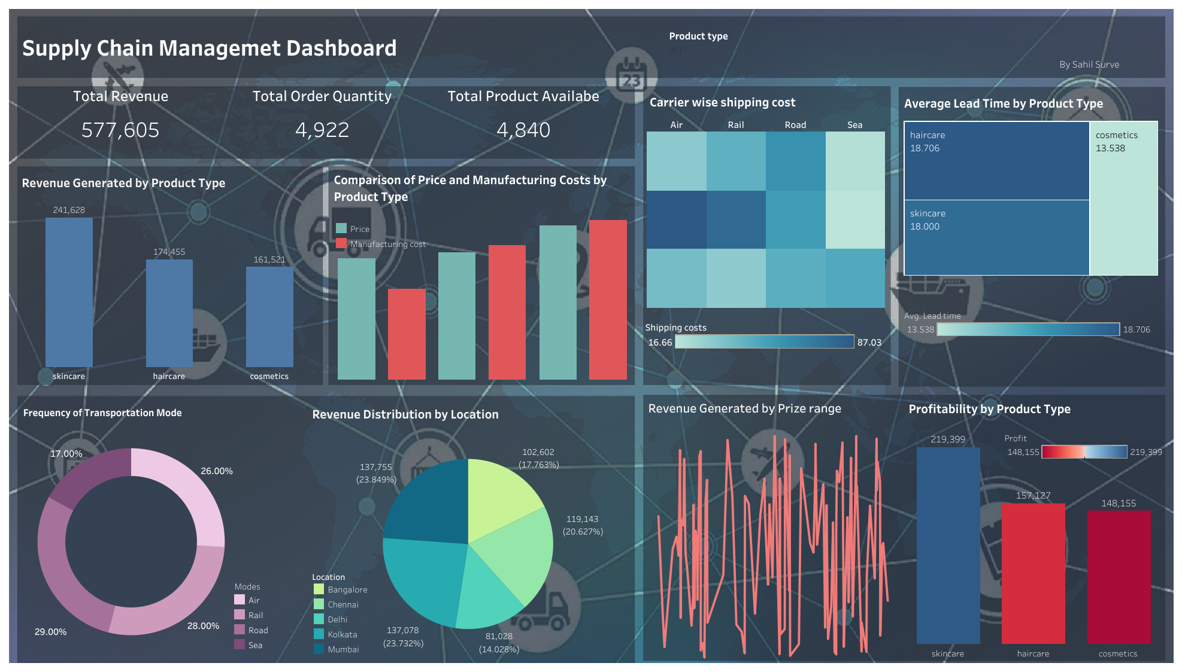
Dashboard
Dashboard link :https://public.tableau.com/app/profile/sahil.surve/viz/SUPPLY_CHAIN_MANAGEMENT_DASHBOARD_BY_SAHIL/Dashboard1?publish=yes

Slide 6
Thankyou

