Slide 1

Employee Attrition Analysis for XYZ Company
By Sahil Surve

Slide 2
Understanding the Attrition Challenge
XYZ company has faced a 15.31% attrition rate for the past couple of years.
High attrition is impacting productivity, morale, and growth.
Company seeks data-driven insights to reduce turnover and retain talent

Slide 3
Key Drivers of Attrition
Analyzed factors like job satisfaction, department, tenure, age group, education, and gender.
Identified departments and demographics with higher attrition.
Top drivers: Lack of satisfaction, career growth, work-life imbalance.

Slide 4
Strategic Recommendations to Reduce Attrition
Improve job satisfaction: Conduct surveys, increase engagement programs.
Career development: Offer clear growth paths and mentorship.
Work-life balance: Reduce overtime, provide flexibility.

Slide 5
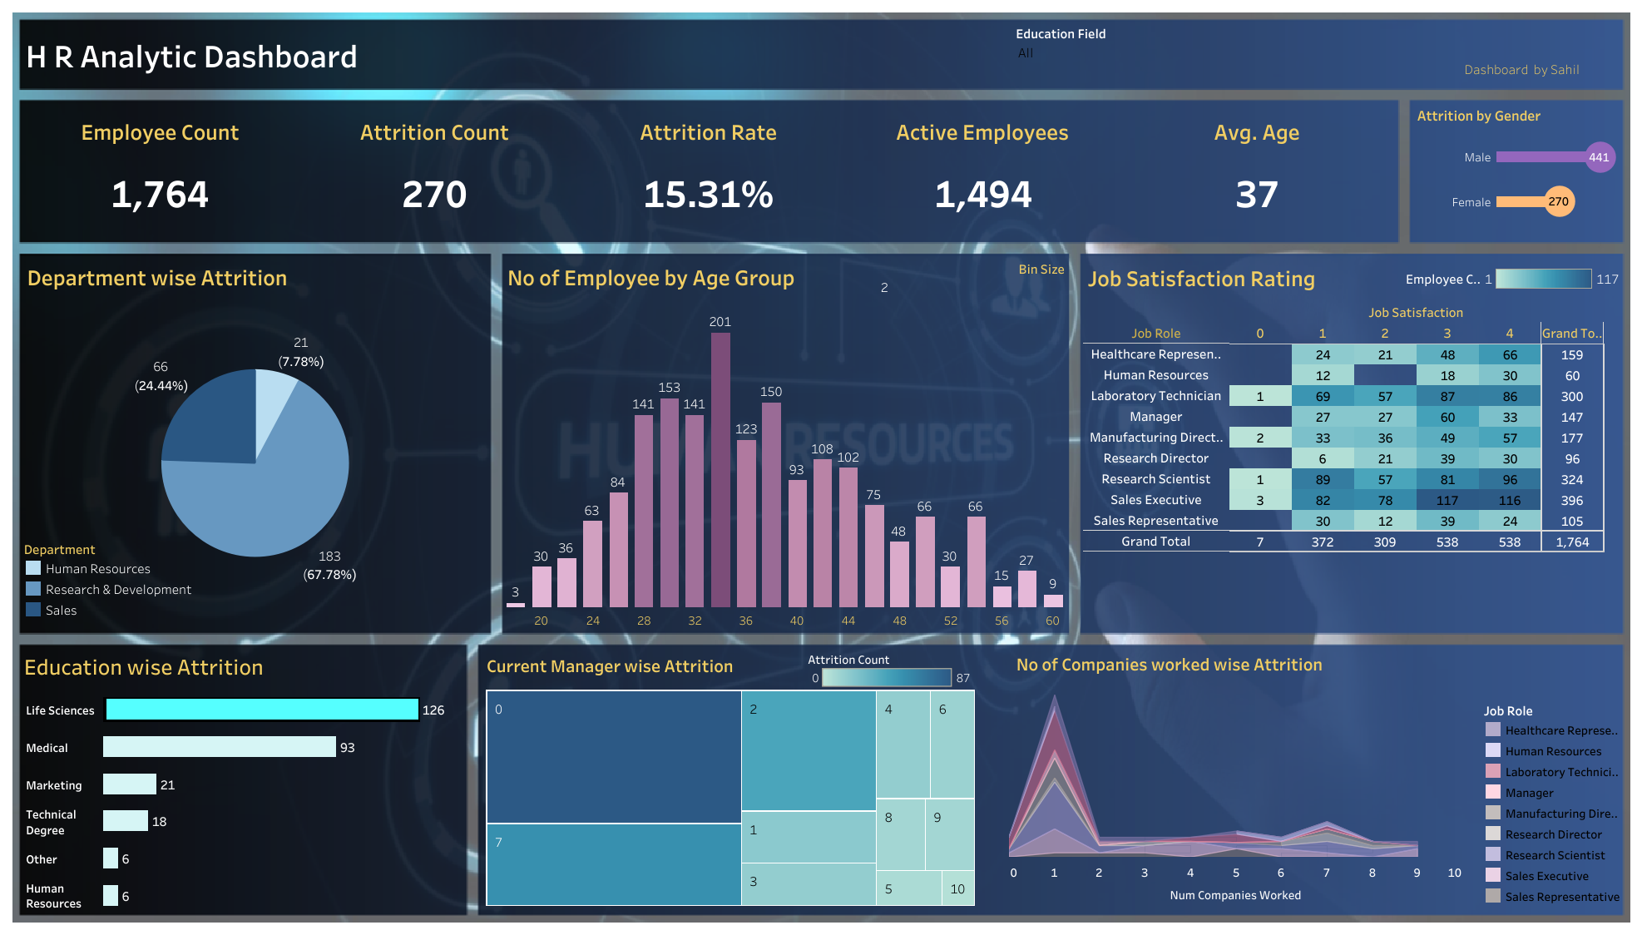
Dashboard
Link for dashboard: https://public.tableau.com/app/profile/sahil.surve/viz/HR_Attrition_Analysis_PROJECT_by_Sahil/HRANALYTICDASHBOARD?publish=yes

Slide 6
Thankyou

