Slide 1
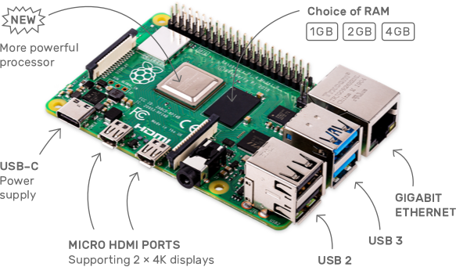
Hardware and Interrupts Introduction to GPIO
Santosh Sam Koshy
Joint Director
C-DAC Hyderabad

Slide 2
Content
Device Description
Memory mapped IO and IO mapped IO
Handling Interrupts in the kernel
BBB Header Information
GPIO Functions
GPIO as an Input Device
GPIO as an Output Device

Slide 3
The Device Driver Abstract View
What is a Device from the Driver’s Perspective?
Peripheral devices are controlled by writing and reading its registers
Registers
Data Registers (Reading and Writing)
Control Registers (Configuring the device. Supports R&W Operations)
Status Registers (Maintains state of the device. Generally Read Only)
Every peripheral has a number of such registers
Therefore, a device from a driver’s perspective is a set of registers that it uses to interact with, configure or transact with the device.
What about Registers? How are they similar/different from memory?

Slide 4
Conventional Memory
1
Initial Condition
2
Load Memory into Registers
Variable A
Variable A
Variable B
Variable B
Variable A
Variable B
Processor Registers
Main Memory
Processor Registers
Main Memory
ALU
ALU

Slide 5
Conventional Memory
3
Compute Arithmetic & Create Result
4
Store Result to Memory
Variable A
Variable A
Variable B
Variable B
Variable A
Variable A
Variable B
Variable B
Processor Registers
Main Memory
Processor Registers
Main Memory
ALU
ALU
Result

Slide 6
IO Memory
Device A
Device Reg
Device Reg
Device B
Processor Registers
Main Memory
ALU

Slide 7
Memory Caching in IO Ports
Volatile Keyword
Disable hardware caching during IO access. Done by the kernel itself

Slide 8
Data Reordering
Consider the Following Code Snippet
Write (PIN FUNCTION, CLOCK DEVICE)
Write (FREQUENCY SETTING, CLOCK DEVICE)
Write (PRESCALAR VALUE, CLOCK DEVICE)
Write (START CLOCK, CLOCK DEVICE)
Compiler Reorders the data for optimized performance
Write (PIN FUNCTION, CLOCK DEVICE)
Write (PRESCALAR VALUE, CLOCK DEVICE)
Write (START CLOCK, CLOCK DEVICE)
Write (FREQUENCY SETTING, CLOCK DEVICE)

Slide 9
Barriers
The code will be modified like this
Write (PIN FUNCTION, CLOCK DEVICE)
Write (FREQUENCY SETTING, CLOCK DEVICE)
Write (PRESCALAR VALUE, CLOCK DEVICE)
BARRIER();
Write (START CLOCK, CLOCK DEVICE)

Slide 10
Barriers in Linux Kernel
The linux kernel provides 1 macro for compiler re-ordering
void barrier(void)‏
The kernel makes it a point that the compiler optimizations are absent across the barrier. The memory values present in the CPU registers are immediately stored in the memory. These do not prevent hardware barriers and therefore, the hardware is free to re-order the code
Header - #include <linux/kernel.h>
4 macros are provided by the kernel for hardware memory re-ordering
void rmb(void);
void read_barrier_depends(void);
void wmb(void);
void mb(void);
These functions insert hardware memory barriers in the compiled instruction flow. They are supersets of the barrier macro.
An rmb guarantees that any reads appearing before the barrier are completed prior to the execution of any subsequent read.
The _depends read memory barrier inserts a barrier only if the read is dependent on data from other reads. This is platform specific and so, be careful on using it
wmb orders write and mb orders both read and write.
Header - #include <asm/system.h>

Slide 11
The Device Driver Abstract View
How to Accesses the Registers of a Device?
These are generally mapped contiguously in the Processor’s Memory Space or IO Address Space, based on the processor architecture or device architecture
Processor architecture – x86 family supports both I/O Ports and Memory mapped IO, ARM supports only Memory Mapped IO
Device Architecture – PCI devices are always memory mapped
Drivers have to gain access to the device memory. For this,
Drivers need to know the mapping – Whether it is I/O Mapped Device or Memory Mapped Device
Drivers need to know the starting address of the mapping
Drivers need to know
the size of the registers,
offsets of specific registers and
how to access and transact with them – read/write

Slide 12
Device Addressing
IO Mapped IO or IO Ports
Peripheral devices are mapped into IO space and are accesssed through special instructions
Additional control lines are required to segregate IO access
Memory is better utilized
Memory Mapped IO or IO Memory
Peripheral devices are mapped into the system memory
All access to this device space is performed using similar instructions that access memory
Effective memory gets reduced

Slide 13
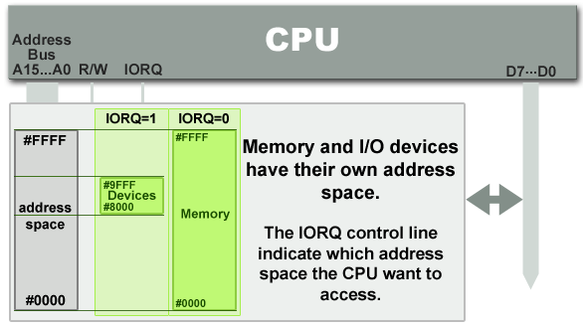
IO mapped IO (IOIO) or IO Ports

Slide 14
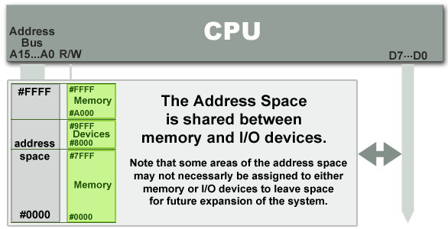
Memory Mapped IO (MMIO) or IO Memory

Slide 15
Communicating with IO Ports
Drivers communicate with many devices through the I/O ports.
Linux introduces a set of functions that may be used to gain exclusive access to an I/O region and communicate data transfers to and from these ports.
Before embarking into communication with the I/O ports, the driver must gain access to the required ports by calling the function
struct resource *request_region(unsigned long first, unsigned long n, const char *name);
The argument first is the first address requested
The argument long specifies the length of the addresses requested
The argument name identifies the requested region by this name in /proc/ioports
Header - #include <linux/ioport.h>

Slide 16
Communicating with IO Ports
When the I/O ports have been used as per requirement, they should be returned to the kernel so that other drivers may avail their existence. The I/O ports are returned by the function
void release_region(unsigned long start, unsigned long n);
Before using a I/O region, a check on the availability has to be conducted to be certain that the requested region will be available for our use. A special function allows this check.
int check_region(unsigned long first, unsigned long n);
This function returns a negative error code if the region is not available. This is a deprecated function and may not always prove to be true since it does not run atomic with the request_region function.

Slide 17
Communicating with IO Ports
On successfully being allotted the region, the actual communication to the ports may be carried out using the kernel provided functions.
These functions are specific to the port sizes on the I/O devices and provide interfaces for 8-bit, 16-bit and 32-bit ports
unsigned inb (unsigned port);
unsigned inw (unsigned port);
unsigned inl (unsigned port);
Get data from the port specified as an argument
void outb (unsigned char byte, unsigned port);
void outw (unsigned short word, unsigned port);
void outl (unsigned long word, unsigned port);
Send data to the port specified in the argument
Header - #include <asm/io.h>

Slide 18
Communicating with IO Ports
The kernel also supports string operations that render its services in allowing a string of ‘n’ bytes to be transferred between the driver and the I/O port
void insb (unsigned port, void *addr, unsigned long count);
Similarly..insw, insl
Copies count bytes of information from the port to addr
void outsb(unsigned port, void *addr, unsigned long count);
Write count data pointed by addr to the port
The kernel provides mechanisms of synchronization between a high-end processor and a relatively slower I/O by allowing a pause functionality in data transfer.
This feature may be accessed by ending the function names previously discussed with an ‘_p’, such as inb_p, outb_p....

Slide 19
IO Memory
IO Memory regions must be allocated prior to use
struct resource *request_mem_region(unsigned long start, unsigned long len, char *name);
IO Memory regions should when no longer in use
void release_mem_region(unsigned long start, unsigned long len);
Accessing IO Memory regions should be preceded by a call to
void *ioremap(unsigned long phys_addr, unsigned long size);
void *ioremap_nocache(unsigned long phys_addr, unsigned long size);
After accessing the IO Memory region, unmap it using
void iounmap(void * addr);

Slide 20
IO Memory
To read from IO memory,
unsigned int ioread8(void *addr);
unsigned int ioread16(void *addr);
unsigned int ioread32(void *addr);
Writing to the IO memory through
void iowrite8(u8 value, void *addr);
void iowrite16(u16 value, void *addr);
void iowrite32(u32 value, void *addr);
Reading a series of values
void ioread8_rep(void *addr, void *buf, unsigned long count);
void iowrite8_rep(void *addr, const void *buf, unsigned long count);

Slide 21
The Device Driver Abstract View
How do drivers deal with speed differences between the processor and the device?
Processor may be too fast, device may be too slow to respond. Transmission may slow down the processor.
Device generates data asynchronously, processor does not know when the data is ready.
Solution: Interrupts – Mechanisms for the device to intimate to the processor that it needs attention.

Slide 22
Interrupts - Definition
Means to notify the kernel that a device is requesting attention.
Characteristics of Interrupts
Interrupts occur Asynchronously
Processor completes the current instruction being executed
Jumps to Interrupt Service Routine
Handle the Interrupt
Return from Interrupt
Global Interrupts are disabled. It may be enabled in the handler by the driver
Interrupts must be handled quickly because the longer interrupts take to execute, the longer interrupts remain disabled
No Sleep, or other delay functions should be called in an interrupt
Less important functions of the interrupt should be performed in a bottom half (tasklet)

Slide 23
Interrupts
Components
IRQ Line – Interrupt Number
These are specific to a peripheral
It could be shared between number of devices
Limited number (32 in x86). You have to find out your IRQ number before you can use it. It is very specific to the hardware that you are using
Interrupt Handler
Each handler has to register itself with the kernel whenever an operation is to be performed on the device.
Registering a handler is a notification by the driver to the kernel, claiming authority for access to the device through a requested IRQ number.
On completion of access to the device, the handler may be unregistered and the irq number freed for allowing access to other applications.

Slide 24
Interrupts – Requesting an IRQ and binding a handler
Registering an interrupt handler to an irq number and notifying the kernel is done by
int request_irq ( unsigned int irq, irqreturn_t (*handler) (int, void *, struct pt_regs *), unsigned long flags, const char *dev_name, void *dev_id);
The value returned from request_irq to the is either 0 to indicate success or a negative error code, as usual.
It is not uncommon for the function to return -EBUSY to signal that another driver is already using the requested interrupt line.
The handler is freed by calling
void free_irq (unsigned int irq, void *dev_id);

Slide 25
Interrupts – FLAGS passed to request_irq
FLAGS
SA_INTERRUPT (May be deprecated.. Just check)
This bit indicates a “fast” handler.
Fast interrupt handlers run with all interrupts disabled on the local processor
SA_SHIRQ
This bit indicates that the interrupt can be shared between devices.
The dev_id must be unique to each registered handler. A pointer to any per-device structure is sufficient. NULL cannot be passed to this field
The interrupt handler must be capable of detecting whether its device generated an interrupt. This requires both hardware support and associated logic in the handler
SA_SAMPLE_RANDOM
Adds to the kernel entropy pool to increase the randomness.

Slide 26
Interrupts – The Handler Function
The Interrupt Handler
static irqreturn_t intr_handler (int irq, void *dev_id, struct pt_regs *regs);
The return value of an interrupt handler is the special type irqreturn_t.
An interrupt handler can return two special values, IRQ_NONE or IRQ_HANDLED.
IRQ_NONE is returned when the handler detects an interrupt for which its device was not the originator.
IRQ_HANDLED is returned if the interrupt handler was correctly invoked

Slide 27
Interrupts – Where to request for IRQ
There are two places where an IRQ can be requested.
During the driver initialization at module_init function
For this, it is advisable that the interrupt is requested as a shared IRQ
In the open method of the driver
If called in the open call, it allows the use of the interrupt line only when the application requests for it.
The disadvantage of this technique is that a per device open count has to be maintained to know when interrupts can be disabled.

Slide 28
Interrupts – Disabling and Re-enabling
Single Interrupts
Sometimes the driver may need to disable interrupt delivery for a specific line. This is achieved by using one of the functions
void disable_irq(int irq);
void enable_irq(int irq);
Disable all Interrupts
void local_irq_save(unsigned long flags);
void local irq_disable(void);
shuts off the interrupts
void local_irq_restore(unsigned long flags);
void local_irq_enable(void);
Re-enables the interrupts

Slide 29
Doing it on the Raspberry Pi4

Slide 30
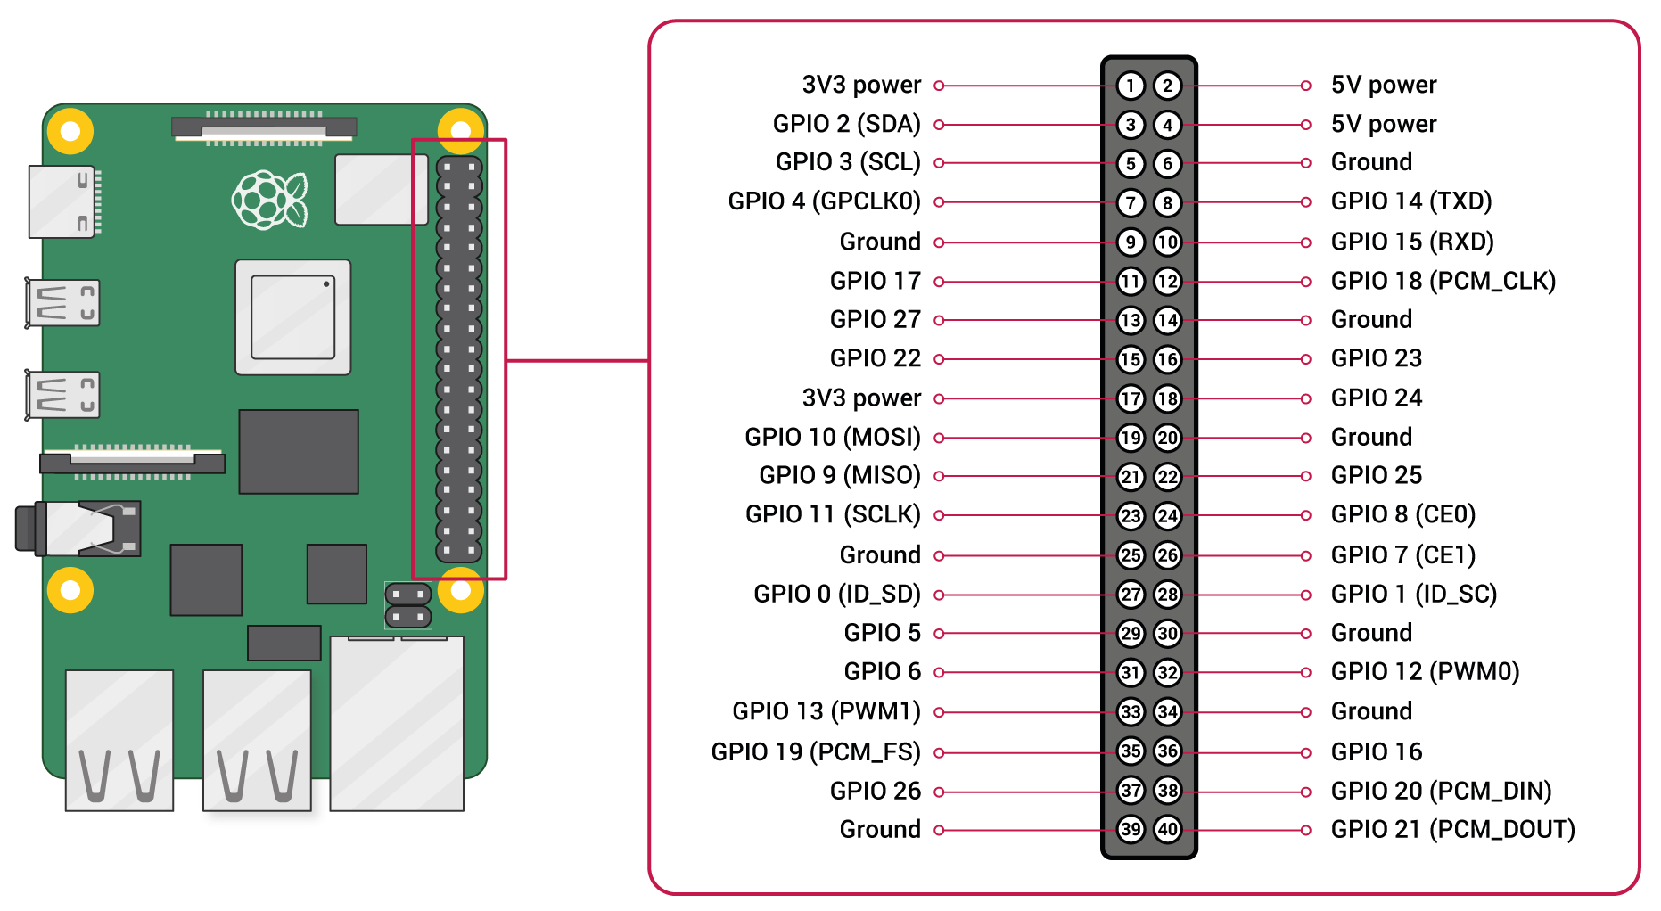
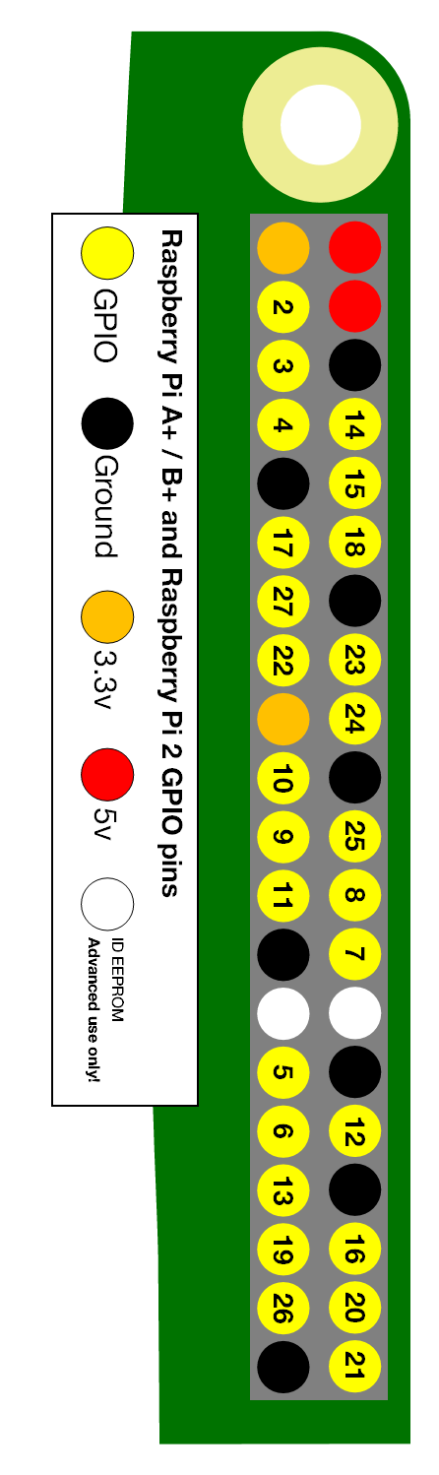
GPIO Available

Slide 31
Introducing GPIO on RPi4
Header - #include <linux/gpio.h>
Functions
static inline bool gpio_is_valid(int number)
check validity of GPIO number
static inline int gpio_request(unsigned gpio, const char *label)
allocate the GPIO number, the label is for sysfs
static inline void gpio_free(unsigned gpio)
deallocate the GPIO line
static inline int gpio_export(unsigned gpio, bool direction_may_change)
make available via sysfs and decide if it can change from input to output and vice versa
static inline void gpio_unexport(unsigned gpio)
remove from sysfs

Slide 32
Introducing GPIO on RPi4
static inline int gpio_direction_input(unsigned gpio)
an input line (as usual, return of 0 is success)
static inline int gpio_get_value(unsigned gpio)
get the value of the GPIO line
static inline int gpio_direction_output(unsigned gpio, int value)
value is the state
static void gpio_set_value(unsigned gpio, value)
Set the value of the GPIO line
static inline int gpio_set_debounce(unsigned gpio, unsigned debounce)
set debounce time in ms (platform dependent)
static inline int gpio_sysfs_set_active_low(unsigned gpio, int value)
set active low (invert operation states)
static inline int gpio_to_irq(unsigned gpio)
associate with an IRQ

Slide 33
Case Study – 1: Variable Frequency LED Toggle
Involves IOCTL, Kernel Timers and GPIO
Toggle an LED connected to GPIO_23 of your RPi4 in a specific periodicity
Use Kernel Timers to maintain toggle periodicity
Using IOCTL from the user space, change the frequency of toggling by sending out a command through the driver to the LED
Demonstrate…

Slide 34
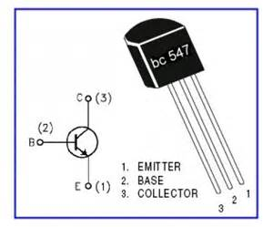
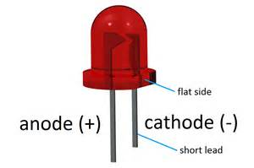
Required Circuit
VDD 3.3V
R = 100 Ohm
C
GPIO_23
B
E
DGND

Slide 35
Case Study – 2: Toggle an LED when Switch is Pressed
Connect a tactile switch to GPIO_24 on your RPi4
The switch should be pulled up, through a 15K Ohm resistor
Whenever the switch is pressed, an interrupt should be generated and in the handler, the LED should be toggled
Register the corresponding interrupt handler and IRQ number through GPIO access

Slide 36
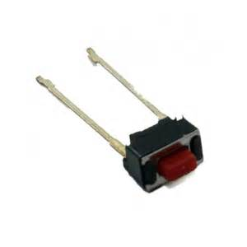
Required Circuit
VDD 3.3V
R = 100 Ohm
R = 15K Ohm
GPIO_24
C
GPIO_23
B
E
DGND

