Slide 1



SMART INDIA HACKATHON 2024
Problem Statement ID – 1605
Problem Statement Title- Women Safety Analytics - Protecting Women from safety threats
Theme- Miscellaneous
PS Category- Software
Team ID-
Team Name- Alpha

Slide 2
PROTECTING WOMEN FROM SAFETY THREATS
TEAM ALPHA
Advanced Real-Time Surveillance: The system leverages deep learning models deployed on edge devices for continuous, real-time video analytics, enabling precise person detection and gender classification across multiple environments.
Anomaly Detection Framework: A sophisticated anomaly detection mechanism identifies high-risk scenarios, such as instances where women are surrounded by groups of men, by analyzing spatial and temporal data in real-time.
Gesture Recognition and SOS Alerts: The system integrates gesture analytics, employing Convolutional Neural Networks (CNNs) and Long Short-Term Memory (LSTM) networks to detect distress signals and trigger immediate alerts to law enforcement.
Predictive Hotspot Mapping: Utilizes historical incident data and machine learning algorithms to forecast potential crime hotspots, optimizing resource allocation and preventive measures.
How it Addresses the Problem :
Proactive Crime Prevention: The solution anticipates and mitigates potential threats before they escalate, significantly reducing response times and enhancing public safety for women.
Comprehensive Safety Analysis: By combining real-time monitoring with predictive analytics, the system offers a holistic approach to safeguarding women in public spaces.
Innovation and Uniqueness:
Edge Computing for Scalability: The deployment of AI models on edge devices ensures low-latency processing and scalability across large urban areas without overwhelming central servers.
Multimodal Threat Detection: The integration of gender classification, anomaly detection, and gesture recognition within a unified framework provides a unique, multifaceted approach to women’s safety.

Slide 3
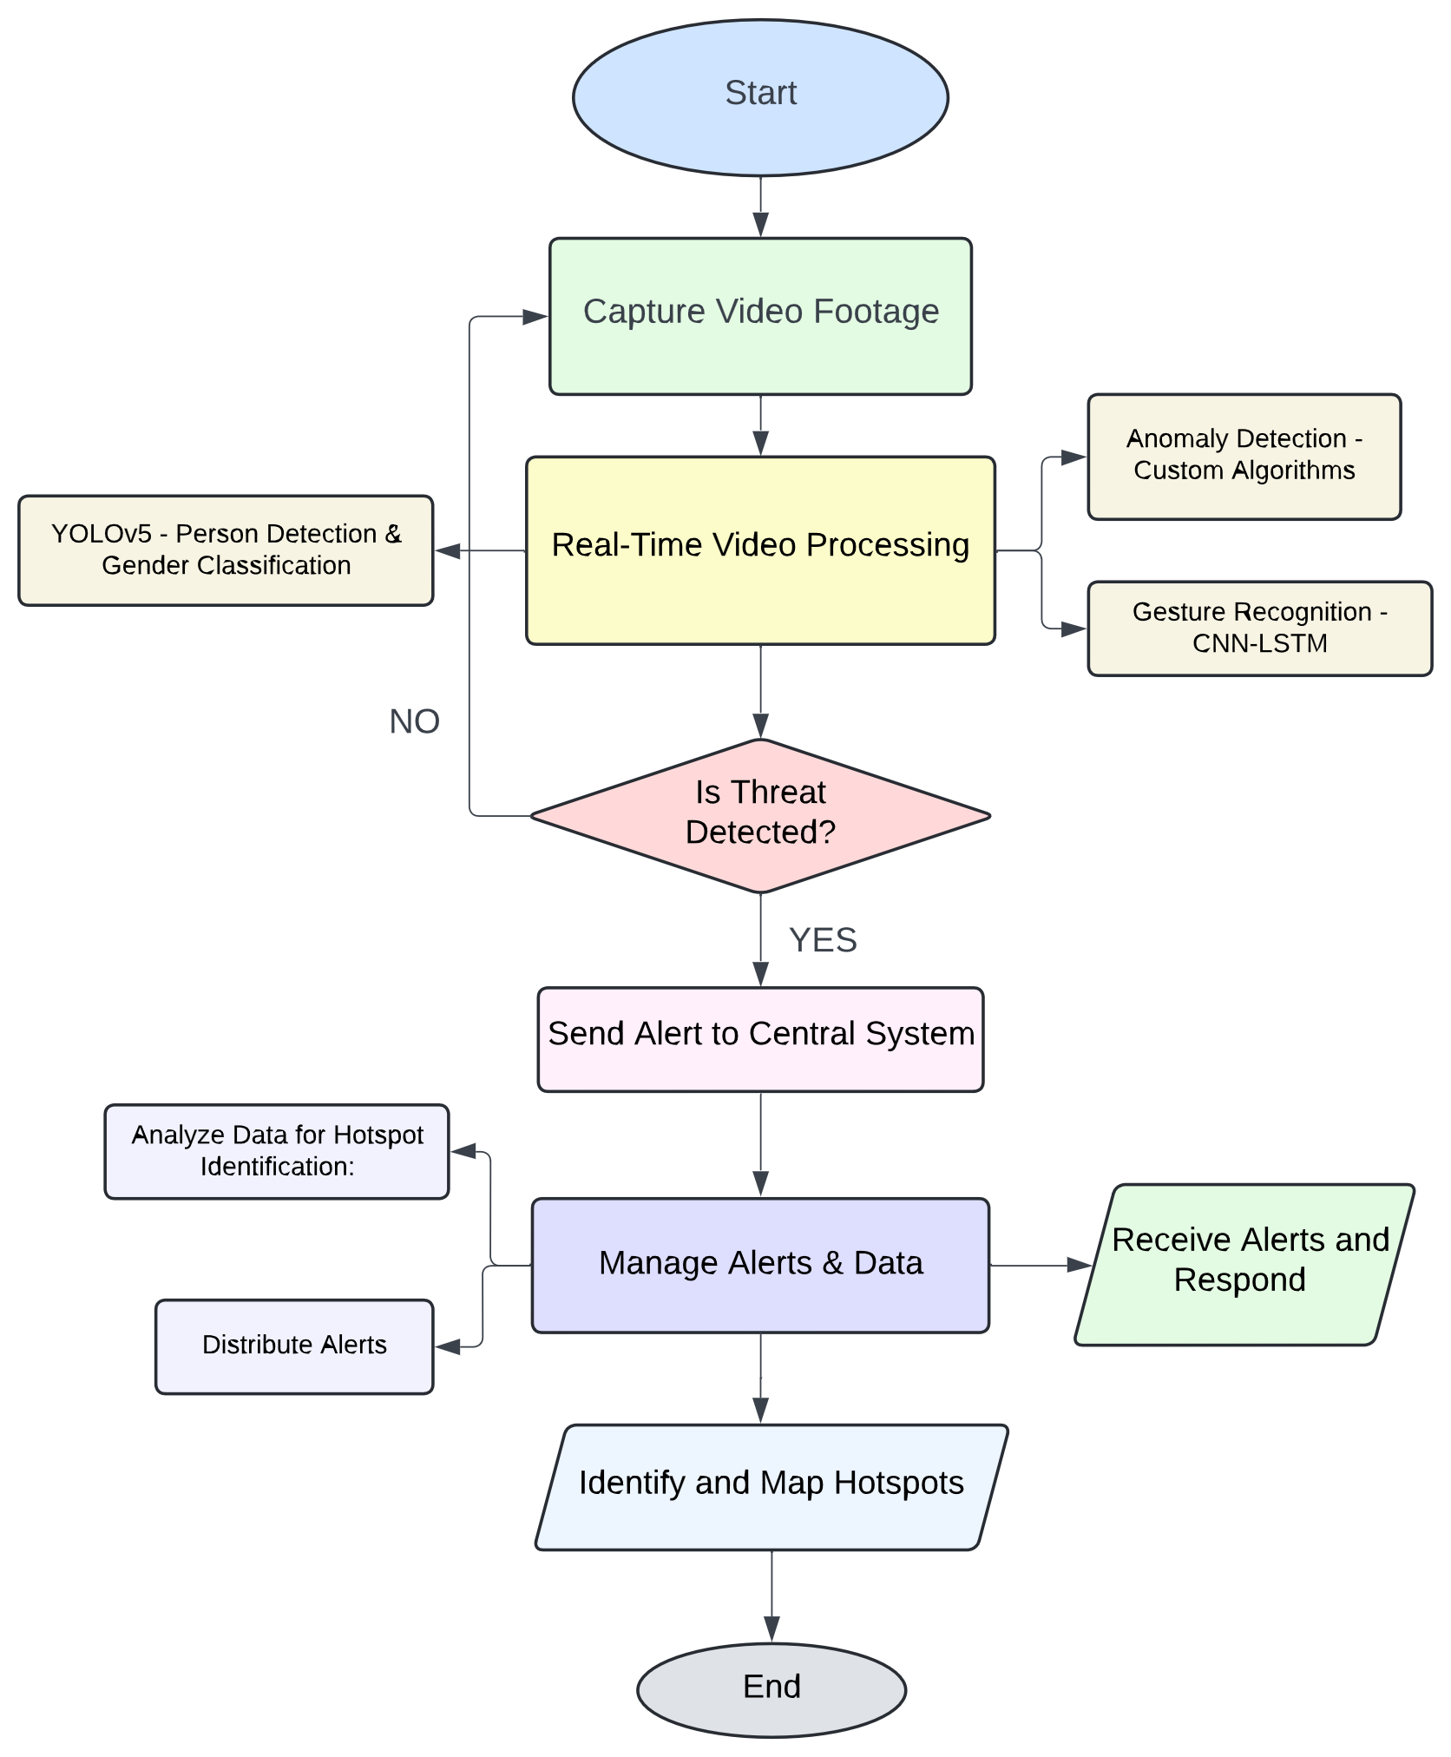
TECHNICAL APPROACH
TEAM ALPHA
Technologies Used:
Languages: Python, C++, JavaScript.
Frameworks: TensorFlow, PyTorch, OpenCV, Apache Kafka.
Hardware: NVIDIA Jetson TX2, CCTV Cameras, IoT Sensors.
Implementation Methodology
Data Acquisition: Continuous video feed and contextual IoT data.
Model Development:
-YOLOv5 for person detection and gender classification.
-Custom Algorithms for anomaly detection.
-CNN-LSTM for gesture recognition.
Deployment: AI models on edge devices, Kafka-based alert system.
Hotspot Analysis: Predictive models using historical data.
3

Slide 4


TEAM ALPHA
FEASIBILITY AND VIABILITY
Analysis of the feasibility of the idea:
1.Technical: Scalable and robust due to edge computing.
2.Operational: Easy integration with existing infrastructure.
3.Economic: Cost-effective by minimizing central processing needs.
Potential challenges and risks
1.Data Privacy: Ensuring compliance with regulations.
2.Model Accuracy: Adapting to diverse environments.
3.Infrastructure: Managing computational and network constraints.
Strategies for overcoming these challenges
1.Security: Encryption, anonymization, access controls.
2.Continuous Improvement: Regular model updates.
3.Resilient Architecture: Redundant systems for reliability.
4

Slide 5
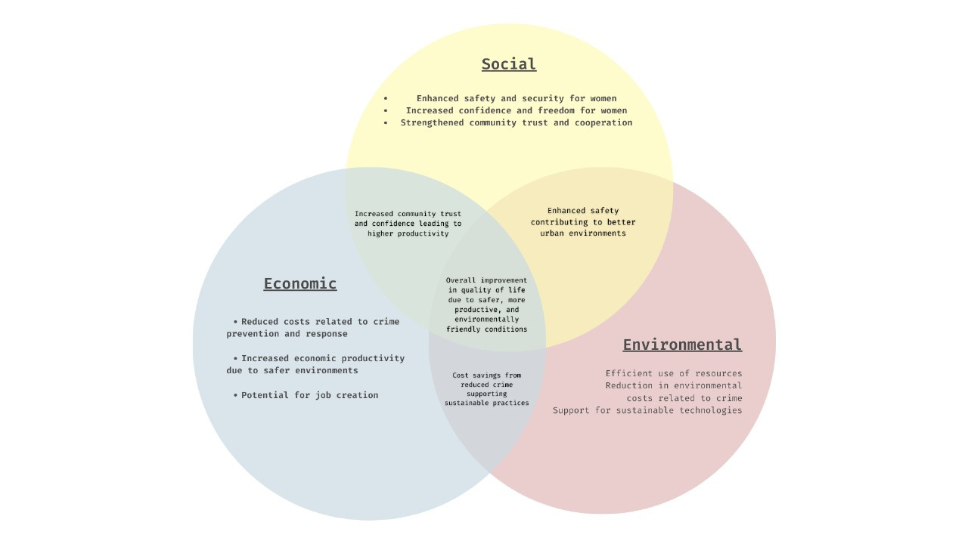
IMPACT AND BENEFITS
TEAM ALPHA
Potential Impact on the Target Audience
Enhanced Public Safety: The system significantly reduces the risk of violence against women by providing early warnings and facilitating timely intervention by law enforcement.
Empowerment of Women: By creating safer public spaces, the system fosters an environment where women can move freely and confidently, enhancing their overall quality of life.
5

Slide 6
TEAM ALPHA
RESEARCH AND REFERENCES
YOLOv5 and Faster R-CNN: Research papers on advanced object detection models and their application in real-world scenarios.
Gesture Recognition with CNN-LSTM: Technical documentation on hybrid deep learning models for human gesture recognition.
Edge Computing in Smart Surveillance: Case studies and whitepapers on the use of edge devices for scalable, real-time analytics.
Data Privacy in Surveillance Systems: Guidelines and best practices for ensuring compliance with GDPR and other relevant regulations.
@SIH Idea submission- Template
6

