Slide 1
MOS Capacitors
ECE 2204

Slide 2
Some Classes of Field Effect Transistors
Metal-Oxide-Semiconductor Field Effect Transistor
MOSFET, which will be the type that we will study in this course.
Metal-Semiconductor Field Effect Transistor
MESFET, typically fabricated with III-V semiconductors
Junction Field Effect Transistor
JFET, resilient to electrostatic discharge (ESD)
High Electron Mobility Transistor or Modulation Doped Field Effect Transistor
HEMT or MODFET, typically fabricated with III-V semiconductors
Fast Reverse/Fast Recovery Epitaxial Diode
FREDFET
DNA Field Effect Transistor
The conduction path is through a strand of DNA

Slide 3
Field Effect Transistors
A voltage is applied to the gate of the transistor, which produces an electric field within the semiconductor.
Typically, the gate current is zero.
The conductivity (or resistivity) of the path between two contacts, the source and the drain, is altered by the voltage applied to the gate.
Device is also known as a voltage controlled resistor.

Slide 4
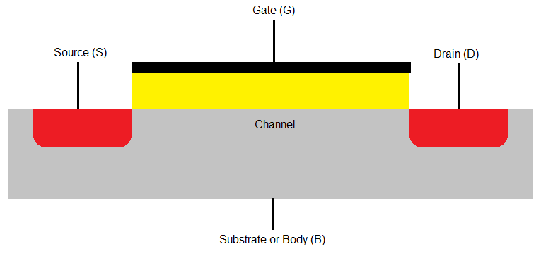
MOS Capacitor
Oxide
Semiconductor
The operation of a metal-oxide-semiconductor is used to explain the operation of the MOSFET.
In a MOSFET, the channel in the semiconductor, the oxide, and the gate metalization forms a MOS capacitor.
The structure looks like a parallel plate capacitor where one of the plates is the semiconductor and the other is the gate metalization. The insulator between the parallel plates is the oxide.

Slide 5
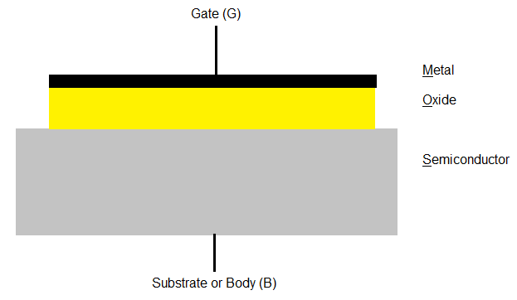
MOS Capacitor
ε_{OX} = ε_{ox} ε_{o} where ε_{ox} is the relative dielectric constant of the oxide.
t_{ox}
ε_{ox}
Notes:
<number>

Slide 6
Operation of a MOS Capacitor
In the following analysis, it is assumed that the channel in the semiconductor is lightly doped with acceptors (i.e., p type).
There are three regions of operation
Accumulation (in this case, V_{G} < 0 V)
Depletion (in this case, 0 V ≤ V_{G} ≤ V_{TN})
Inversion (in this case, V_{G} ≥ V_{TN})

Slide 7
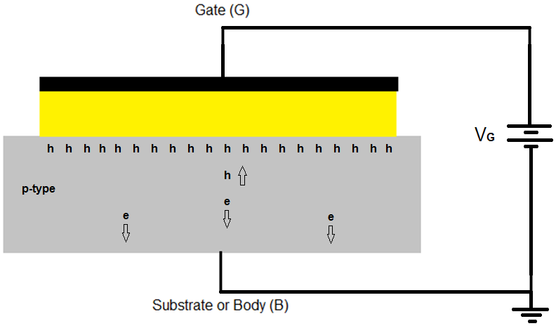
Accumulation (V_{G} < 0 V)
An electric field E is induced by the applied voltage V_{G}.
More holes are at the oxide-semiconductor interface than expected from the concentration of acceptors.
Holes are attracted to interface by the negative gate voltage.
Electrons are repelled towards the body contact.

Slide 8
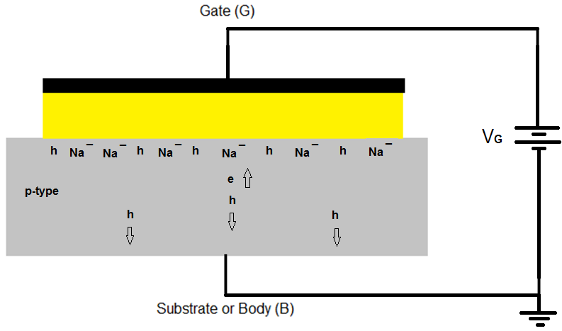
Depletion (0 V < V_{G} ≤ V_{TN})
The induced electric field E causes the concentration of holes at the oxide-semiconductor interface to be smaller than the acceptor concentration and the electron concentration to be greater than expected.

Slide 9
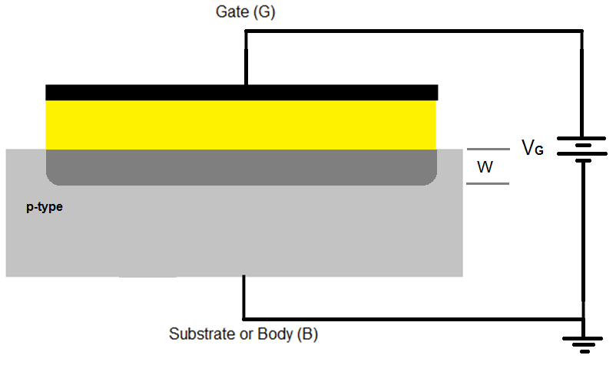
Depletion Mode Capacitance
The unscreened acceptors and a higher than expected electron concentration at the oxide semiconductor interface induce an electric field in the semiconductor, producing a depletion region to form.

Slide 10
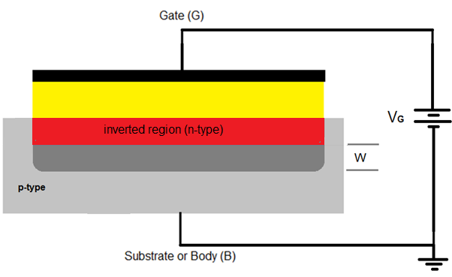
Inversion (V_{G} ≥ V_{TN})
The gate voltage is large enough that the concentration of electrons at the oxide-semiconductor interface is greater than the concentration of holes.
The type of the semiconductor has effectively been converted from p-type to n-type. The voltage when n = p at the oxide-semiconductor interface is called the threshold voltage, V_{TN}.

Slide 11
Inversion Mode Capacitance
A depletion region still exists in the semiconductor, but is now located between the inverted (n-type) region and the remaining p-type semiconductor.
The thickness of the depletion region W is constant, even if V_{G} increases so the magnitude of the MOS capacitance is constant.

Slide 12
MOS Capacitance
Is largest in the accumulation mode when V_{G} ≤ 0 V
Is smallest in the inversion mode when V_{G} ≥ V_{TN}
Varies with V_{G} in the depletion mode

Slide 13
Questions
If the acceptor concentration is increased, will be threshold voltage have to increase or decrease?
Do you expect the threshold voltage to increase or decrease as the temperature of the MOS capacitor is increased?
Can you explain how the electron and hole concentration varies with V_{G} if the semiconductor is initially n-type instead of p-type?

