Slide 1

University Institute of Engineering
DEPARTMENT OF COMPUTER SCIENCE & ENGINEERING
Bachelor of Engineering (Computer Science & Engineering)
Subject Name : Machine Learning
Subject Code: CST-316
Topic: Dimensionality Reduction(CO4,CO5)
Lecture-3.5
DISCOVER . LEARN . EMPOWER

Slide 2
Course Outcomes
CO-1:Apply the basic concept of Machine learning and statistics learning to deal with real-life Problems.
CO-2: Understand different machine learning algorithms, as well as underlying theories the behind them.
CO-3: Select and apply the appropriate machine learning algorithm to solve problems of moderate complexity
CO-4: Interpret and evaluate models generated from data.
CO-5: Optimize the models learned and report on the expected accuracy that can be attained by applying the algorithms to a real-world problem.

Slide 3
Course Objectives
To understand the history and development of Machine Learning.
To provide a comprehensive foundation to Machine Learning and Optimization methodology with applications t.
To study learning processes: supervised and unsupervised, deterministic and statistical knowledge of Machine learners, and ensemble learning
To understand modern techniques and practical trends of Machine learning.

Slide 4
Dimensionality reduction
In machine learning classification problems, there are often too many factors on the basis of which the final classification is done.
These factors are basically variables called features.
The higher the number of features, the harder it gets to visualize the training set and then work on it.
Sometimes, most of these features are correlated, and hence redundant.
Dimensionality reduction is the process of reducing the number of random variables under consideration, by obtaining a set of principal variables.

Slide 5
Dimensionality reduction
Example
Email: Spam or not Spam
Features: whether or not the e-mail has a generic title, the content of the e-mail, whether the e-mail uses a template, etc.
Classification:
Dataset Features: Temperature, Humidity, Rainfall etc..
Dimensionality reduction can be divided into:
Feature selection :
Find a subset of the original set of variables, or features, to get a smaller subset which can be used to model the problem.
Feature extraction/scaling:
This reduces the data in a high dimensional space to a lower dimension space, i.e. a space with lesser no. of dimensions.

Slide 6
Feature Selection
Higher dimensional data sets increase the time complexity and also the space required will be more.
Also, all the features in the dataset might not be useful.
Some may contribute no information at all, while some may contribute similar information as the other features.
Selecting the optimal set of features will help us hence reduce the space and time complexity as well as increase the accuracy or purity of classification (or regression) and clustering (or association) for supervised and unsupervised learning respectively.

Slide 7
Feature Selection
Also called Variable Selection and Attribute Selection.
Task of selecting a subset of relevant features for use in model construction
It is used to identify and remove unneeded, irrelevant and redundant attributes from data.
It has Four approaches
Wrapper method
Filter Method
Embedded Method
Hybrid Method

Slide 8
Feature Selection Approaches
Wrapper method
It considers the selection of a set of features as a search problem, where different combinations are prepared, evaluated and compared to other combinations.
A predictive model is used to evaluate a combination of features and assign a score based on model accuracy.
Eg: Best Fit Search and Random Hill Climbing
Filter Method
Applies a statistical measure to assign a scoring to each feature.
Features are ranked by the score and either selected or rejected from the dataset.
Eg: Correlation Coefficient Scores, Chi Square Test

Slide 9
Feature Selection Approaches
Embedded method
The applied learning algorithms determine the specificity of this approach
It selects the features during the process of training the data set.
Hybrid Method
Both filter and wrapper-based methods are used in hybrid approach.
This approach first selects the possible optimal feature set which is further tested by the wrapper approach.
It hence uses the advantages of both filter and wrapper-based approach.

Slide 10
Parameters for Feature Selection
The parameters are classified based on two factors:
The Similarity of information contributed by the features :
Correlation
Quantum of information contributed by the features :
Entropy
Mutual Information

Slide 11
Parameters for Feature Selection
Correlation
Features may be correlated and may have some correlation factor.
If f1 and f2 are two correlated features of a data set, then the classifying or regression model including both f1 and f2 will give the same as the predictive model compared to the scenario where either f1 or f2 was included in the dataset.
This is because both f1 and f2 are correlated Only one representative can be considered
Method of finding Correlation: Pearson’s correlation coefficient(ρ)
where ,
cov(X, Y) - covariance
σ(X) - standard deviation of X
σ(Y) - standard deviation of Y

Slide 12
Parameters for Feature Selection
Entropy
It is the measure of the average information content.
The higher the entropy, the higher is the information contribution by that feature. Entropy (H) can be formulated as:
To calculate Entropy of feature fi: Exclude fi and calculate entropy for rest of the features.
If Entropy is low, then the information by feature fi is high.
Entropy is mostly used for Unsupervised Learning
Where, X - discrete random variable X
P(X) - probability mass function
E - expected value operator,
I - information content of X.
I(X) - a random variable.

Slide 13
Parameters for Feature Selection
Mutual Information
Amount of uncertainty in X due to the knowledge of Y.
It is calculated as:
where
p(x, y) - joint probability function of X and Y,
p(x) - marginal probability distribution function of X
p(y) - marginal probability distribution function of Y
Calculated to know the amount of information shared about the class by a feature.
Mostly used for dimensionality reduction in Supervised Learning

Slide 14
Feature Scaling
Feature Scaling is a technique to standardize the independent features present in the data in a fixed range.
It is performed during the data pre-processing.
Feature Scaling Algorithms will scale Age, Salary, BHK in fixed range say [-1, 1] or [0, 1].
And then no feature can dominate other.
If feature scaling is not done, then a machine learning algorithm tends to weigh greater values, higher and consider smaller values as the lower values, regardless of the unit of the values.

Slide 15
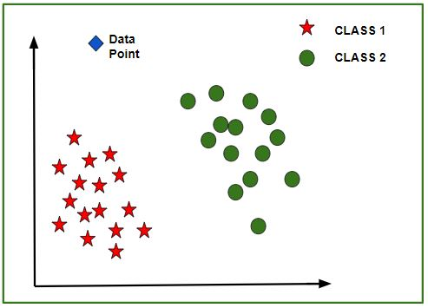
Without Feature Scaling
Eg: Classes: Yes or No
Prediction of the class of new data point:
The model calculates the distance of this data point from the centroid of each class group.
Finally this data point will belong to that class, which will have a minimum centroid distance from it.

Slide 16
Feature Scaling
Example:
If an algorithm is not using feature scaling method then it can consider the value 3000 meter to be greater than 5 km but that’s actually not true and in this case, the algorithm will give wrong predictions.
So, we use Feature Scaling to bring all values to same magnitudes and thus, tackle this issue.

Slide 17
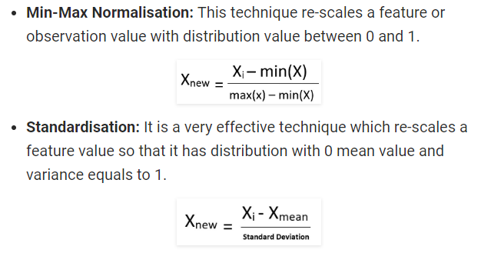
Techniques for Feature Scaling

Slide 18
Methods of Dimensionality Reduction
Dimensionality reduction may be both linear or non-linear, depending upon the method used.
The various methods used for dimensionality reduction include:
Principal Component Analysis (PCA)
Linear Discriminant Analysis (LDA)
Generalized Discriminant Analysis (GDA)
Most Common Linear Method:
Principal Component Analysis (PCA)

Slide 19
Pros and cons of Dimensionality Reduction
Advantages of Dimensionality Reduction
It helps in data compression, and hence reduced storage space.
It reduces computation time.
It also helps remove redundant features, if any.
Disadvantages of Dimensionality Reduction
It may lead to some amount of data loss.
PCA tends to find linear correlations between variables, which is sometimes undesirable.
PCA fails in cases where mean and covariance are not enough to define datasets.
We may not know how many principal components to keep- in practice, some thumb rules are applied.

Slide 20
References
Books and Journals
Understanding Machine Learning: From Theory to Algorithms by Shai Shalev-Shwartz and Shai Ben-David-Cambridge University Press 2014
Introduction to machine Learning – the Wikipedia Guide by Osman Omer.
Video Link-
https://www.youtube.com/watch?v=cowHdW2-RkU
https://www.youtube.com/watch?v=3uxOyk-SczU
Web Link-
https://towardsdatascience.com/11-dimensionality-reduction-techniques-you-should-know-in-2021-dcb9500d388b
https://www.geeksforgeeks.org/dimensionality-reduction/
https://machinelearningmastery.com/dimensionality-reduction-for-machine-learning/

