Slide 1

University Institute of Engineering
DEPARTMENT OF COMPUTER SCIENCE & ENGINEERING
Bachelor of Engineering (Computer Science & Engineering)
Subject Name : Machine Learning
Subject Code: CST-316
Topic: Reinforcement Learning(CO2,CO3)
Lecture-3.7
DISCOVER . LEARN . EMPOWER

Slide 2
Course Outcomes
CO-1:Apply the basic concept of Machine learning and statistics learning to deal with real-life Problems.
CO-2: Understand different machine learning algorithms, as well as underlying theories the behind them.
CO-3: Select and apply the appropriate machine learning algorithm to solve problems of moderate complexity
CO-4: Interpret and evaluate models generated from data.
CO-5: Optimize the models learned and report on the expected accuracy that can be attained by applying the algorithms to a real-world problem.

Slide 3
Course Objectives
To understand the history and development of Machine Learning.
To provide a comprehensive foundation to Machine Learning and Optimization methodology with applications t.
To study learning processes: supervised and unsupervised, deterministic and statistical knowledge of Machine learners, and ensemble learning
To understand modern techniques and practical trends of Machine learning.

Slide 4
Reinforcement Learning
Reinforcement Learning is defined as a Machine Learning method that is concerned with how software agents should take actions in an environment. Reinforcement Learning is a part of the deep learning method that helps you to maximize some portion of the cumulative reward.
This neural network learning method helps you to learn how to attain a complex objective or maximize a specific dimension over many steps.

Slide 5
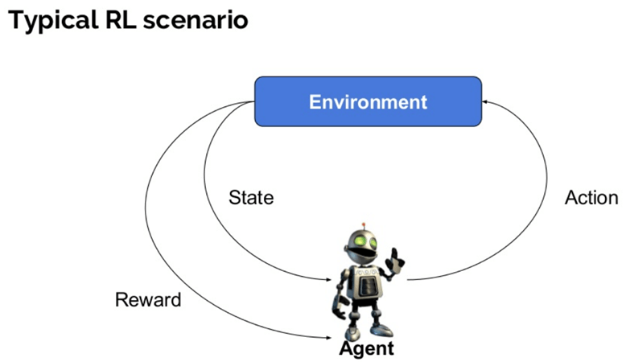
Important Components of Reinforcement Learning Method

Slide 6
Here are some important terms used in Reinforcement AI
Agent: It is an assumed entity which performs actions in an environment to gain some reward.
Environment (e): A scenario that an agent has to face.
Reward (R): An immediate return given to an agent when he or she performs specific action or task.
State (s): State refers to the current situation returned by the environment.
Policy (π): It is a strategy which applies by the agent to decide the next action based on the current state.
Value (V): It is expected long-term return with discount, as compared to the short-term reward.
Value Function: It specifies the value of a state that is the total amount of reward. It is an agent which should be expected beginning from that state.
Model of the environment: This mimics the behavior of the environment. It helps you to make inferences to be made and also determine how the environment will behave.
Model based methods: It is a method for solving reinforcement learning problems which use model-based methods.
Q value or action value (Q): Q value is quite similar to value. The only difference between the two is that it takes an additional parameter as a current action.

Slide 7
How Reinforcement Learning works?
Let’s see some simple example which helps you to illustrate the reinforcement learning mechanism.
Consider the scenario of teaching new tricks to your cat
As cat doesn’t understand English or any other human language, we can’t tell her directly what to do. Instead, we follow a different strategy.
We emulate a situation, and the cat tries to respond in many different ways. If the cat’s response is the desired way, we will give her fish.
Now whenever the cat is exposed to the same situation, the cat executes a similar action with even more enthusiastically in expectation of getting more reward(food).
That’s like learning that cat gets from “what to do” from positive experiences.
At the same time, the cat also learns what not do when faced with negative experiences.

Slide 8
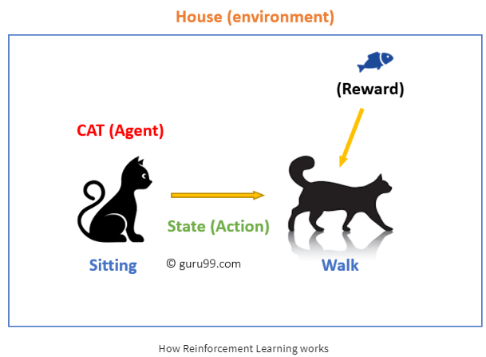
Example of Reinforcement Learning

Slide 9
In this case…
Your cat is an agent that is exposed to the environment. In this case, it is your house. An example of a state could be your cat sitting, and you use a specific word in for cat to walk.
Our agent reacts by performing an action transition from one “state” to another “state.”
For example, your cat goes from sitting to walking.
The reaction of an agent is an action, and the policy is a method of selecting an action given a state in expectation of better outcomes.
After the transition, they may get a reward or penalty in return.

Slide 10
Reinforcement Learning Algorithms
There are three approaches to implement a Reinforcement Learning algorithm.
Value-Based:
In a value-based Reinforcement Learning method, you should try to maximize a value function V(s). In this method, the agent is expecting a long-term return of the current states under policy π.
Policy-based:
In a policy-based RL method, you try to come up with such a policy that the action performed in every state helps you to gain maximum reward in the future.
Model-Based:
In this Reinforcement Learning method, you need to create a virtual model for each environment. The agent learns to perform in that specific environment.

Slide 11
Characteristics of Reinforcement Learning
There is no supervisor, only a real number or reward signal
Sequential decision making
Time plays a crucial role in Reinforcement problems
Feedback is always delayed, not instantaneous
Agent’s actions determine the subsequent data it receives

Slide 12
Types of Reinforcement Learning
Two types of reinforcement learning methods are:
Positive:
It increases the strength and the frequency of the behavior and impacts positively on the action taken by the agent.
This type of Reinforcement helps you to maximize performance and sustain change for a more extended period.
Negative:
It is defined as strengthening of behavior that occurs because of a negative condition which should have stopped or avoided. It helps you to define the minimum stand of performance.

Slide 13
Learning Models of Reinforcement
There are two important learning models in reinforcement learning:
Markov Decision Process
Q learning

Slide 14
Markov Decision Process
The following parameters are used to get a solution:
Set of actions- A
Set of states -S
Reward- R
Policy- n
Value- V
The mathematical approach for mapping a solution in reinforcement Learning is recon as a Markov Decision Process or (MDP).

Slide 15
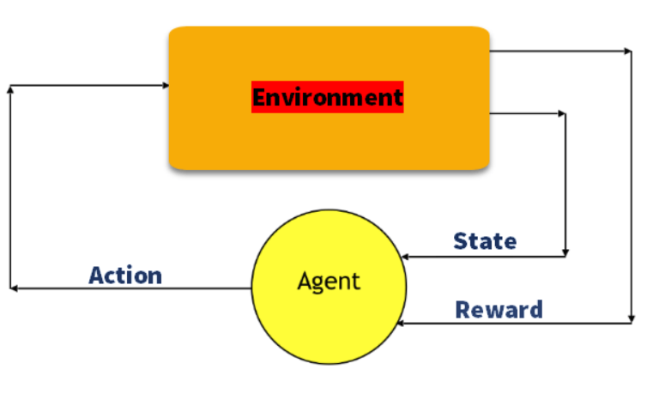
Markov Decision Process

Slide 16
Q-Learning
Q learning is a value-based method of supplying information to inform which action an agent should take.
Let’s understand this method by the following example:
There are five rooms in a building which are connected by doors.
Each room is numbered 0 to 4
The outside of the building can be one big outside area (5)
Doors number 1 and 4 lead into the building from room 5

Slide 17
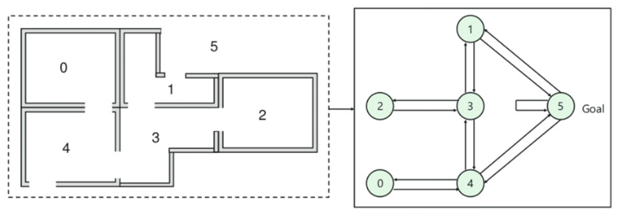
Explanation….
In this image, you can view that room represents a state
Agent’s movement from one room to another represents an action
In the below-given image, a state is described as a node, while the arrows show the action.

Slide 18
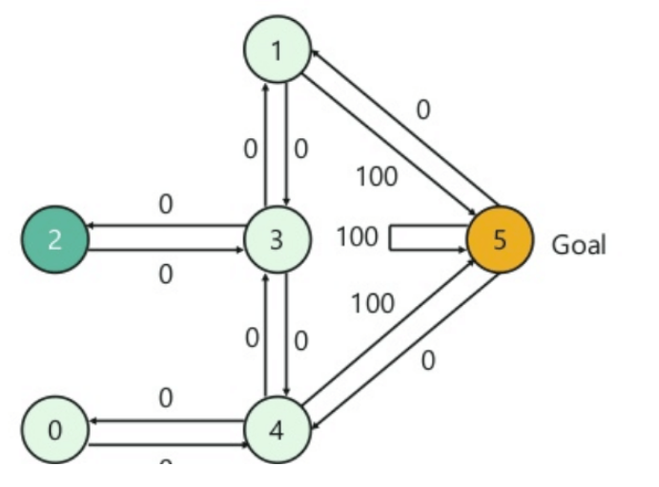
Next, you need to associate a reward value to each door:
Doors which lead directly to the goal have a reward of 100
Doors which is not directly connected to the target room gives zero reward
As doors are two-way, and two arrows are assigned for each room
Every arrow in the above image contains an instant reward value
For example, an agent traverse from room number 2 to 5
Initial state = state 2
State 2-> state 3
State 3 -> state (2,1,4)
State 4-> state (0,5,3)
State 1-> state (5,3)
State 0-> state 4

Slide 19
Reinforcement Learning vs. Supervised Learning
Parameters | Reinforcement Learning | Supervised Learning
Decision style | reinforcement learning helps you to take your decisions sequentially. | In this method, a decision is made on the input given at the beginning.
Works on | Works on interacting with the environment. | Works on examples or given sample data.
Dependency on decision | In RL method learning decision is dependent. Therefore, you should give labels to all the dependent decisions. | Supervised learning the decisions which are independent of each other, so labels are given for every decision.
Best suited | Supports and work better in AI, where human interaction is prevalent. | It is mostly operated with an interactive software system or applications.
Example | Chess game | Object recognition

Slide 20
Applications of Reinforcement Learning
Here are applications of Reinforcement Learning:
Robotics for industrial automation.
Business strategy planning
Machine learning and data processing
It helps you to create training systems that provide custom instruction and materials according to the requirement of students.
Aircraft control and robot motion control

Slide 21
Why use Reinforcement Learning?
Here are prime reasons for using Reinforcement Learning:
It helps you to find which situation needs an action
Helps you to discover which action yields the highest reward over the longer period.
Reinforcement Learning also provides the learning agent with a reward function.
It also allows it to figure out the best method for obtaining large rewards.

Slide 22
Challenges of Reinforcement Learning
Here are the major challenges you will face while doing Reinforcement earning:
Feature/reward design which should be very involved
Parameters may affect the speed of learning.
Realistic environments can have partial observability.
Too much Reinforcement may lead to an overload of states which can diminish the results.
Realistic environments can be non-stationary.

Slide 23
Summary
Reinforcement Learning is a Machine Learning method
Helps you to discover which action yields the highest reward over the longer period.
Agent, State, Reward, Environment, Value function Model of the environment, Model based methods, are some important terms using in RL learning method
The biggest characteristic of this method is that there is no supervisor, only a real number or reward signal
Two types of reinforcement learning are 1) Positive 2) Negative
Two widely used learning model are 1) Markov Decision Process 2) Q learning
Reinforcement Learning method works on interacting with the environment, whereas the supervised learning method works on given sample data or example.

Slide 24
References
Books and Journals
Understanding Machine Learning: From Theory to Algorithms by Shai Shalev-Shwartz and Shai Ben-David-Cambridge University Press 2014
Introduction to machine Learning – the Wikipedia Guide by Osman Omer.
Video Link-
https://www.youtube.com/watch?v=b-yhKUINb7o
https://www.youtube.com/watch?v=R46XvFLJ5ZM
Web Link-
https://towardsdatascience.com/introduction-to-various-reinforcement-learning-algorithms-i-q-learning-sarsa-dqn-ddpg-72a5e0cb6287
https://smartlabai.medium.com/reinforcement-learning-algorithms-an-intuitive-overview-904e2dff5bbc
https://www.guru99.com/reinforcement-learning-tutorial.html

