Slide 1
BIBLIOTECA (Based on Library Management System)
Submitted by-
ANAND (190720204001)
SAHIL KAUNDAL (180710204031)
SUMIT CHANDEL (180710204041)
ROHIT KUMAR (190720204008)
SONIA SHARMA (180710204040)
SHIVANI DEVI (180710204038)

Slide 2
INTRODUCTION
Biblioteca is an online website where admin can maintain all the records of books of a library and students can search, place order for the reservation of required book. Website provides simplest methods for storing and searching/fetching of all records. Admin can add or remove the books, students from the record easily. Students can also able to get all the facilities after 1st time getting the login credentials form the admin. This web application is user friendly i.e., admin can easily maintain all the records of books online rather than maintaining it manually.

Slide 3
ABSTRACT
Admin(librarian) can store and maintain all the library records easily also students will be able to search whether the required book is available in the library or not, also students will be able to place order for the reservation of required book if it is available in the library. The website provides a user-friendly interface for both admin and user. Admin can easily view, add, delete, update all the library records. Admin can register by creating an account and can login after creating account through username and password. Also, admin has provided a functionality to issue login credentials to the students when they got registered in Library so that they can access all the resources available for students. Website also includes an easy search option via which both admin and user can easily search for the required book from all the available books.

Slide 4
Project Overview
The Project named “BIBLIOTECA” keeps track and maintain all the information of the library like books, registered students etc, it also helps students to find whether the required book is available in the library or not also students can place order for the reservation of the required book. The user will find it easy to store and retrieve the information in this automated system rather than using the manual writing system. The system is user-friendly and error free. This project is also helpful for students to find and apply for the reservation of required book. The software will be able to handle all the necessary information.

Slide 5
Advantages are as follows:
No need of maintaining records in registers manually.
User Interface is so easy, so no one would have problem to understand the functionality of Project.
This website is easy to use.
Long term storage of records.
User friendly interface.
Easy to operate.
Fast access to database.
Minimal errors.
Saves lot of time and manpower.
Saves money

Slide 6
EXISTING SYSTEM
It is a detailed study of the various operations performed by a system which is currently working and their relationship within and outside of the system. Here the key question is what all problems exist in the present system? What must be done to solve the problem? Analysis begins when a user or management begins a study of the program using existing system. Training, experience and common sense are required for collection of relevant information needed to develop the system. The success of the system depends largely on how clearly the problem is defined thoroughly investigated and properly carried out through the choice of solution. A good analysis model should provide not only the mechanisms of problem understanding but also the frame work of the solution. Thus, it should be studied thoroughly by collecting data about the system then the proposed system should be analyzed thoroughly in accordance with the needs.

Slide 7
PROPOSED SYSTEM
In our proposed system i.e., Biblioteca the admin (Librarian) will be able to maintain and keep track of all the library record online also user(students) will be able to search whether the required book is available in the library or not also they can place order for the reservation of the required book and if the request is approved by admin, then user can go to the library and take his/her book. Proposed system provides easy search option which will help them to search the required book form all the available books by just typing book name. It also provides admin the functionality of registering and issuing of login credentials to students so that they can login into their account and access and use all the options available for students. The admin (Librarian) will be able to view, add, delete, edit books and registered student records. The main motive of the website is to provide an automated system for users to maintain all the library records.

Slide 8
Technologies Used
FRONT END
In this Project HTML-5, CSS, JAVASCRIPT are used in front-end of website. Front-end is a front-end web developer is responsible for implementing visual elements that users see and interact with in a web application. They are usually supported by back-end web developers, who are responsible for server-side application logic and integration of the work front-end developers do.
HTML
HTML or Hyper Text Mark-up Language is the standard mark-up language used to create web pages HTML is written in the form of HTML elements consisting of tags enclosed in angle brackets (like <html>). HTML tags most commonly come in pairs like <hl> and </h]>, although some tags represent empty elements and so are unpaired, for example <img>. The ﬁrst tag in a pair is the start tag, and the second tag is the end tag (they are also called opening tags and closing lags). HTML is the Web’s core language for creating content for everyone to use anywhere HTML stands for Hypertext Markup Language, and it is the most widely used language to write Web Pages.

Slide 9
Technologies Used PHP
The PHP framework can be defined as a language platform designed to provide a number of rich and powerful application development tools and technologies. It has an extensive class library that provides wide-ranging support for data access. PHP framework has a dependent code execution and management environment called the WAMP server which compile the PHP code and forward it to the browser and provides an abstract layer on top of the operating system, which allows the elements of the PHP framework to run on many operating systems and devices.
PHP is a recursive acronym for "PHP: Hypertext Pre-processor". PHP is a server-side scripting language that is embedded in HTML. It is used to manage dynamic content, databases, session tracking, even build entire e commerce sites.
It is integrated with a number of popular databases, including My SQL, PostgreSQL SQL, Oracle, Sybase, Informix, and Microsoft SQL Server.

Slide 10
Technologies Used MYSQL
MySQL is an open-source relational database management system (RDBMS). Its name is a combination of "My", the name of cofounder Michael Wideness's daughter, and "SQL", the abbreviation for Structured Query Language.
MySQL is free and open-source software under the terms of the GNU General Public License, and is also available under a variety of proprietary licenses. MySQL was owned and sponsored by the Swedish company MySQL AB, which was bought by Sun Microsystems (now Oracle Corporation). In 2010, when Oracle acquired Sun, Widenius forked the open-source MySQL project to create MariaDB.
MySQL is offered under two different editions: the open source MySQL Community Server and the proprietary Enterprise Server. MySQL Enterprise Server is differentiated by a series of proprietary extensions which install as server plugins, but otherwise shares the version numbering system and is built from the same code base.

Slide 11
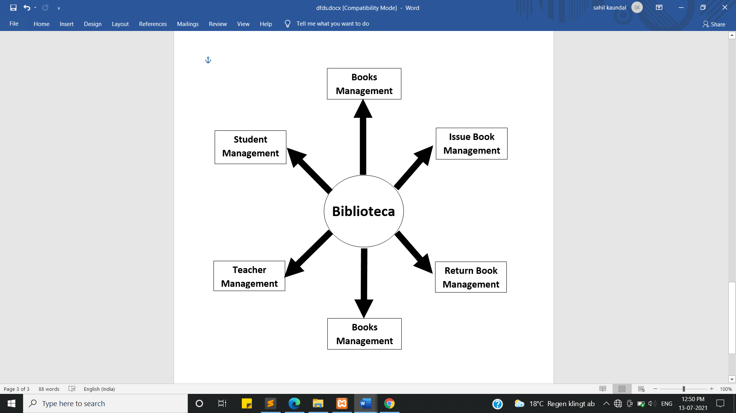
Data Flow Diagram

Slide 12
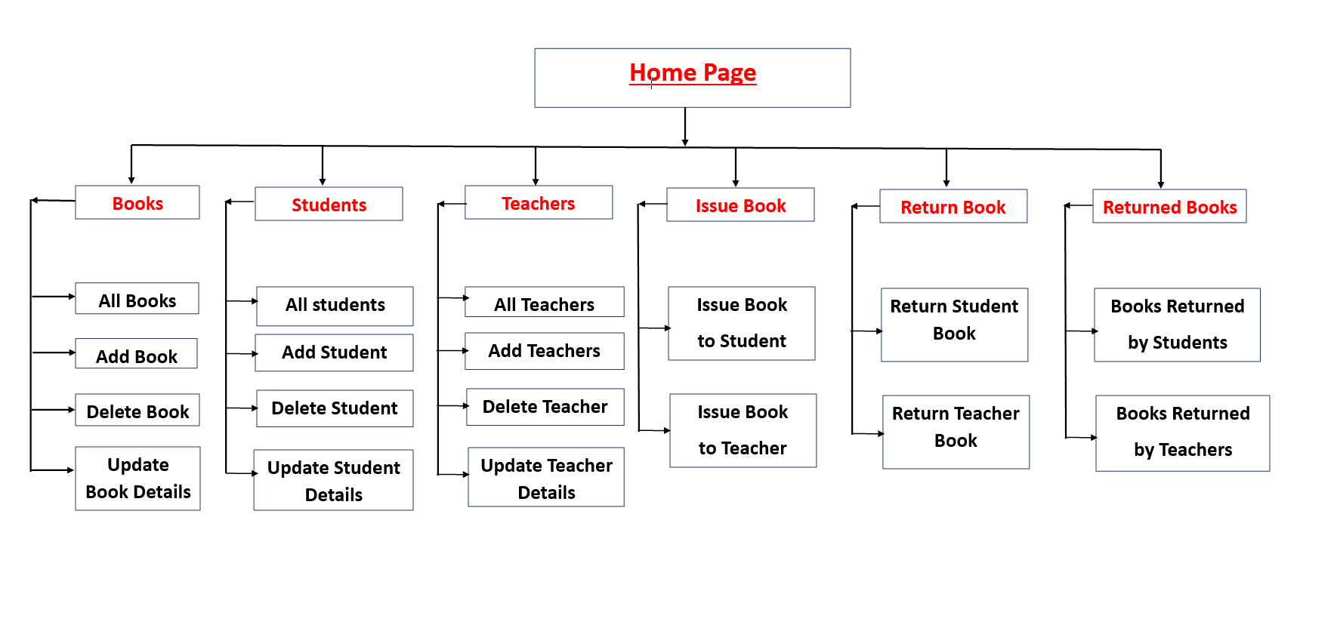
Data Flow Diagram

Slide 13
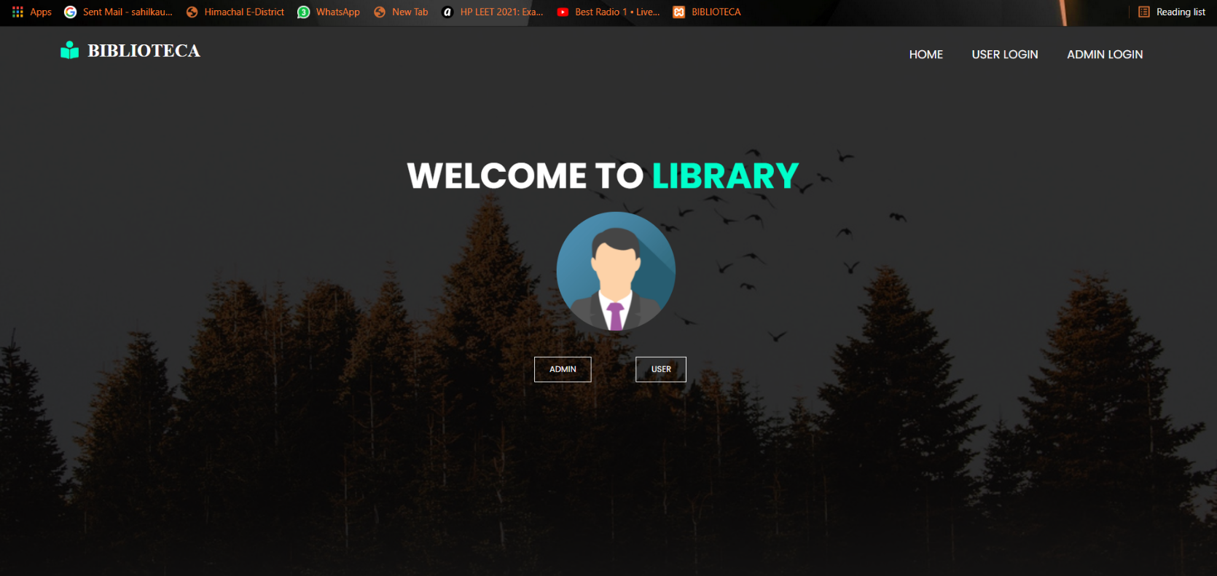
RESULT/OUTPUT
IMAGE: Welcome Page

Slide 14
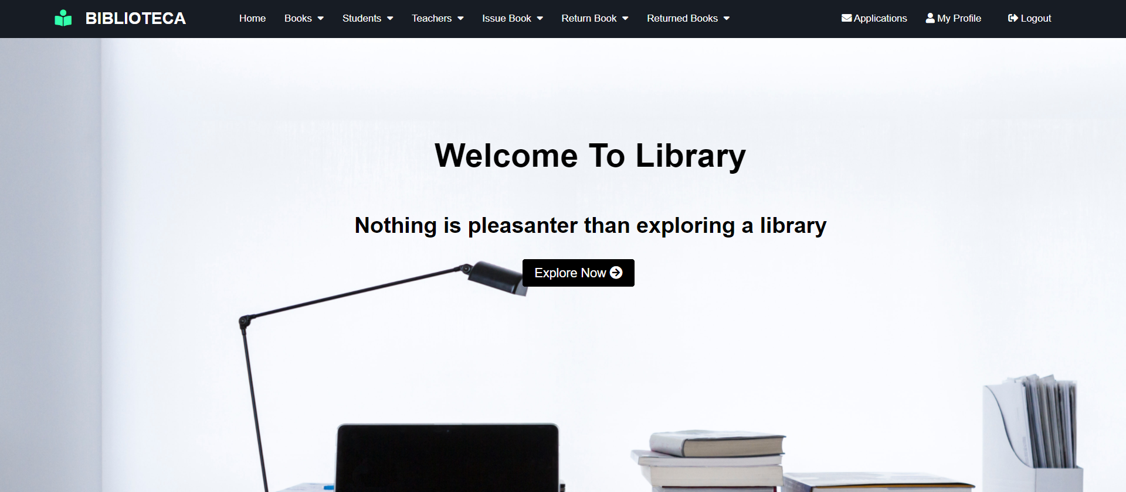
RESULT/OUTPUT
IMAGE: Admin Home Page

Slide 15
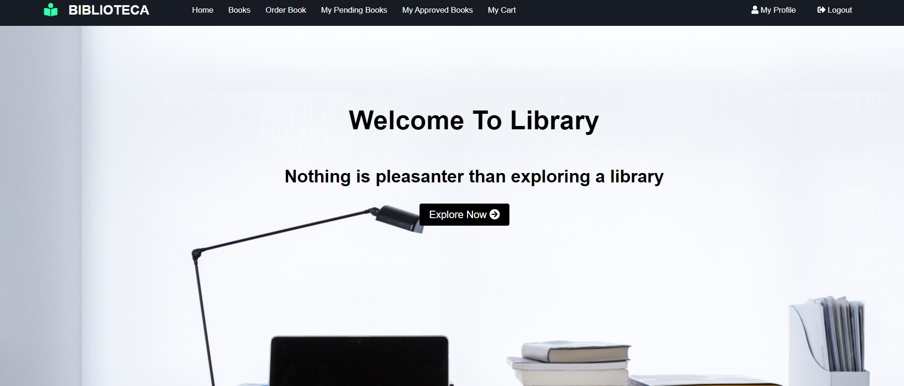
RESULT/OUTPUT
IMAGE: Student Home Page

Slide 16
CONCLUSION
The conclusion of this website is that admin(librarian) can store and maintain all the library records easily also students will be able to search whether the required book is available in the library or not, also students will be able to place order for the reservation of required book if it is available in the library. The website provides a user-friendly interface for both admin and user. Admin can easily view, add, delete, update all the library records. Admin can register by creating an account and can login after creating account through username and password. Also, admin has provided a functionality to issue login credentials to the students when they got registered in Library so that they can access all the resources available for students. Website also includes an easy search option via which both admin and user can easily search for the required book from all the available books.

Slide 17
Thank You

