Slide 1


CAPSTONE PROJECT
Submitted by: SAHIL KUMAR VISHWAKARMA
Submission type : Individual
Name: SAHIL KUMAR VISHWAKARMA
Batch : 1
LMS Id : halosahil@gmail.com
Program : HDFC API DEVELOPER PROGRAMME
Date: 28/04/2023

Slide 2

Table of Contents
Table of contents
Introduction
Project Overview
Architecture Design
Back-end Development
Testing
Deployment
Conclusion
Future Work
References
Appendices

Slide 3
Introduction
Problem statement: Many companies have sensitive employee data that needs to be accessed securely, but traditional methods of storing and accessing this data can be cumbersome and time-consuming.
Research question: How can we create a more efficient and secure way to store and access employee data?
Objectives: The objectives of this project is to design and implement a database solution for storing employee data, create a secure web service to access this data, and develop a client program to interact with the web service.
Importance and relevance: In today's data-driven world, the security and privacy of sensitive information is of utmost importance. By creating a more efficient and secure way to store and access employee data, this project can help companies better manage their information and protect their employees' privacy.
Importance of CI/CD deployment: Continuous Integration (CI) and Continuous Deployment (CD) are practices that involve automating the process of building, testing, and deploying software changes. By implementing CI/CD for your program, you can ensure that any changes to the codebase are automatically tested and deployed to production.
Importance of DevOps: DevOps is a set of practices that combines software development and IT operations to enable continuous delivery of high-quality software.

Slide 4
Project Overview
Implementing a Secure REST API for Employee Management System using Spring Boot
Our project is an implementation of a REST web service that provides READ operations for accessing employee data in a database in a secure manner.
The application is built using Spring Boot framework, which allows for quick and easy development of web applications and also provides additional benefits such as Rapid Application Development, minimal configuration, embedded server, easy integration with other Spring frameworks such as Spring MVC, Spring Security etc.
The REST API is secured using Bouncy Castle security provider which offers a wide range of security benefits including data encryption and decryption. The Rest API is secured using AES – 256 bits to secure Employee data. The algorithm was standardized by NIST (National Institute of Standards and Technology) in 2001 and is considered to be one of the most secure encryption algorithms available today.
A PKCS12 keystore was used to generate HTTPS server for Spring Boot, providing secure communication over the internet. PKCS12 is a format for storing keys and self-signed certificates.
The logging feature records the date-timestamp for every time the web service is called, and the log file is rotated if the size exceeds 1 MB or if the day changes. The logging feature uses logback.xml file as configuration file.
For testing the Rest API, Junit with Mockito is implemented which tests the service layer by creating mock objects to simulate behavior of dependencies for isolated and faster testing.

Slide 5
Project Overview
TECHNOLOGY STACK
Java language and Spring Boot frameworks are used to develop the web service.
Spring Web and Spring Data JPA are used for web development and database access, respectively.
Bouncy Castle security provider is used to secure the API.
Logback framework is used for logging data every time REST webservice is called.
Self-signed Certificate is used to get access to Https Protocol for the web service
JUnit tests with Mockito are used to test the service layer.
Git is used as the version control system.
Jenkins is used for continuous integration and deployment.
Docker is used to containerize the web service.
Kubernetes is used to deploy and manage the containers.

Slide 6
Architecture Design
Back-end: The back-end of the application will be developed using Java programming language with Spring Boot framework, Spring Web, Spring Data JPA, and Bouncy Castle security provider. The back-end will handle all the business logic, data validation, and database interactions. The back-end will handle all the heavy load of processing the data and sending the appropriate response to the client.
Database: The database component of the application will be designed using MySQL. The Employee table with three columns (EmployeeID, EmployeeName, DateOfBirth) will be created to store the employee information for the Employee Management System.
Security: The security component of the application will use HTTPS protocol with self-signed PKCS12 keystore to secure communication between the client and server. The security architecture of the web service involves providing secure environment for transfer of sensitive data between the webservice and the client.
Continuous Integration and Deployment: The application will be deployed using Docker containers on a Kubernetes cluster, with CI/CD pipeline implemented using GitHub and Jenkins. Overall, continuous integration and development process ensures that the code changes are automatically tested, built, and deployed to your target environment in an efficient and reliable manner. This ensures automation of repetitive tasks and also reduces the chances of human error affecting development and deployment lifecycle.

Slide 7
Architecture Design
WEBSERVICE
Architecture of Employee Management System
JPA Repository interface provides CRUD operations
JpaRepository
JPA Specification executor interface allows dynamic queries
JpaSpecificationExecutor
Repository Interface
Dependency injection
CLIENT
Https Request
CONTROLLER
SERVICE LAYER
MODEL
Response
AES-256 Data Encryption
DATABASE
JPA Entity
DTO

Slide 8
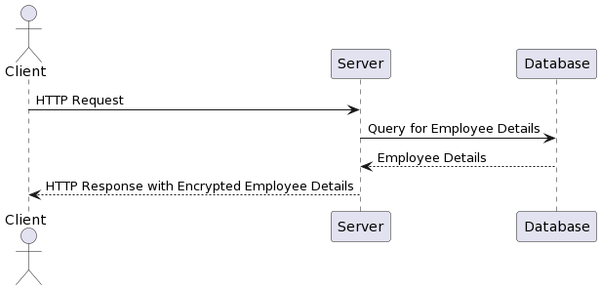
Architecture Design
Sequence diagram depicting the flow of information between the client and server during an HTTPS request.
HTTPS Request
MySQL

Slide 9
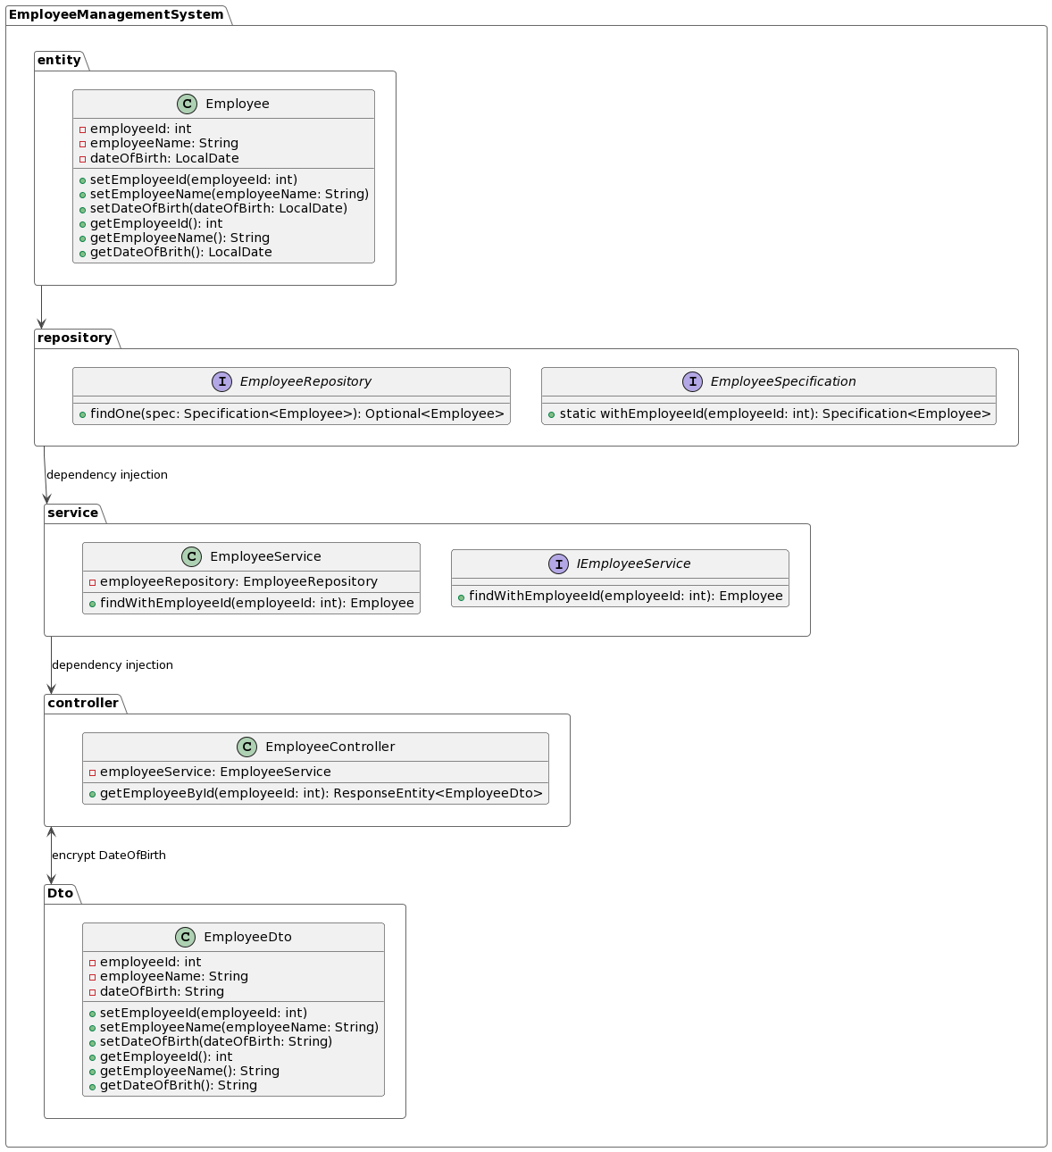
Architecture Design
Class Diagram for Employee Management System

Slide 10
Back-end Development
Programming language: Java with Spring Boot, using Spring Data JPA for database communication.
Database Schema: One table named "employee" with columns "employee_id" (int), "employee_name" (varchar(50)), and "employee_date_of_birth" (date).
APIs: RESTful API with a single endpoint for GET request operations on the employee table. Example endpoint could be:
GET /employees/{id} - get an employee by ID
BACK-END DEVELOPMENT PROCESS:
Define Database Schema: Define the database schema for your employee table with the columns mentioned earlier.
Create Entity class: Create an entity class with the instance variables matching the column name and data types of employee table.
Create JPA repository: Create an EmployeeRepository interface that encapsulates the logic for retrieving employee details from the database.
Create a Service class: Create an EmployeeService class that acts as an interface between the DAO and the REST endpoint.
Create Controller class: Create an EmployeeController with a single GET endpoint for handling the incoming client requests.
Write unit tests: Write JUnit tests to test the functionality of the service class.
Deploy the application: Deploy the Spring Boot application to a web server like Tomcat or Jetty, and test the endpoint using a REST client like Postman.

Slide 11
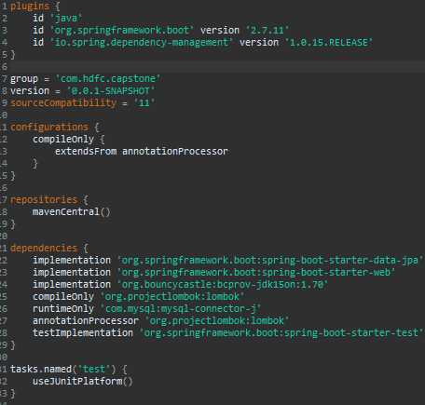
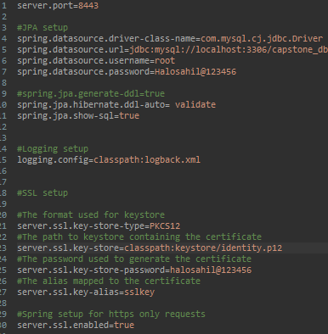
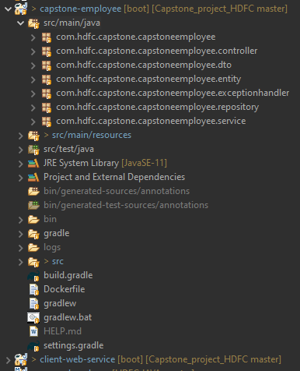
Back-end Development
PROJECT SETUP(Gradle)
build.gradle
application.properties
Spring boot project setup

Slide 12
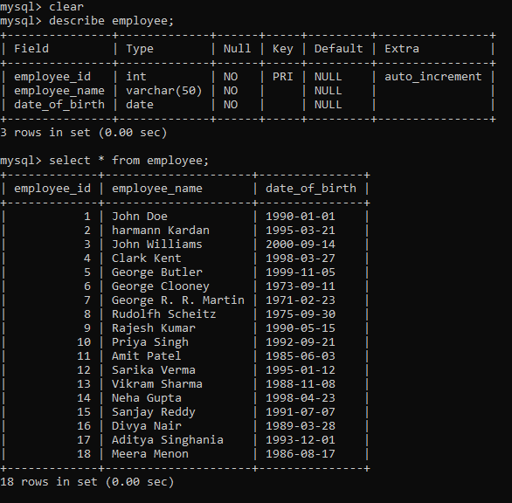
Back-end Development
DATABASE SETUP

Slide 13
Integration and Testing
Unit Testing
Early bug detection: Unit tests help detect bugs early in the development process, making it easier and less expensive to fix them.
Code quality improvement: Writing unit tests forces developers to write more modular, reusable, and maintainable code.
Refactoring support: Unit tests provide a safety net when refactoring code, ensuring that changes to one part of the codebase do not break other parts.
Regression testing: Unit tests help prevent regression issues by providing a suite of tests that can be run after changes are made to the code.
Documentation: Unit tests serve as a form of documentation, providing examples of how the code should be used and what its expected behavior is.

Slide 14
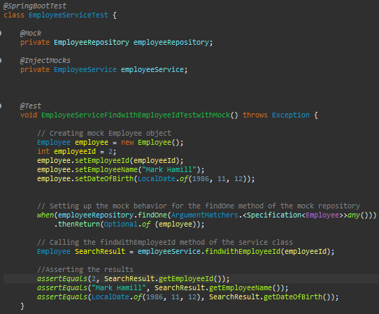
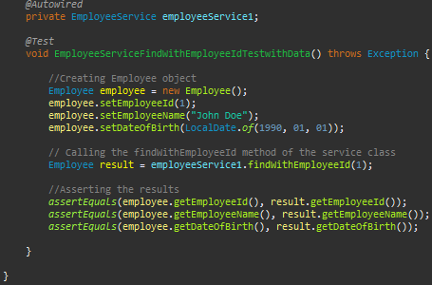
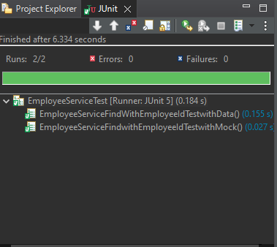
Integration and Testing
Testing Service Layer in Spring boot using Junit and Mockito library
EmployeeServiceTest Class
Testing with mock object
Testing with real object
Test Results

Slide 15
Deployment
DEPLOYMENT OVERVIEW
Continuous Integration (CI) is the practice of regularly integrating new code changes into a shared repository and running automated tests to catch any issues early on. This process helps to ensure that the code is always in a releasable state.
For my capstone project, I have used GitHub as my version control system to store code changes. I have also used Jenkins, which is a popular open-source automation server, to automate my build and deployment process. Jenkins is used to compile, test, and package the code, and then deploy it to the target environment.
To make the deployment process more efficient and easier to manage, I have used Docker to create containerized versions of my application. Containers provide a lightweight and portable way to package and deploy software applications. I have also used Kubernetes, which is an open-source container orchestration platform, to automate the deployment, scaling, and management of my containers.
Overall, continuous integration and development process ensures that code changes are automatically tested, built, and deployed to the target environment in an efficient and reliable manner.

Slide 16
Deployment
STEPS INVOLVED
Developer makes changes to the code.
Code changes are pushed to the Git repository.
Jenkins detects changes in the Git repository and pulls the code.
Jenkins runs a series of automated tests to ensure that the code is functioning correctly.
If the tests pass, Jenkins builds the Gradle project and creates a Docker image of the application.
The Docker image is pushed to Docker Hub, a cloud-based container registry.
Kubernetes, an open-source container orchestration platform, automatically deploys the Docker image to containers as part of a pod, and exposes the deployment as a service.
The application is now live and accessible to end-users.

Slide 17
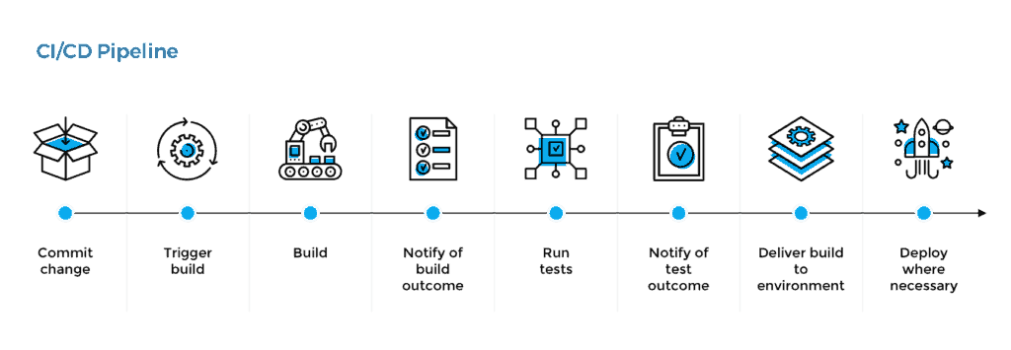
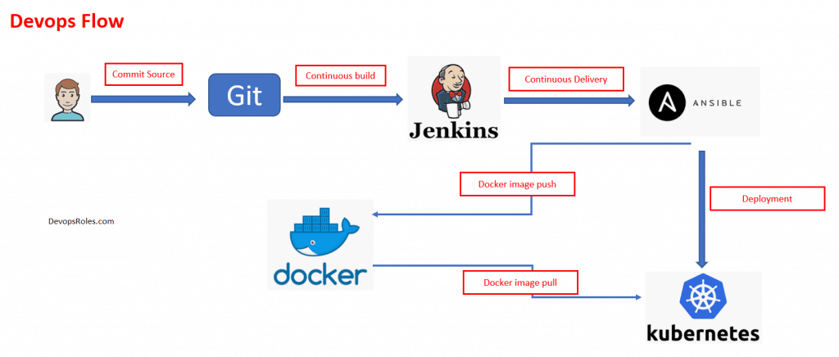
Deployment
DevOps Lifecycle

Slide 18
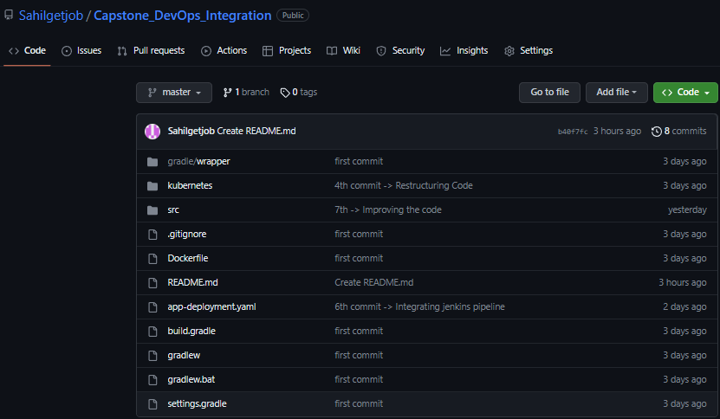
Deployment
GITHUB

Slide 19
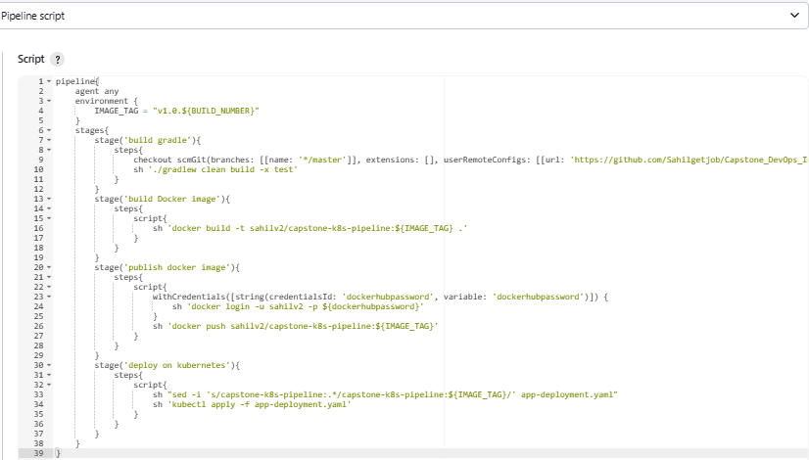
Deployment
Jenkins Groovy Pipeline script for controlling DevOps lifecycle

Slide 20
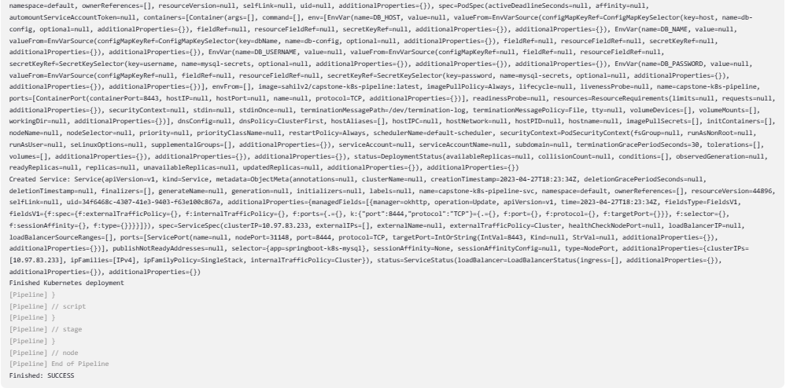
Deployment
Jenkins Deployment result: Success

Slide 21
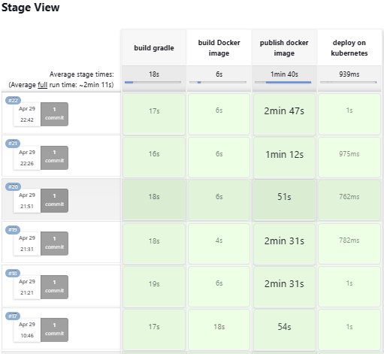
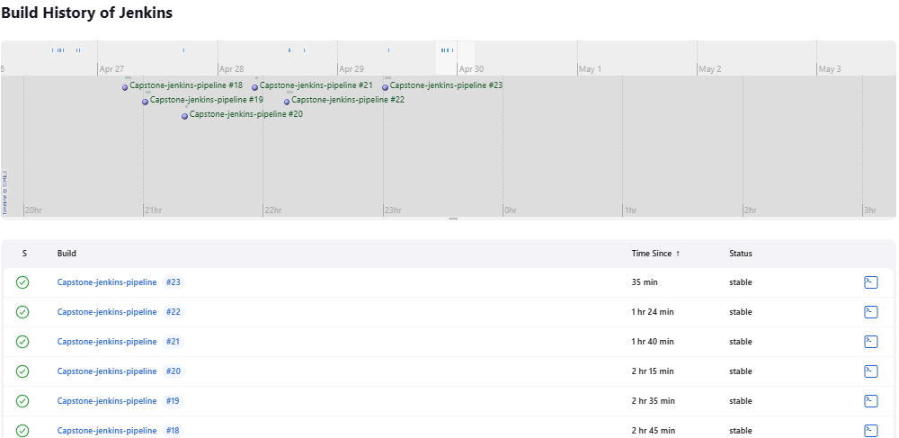
Deployment
Jenkins Pipeline Build history

Slide 22
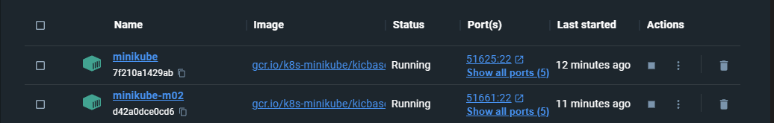
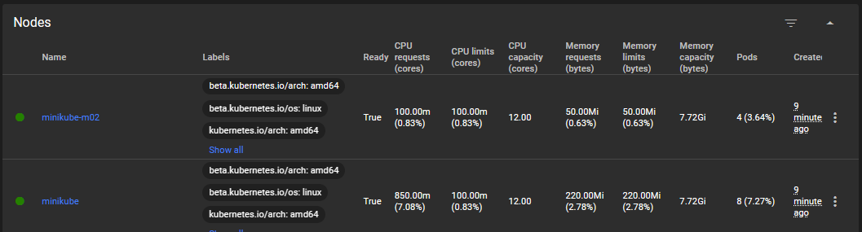
Deployment
Kubernetes Cluster Setup
Master node and Worker node running inside docker containers
Master node and Worker node(Dashboard view)

Slide 23
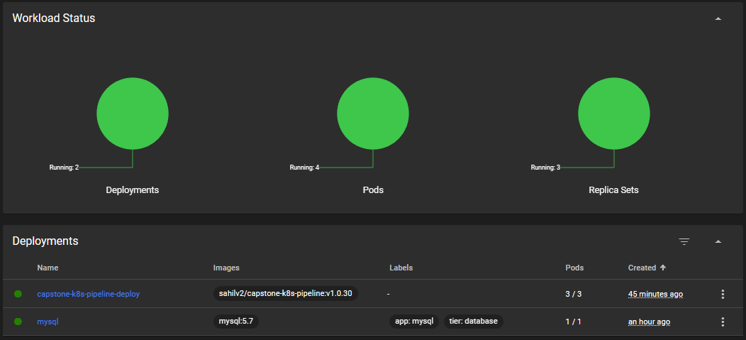
Deployment
Kubernetes Deployment Information

Slide 24
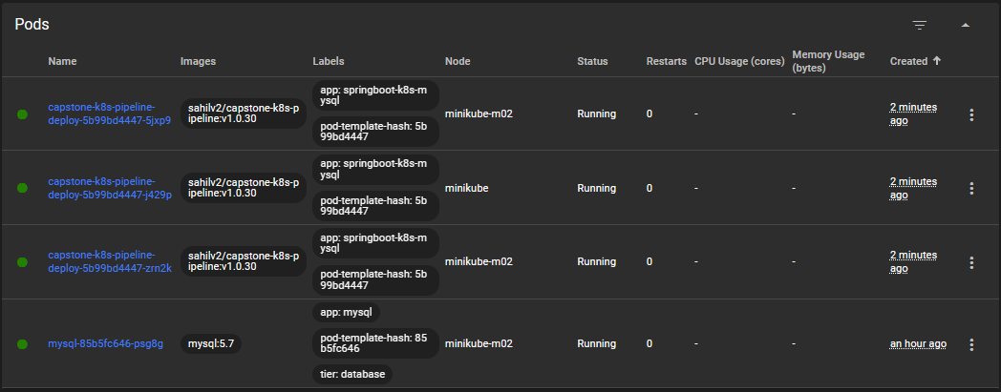
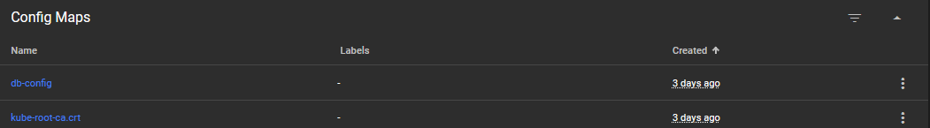
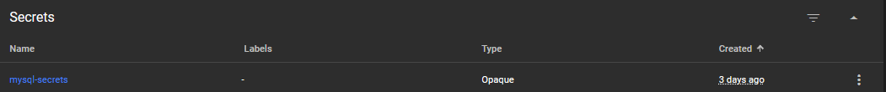
Deployment
Pod status & Config Maps & Secrets

Slide 25
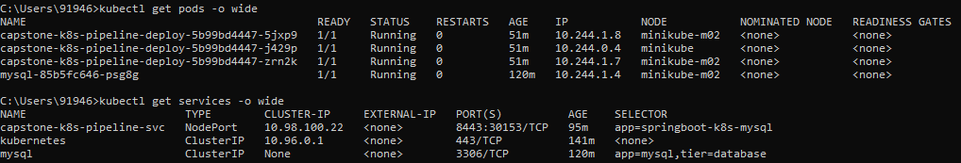
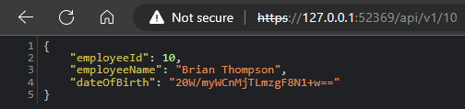
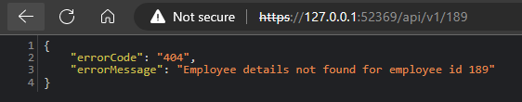
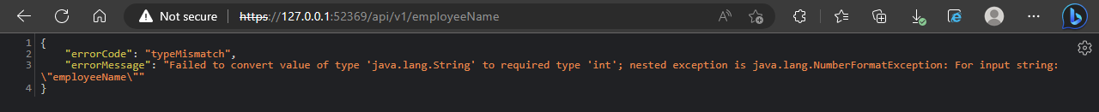
Deployment
Accessing containerised webservice through external host using minikube

Slide 26
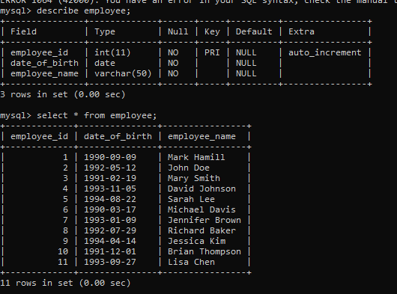
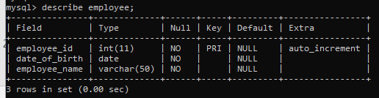
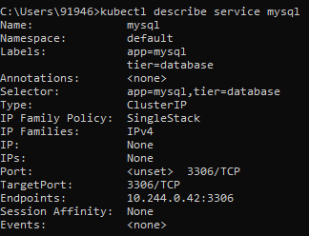
Deployment
DATABASE STRUCTURE OF CONTAINERIZED WEBSERVICE
Employee Table
Table Schema
MySQL instance on cluster

Slide 27
Conclusion
This capstone project involved creating a database table for Employee with EmployeeID, EmployeeName, and DateOfBirth columns. A Java program was written to query a single record based on EmployeeID, and Jenkins was used to deploy changes to the code to the Application server. A client program was also created to interact with our webservice.
In conclusion, our capstone project successfully achieved the goal of creating a RESTful web service that queries a single record from a database and returns a response containing all relevant employee information. We also ensured security by using HTTPS with a self-signed certificate and encrypting sensitive information with AES-256.
We utilized Spring boot and Jenkins for continuous integration and deployment, and deployed our containerized web service on Kubernetes.
During the development process, we faced several challenges such as debugging and troubleshooting issues with our containerized deployment on Kubernetes, ensuring secure communication between the client and server, and managing the rotation of log files. However, we were able to overcome these challenges by using online resources and interacting with batchmates to find effective solutions.
Overall, this capstone project provided valuable experience in developing and deploying a secure, scalable, and containerized web service, while also learning how to overcome challenges in a development environment.

Slide 28
Future Work
These future work items will improve the overall functionality, usability, and performance of the application, providing more value to end-users and stakeholders.
Implement a User Interface - Although the current application is designed as a back-end service, creating a user interface will provide better usability and accessibility for end-users.
Integration with Third-Party Services - The application can be enhanced by integrating it with third-party services such as payroll management, performance management, or attendance management systems.
Add Role-Based Access Control (RBAC) - Implementing RBAC will provide more fine-grained access control to the application, allowing different roles to access only the necessary functionality.
Introduce Machine Learning Algorithms - Integrating machine learning algorithms can provide better insights into employee performance, identifying trends and predicting future outcomes.
Optimize Containerization and Deployment - As the application scales and more instances of the container are added, optimizing the deployment and containerization process can improve the overall performance and efficiency of the application.

Slide 29
References
Spring framework documentation(2022). Retrieved from https://docs.spring.io/spring-framework/docs/current/reference/html/
AES256 encryption-decryption reference from Java AES Encryption and Decryption | Baeldung
Https self-signed certificate reference retrieved from HTTPS using Self-Signed Certificate in Spring Boot | Baeldung
Bouncy Castle library reference from bouncycastle.org
Jenkins automation tool reference retrieved from Jenkins User Documentation.
Docker Documentation. (2021). Retrieved from https://docs.docker.com/
Kubernetes Documentation. (2021). Retrieved from https://kubernetes.io/docs/home/
Under Guidance of Mr. Javeed Mohammed Husnuddin Sir

Slide 30
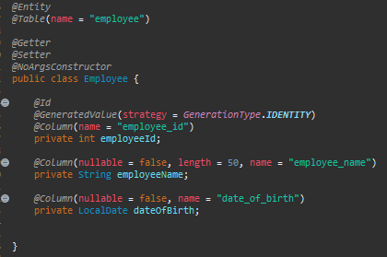
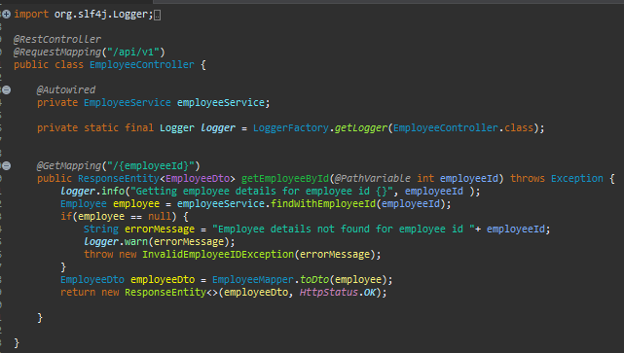
Appendices
Structure of Spring boot project
Entity Class
Employee Controller

Slide 31
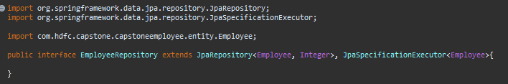
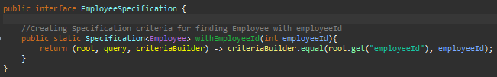
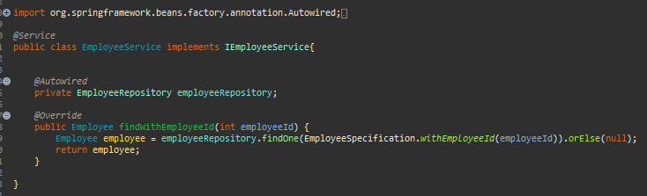
Appendices
Structure of Spring boot project
JPA Repository interface
EmployeeSpecification Interface
EmployeeService class

Slide 32
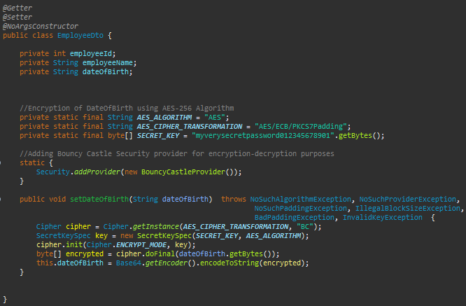
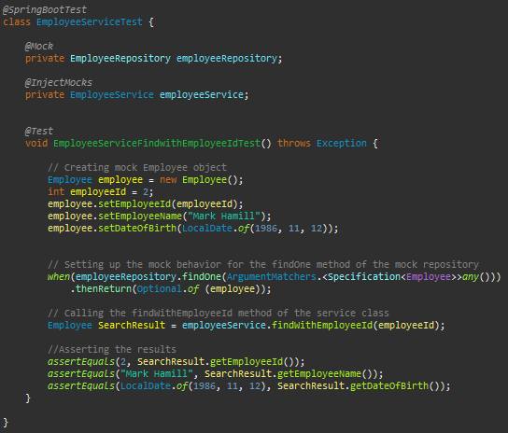
Appendices
Structure of Spring boot project
DTO Class(Encryption to AES-256 in DTO class)
Employee Service Test using Junit

Slide 33
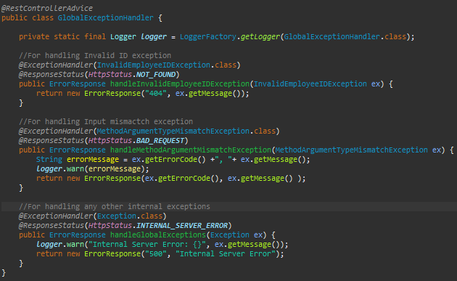
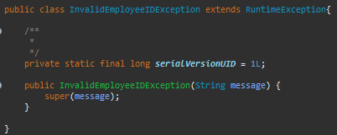
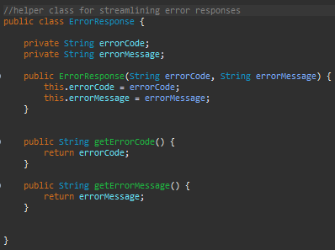
Appendices
Structure of Spring boot project
GlobalExceptionHandler Class
InvalidEmployeeIDException & ErrorResponse Class

Slide 34
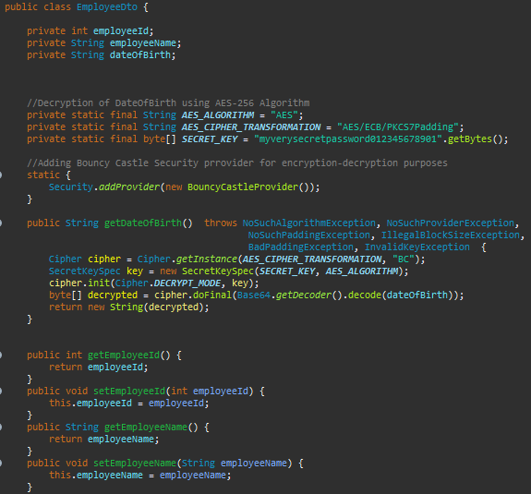
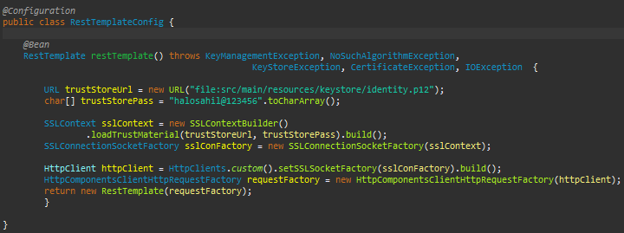
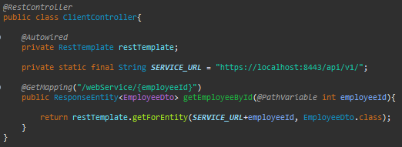
Appendices
Structure of Client program
DTO class(Decryption of webservice response)
RestTemplate custom config & Client Controller class

Slide 35
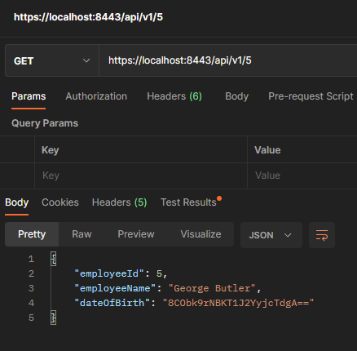
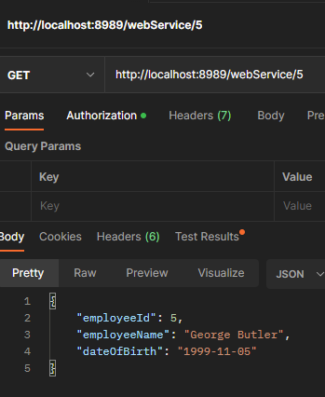
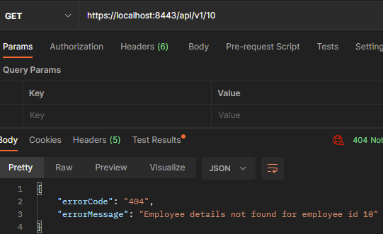
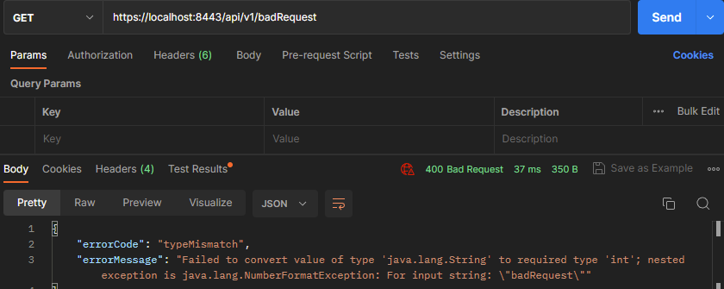
Appendices
Postman API Platform Screenshots
Webservice Response Data encrypted
Client request-response
Exception Handling

Slide 36
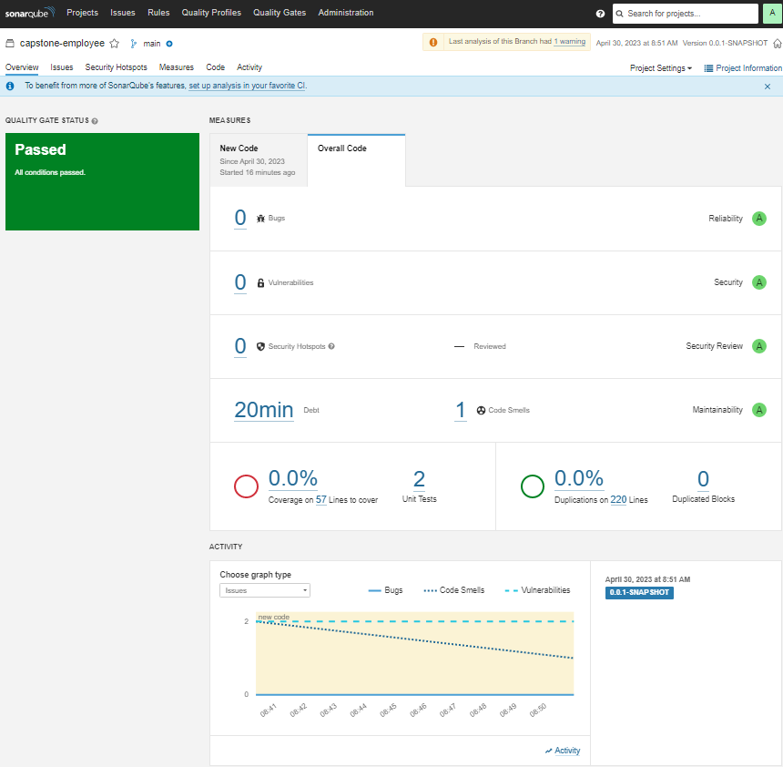
Appendices
SonarQube Inspection

Slide 37
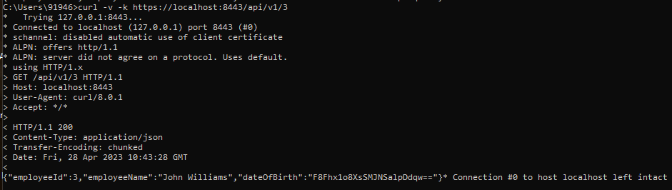
Appendices
CURL RESPONSE

Slide 38
THANK YOU

