Slide 1
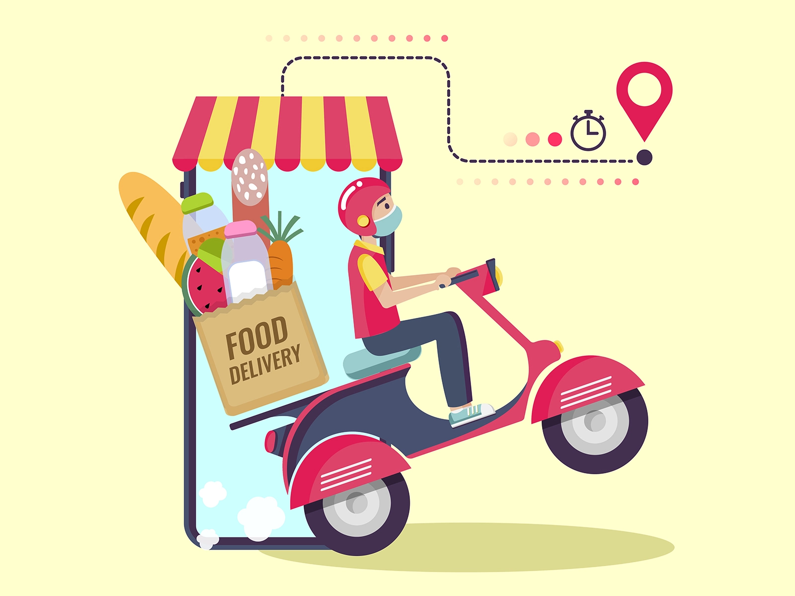
HDFC BANK API DEVELOPER MID-TERM PROJECT
Submitted by: Sahil Kumar Vishwakarma
Submission Type: Individual
Name: Sahil Kumar Vishwakarma
Batch: Batch-1
Program: HDFC API Developer Programme

Slide 2
TABLE OF CONTENT
Introduction
Project Overview
Architecture Design
API Development
Testing
Conclusion

Slide 3
INTRODUCTION
This presentation will cover the mid-term report on server side food delivery app created using Java language with the help of tools and frameworks like Spring boot, Spring framework, Spring data JPA, Spring Web and MySQL for database schema design for my food delivery app. For testing and Security purposes, other tools such as Junit, Mockito, Spring Security and other such tools and frameworks were also applied.

Slide 4
Project Overview
OUR FOOD DELIVERY APP IS A WEB-BASED PLATFORM THAT ALLOWS CUSTOMERS TO ORDER FOOD FROM THEIR FAVORITE RESTAURANTS FOR HOME DELIVERY OR PICKUP. THE APP CONNECTS CUSTOMERS WITH A NETWORK OF RESTAURANTS AND DELIVERY DRIVERS TO PROVIDE A SEAMLESS EXPERIENCE FOR ORDERING AND DELIVERING FOOD.
KEY FEATURES:
User registration and authentication
Browse and search for restaurants and menu items
Place and manage orders
Real-time order tracking
Payment processing
Rating and review system for restaurants
Restaurant management dashboard for menu and order management
Delivery driver management dashboard for order delivery management
Admin dashboard for managing the entire platform

Slide 5
ARCHITECTURE DESIGN
BACKENED DESIGN:
LANGUAGE USED – Java
FRAMEWORKS :
Spring Framework,
Hibernate Framework,
Spring Web(For Restful APIs),
Spring Data JPA(Provides abstraction over Hibernate complexity),
Spring Security(Security and protection of our APIs
JUnit(For Unit testing our backend to ensure proper functionality)

Slide 6
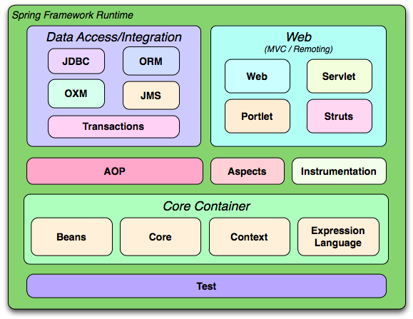
Spring framework
The Spring Framework is built on top of the Java platform and follows a layered architecture. At its core is the Spring Container, which provides the basic functionality of the framework. The container manages the lifecycle of objects and provides dependency injection (DI) and inversion of control (IoC) capabilities.

Slide 7
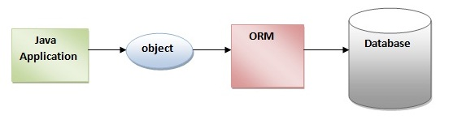
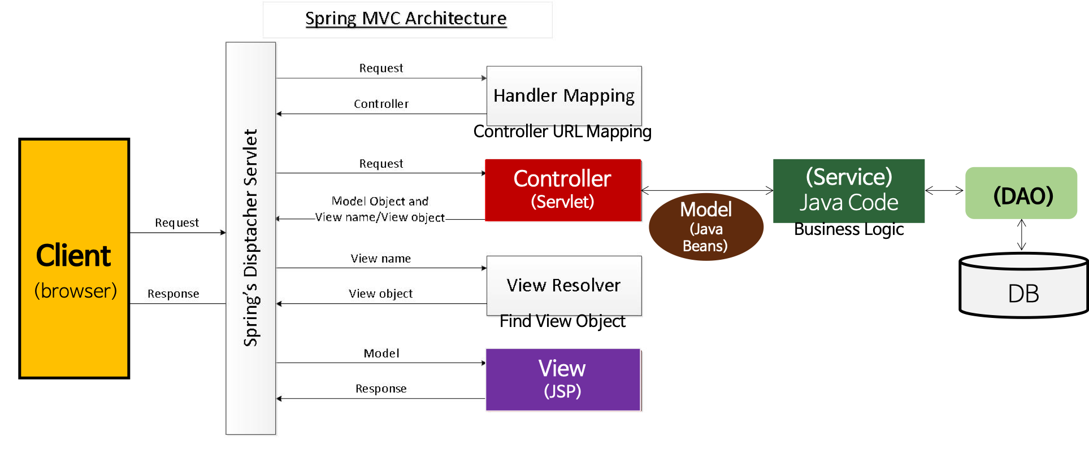
HIBERNATE FRAMEWORK SPRING WEB FRAMEWORK

Slide 8
API DEVELOPMENT
Restful architectural approach is taken to develop this food delivery app.
API is developed with spring data JPA interacting with a MySQL database in the backend which contains the schema for all the necessary tables for Food delivery App.
API documentation is done using Swagger to make it easier to interact with the APIs while development. Swagger helped me immensely to maintain and update my APIs over time.
API endpoints which are used in this App are GET, PUT, POST, DELETE. These endpoints were sufficient for carrying out all the operations in the backend necessary for proper function.
Error handling is done via Global Exception handler which handles all the exceptions such as resource not found, validation exception etc and provides meaningful error info to the users.
Mockito and Junit were used to mock test the APIs and validations were also tested using mock data to test proper functioning of the API endpoints without persisting any data in the database during tests and validation.
Necessary UML diagrams and flowcharts were also prepared after the development of the API to provide the overview of the functionality of the API.

Slide 9
BACKENED DESIGN
BACKEND DESIGN HAS SEVERAL FOLLOWING PARTS WORKING TOGETHER:
DATABASE – for storage and retrieval of data related to the food delivery app such as user details, restaurant details etc.
HIBERNATE FRAMEWORK – Hibernate is an ORM tool which makes java object persistence possible by acting as an interface between Database and Java objects. It uses JDBC internally.
Spring Data JPA - Spring Data JPA is a subproject of the Spring Framework which provides abstraction over the underlying data access frameworks such as Hibernate, JPA or JDBC.
Spring Security -Spring Security is a powerful and highly customizable authentication and access-control framework that is a part of the Spring Framework. It is used to secure Spring-based web applications and RESTful web services.
Junit - JUnit is a unit testing framework for Java programming language. It provides a simple and easy-to-use way to write automated tests for Java code, particularly for unit testing.

Slide 10
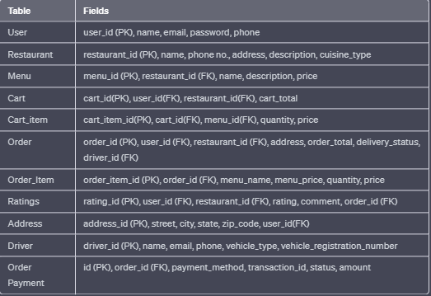
Database structure:
Gropp App Schema(Food delivery App):

Slide 11
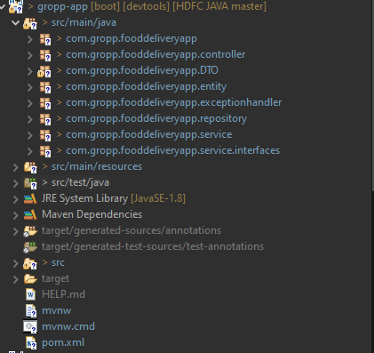
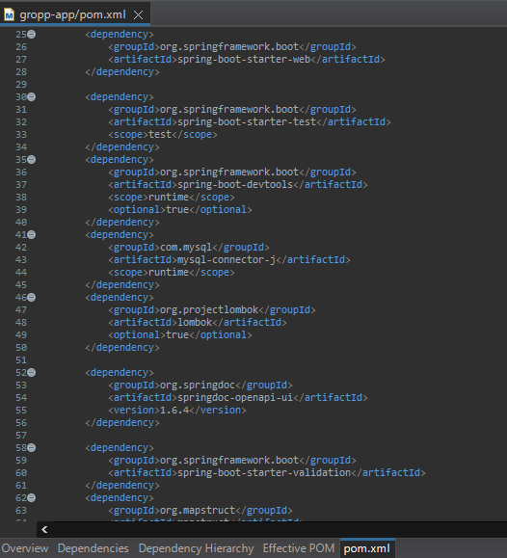
Backend Project Structure POM.xml

Slide 12
Modules
User module: contains all the classes and components related to managing user accounts, authentication, and authorization.
Restaurant module: contains all the classes and components related to managing restaurants, menus, and other restaurant-related functionality.
Cart module: contains all the classes and components related to managing shopping cart functionality for users.
Order module: contains all the classes and components related to managing orders, payment processing, and order tracking.
Rating module: contains all the classes and components related to managing ratings and reviews left by users for restaurants and their orders.
Driver module: contains all the classes and components related to managing drivers, their assignments, and tracking their deliveries.

Slide 13
UML DIAGRAMS provided:
Entity Relationship Diagram - An entity-relationship diagram (ERD) is a type of data modeling that illustrates how different entities or objects in a system or application relate to each other. It is a visual representation of the relationships between entities, which typically includes entities such as customers, products, orders, and so on.
Class Diagram - A class UML diagram is a type of UML diagram that provides a graphical representation of the classes in a system or application, along with their attributes, methods, and relationships with other classes. It is a static structure diagram that allows developers to visualize and organize the code structure of a system, which can aid in understanding and designing the system architecture.
Sequence Diagram - A sequence UML diagram is used to represent the interactions between objects or components within a system or process in a sequential order. It provides a visual representation of the messages that are passed between objects or components over time, helping developers to understand the flow of control in a system.
Use Case Diagram - A use case UML diagram is used to describe the behavior of a system from a user's point of view. It is a visual representation of the different types of users and their interactions with the system.

Slide 14
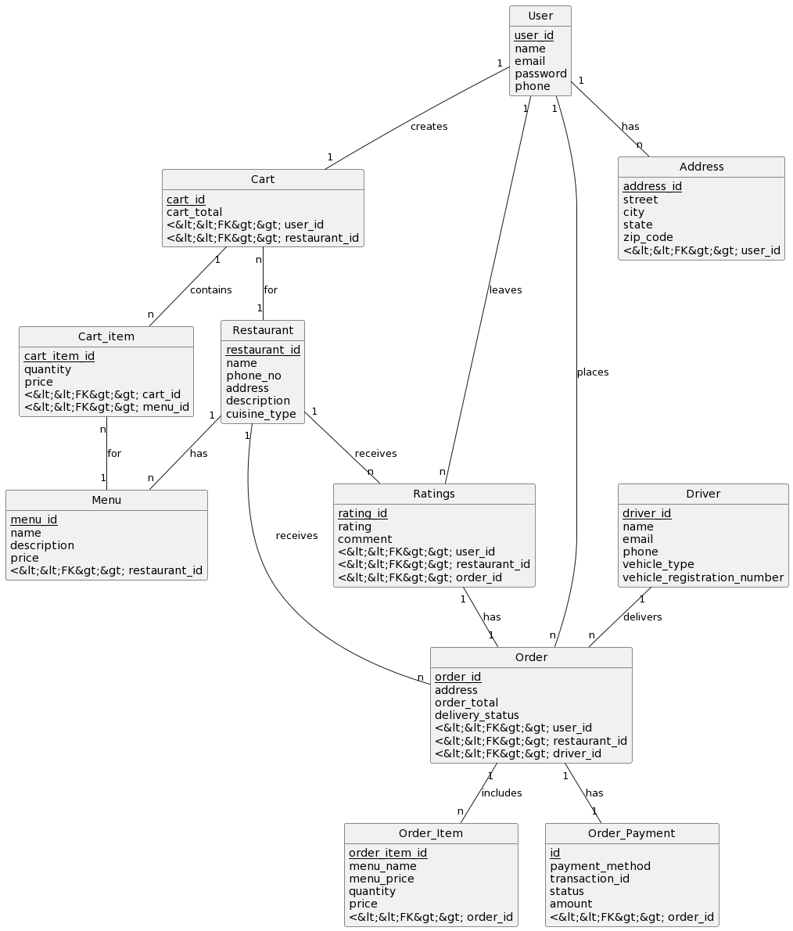
Entity relationship diagram:

Slide 15
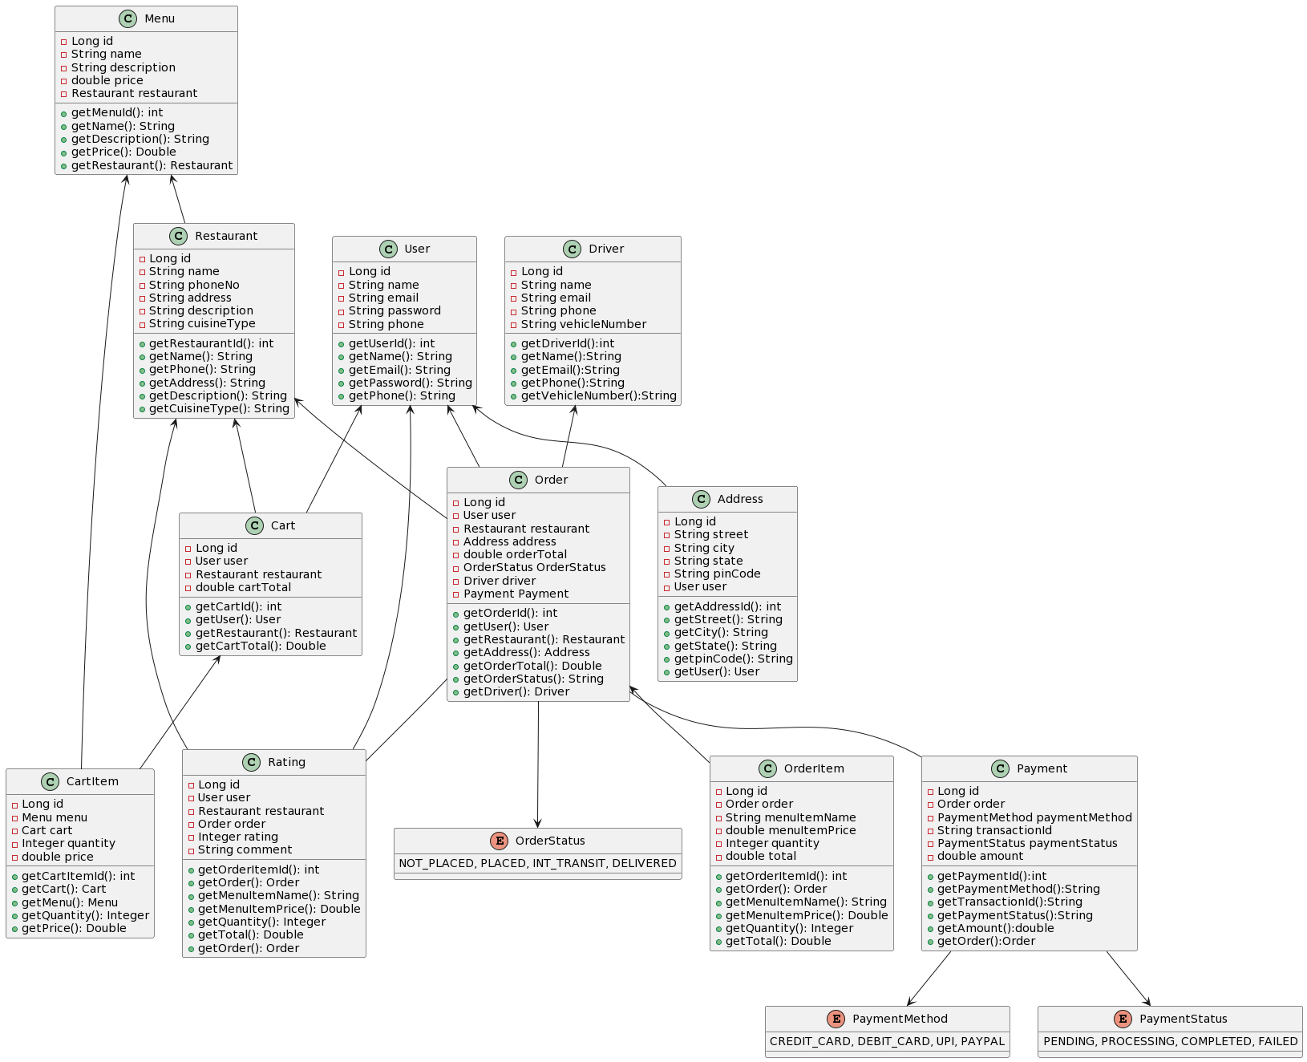
Class uml diagram:

Slide 16
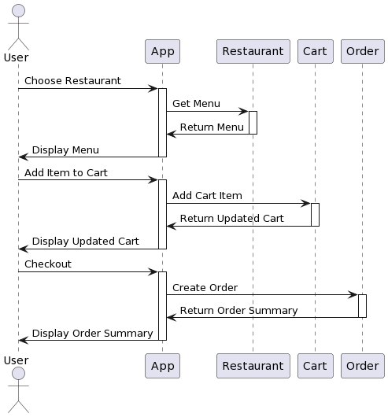
Sequence UML Diagram
Simple Sequence Diagram of Application:

Slide 17
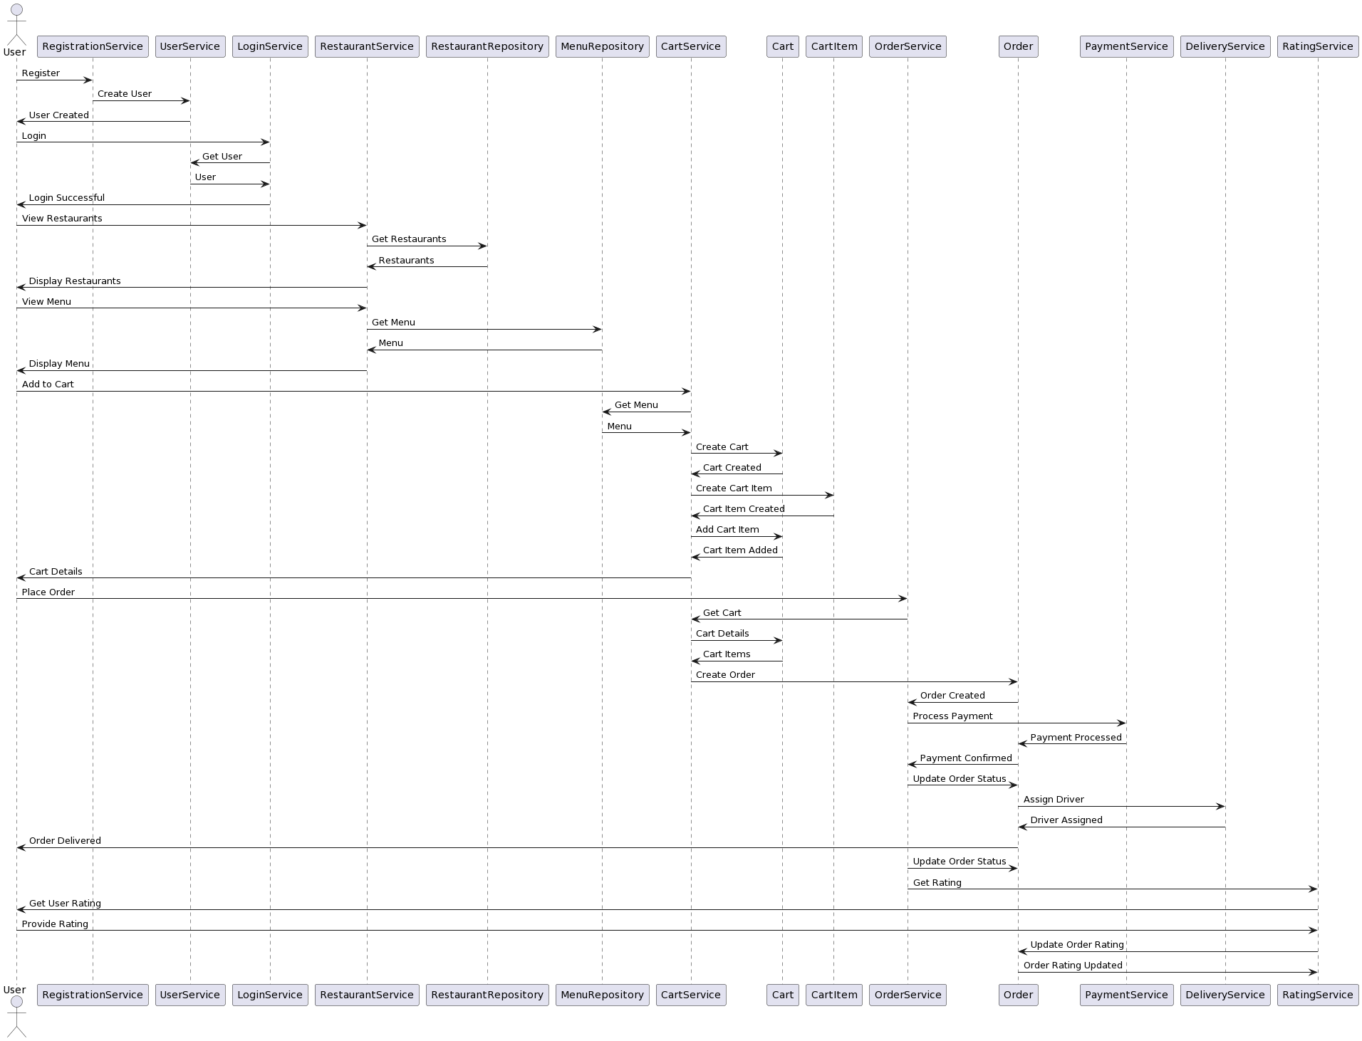
Sequence UML Diagram
Complete Sequence Diagram of Application

Slide 18
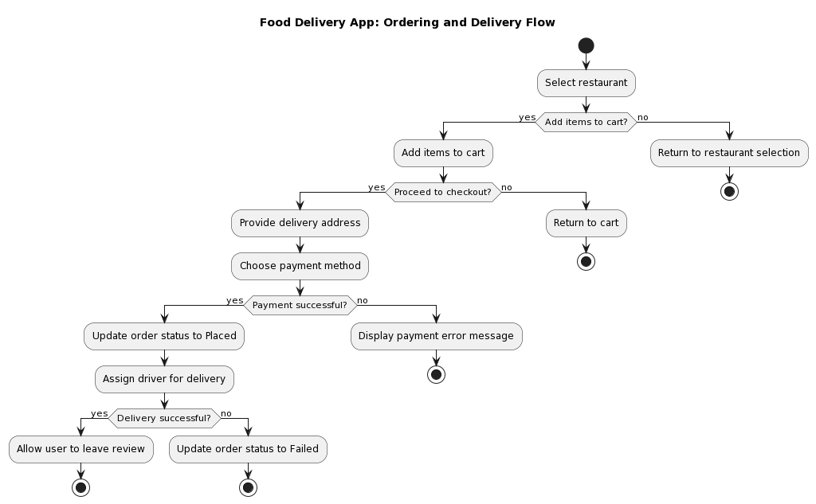
Application flowchart

Slide 19
Food delivery process:
Step 1 : User will signup on the application by providing required details.
Step 2: After successful sign up, User will be prompted to login in to the application.
Step 3: User will add the food items to cart from the given menu list of a particular restaurant.
Note: A user can only order from a particular restaurant one at a time. If a user attempts to browse a different restaurant and add food items to card, previous data of the cart of previous restaurant will not
display there.
Step 4: User proceeds to order page when he orders the selected items, he then has to pay the total amount for the order. If and when the payment is successful, the order status in Orders page will change to “PLACED”.
Note: In the backend, Admin will get the info of successful order placement by User, and he will assign a delivery guy for the delivery of the Order.
Step 5: When the Order is successfully delivered to the User, he can then provide a rating for the said order which includes numerical rating and a comment from the user regarding his whole experience ordering food from the app.

Slide 20
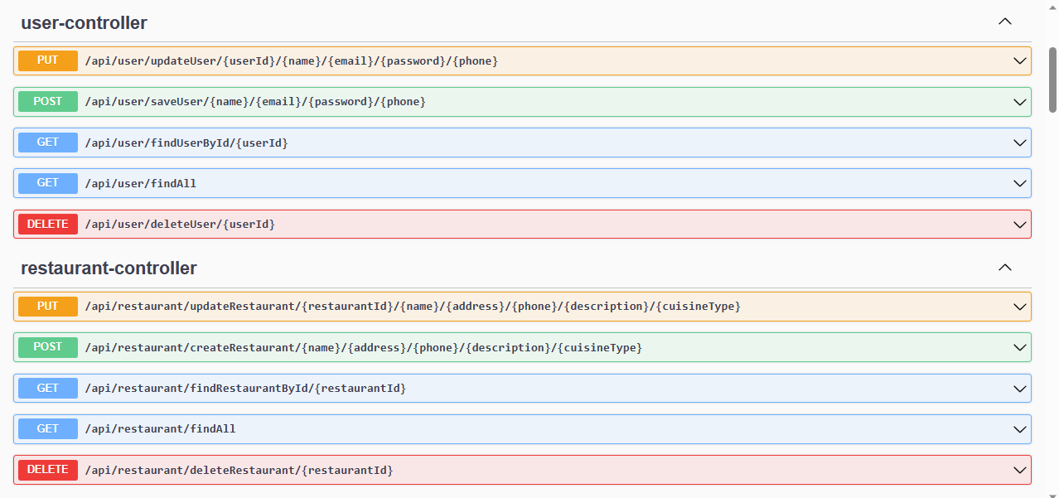
BACKEND MODULES - User and restaurant

Slide 21
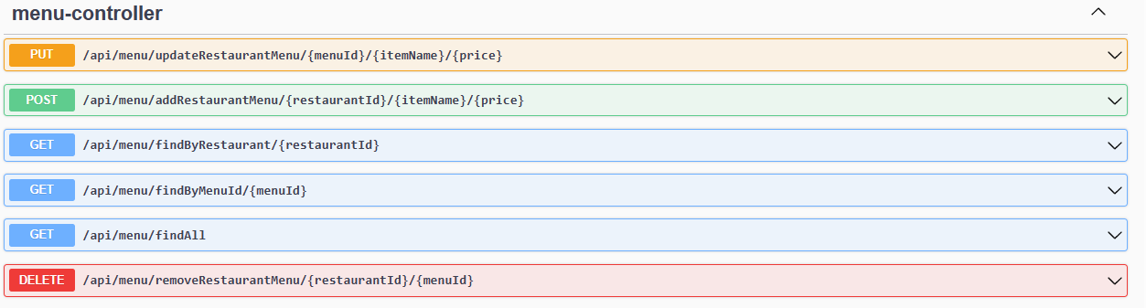
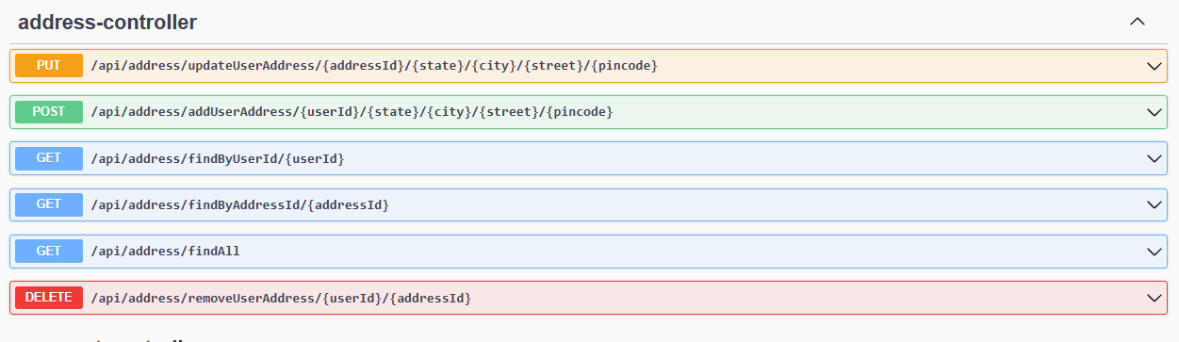
BACKEND MODULES - restaurant menu and user address

Slide 22
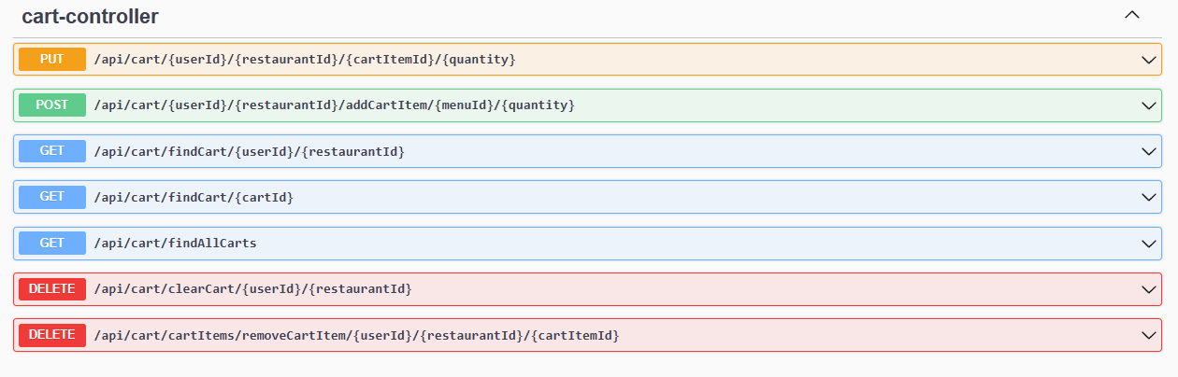
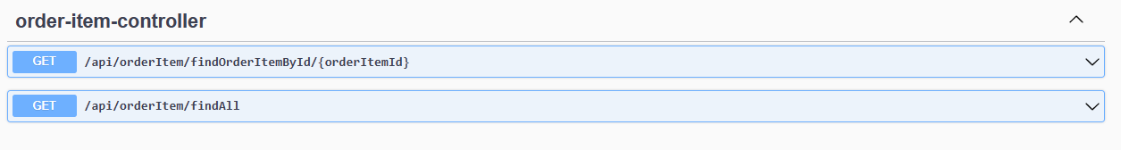
BACKEND MODULES- Cart menu and order items

Slide 23
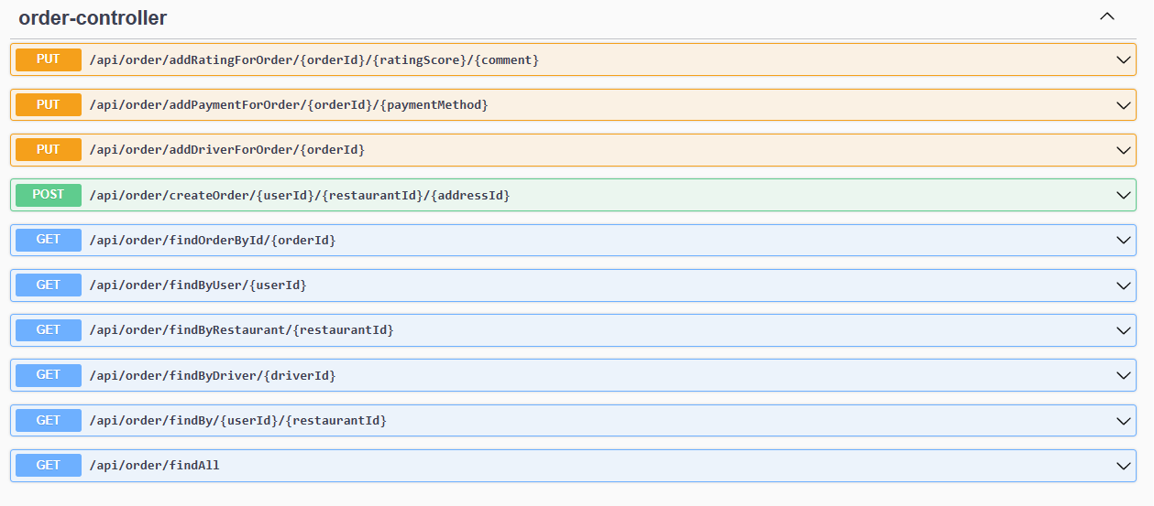
BACKEND MODULE – order

Slide 24
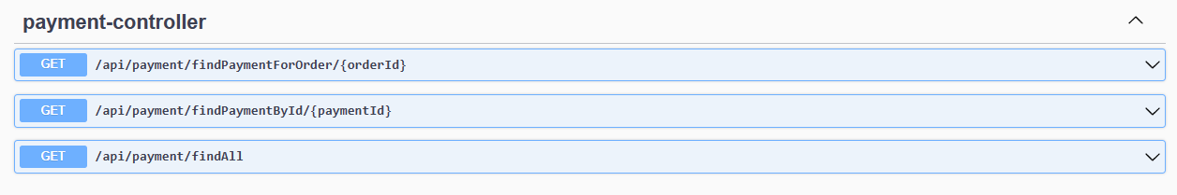
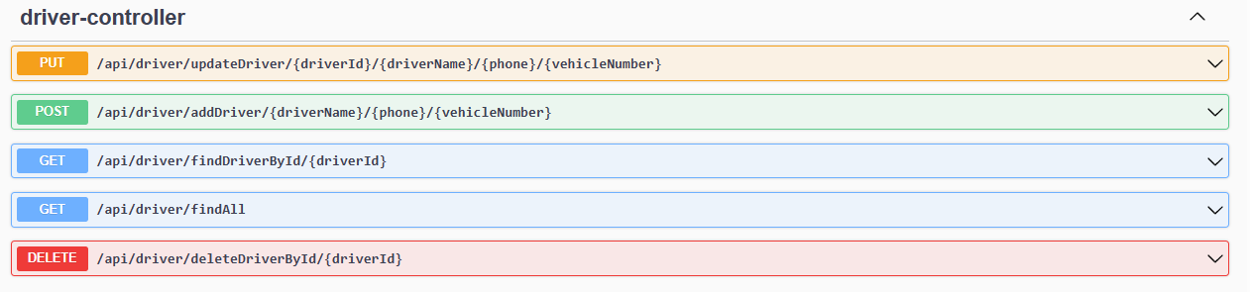
BACKEND MODULES - Order payment and delivery guy

Slide 25
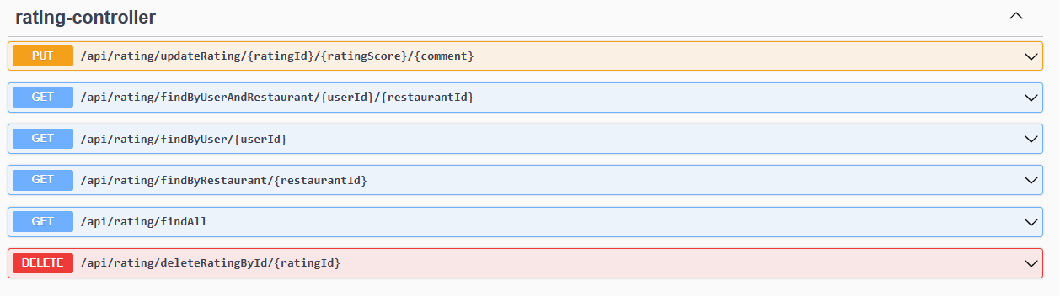
BACKEND MODULE - Order rating

Slide 26
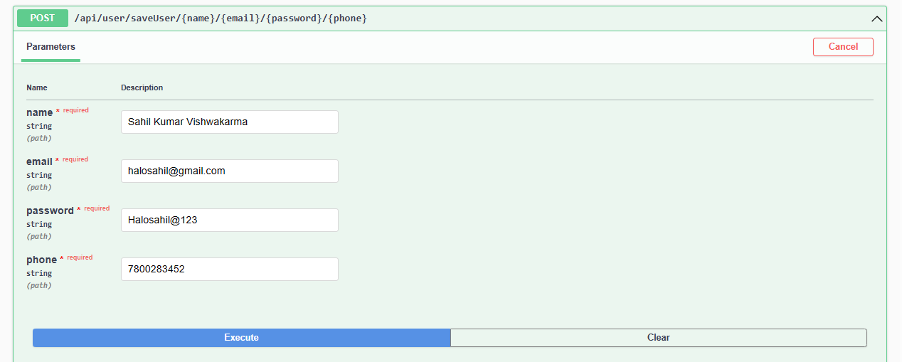
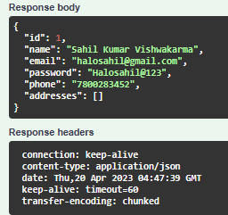
ordering process of food delivery application(Groppe)
Step 1: Create user

Slide 27
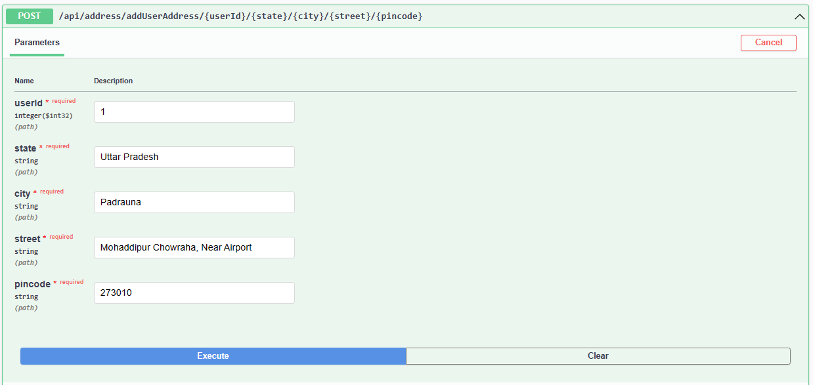
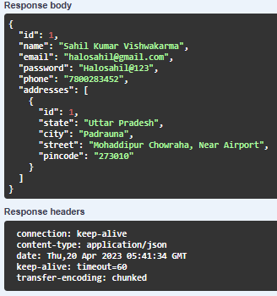
ordering process of food delivery application(Groppe)
Step 2: Add address for User

Slide 28
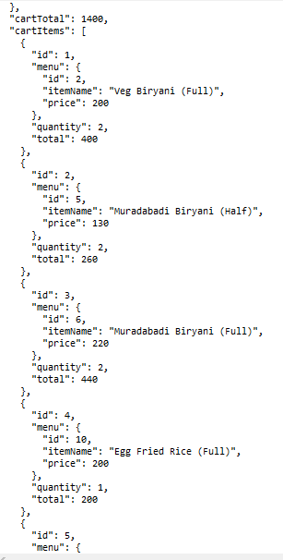
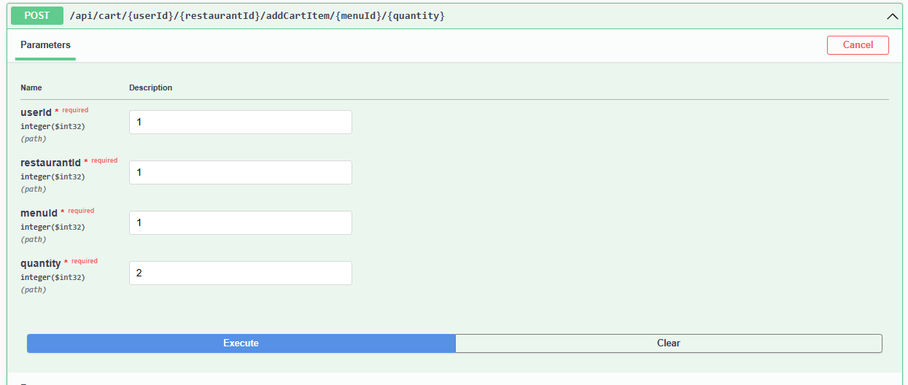
ordering process of food delivery application(Groppe)
Step 3: Add food items to cart from selected restaurant

Slide 29
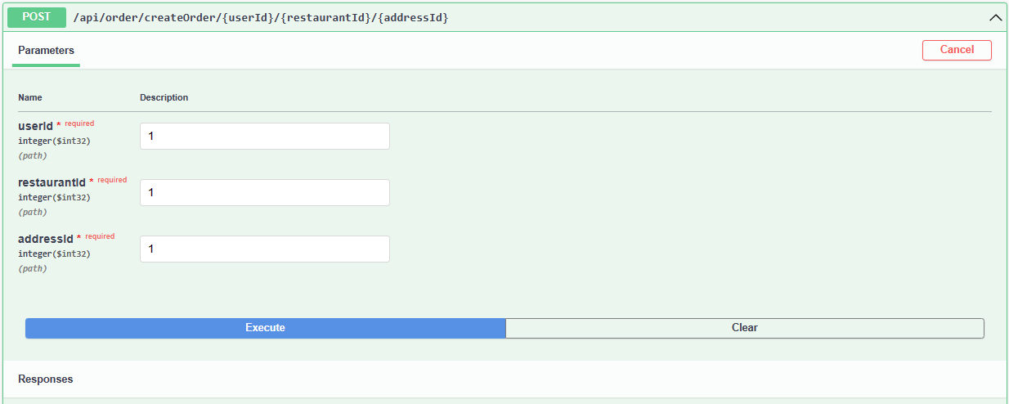
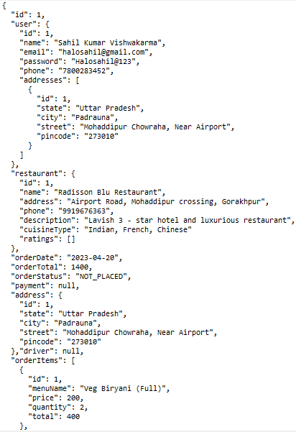
ordering process of food delivery application(Groppe)
Step 4: Proceed with order and move cart to Order table for order preparation

Slide 30
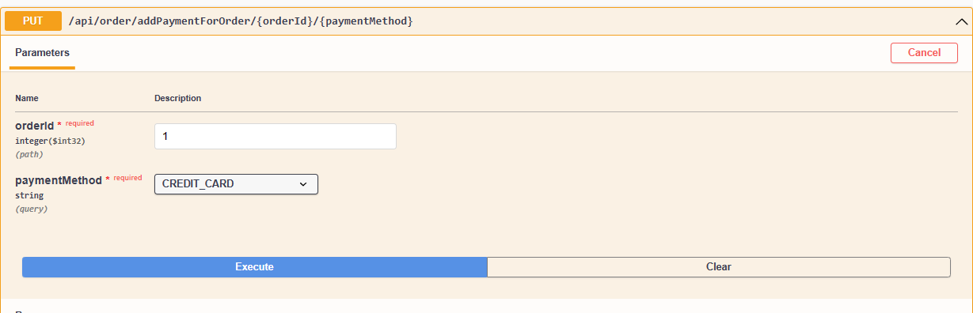
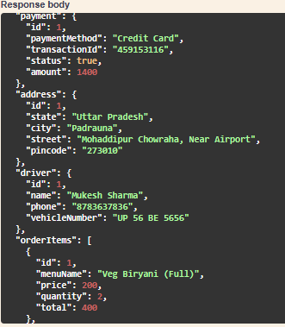
ordering process of food delivery application(Groppe)
Step 5: User will proceed to payment after order is initiated

Slide 31
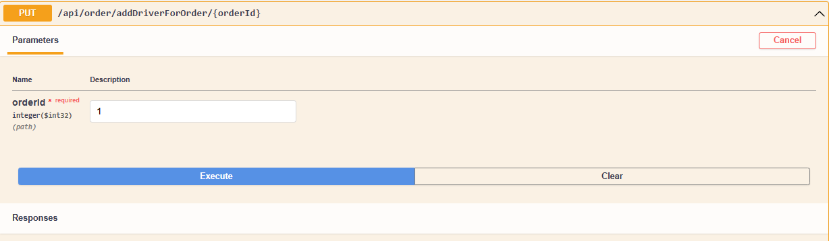
ordering process of food delivery application(Groppe)
Note: Admin/ Restaurant Owner will add the driver after the payment is confirmed

Slide 32
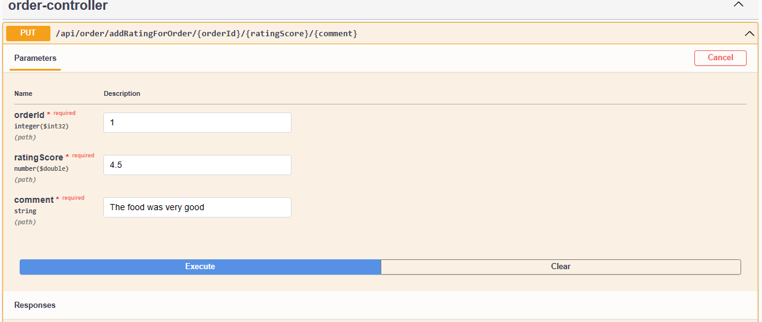
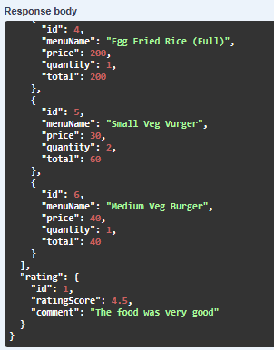
ordering process of food delivery application(Groppe)
Step 6: Add Rating for the delivered order

Slide 33
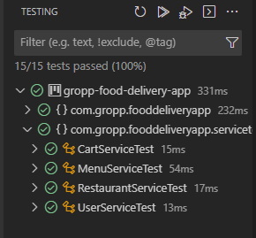
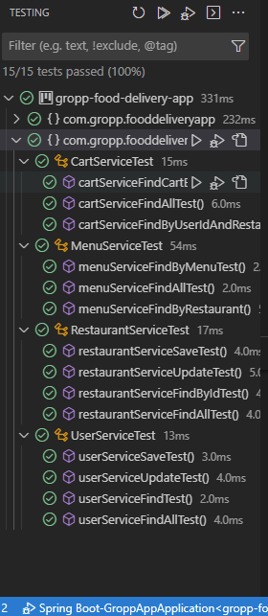
Testing of food delivery app
The app was intensively tested for data integrity, data consistency, information leaks and security flaws using tools such as Junit and Mockito.
JUnit is a popular open-source testing framework for Java applications. It provides a set of tools and annotations to help developers write and run unit tests in a simple and efficient manner.
Mockito is a popular open-source testing framework for Java applications, which is used for creating mock objects to facilitate unit testing. Mock objects are objects that simulate the behavior of real objects in a controlled manner, allowing developers to test their code in isolation.

Slide 34
Conclusion
Our food delivery app provides a convenient and user-friendly platform for customers to order food from their favorite restaurants.
Our app uses a robust backend architecture built on Spring Boot and Hibernate frameworks, with a secure authentication mechanism using Spring Security.
The database schema is designed to efficiently handle customer orders and support order tracking and delivery management through the use of the Order and Driver tables.
UML diagrams have been used throughout the development process to visualize and communicate the software design and architecture.
The food delivery app is very scalable and very efficient in its operation which makes handling of large number of customers very convenient and efficient for both Users and Developers.

