Slide 1
Chatbot
Mini project
Submitted By: Sahil Gupta
University Roll No: 2017539
Submitted to : Dr. Sumit Pundir (Professor)

Slide 2
AGENDA
Introduction
Methodology
Result and Discussion
Conclusion and future work
Reference

Slide 3
INTRODUCTION
A chatbot, at its most basic, is a computer programme that mimics and interprets human interaction (spoken or typed), enabling users to converse with digital gadgets as if they were speaking to real people. Chatbots can be as basic as one-line programmes that respond to straightforward questions, or they can be as complex as digital assistants that learn and develop over time to provide ever more individualised service as they acquire and process more data.

Slide 4
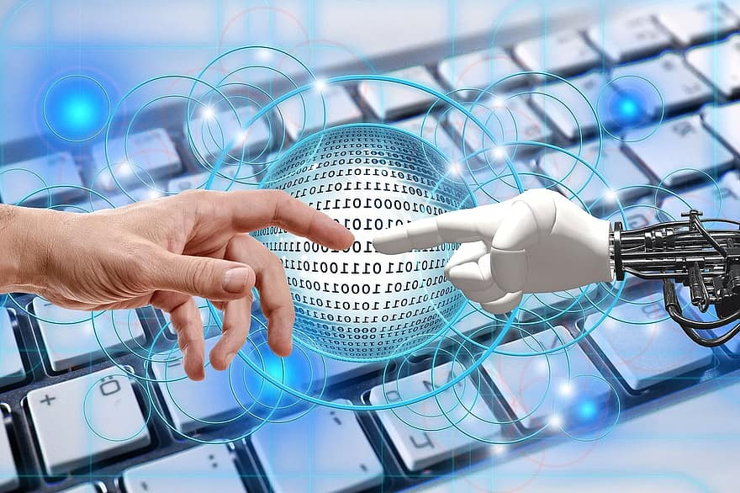
Methodology
1).Collect the data
2). Use the suitable library to vectorize the data
3). Pre-Process the data, create the bag of words
4). Hypertune the model
5). Test the chatbot and feedback

Slide 5
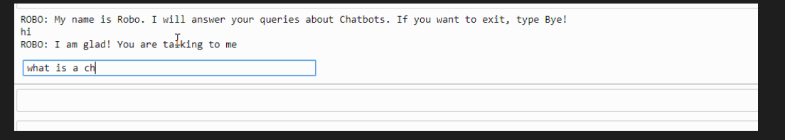
After the implementation of the methodology, the chatbot can actually reply to your questions and not only this it can really take up the conversation. After the overall concatenation of all these libraries and tokens, the chatbot is simply ready to carry out a conversation or give you the desired information.
Result and Discussion

Slide 6
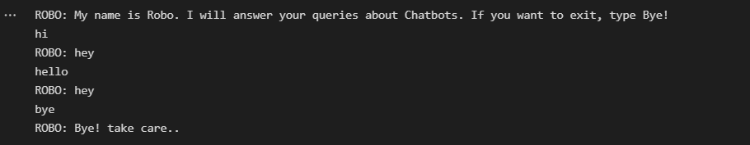
Conclusion
Now, the chatbot is ready with all the information and data needed. Ready and open for a good conversation with a human being.

