Slide 1
COMPUTER
COMMONLY OPERATING MACHINE PURPOSALY USED FOR TECHNICAL AND EDUCATIONAL REASEARCH.

Slide 2

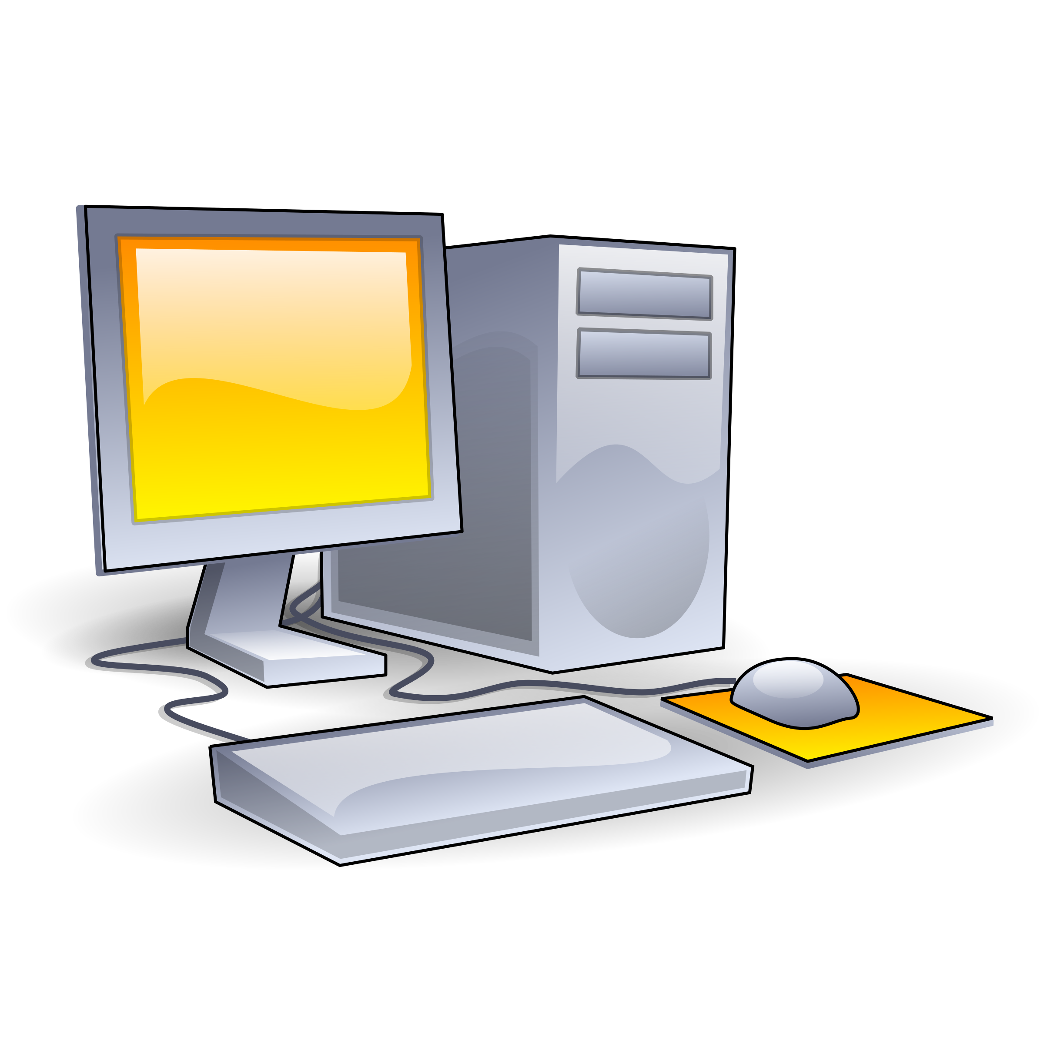
WHAT IS COMPUTER
A computer is an electronic device that manipulates information, or data. It has the ability to store, retrieve, and process data. You may already know that you can use a computer to type documents, send email, play games, and browse the Web. You can also use it to edit or create spreadsheets, presentations, and even videos.

Slide 3
FUNDAMENTAL OF COMPUTER
INPUT
INPUT DEVICE:-KEYBOARD,MOUSE,JOYSTICK.
OUTPUT
OUTPUT DEVICE:-PRINTER:-MONITER,SPEAKER,HEADPHONE.M

Slide 4
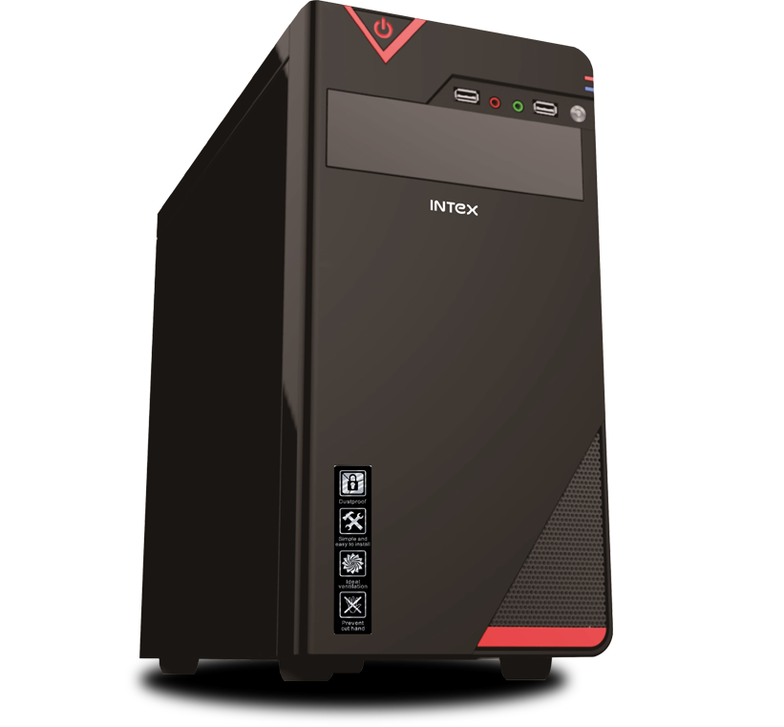
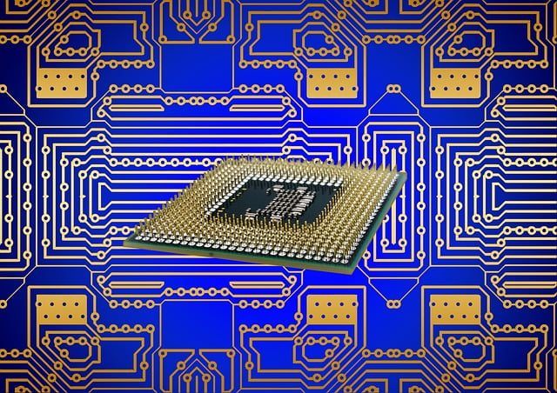
BRAIN OF COMPUTER
CPU is the brain of computer
Control processing unit is the full form of CPU.
It is also known as a processor or microporcessor.

Slide 5
GENERATION OF COMPUTER
GENERATIONS | TECHNOLOGY | TIME PERIOD
1 GENERATION | VACCUME TUBE | 1940-1956
2 GENERATION | TRANSISTOR | 1956-1963
3 GENERATION | INTERGRATED CIRCUIT | 1964-1971
4 GENERATION | MICROPROCESSOR | 1972-PRESENT
5 GENERATION | A.I | PRESENT-FUTURE

