Slide 1

K. V. Pendharkar College of
Arts, Science & Commerce(Autonomous)
E-Vegetable Mart
Name:- “Sahil Ramesh Prasad”
Roll no:- “22-7282”
Class :- “TY.B.Sc (CS)”

Slide 2
01
Project introduction
Agenda
Style
02
Advantage & Dis-advantage
03
Features & Limitation
04
System design detail
05
Forms Layout
06
Future Scope
07
Conclusion
08
References

Slide 3
The “E-VEGETABLE MART” is developed to help customers order vegetables from their home. It also allows vendor to reach more customers.
Customers can complain to vendor if they are not satisfied with food quality or price. Hence, the website brings transparency and helps to connect buyers with sellers.
Project Introduction
Website is secure, fast and reliable. Customer has variety of options to choose from and they can make payment on platform itself. On the other hand, Vendor can see orders placed and can either accept or reject it. Same website can be used by different vendors with some customization.

Slide 4
Advantages
1. Vendors will get more customer online.
2. Customers can order food from their home
3. Customers have lot of choices
Dis-advantages
1. Customers can’t check quality of vegetable before buying
2. Orders can sometime have late deliveries
3. All the products may not be able in one shop

Slide 5
Features & Limitations
Features
User can add as many items in cart and can purchase all of them at once
Admin can accept and reject orders depending on inventory
Admin can change product prices for attracting more customers in few clicks
Customers can track orders and get it delivered at their home

Slide 6

Features & Limitations
1. Feedback and Review is not there
2. Cash on Delivery payment option is not there
3. Negotiation on Price feature is not there yet
4. Customer Relationship Management is not developed yet
C

Slide 7
System Design Detail
Activity
Diagram
Sequence Diagram
Use Case Diagram
Component Diagram
DFD Diagram

Slide 8
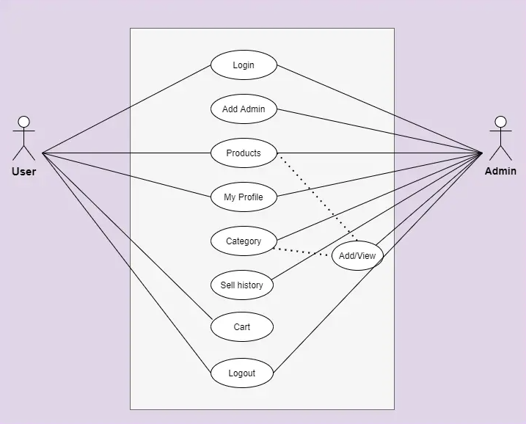
Use Case Diagram :-
Use case diagrams model how users, displayed as stick figures called “actors,” interact with the system. This type of UML diagram should be a high-level overview of the relationships between actors and systems, so it can be a great tool for explaining your system to a non-technical audience. A use-case model describes a system's functional requirements in terms of use cases. Use cases enable you to relate what you need from a system to how the system delivers on those needs.
Content Here
Content Here
Content Here

Slide 9
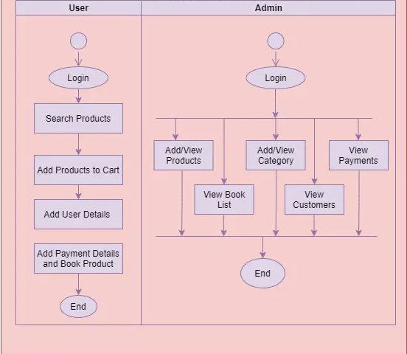
Activity Diagram :-
Content Here
Activity diagrams visualize the steps performed in a use case the activities can be sequential, branched, or concurrent. This type of UML diagram is used to show the dynamic behavior of a system, but it can also be useful in business process modeling. Activity diagrams are graphical representations of workflows of stepwise activities and actions with support for choice, iteration and concurrency. It describes the flow of control of the target system, such as the exploring complex business rules and operations, describing the use case also the business process.
Content Here
Content Here

Slide 10
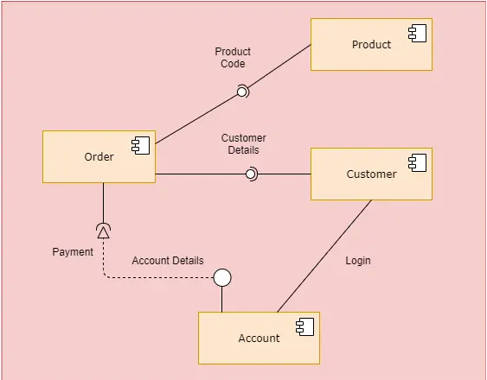
Component Diagram :-
Content Here
Component diagrams are different in terms of nature and behavior. Component diagrams are used to model the physical aspects of a system. Now the question is, what are these physical aspects? Physical aspects are the elements such as executables, libraries, files, documents, etc. which reside in a node. Component diagrams are used to visualize the organization and relationships among components in a system. These diagrams are also used to make executable systems.
Content Here

Slide 11
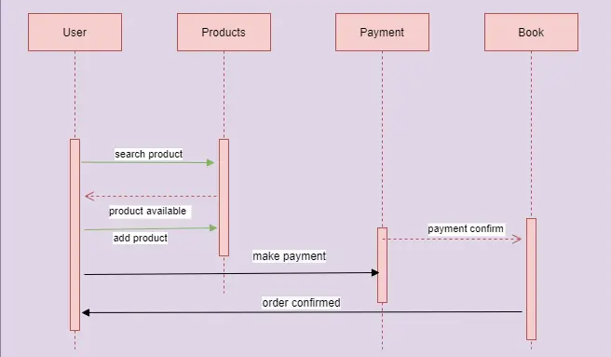
Sequence Diagram :-
Content Here
A sequence diagram, sometimes referred to as an event diagram or an event scenario, shows the order in which objects interact. This way, you can visually represent simple runtime scenarios. With the advanced visual modeling capability, you can create complex sequence diagram in few clicks.
Content Here
Content Here

Slide 12
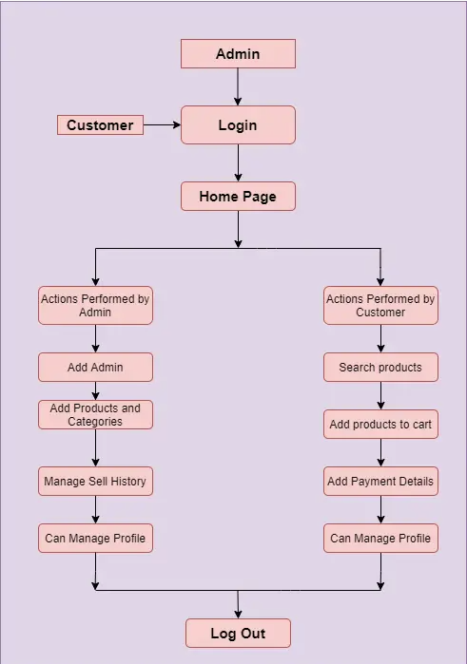
DFD Diagram :-
Content Here
A Data Flow diagram represents the flow of information for any process or system. It shows the system with its relationship to external entities. Here, we can see how the users and process flow work in a system.
Content Here
Content Here

Slide 13
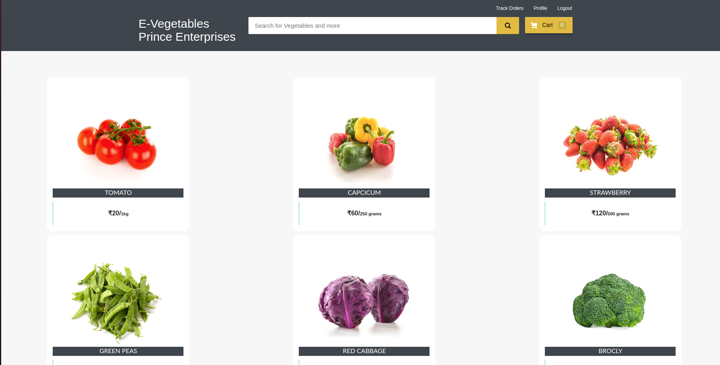
Forms Layout :-
Home Page :-

Slide 14
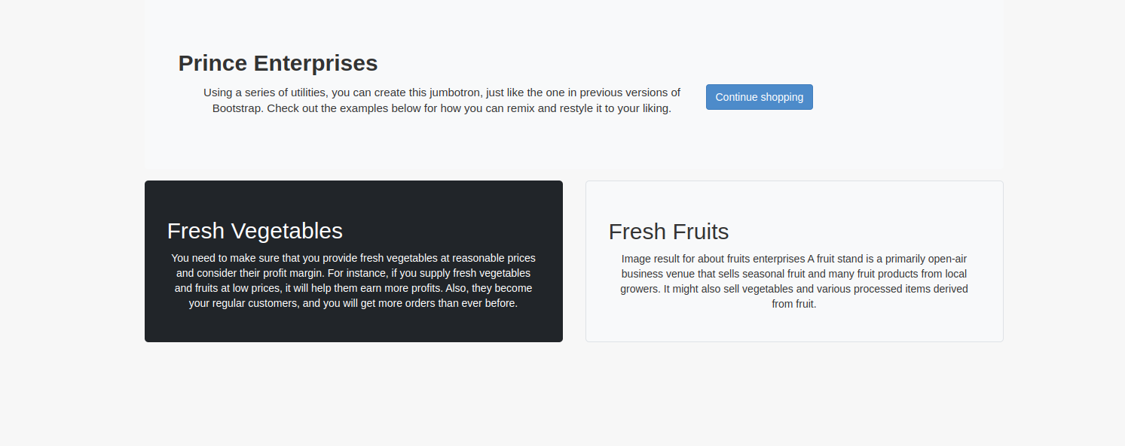
Forms Layout :-
About Us :-

Slide 15
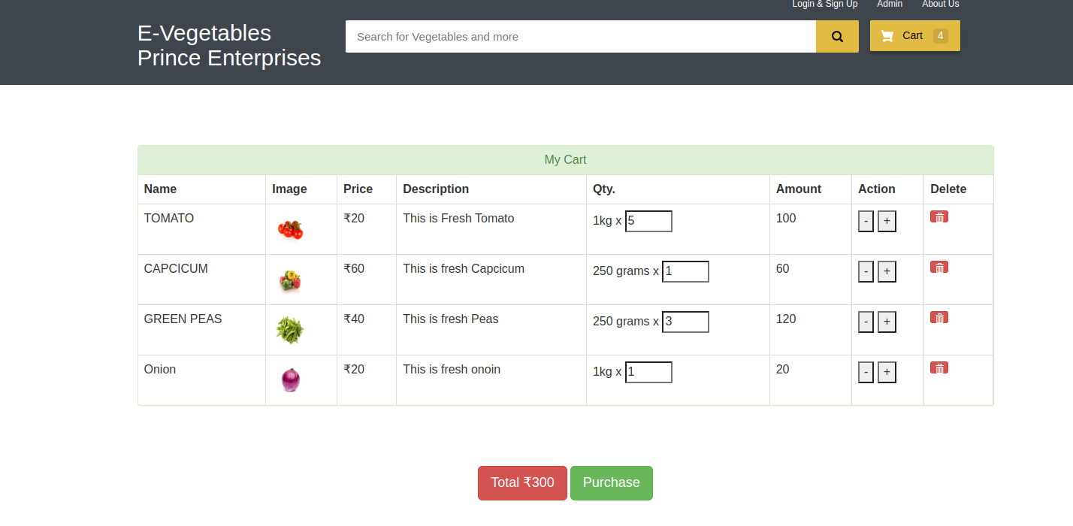
Forms Layout :-
Cart :-

Slide 16
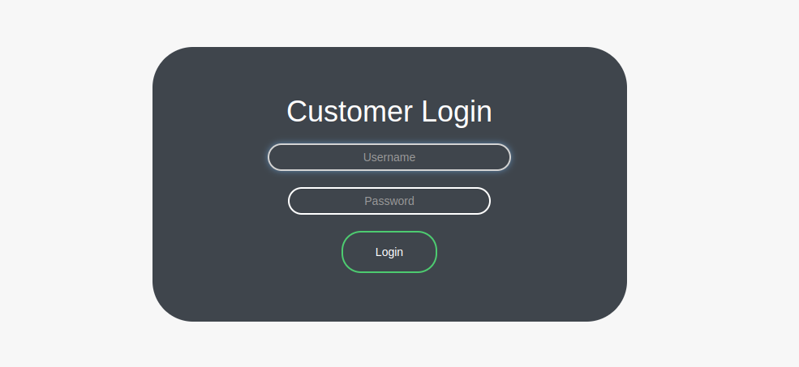
Forms Layout :-
Login :-

Slide 17
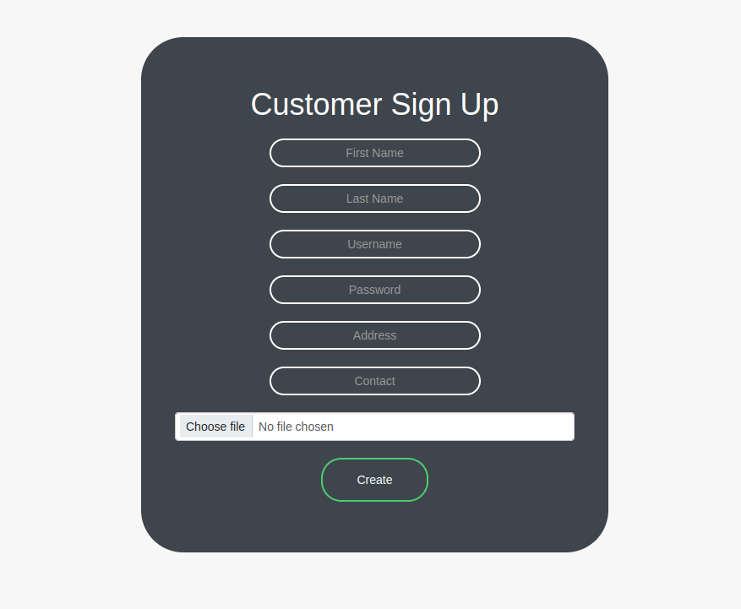
Forms Layout :-
Signup :-

Slide 18
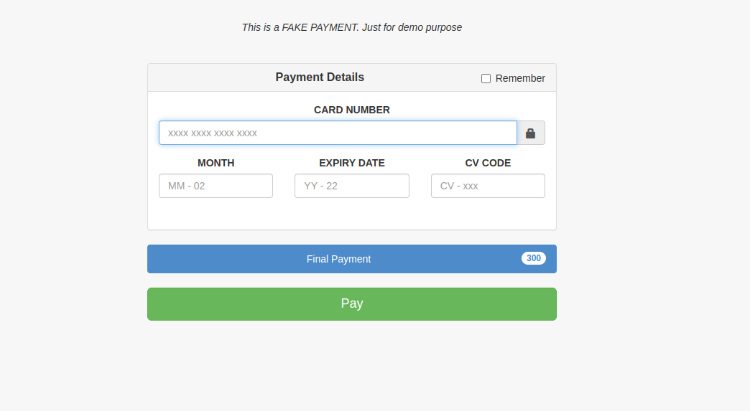
Forms Layout :-
Payment :-

Slide 19
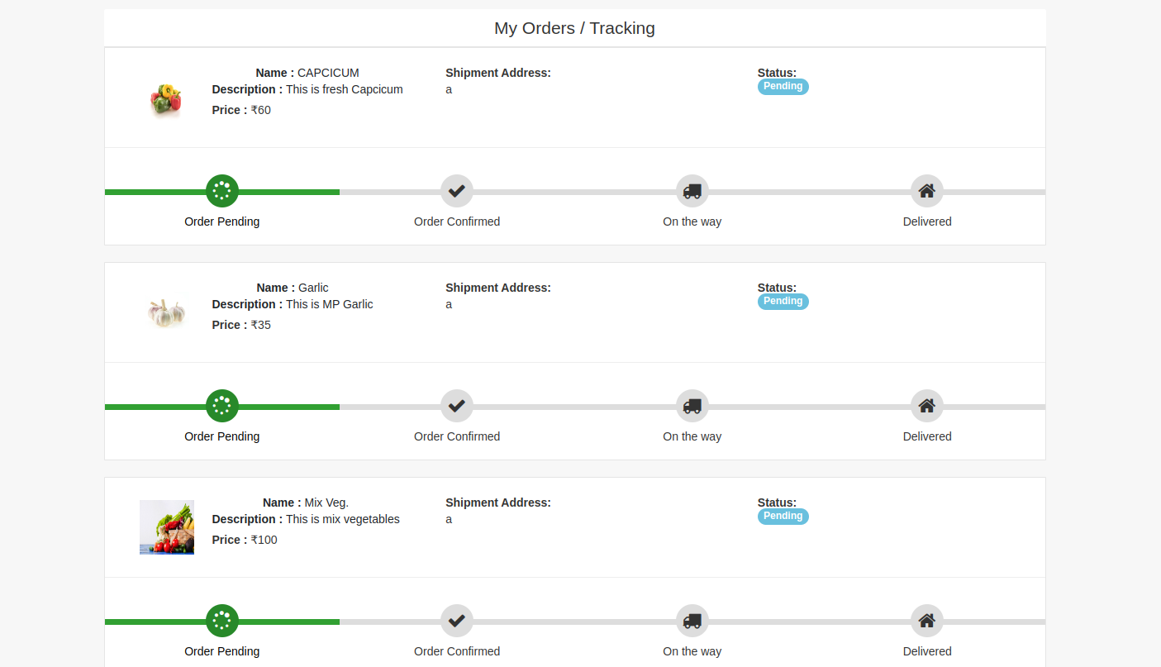
Forms Layout :-
Track Orders :-

Slide 20
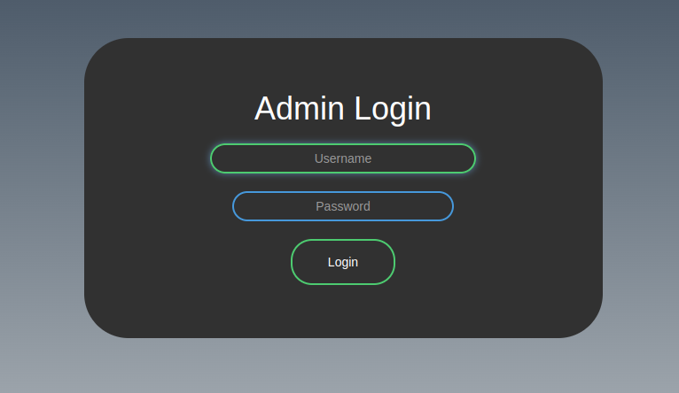
Forms Layout :-
Admin Login

Slide 21
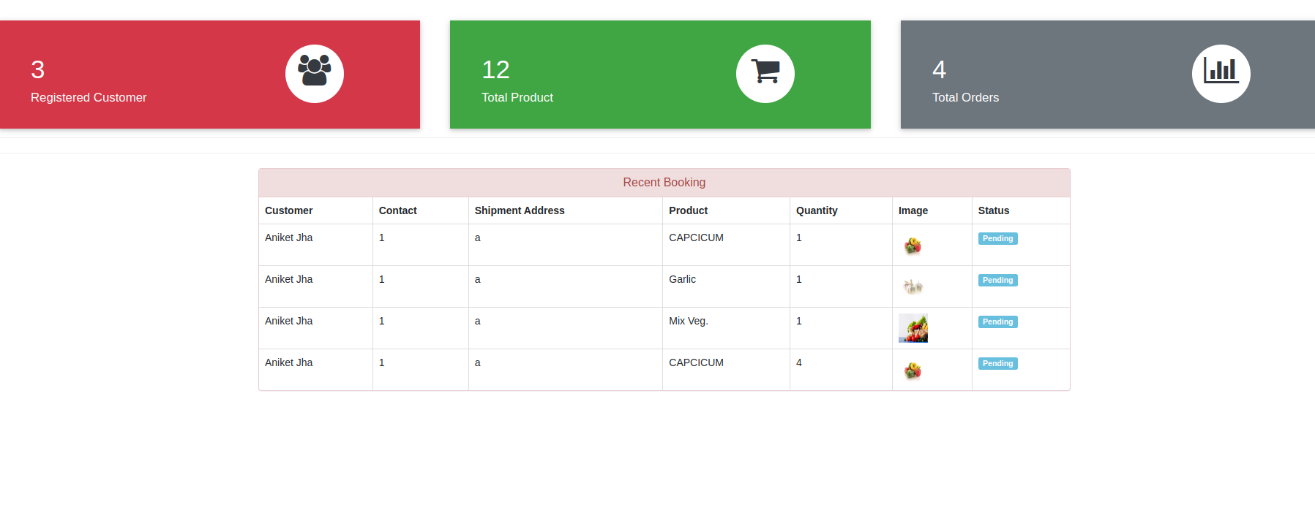
Forms Layout :-
Admin Dashboard

Slide 22
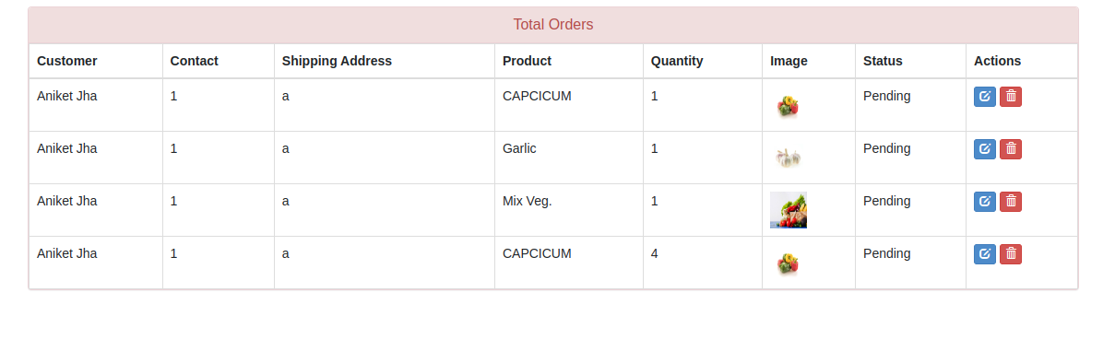
Forms Layout :-
View Orders :-

Slide 23
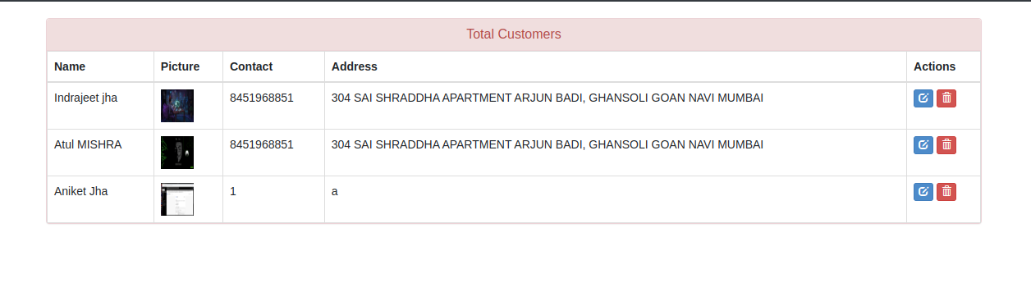
Forms Layout :-
View Customers :-

Slide 24
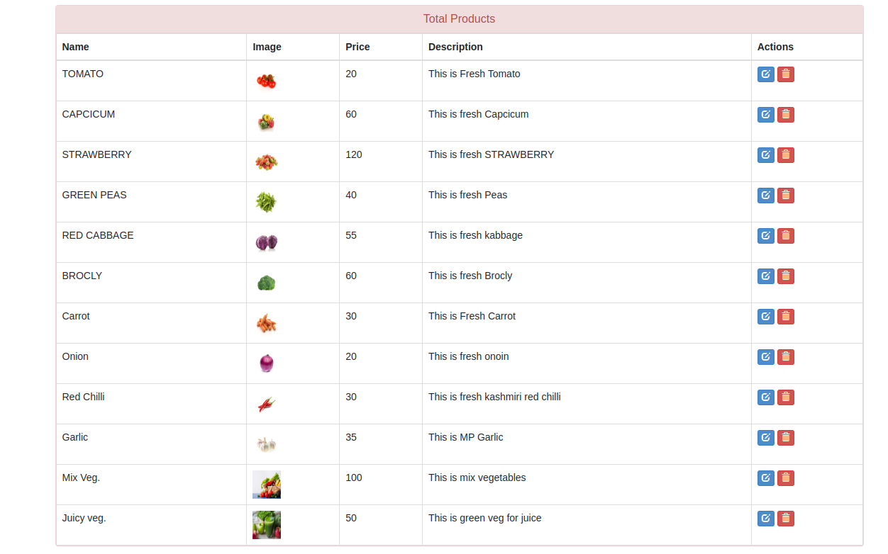
Forms Layout :-
Manage Product :-

Slide 25
Future Scope :-
Review and Feedback feature would be added in future. Invoice Download feature would be added as proof of transaction between customer and vendor. Multiple Payment system would be integrated and return policy would be added. Chatbot will be added for negotiating on price with customers. Machine Learning and Artificial Learning will be used which will make system intelligent.

Slide 26
Conclusion
E-Vegetable Mart will act as bridge between buyers and sellers of vegetables. It will help customers to place order of vegetables from their home. Also vendors will reach to large number of people. Website is designed in a way such that it can be used multiple vendors with some customization. User can add items to his cart and order them at once. This ordered items will be visible to the vendor who can either accept or reject the order.
Hence, E-Vegetable Mart will make shopping vegetables more easier and save time and money of customer. Also vendor will make more profit as he would be able to sell to more customers online.

Slide 27
References :-
https://getbootstrap.com
https://fonts.google.com/
https://fontawesome.com/v4.7.0./icons/
https://google.com
https://youtube.com
https://w3resource.com
https://geeksforgeeks.com
You can simply impress your audience and add a unique zing and appeal to your Presentations. I hope and I believe that this Template will your Time, Money and Reputation. Get a modern PowerPoint Presentation that is beautifully designed.
S
W
O
T
You can simply impress your audience and add a unique zing and appeal to your Presentations. I hope and I believe that this Template will your Time, Money and Reputation. Get a modern PowerPoint Presentation that is beautifully designed.

Slide 28
THANK YOU

