Slide 1

Creating IoT Setup for Battery Digital Twin
CP301: Developmental Engineering Project Report
Submitted by
Sahil Nitin Mhapsekar (2022MEB1324)
Jai Kumar Prajapati (2022MEB1316)
Kultaj Singh (2022MEB1321)
Under the Guidance of
Dr. Manish Agrawal & Dr. Jagpreet Singh

Slide 2
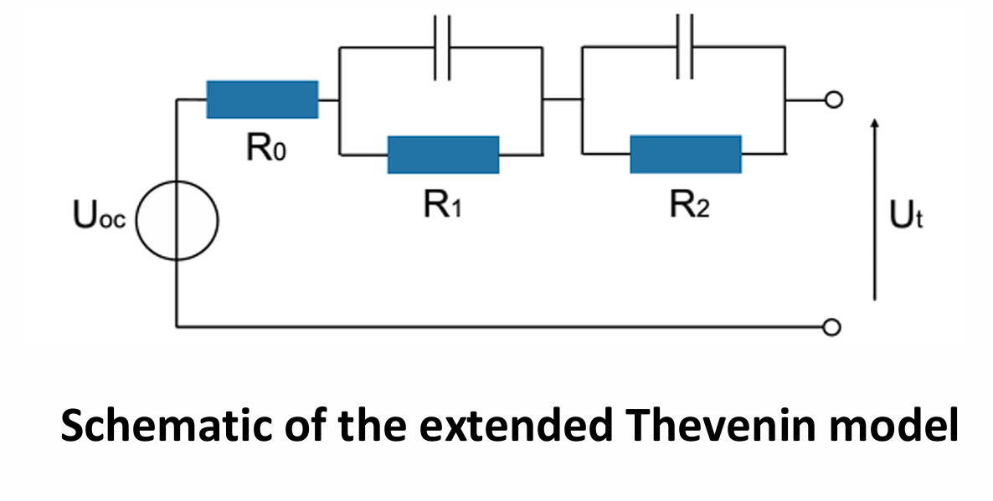
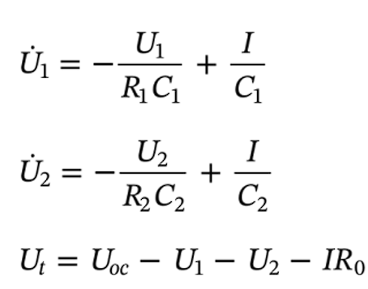
The Need for Battery Digital Twins
The Battery Challenge: Modern battery management faces increasing demands for reliability, longevity, and safety, especially in applications like Electric Vehicles (EVs) and renewable energy storage.
Traditional Monitoring: Traditional BMS relies on voltage and current, lacking deeper insights into internal battery health. This limits accurate state-of-charge (SoC) and state-of-health (SoH) estimations, preventing early detection of degradation.
Digital Twins: Digital twins offer a virtual replica of the battery, capable of simulating its behavior and predicting its future performance.
Project Goal: This project aims to create an IoT-enabled system that integrates Electrochemical Impedance Spectroscopy (EIS) with a Battery Digital Twin. This allows for real-time monitoring, diagnostics, and optimization, paving the way for more efficient and reliable battery management.

Slide 3
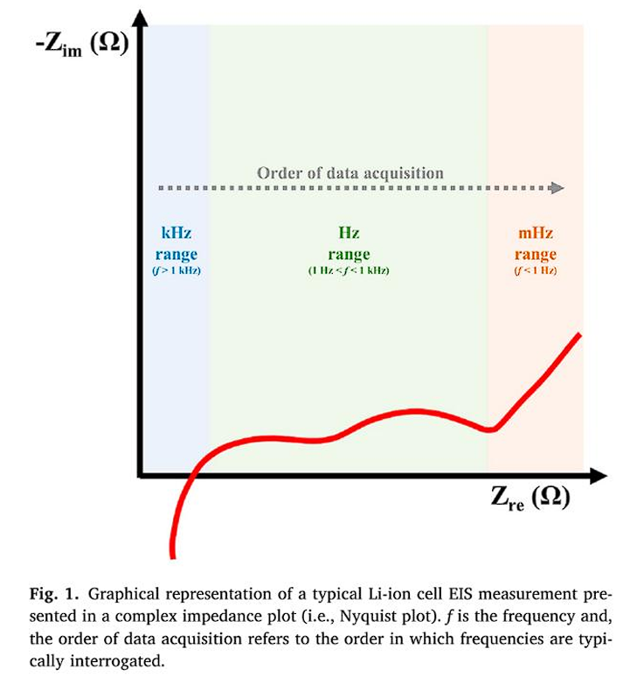
EIS: A Powerful Diagnostic Tool
Electrochemical Impedance Spectroscopy (EIS): A non-destructive technique that measures a battery's impedance response across a range of frequencies. It provides valuable insights into internal resistance, charge transfer kinetics, and diffusion processes.
The Need for Accurate EIS: Accurate and reproducible EIS measurements are crucial. They require careful calibration, precise instrumentation, and adherence to established protocols to minimize measurement errors and ensure traceability to the International System of Units (SI).
EIS Measurement Techniques: Key techniques include:
Potentiostatic (PEIS) and Galvanostatic (GEIS) EIS
Dynamic EIS (DEIS): Measures impedance during charge/discharge cycles for real-time dynamic behavior analysis.
Types of analysis: Equivalent Circuit Modelling (ECM), Distribution of Relaxation Times (DRT).

Slide 4
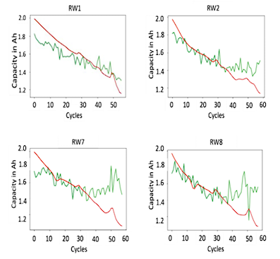
Addressing the Challenges
Traditional methods fail to detect early signs of degradation in Batteries.
Need for precise control of voltage perturbations and maintaining linearity.
Challenges in ensuring measurement quality, reproducibility, and reliable interpretation of impedance data.
Goal: Accurate and real-time monitoring for predictive maintenance, improve safety, extend battery life, enable adaptable and accurate system, and ensure insightful characterization.

Slide 5
Building the Digital Twin
Integrated approach of Digital Twin Building and monitoring
Hardware setup design
Measurement Techniques:
Potentiostatic EIS (PEIS): High-resolution impedance spectra across a wide frequency range.
Dynamic EIS (DEIS): Capturing impedance behavior during active charge/discharge cycles.
Data Analysis and interpretation:
Equivalent Circuit Modelling (ECM): Quantify key battery parameters.
Distribution of Relaxation Times (DRT): Enhance accuracy by identifying overlapping processes.
Validation:
Kramers-Kronig Relations: Ensure linearity, causality, and stationarity of measurements.
Future Directions: Integrate Machine Learning (ML) to automate the fitting of ECMs and DRTs, predict battery states (e.g., SOC, SOH), and identify patterns that indicate early signs of failure.

Slide 6
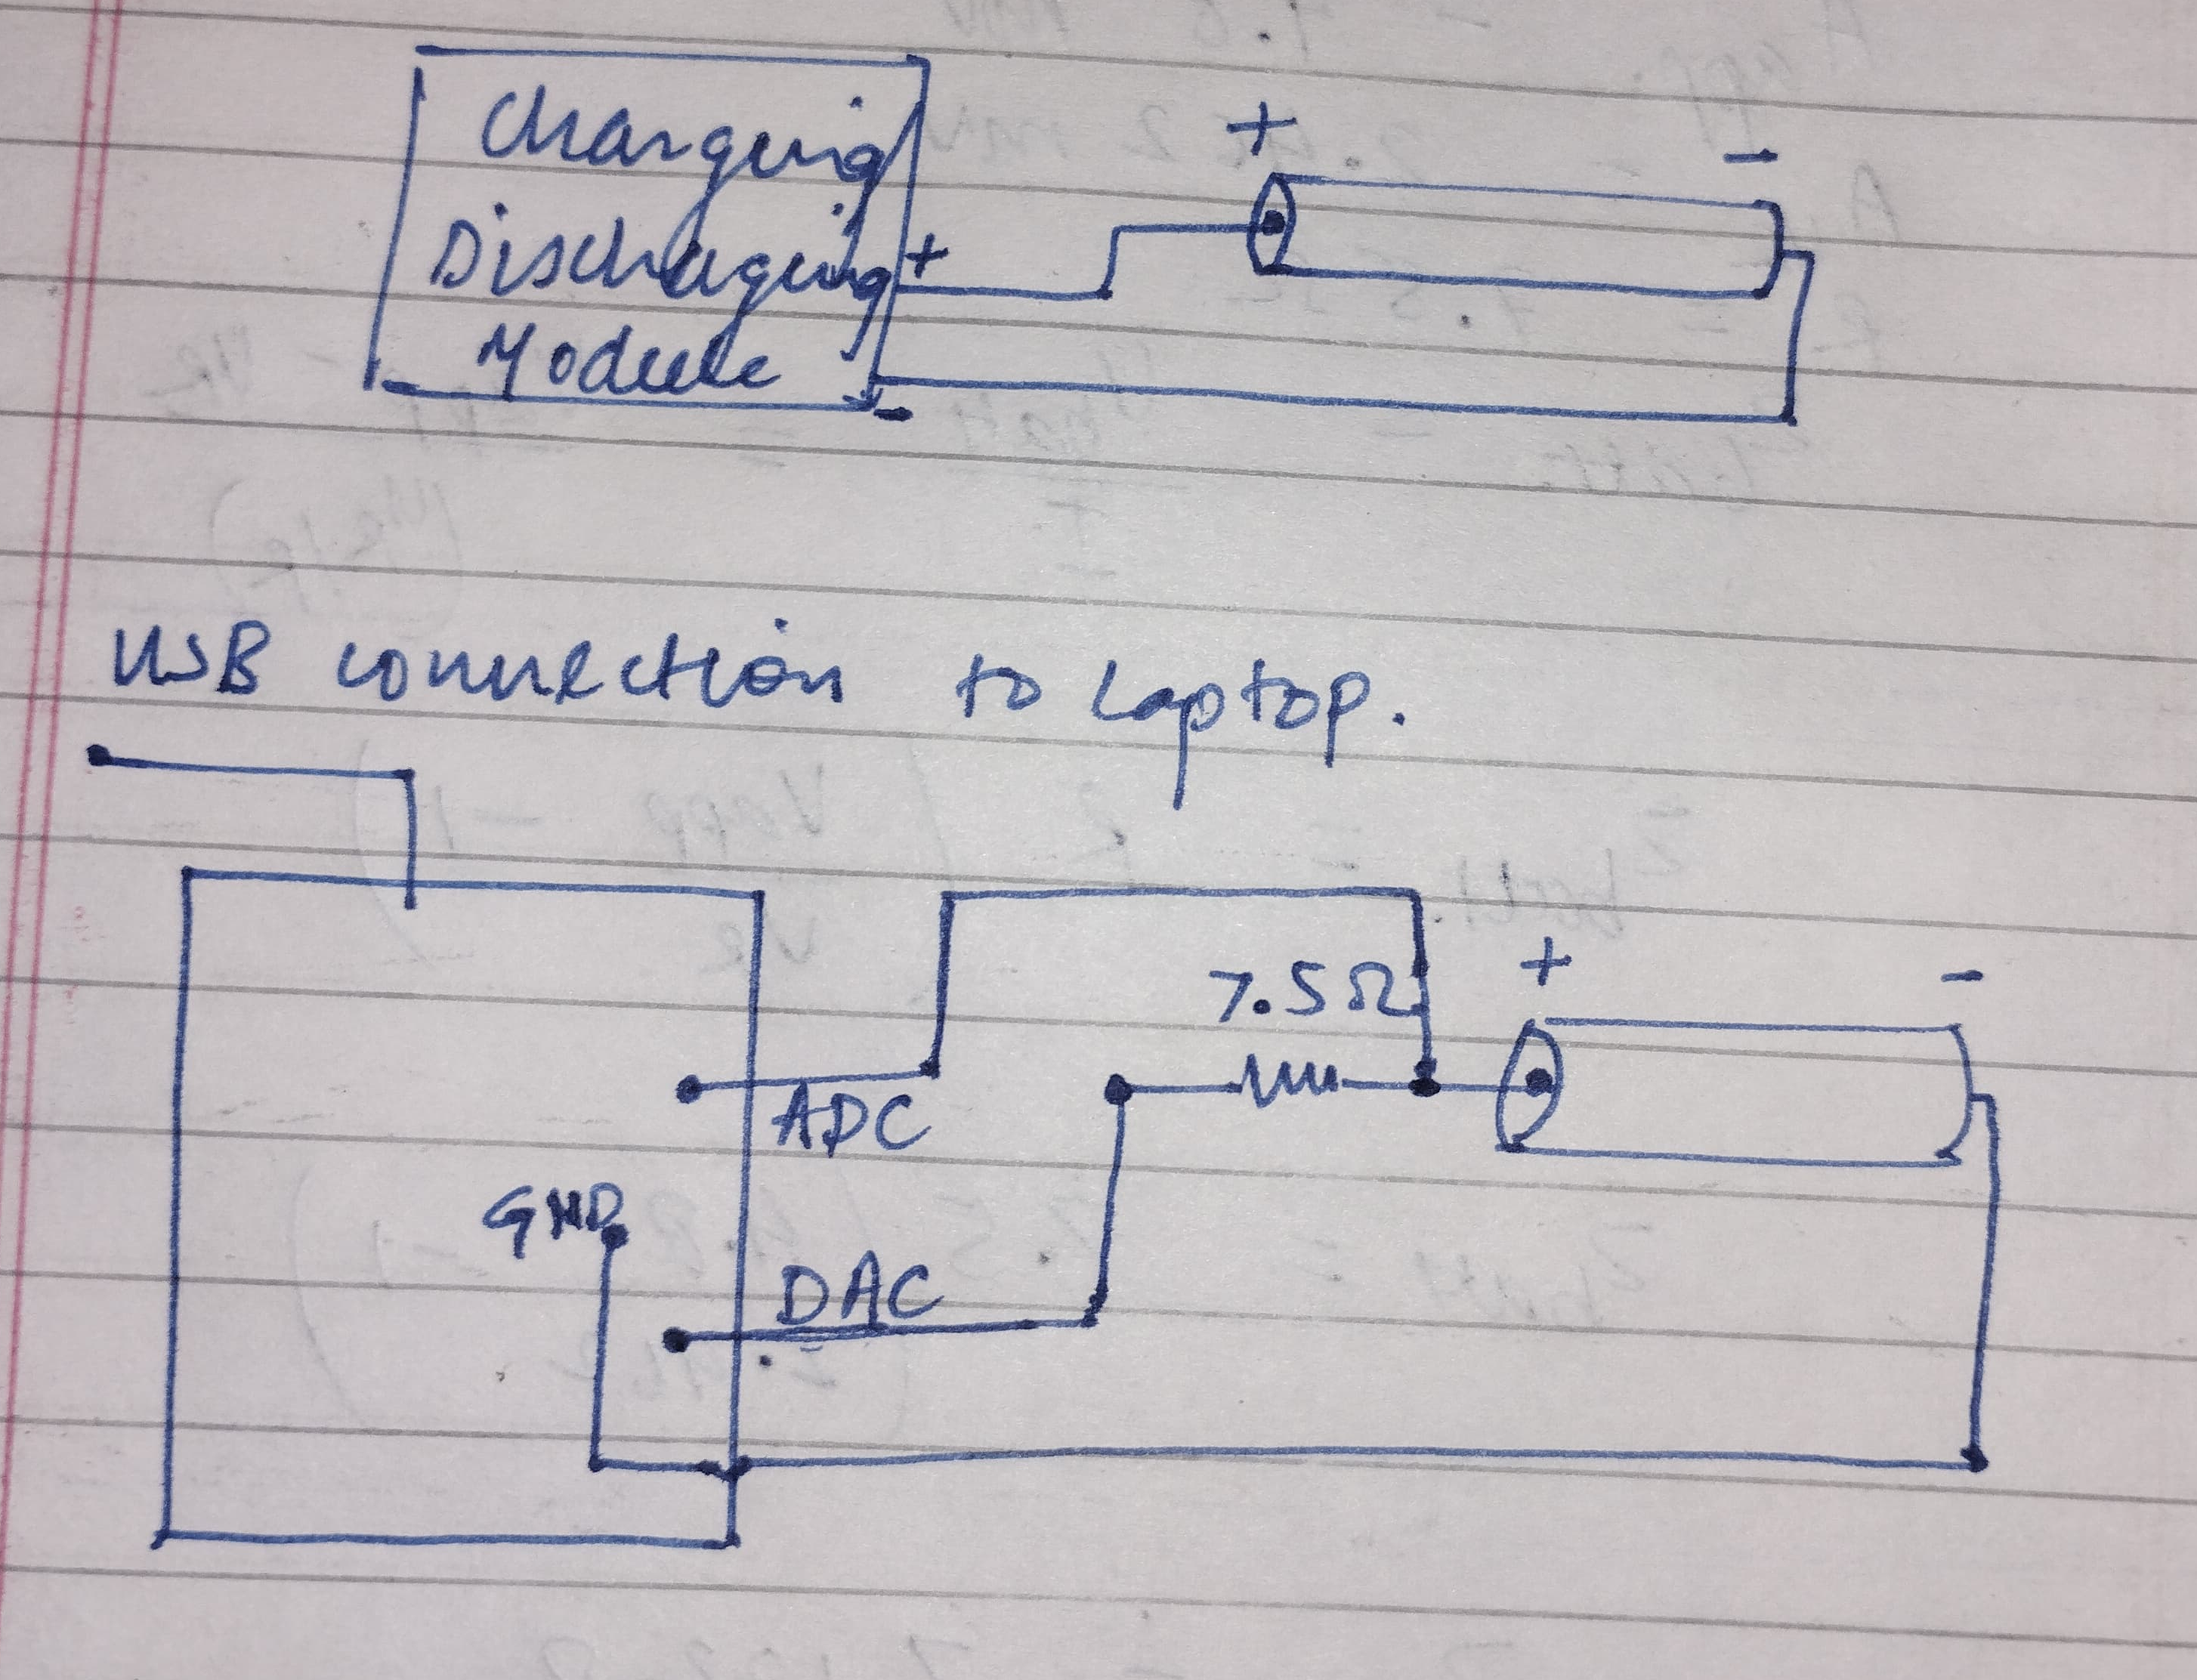
Hardware Implementation and Sine Wave Generation
Hardware Setup:
Designed and implemented signal generation and data acquisition circuit using the STM32G474RE microcontroller.
Employed SkyRC IMAX B6 Mini for controlled charging/discharging of the INR18650-30Q Lithium-ion battery.
Used jumper wires, resistors, LEDs (for GPIO verification), and USB data cable for connectivity.
Objective: To create a sinusoidal signal using the DAC peripheral of the STM32G474RE to act as the excitation voltage for EIS measurements.
Firmware Variants: Created firmware with varying control schemes:
Frequency Control: Emphasized control through timers and DMA.
Amplitude Control: Emphasized amplitude control through scaling of DAC buffer values.

Slide 7
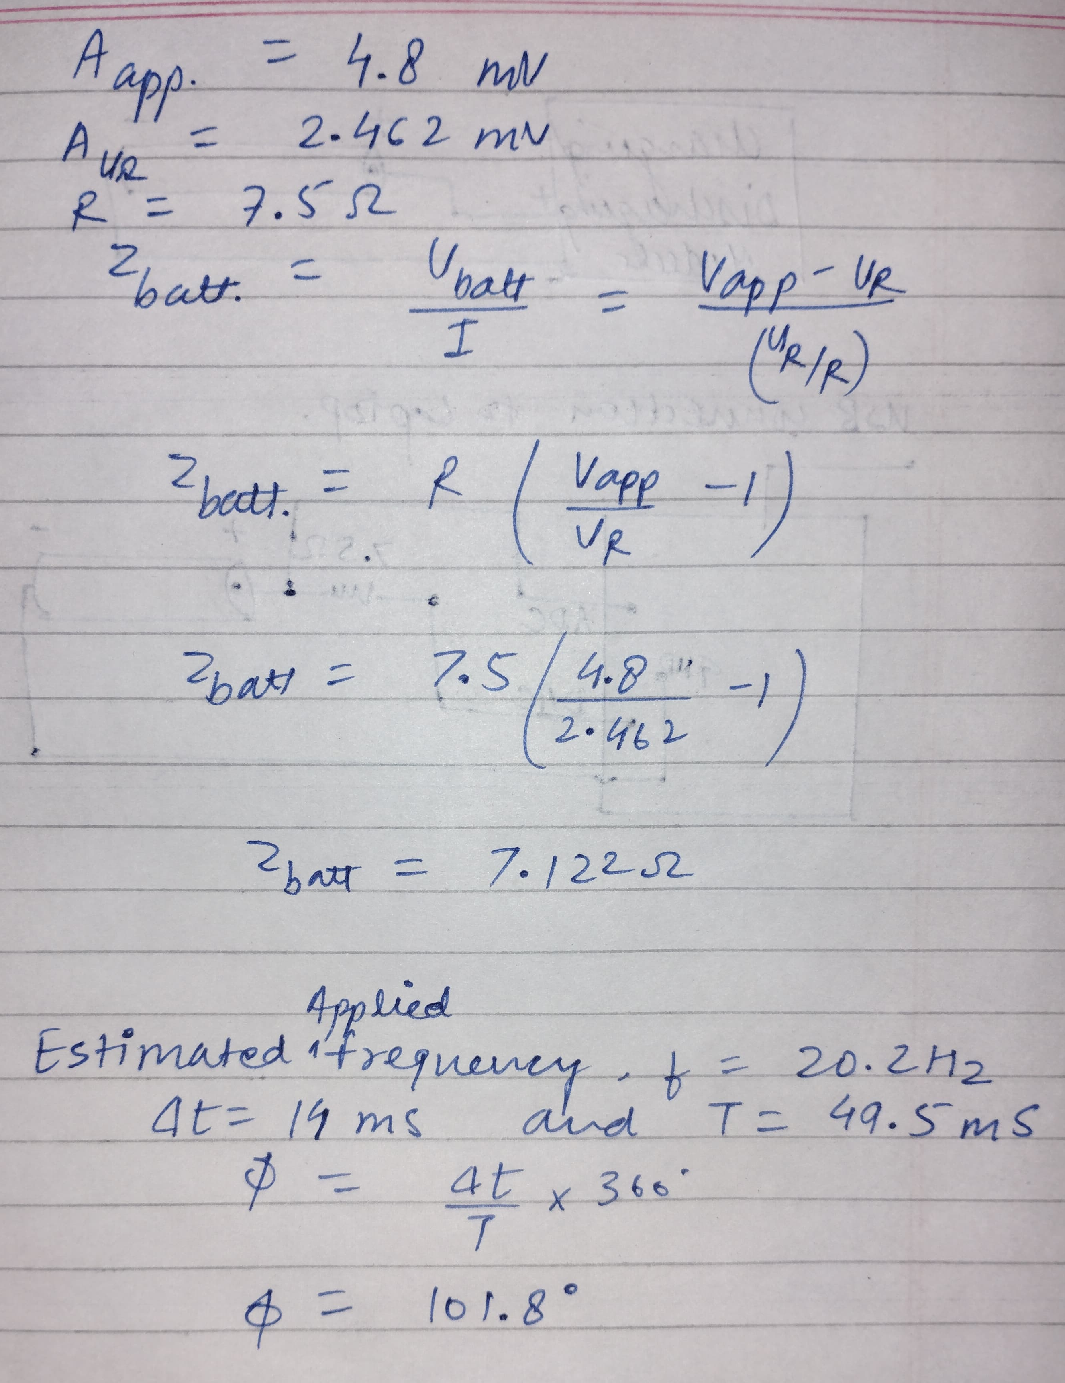
Experimental Results
Testing Setup:
Applied a 10mV peak-to-peak sine wave generated by the STM32G474RE, across a series combination of the INR18650-30Q battery (3.3V) and a 7.5 Ω resistor.
The UART sent the output for logging to analyze.
Key Measurements:
Estimated Applied Frequency of the Signal: ≈ 20.2 Hz
Amplitude of Applied Voltage: ≈ 4.80 mV
Amplitude of Voltage Across 7.5 Ω Resistor: ≈ 2.462 mV
Calculated Battery Impedance: ≈ 7.122 Ω
Phase Shift (Current Lags Voltage): ≈ 101.82°
Results Validation:
The output validated that our STM32 based system can generate a valid low-amplitude excitation signal and capture the voltage response needed to compute the impedance of the battery at a given frequency.
Impedance Behavior Results:
The observed phase lag and impedance magnitude are consistent with the behavior of an electrochemical system under AC excitation, indicating successful proof-of-concept for the first stage of EIS implementation.

Slide 8
Limitations
Program execution limitations affecting the high frequency signal generation.
Delays with UART and control logic limited maximum frequency of waveform achieved.
sinf() ~ 8–20 μs
HAL_DAC_SetValue() ~ 3–5 μs
read_adc_voltage() ~ 10–15 μs
sprintf() ~ 20–40 μs
HAL_UART_Transmit() ~ 80–200 μs (In our case it was 2.6 ms)
HAL_GPIO_TogglePin() ~ 2 μs
Not able to synchronize control of voltage and frequency.
Lack of technical resources demonstrated varying voltage and frequency.

Slide 9
Findings & Conclusion
Progress Made so far:
Theoretical and design phases
Experimental Set up Sourcing and identification
Initial ElS measurement and validated impedance estimation
Remaining Tasks:
Conduct EIS measurements to validate data accuracy.
Hardware limitations.
Successfully established a platform for low-amplitude, fixed-frequency impedance measurements.

Slide 10
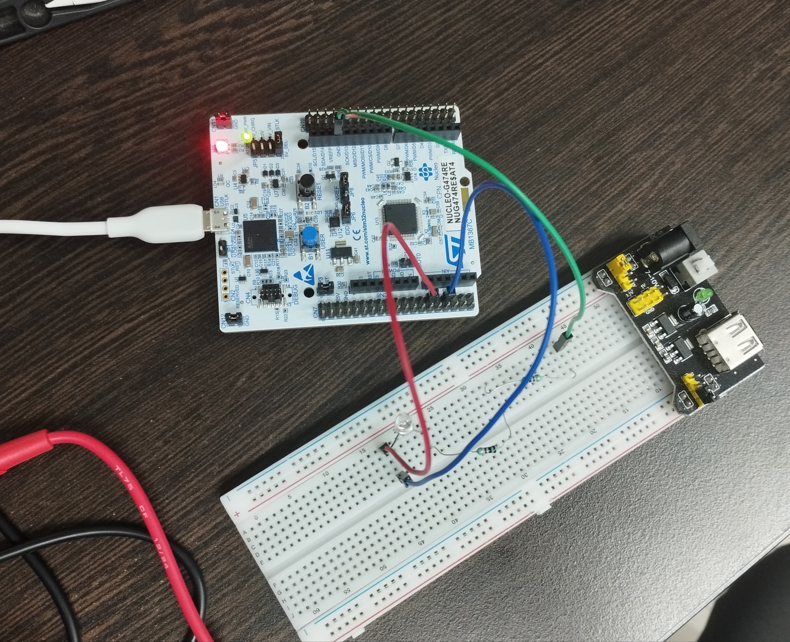
Hardware Setup
Hardware setup for sine wave testing:

Slide 11
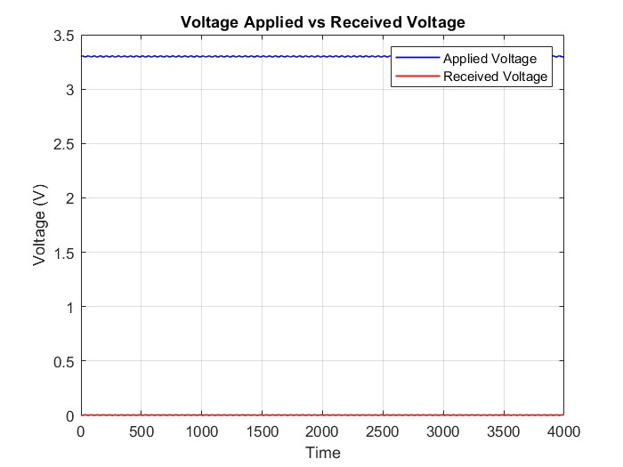
Result plots - Sine Waves, Impedance Results
Blue wave is the applied wave
Red wave is the response voltage wave across 7.5-ohm resistor
For reference of data, follow Link

