Slide 1
One Encoder for Shared Physics
Multi-task learning across correlated polymer properties, with measured representation invariance
Team NeonNull · Sahil Sadhwani · VIT
Amalgam Hackathon — Round 3 Finale · Polymer Property Prediction · September 2026
Notes:
Seven polymer properties from SMILES. Our approach is built around one measured fact: six of the seven are the same physics, and five of them have almost no data.

Slide 2
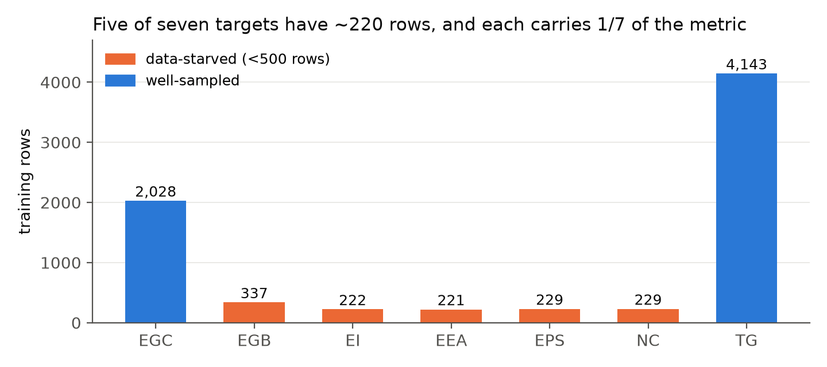
The problem is not accuracy. It is imbalance.
Seven targets, one unweighted mean of per-target R². Five targets have ~220 training rows each.
5 of 7
targets under 500 rows
71%
of the metric carried by
14% of the data
A per-target LightGBM reaches only R² 0.75 on dielectric constant. Fitting these independently is hopeless.
Notes:
Because the metric averages per-target R2 without weighting, the five small targets carry five sevenths of the score while contributing a seventh of the data. Everything we did follows from that.

Slide 3
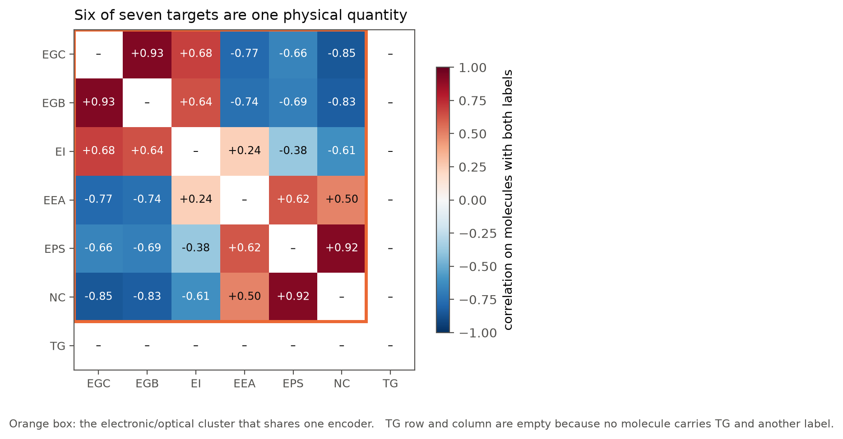
We measured the targets before modelling them
On the 415 molecules carrying more than one label, the structure is unambiguous.
+0.93
chain vs bulk band gap
+0.92
dielectric constant vs refractive index — the textbook n² ≈ ε
−0.85
chain band gap vs refractive index
All six are frontier-orbital quantities. Glass transition is thermal and shares no molecule with any of them — so it trains alone.
Notes:
This measurement, not a hyperparameter search, dictated the architecture. Six targets share an encoder; Tg does not.

Slide 4
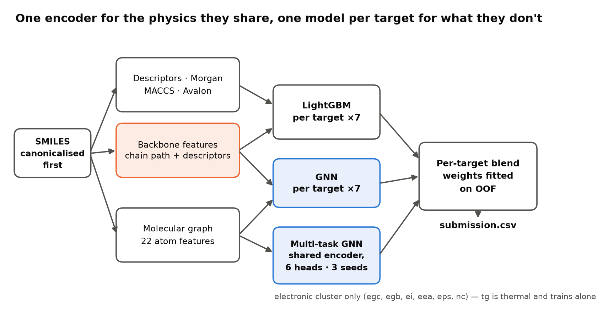
Architecture
Tree path, graph path, and one encoder shared across the six electronic targets.
Notes:
Tree path: RDKit descriptors, fingerprints, and our polymer backbone features. Graph path: a message-passing network. The multi-task encoder serves the six electronic targets through six heads; each row trains only its own head. Blend weights fitted per target on out-of-fold predictions.

Slide 5
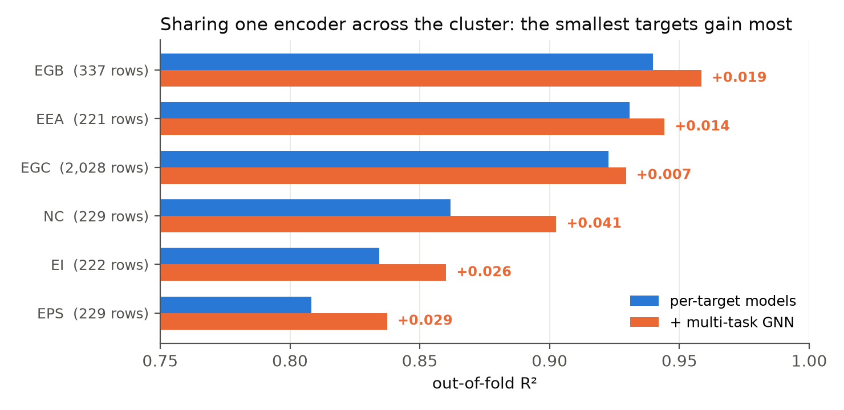
The shared encoder pays where data is thinnest
Gains scale inversely with training rows — exactly what transfer should look like.
+0.041
refractive index
229 rows
+0.029
dielectric constant
229 rows
+0.007
chain band gap
2,028 rows
Multi-task over the cluster: +0.0157 on the official metric.
Notes:
The smallest targets gain most. Refractive index, with 229 rows, gains 0.041 R2 purely from borrowing a representation learned on 3,266 electronic rows.

Slide 6
Results
Out-of-fold, blend weights fitted by nested cross-validation so they never see the rows they score.
Target | Rows | LightGBM | GNN | Multi-task | Blend
EGC | 2,028 | 0.908 | 0.913 | 0.927 | 0.930
EGB | 337 | 0.902 | 0.940 | 0.958 | 0.959
EI | 222 | 0.798 | 0.826 | 0.866 | 0.864
EEA | 221 | 0.891 | 0.930 | 0.942 | 0.945
EPS | 229 | 0.746 | 0.805 | 0.834 | 0.837
NC | 229 | 0.810 | 0.860 | 0.906 | 0.903
TG | 4,143 | 0.913 | 0.905 | — | 0.920
0.9139
official metric, mean R² over 7 targets
0.537
organizer Ridge baseline
Progression across submissions: 0.889 per-target → 0.904 adding the shared encoder → 0.908 seed-averaged → 0.914 at ten folds
Notes:
The multi-task column is the story: it beats the per-target models on every one of the six, and the blend adds a little more.

Slide 7
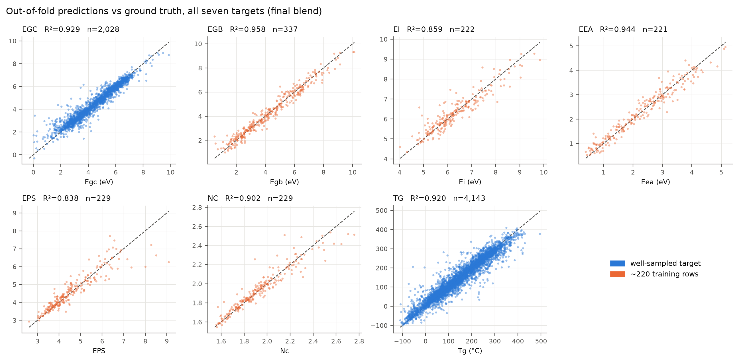
Predictions against ground truth
All seven targets, out-of-fold.
Notes:
Orange panels are the 220-row targets. They are noisier, as expected, but no longer unusable.

Slide 8
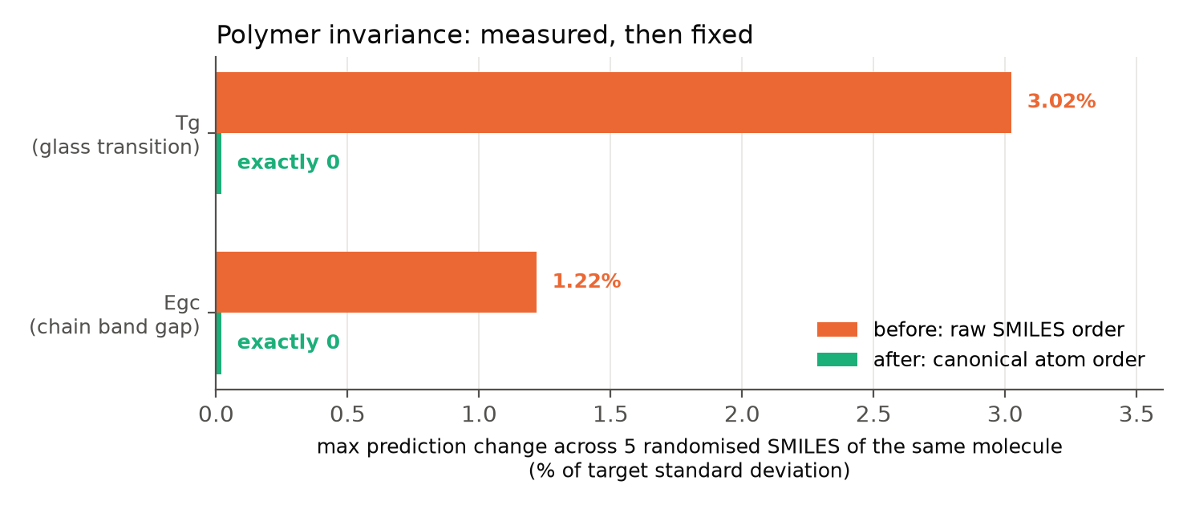
Polymer invariance: we measured it, then fixed it
A model that answers differently for two spellings of the same molecule cannot be trusted.
Found
predictions moved up to 3.02% of target sd across randomised SMILES
Cause
atom ordering — tied ring paths, Gasteiger charges, Ipc rounding
Why it mattered
65% of the supplied SMILES are not canonical
Fix
re-parse from canonical SMILES, drop Ipc. Cost: 0.0001
deviation after the fix: exactly 0
Notes:
Nothing in cross-validation reveals this, because train and test SMILES are each written one particular way. It only appears if you deliberately re-spell the molecules.

Slide 9
What did not work
Nineteen experiments across the competition. Four survived.
PI1M pretraining
Masked-atom pretraining on 100k unlabeled repeat units reached 99% reconstruction accuracy. The representation still did not beat supervised training on 3,266 labelled rows.
−0.0038
Multi-task including Tg
Tested in Round 2. Tg and Egc share no physics, so one encoder serving both diluted each. Same technique, opposite result — which is why we measured the correlations first this time.
−0.0230
Multi-task LightGBM
Too weak alone (R² 0.79) to earn blend weight.
+0.0004
Notes:
We report the pretraining result as a negative rather than omitting it. The auxiliary dataset was the one the organizers highlighted, and the honest finding is that it did not transfer.

Slide 10
What changed from Round 2 to Round 3
The same technique, applied where the physics justified it.
Round 2 · two targets
Round 3 · seven targets
Polymer backbone features
18 scalars from the chain between the two attachment points. Worth +0.0056, more than 1,024 Avalon bits.
Message-passing GNN
Reads topology directly; errors decorrelated from the trees. Worth +0.0053.
Multi-task across Tg and Egc
Rejected: −0.0230.
Measure the targets first
Correlation structure decided the architecture before any model ran.
Multi-task across the electronic cluster
Same technique that failed in Round 2, now +0.0157 — because these six targets are one physical quantity.
Invariance treated as a measurement
Not an assumption. Found a 3% defect and removed it.
Notes:
The paradigm shift is that we stopped asking which model is best and started asking which targets belong together.

Slide 11
Model particulars
Everything runs from scratch inside one Kaggle notebook. No pretrained weights, no uploaded artifacts.
387k
10 × 3
3h 20m
<1 ms
parameters
multi-task encoder
folds × seeds
multi-task
training
Kaggle CPU, no GPU
inference
per molecule
Reproducibility. Single-threaded with per-fold seeds — parallel index_add_ in message passing is otherwise non-deterministic, and we measured two identical runs differing by 0.18 per prediction before pinning it. Kaggle reproduced our local out-of-fold score within 0.0035 on every run of the competition.
Notes:
Determinism matters because the hosts re-run the pinned notebook. Single-threading cost nothing because the graphs are small.

Slide 12
What we would tell a materials scientist
Electronic
Band gap falls as conjugation runs along the backbone lengthen and as attachment atoms turn sp² — conjugation then propagates across repeat units instead of stopping at the unit boundary. Dimer conjugated-bond fraction correlates −0.76 with chain band gap.
Optical
Refractive index and dielectric constant rise with the same polarisable, aromatic-rich backbones that narrow the gap (+0.92 with each other, −0.85 with band gap). The absorption edge follows at ≈1240/Egc nm. Side-chain bulk blue-shifts and solubilises.
Team NeonNull · kaggle.com/code/sahilsadhwani25/neonnull-round-3
Notes:
The model is legible: its feature importance concentrates on the backbone block, so for a new polymer it reports not just the predicted value but which structural motifs drive it.

