Slide 1
PROJECT PRESENTATION
ON
Library Management System
By
Sahil Kumar (AF0351742)
Shreshtha Gupta (AF0351182)

Slide 2
Library Management System
Introduction
Library Management System is a software used to manages the catalog of a library.
This helps to keep the records of whole transactions of the books available in the library.
Library Management handling the records of books and readers.
It provides Books for large number of readers.

Slide 3
Library Management System
OBJECTIVE OF THE PROJECT:-
The objective of the "Library Management Software" is to handle the entire activity of a library.
The software keeps track of all the information about the books in the library, their cost, their complete details and total number of books available in the Library.
The user will find it easy in this automated system rather than using the manual writing system.
The system contains a database where all the information will be stored safely.
The system is user-friendly and error free.
It saves time for the management of library.-
Faster search of available books and members than by hand.

Slide 4
Library Management System
Product Scope
Any education institute and government office's can make use of it for providing information about author, content of the available books etc.
This project can further be extended by adding the facility of e-book's , to overcome the problem of book stock in library

Slide 5
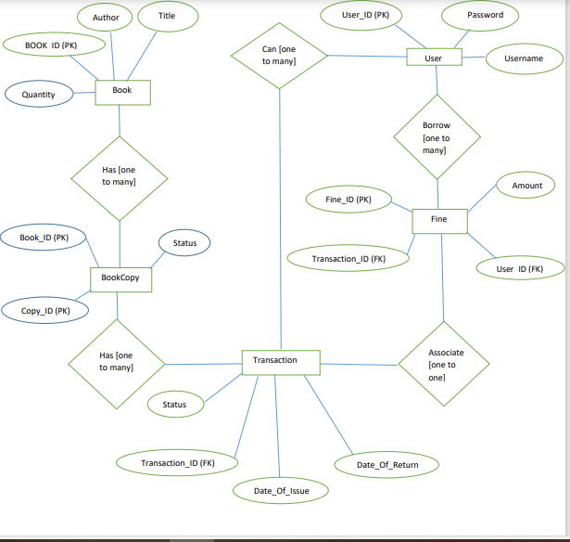
Library Management System
ER Diagram:-

Slide 6
STRUCTURE OF THE PROJECT:-
Library Management System
Admin:-
Admin has the authority to add, delete the details of the book available to/from the system.
He also has the authority to provide username and password for the receptionist.
He can also add the details of the book purchased from shops along with the shop name. Monthly expense report, books purchased report, cash collected for fee can also be viewed.
User Module:-
It can show details of books who are listed in library. Search facility based on different criteria in depth.
Allows user to view quick report like book issue/return etc. in between particular time

Slide 7
Library Management System
PROPOSED OF PROJECT:-
We create a computerized solution for such problem.
This system is specially built to track information about all student and book details. Search for desired book index system make less time consuming.
Improved customer service through greater access to accurate information.
To provide a friendly environment to maintain the details of books and library members.

Slide 8
Library Management System
REQUIREMENTS OF PROJECT:-
Window 10/XP Registration with System
Authorized System
User name and Password

Slide 9
Library Management System
FEATURES OF PROJECT:-
LMS is windows based Library management software.
Provides password facility for different users to ensure high level of security.
Single database management system.
Add, Modify and delete the book's and member's record.
Help option is provided for the user.
View the records of book's stock, member's and issued book's.
It is completely user friendly Library management software.
It is Avoid Data manipulations.
Huge data storage with less computer memory. More efficient & reliable.

Slide 10
Library Management System
ADVANTAGE OF PROJECT:-
Less Minimize handwritten work.
It helps you to minimize your repeated works and take care of the complete functionality of your Library.
It is a huge time saver and facilitates proper communication among the management staff.
Provide computerized system for maintaining records.
Avoid Human storage with less computer memory.

