Slide 1
Olist E-Commerce Business Analytics
/ Data Analytics
Business Performance Analysis using SQL Server
Sales • Customers • Products & Sellers • Delivery • Satisfaction

Slide 2
1. Business Problem
Turning transactional data into business decisions
Olist needs a clear view of sales performance, customer behavior and operational efficiency.
Management needs to understand delivery reliability and its relationship with customer satisfaction.
SQL analysis converts raw transactions into KPIs, trends, segment-level findings and business actions.
Objective: identify performance strengths, operational gaps and areas for deeper investigation.

Slide 3
2. Dataset & Analytical Scope
Olist Brazilian E-Commerce dataset
Dataset
Analysis Areas
9 relational tables covering customers, orders, order items, products, sellers, payments, reviews and geolocation.
~100K orders in the dataset.
Analysis period: 2016–2018.
SQL environment: Microsoft SQL Server / SSMS.
Sales performance
Customer analytics
Product & seller performance
Delivery operations
Customer satisfaction

Slide 4
3. Data Model
Key relationships used in the analysis
Customers
Orders
Order Items
Reviews
Sellers
Products
Modeling note: customer_unique_id was used for unique/repeat customer analysis because customer_id can represent multiple
order/address instances.

Slide 5
4. Executive KPI Dashboard
Headline metrics from the SQL analysis
R$13.59M
Total product sales
98,666
Unique orders
96,096
Unique customers
R$137.70
Average order value
12 days
Average delivery time
8.11%
Late delivery rate
4 / 5
Average review score
2,997
Repeat customers

Slide 6
5. Sales Performance
Key findings from Q1–Q8
2017 is the only complete calendar year; 2016 and 2018 are partial periods.
November 2017 was the highest observed month at ~R$1.01M.
Top categories include beleza_saude, relogios_presentes, cama_mesa_banho, esporte_lazer and informatica_acessorios.
State-level analysis identifies geographic sales concentration.

Slide 7
6. Customer Analytics
Customer base, repeat behavior and value concentration
Key Metrics
Business Interpretation
96,096 unique customers.
2,997 customers placed more than one order.
High-value customer analysis identified customers with the largest cumulative product sales.
Repeat-customer base is much smaller than the total customer base.
Retention and repeat-purchase programs are an area for further investigation.
High-value customers can be segmented for targeted retention and service strategies.

Slide 8
7. Product & Seller Performance
Identifying concentration among products and sellers
Top Product Categories by Sales
Business Use
Beleza_saude — ~R$1.259M
Relogios_presentes — ~R$1.205M
Cama_mesa_banho — ~R$1.038M
Esporte_lazer — ~R$0.988M
Informatica_acessorios — ~R$0.912M
Moveis_decoracao — ~R$0.730M
Rank top sellers and products by cumulative sales.
Use rankings for inventory, seller-account and assortment investigations.
High sales does not equal high profit because product cost is not available.
Prioritize deeper analysis of high-contribution categories and sellers.

Slide 9
8. Delivery Performance
Operational reliability and geographic variation
Overall KPIs
State-level Finding
Average delivery time: 12 days.
Late delivery rate: 8.11%.
Late = actual delivery after estimated delivery date.
Only orders with both delivery dates were included.
Alagoas (AL) had the highest observed late-delivery percentage: 23.93%.
Other high-rate states in the returned ranking included MA, PI, CE and SE.
State percentages should be interpreted together with order volume.

Slide 10
9. Customer Satisfaction
Review performance and delivery experience
Review KPIs
Delivery vs Satisfaction
Average review score: 4 / 5.
14,575 orders received a low review score of 1 or 2.
Low-rated orders are a meaningful segment for root-cause analysis.
On-time deliveries: average review score = 4.
Late deliveries: average review score = 2.
Observed reviews differ substantially between delivery groups.
Further analysis should control for category, seller and state before treating delivery as the only driver.

Slide 11
10. Business Insights
What the analysis tells management
Sales are concentrated in a limited set of product categories, creating clear areas for assortment and inventory analysis.
Customer retention is an important opportunity: 2,997 repeat customers compared with 96,096 unique customers.
8.11% of delivered orders arrived after the estimated date, creating a measurable operational improvement area.
Delivery performance varies materially by customer state; regional investigation can reveal operational bottlenecks.
Customer satisfaction differs between late and on-time deliveries in the observed data.
Management should combine sales, customer, seller and operational metrics rather than relying on one KPI alone.

Slide 12
11. Business Solutions & Trade-offs
Actions derived from the analysis
Potential Business Solutions
Trade-offs / Risks
Investigate late-delivery hotspots by state, seller and category.
Monitor seller-level late-delivery rates and delivery consistency.
Create retention campaigns for repeat and high-value customers.
Prioritize inventory and seller coverage for high-sales categories.
Use low-rated orders for root-cause analysis across delivery, seller and category.
Late-delivery % can overreact to states with very low order volume.
Retention campaigns add cost and should be measured for incremental impact.
Focusing on high-sales categories may reduce assortment breadth.
Delivery improvement can increase logistics cost.
Delivery vs review differences do not prove causation without further analysis.

Slide 13
12. Limitations & Next Steps
Keeping the analysis realistic
Limitations
Next Steps
2016 and 2018 are partial periods.
No product cost data, so true profit/margin cannot be calculated.
Some products have missing category values.
Review analysis does not establish causation.
Add payment-method and installment analysis.
Build seller-level delivery and review dashboards.
Compare Jan–Sep 2017 vs Jan–Sep 2018 for like-for-like growth.
Analyze low-rated orders by category, state and seller.
Build a Power BI dashboard from the SQL outputs.

Slide 14
13. Conclusion
From SQL queries to business decisions
Olist generated ~R$13.59M in product sales across 98,666 unique orders in the analyzed dataset.
Sales concentration, customer retention and delivery performance emerged as key analytical areas.
Average delivery time was 12 days and 8.11% of delivered orders were late relative to the estimated date.
Average review score was 4/5; late deliveries had a lower observed average review score than on-time deliveries.
The project demonstrates an end-to-end workflow: Business Question → KPI → SQL → Insight → Business Action.

Slide 15
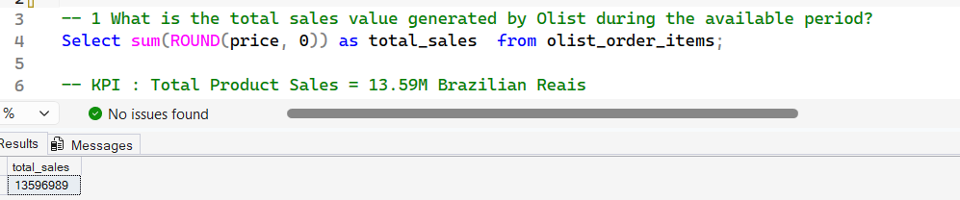
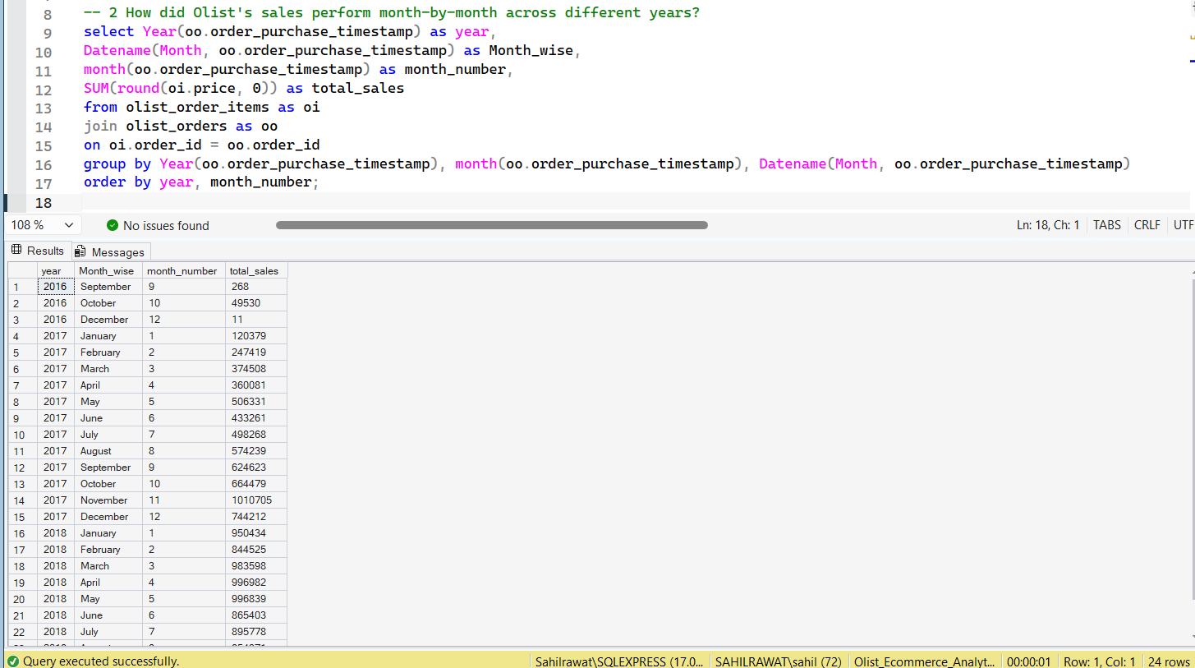
Case 1: SalesPerformance
1.
2.

Slide 16
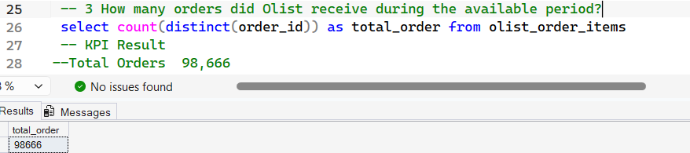
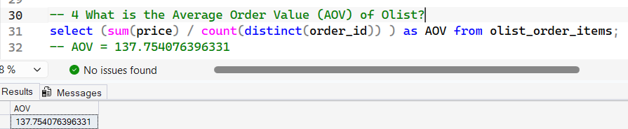
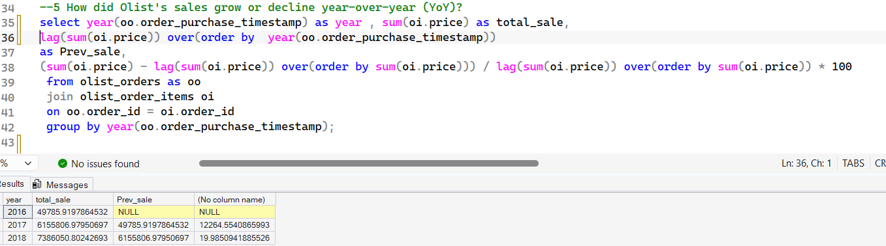
3.
4.
5.

Slide 17
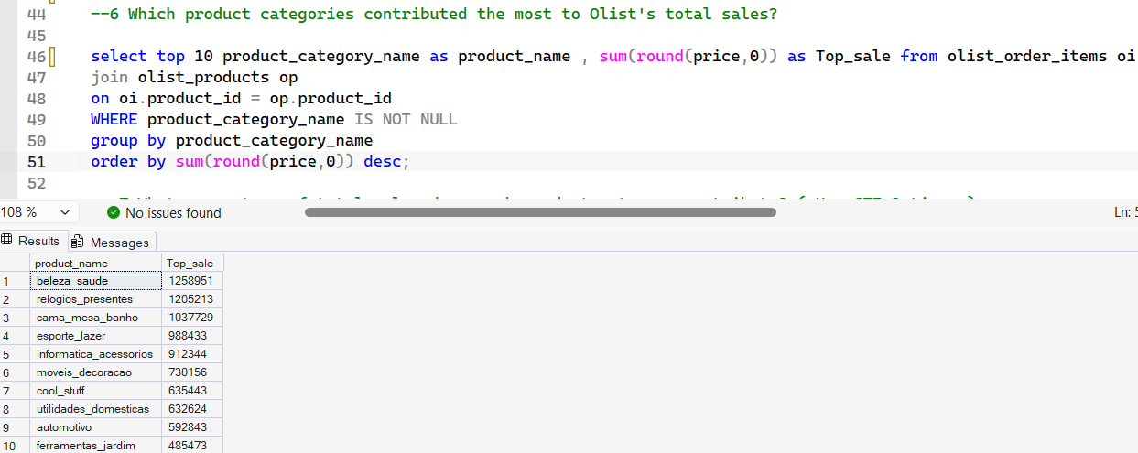
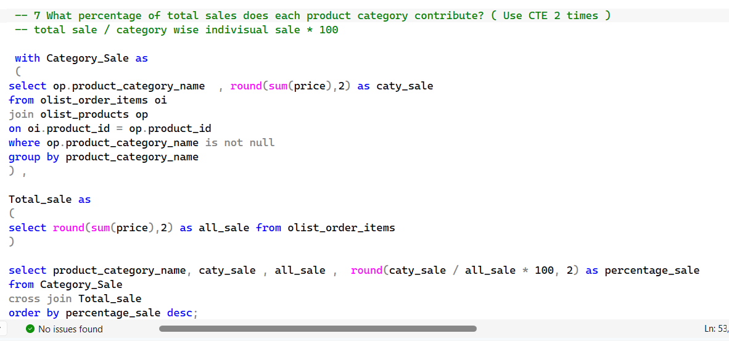
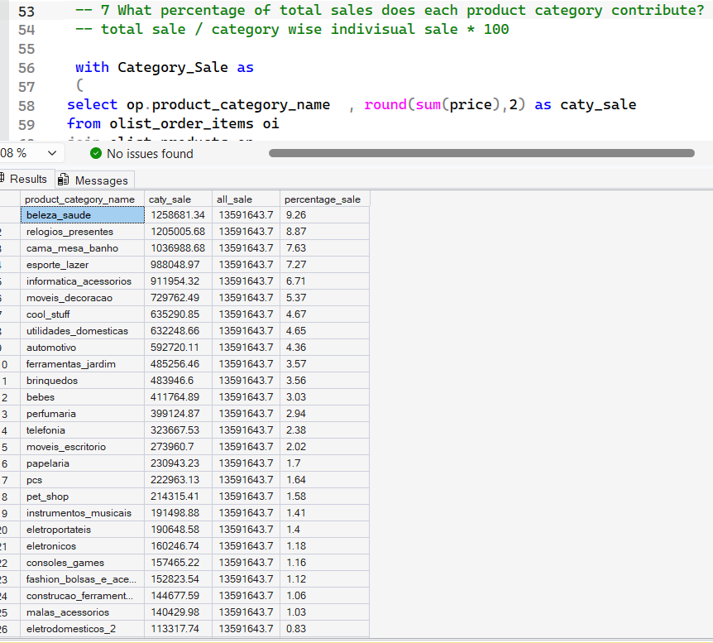
6.
Output: 7
7.

Slide 18
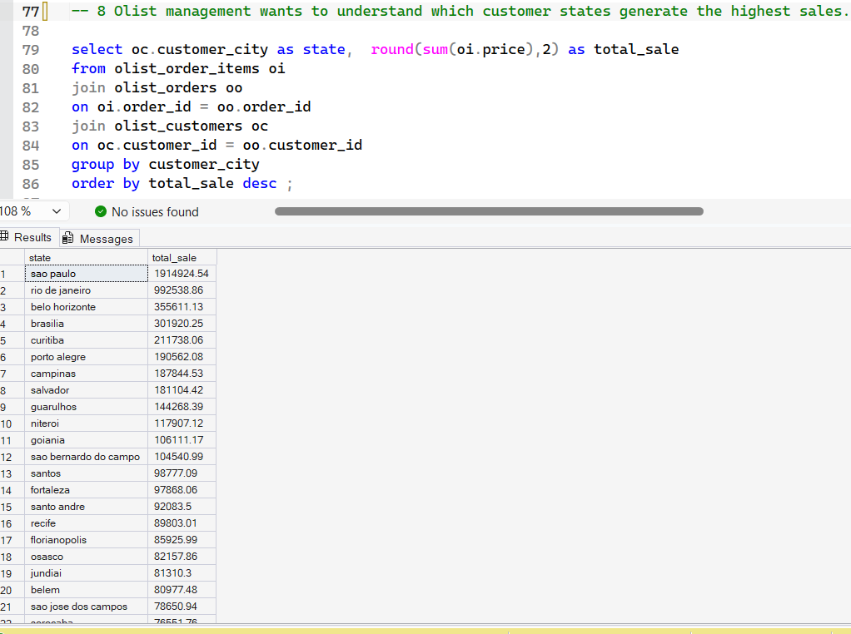
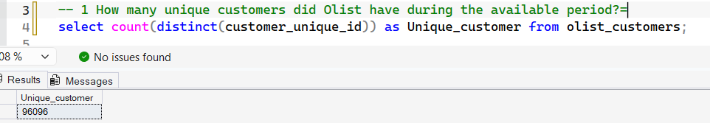
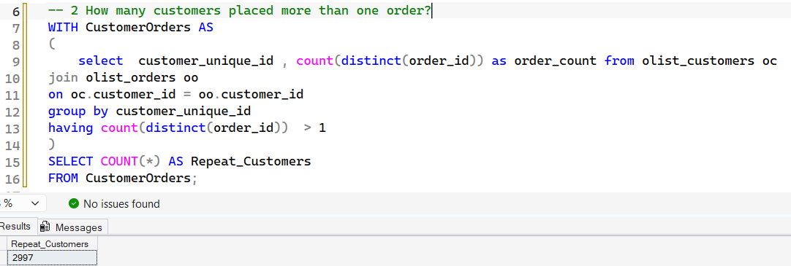
8.
Output :8
Case 2: Customer Analytics
1.
2.

Slide 19
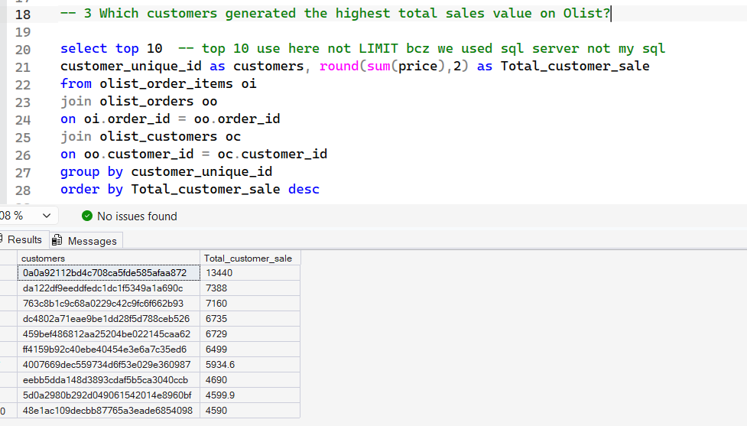
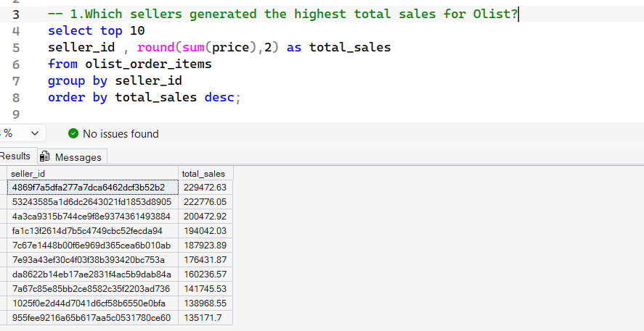
3.
Case 3 Product & Seller
1.

Slide 20
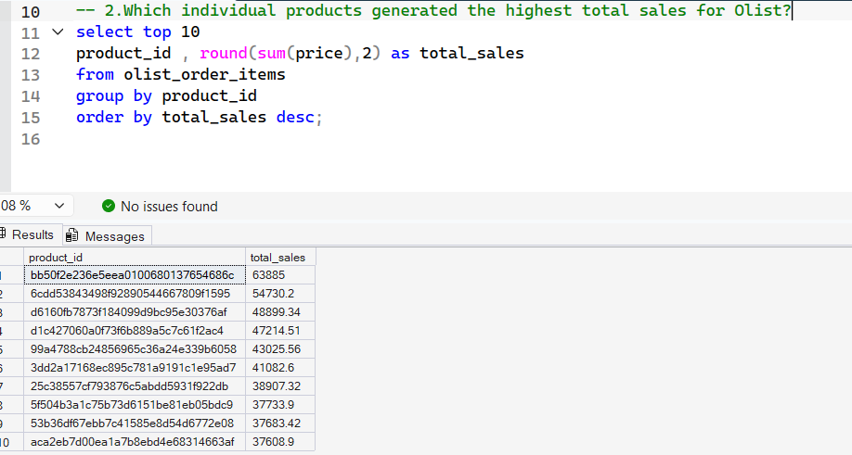
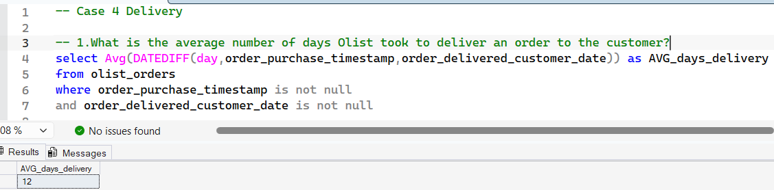
2.
Case 4 Delivery
1.

Slide 21
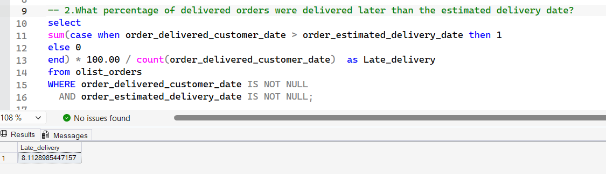
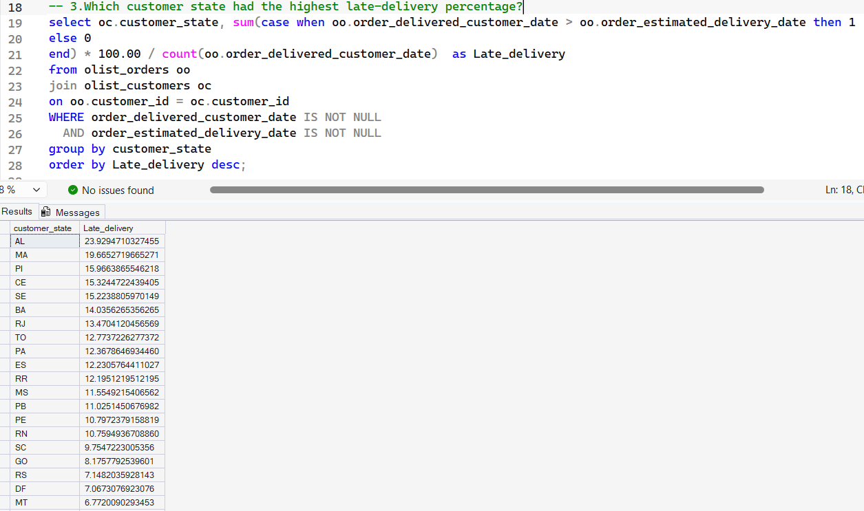
2.
3.

Slide 22
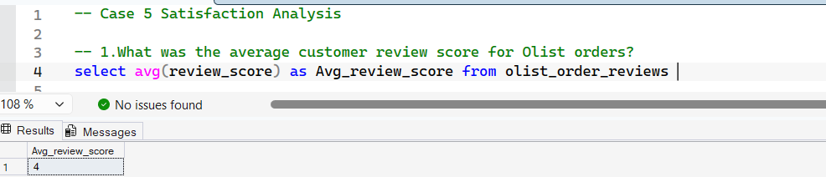
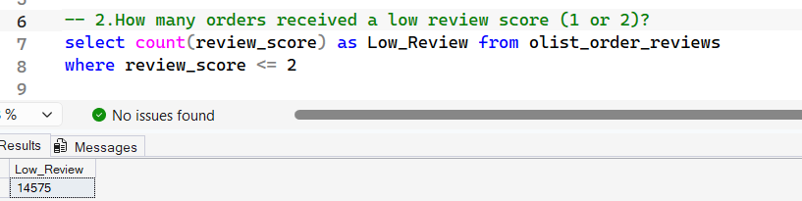
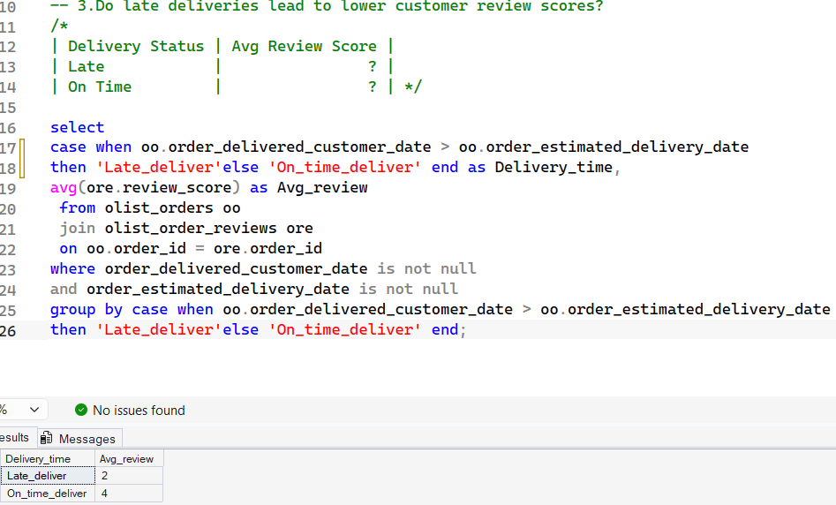
Case 5 Satisfaction Analysis
1.
2.
3.

