Slide 1

RESUME CLASSIFICATION
GROUP MEMBERS:
1.Harish Gone
2.M.Sivasankari
3.Dhairyasheel Dinesh Sadupatil
4.Arunesh Aniket
5.Aishwarya Balasaheb Potadar
6.Pavan Gangadhar Bagate
7.Atul Chandrashekhar Patil
GROUP NO : 02

Slide 2

Business objectives:
The document classification solution should significantly reduce the manual human effort in the HRM. It should achieve a higher level of accuracy and automation with minimal human intervention
Abstract:
A resume is a brief summary of your skills and experience. Companies recruiters and HR teams have a tough time scanning thousands of qualified resumes. Spending too many labor hours segregating candidates resume's manually is a waste of a company's time, money, and productivity. Recruiters, therefore, use resume classification in order to streamline the resume and applicant screening process. NLP technology allows recruiters to electronically gather, store, and organize large quantities of resumes. Once acquired, the resume data can be easily searched through and analyzed.
Resumes are an ideal example of unstructured data. Since there is no widely accepted resume layout, each resume may have its own style of formatting, different text blocks and different category titles. Building a resume classification and gathering text from it is no easy task as there are so many kinds of layouts of resumes that you could imagine

Slide 3
PROJECT ARCHETECTURE & PROJECT FLOW:
Data understanding
Data scrapping
Data preprocessing
Exploratory data analysis (EDA)
Model building
Model deployment

Slide 4
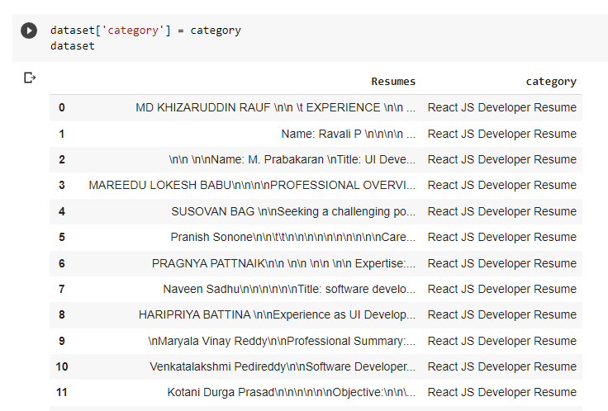
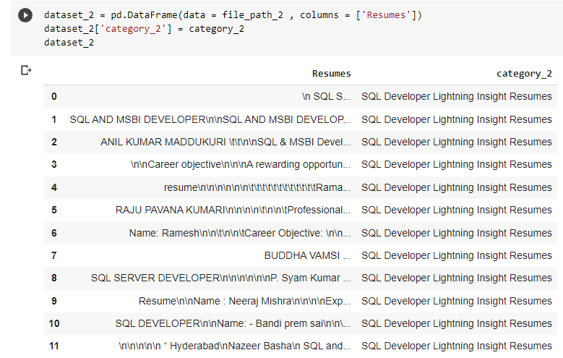
DATA SET DETAILS:
We have categorized the resumes in each category and then we have used glob function to get their file paths and then we have scrapped the data from all categories and created their respective dataframe
Preview of Scrapped Data From Different Folders

Slide 5
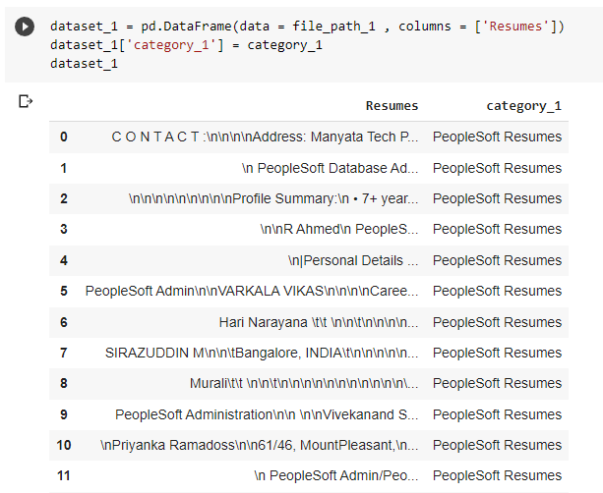
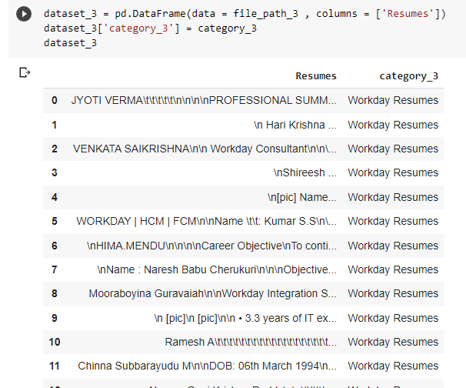
DATA SET DETAILS:

Slide 6
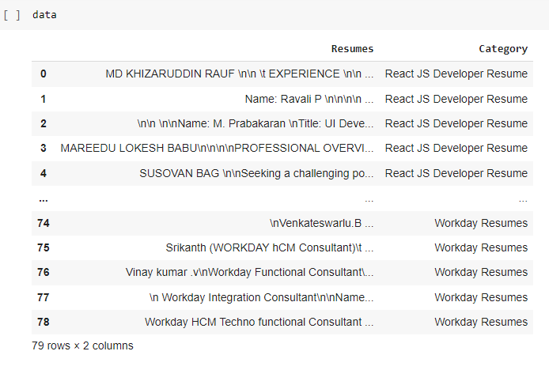
FEATURE ENGINERRING:
We Have Concatenated All The Data Frame To Make Our Final Dataframe

Slide 7

EXPLORETORY DATA ANALYSIS(EDA)

Slide 8
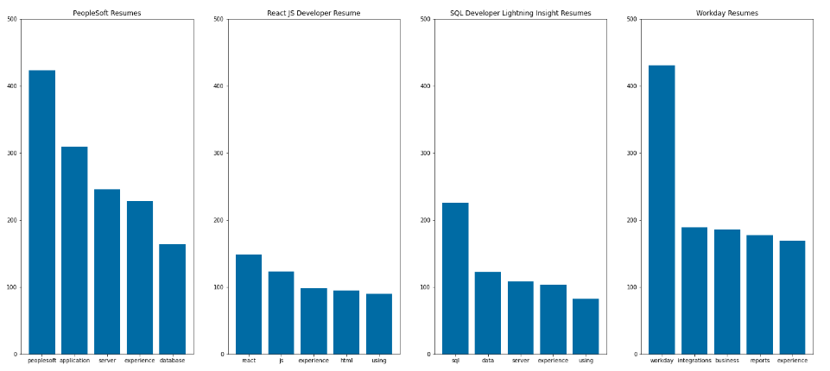
EXPLORETORY DATA ANALYSIS
Show Word - Frequency from Resumes Column:

Slide 9
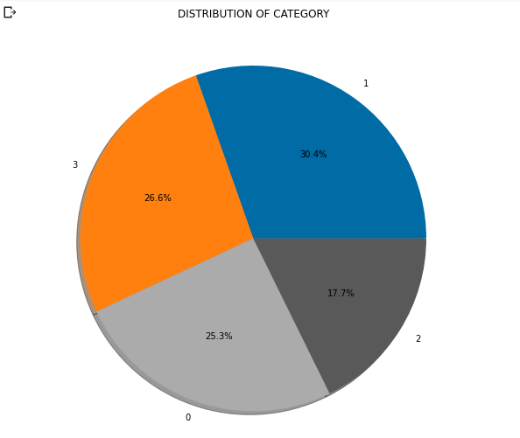
EXPLORETORY DATA ANALYSIS
Extracting text from different resume files and creating a data-frame with column of text from resumes and labels for which each of it applied for.

Slide 10
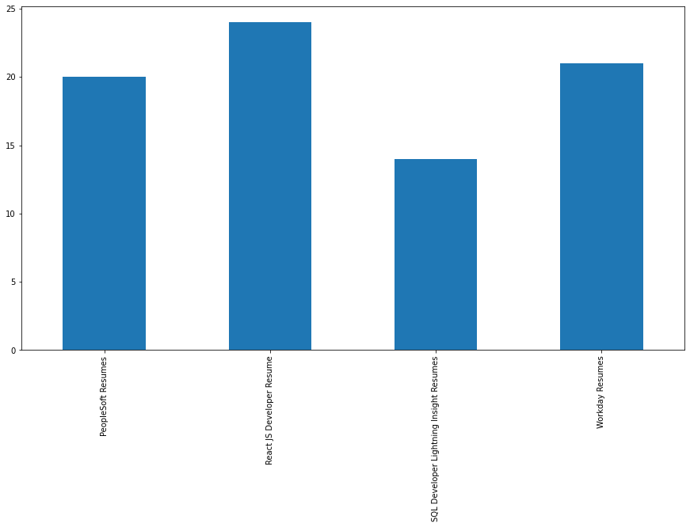
EXPLORETORY DATA ANALYSIS
Number of Classes in Data-Frame

Slide 11
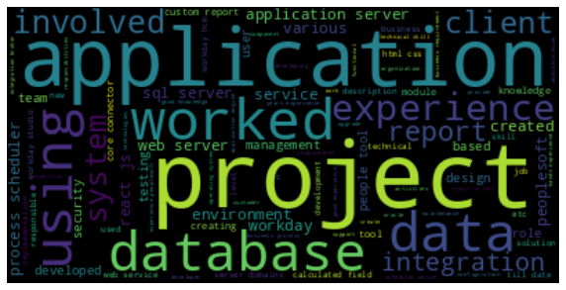
EXPLORETORY DATA ANALYSIS
World cloud

Slide 12
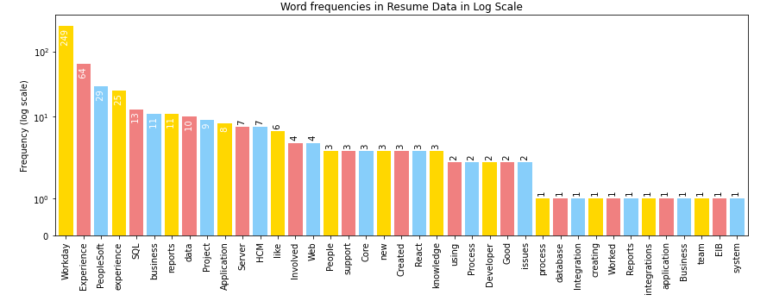
EXPLORETORY DATA ANALYSIS
Word frequencies in resume data log scale

Slide 13
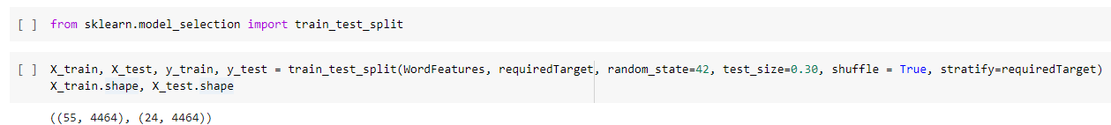
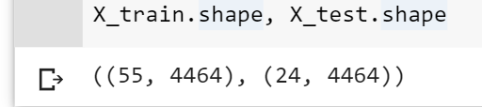
SPLIT DATA INTO TRAIN AND TEST

Slide 14
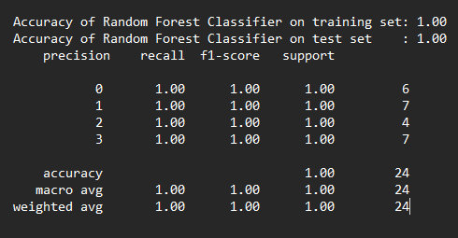
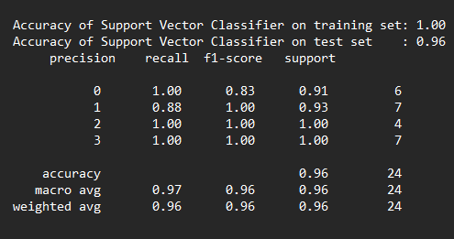
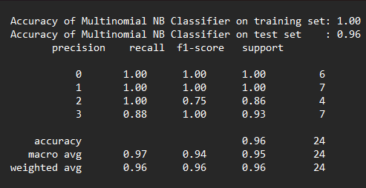
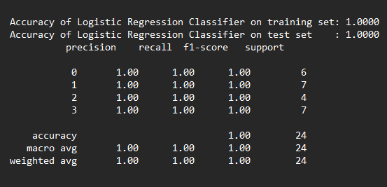
MODEL BUILDING
Random Forest Classifier
Support Vector Classifier
Naive Bayes_ MultinomialNB
Logistic Regression Classifier

Slide 15
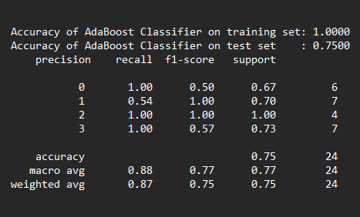
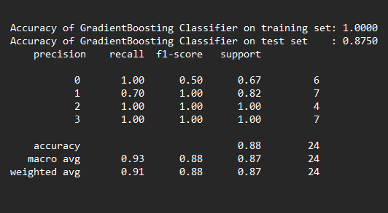
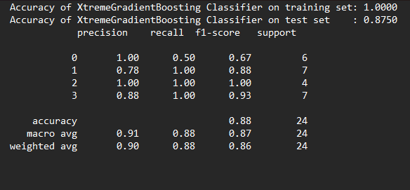
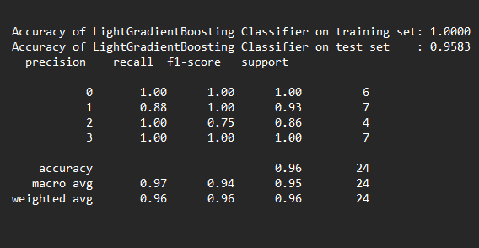
MODEL BUILDING
AdaBoost Classifier
Gradient Boosting Classifier
Xtreme Gradient Boosting Classifier
Light Gradient Boosting Classifier

Slide 16
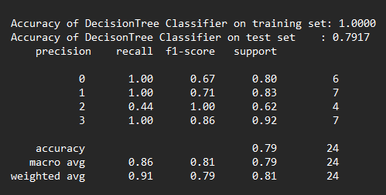
MODEL BUILDING
Decision tree

Slide 17
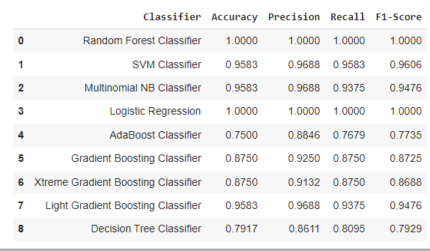
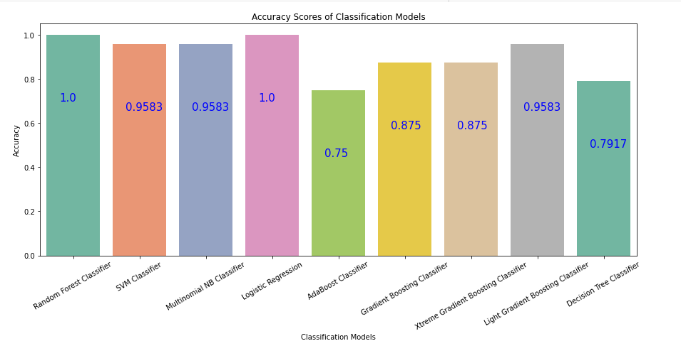
MODEL BUILDING
Test Accuracy Score for all Classification Models

Slide 18
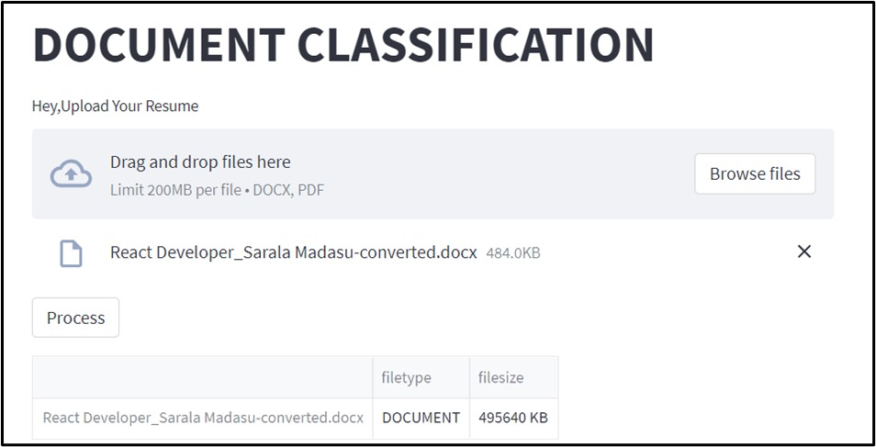
DEPLOYMENT

Slide 19


