Slide 1
1. ipShield: A Framework For Enforcing Context-Aware Privacy 2. Comparison of TCP-only and UDP-only setups in terms of throughput and number of dropped packets in wireless multi-hop networks.
SHREYAS GAONKAR
Sahil shetye

Slide 2
Roadmap
Paper Review
What is ipShield and its need
Why Android OS?
Installing Android Application
Enter ipShield
Working
Open Problems
References
Implementation Part
What is ipShield and its need
Why Android OS?
Installing Android Application
Enter ipShield
Working
Open Problems
References

Slide 3
What is ipShield and Why is it needed?
Internet of Things
Needs to be controlled effectively
User Privacy & Data-logging are the key things
ipShield aims to solve these problems in Android OS.

Slide 4
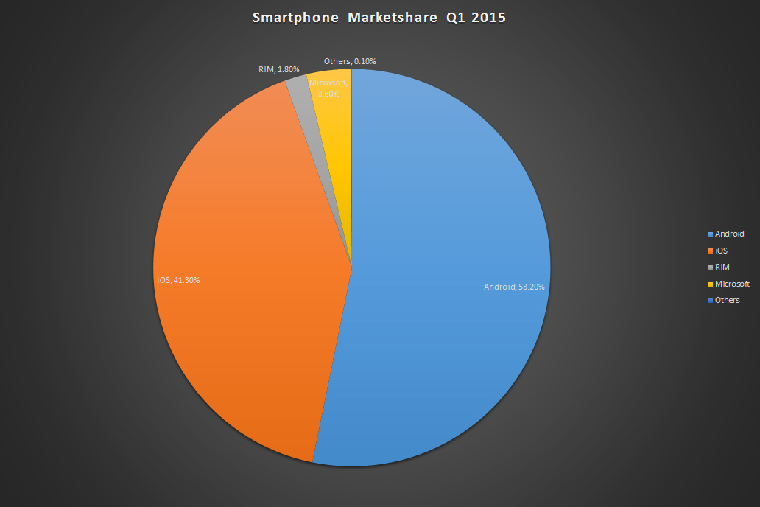
Why Android?
Most widely used operating system.
Widely Popular.
Open Source.
[11] Image 1: Market share held by smartphone platforms in the United States from January 2012 to January 2015 http://www.statista.com

Slide 5
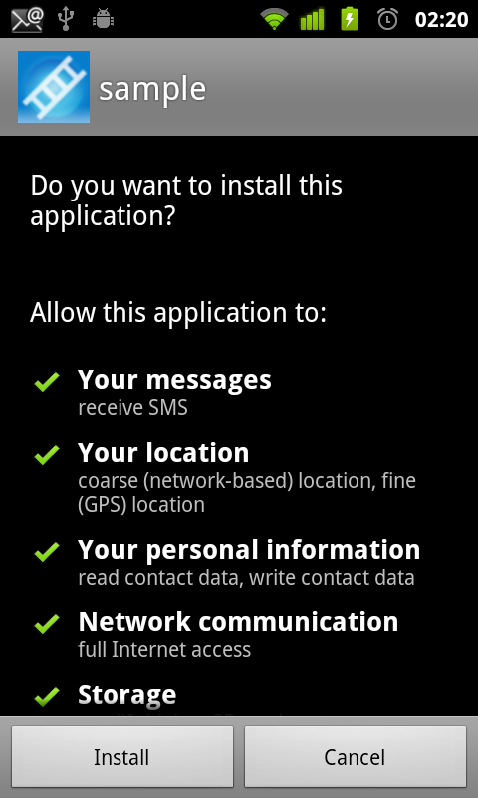
Installing Android Application
Two Options
Install – with these constrains
Or Do not Install
What if I don’t want an app to access of the sensors? But I still want the app to be installed.
Types of Sensors [12]
GPS
Microphone
Camera
Accelerometer
3 axis Gyroscope
Proximity sensor
Image 2 : Source: http://www.appception.com/tutorial/using-an-android-device/0004.png

Slide 6
Enter ipShield
IpShield^{[5]} is a privacy enforcing framework build over the basic Android Operating System, which can be used to keep track of malicious applications which are trying to access your private data through either external or passive innocuous sensors.
Gives users the power to control what data is sent over the external sensors.
Sensors used in apps can be either Blacklisted/Whitelisted depending upon the user preference.

Slide 7
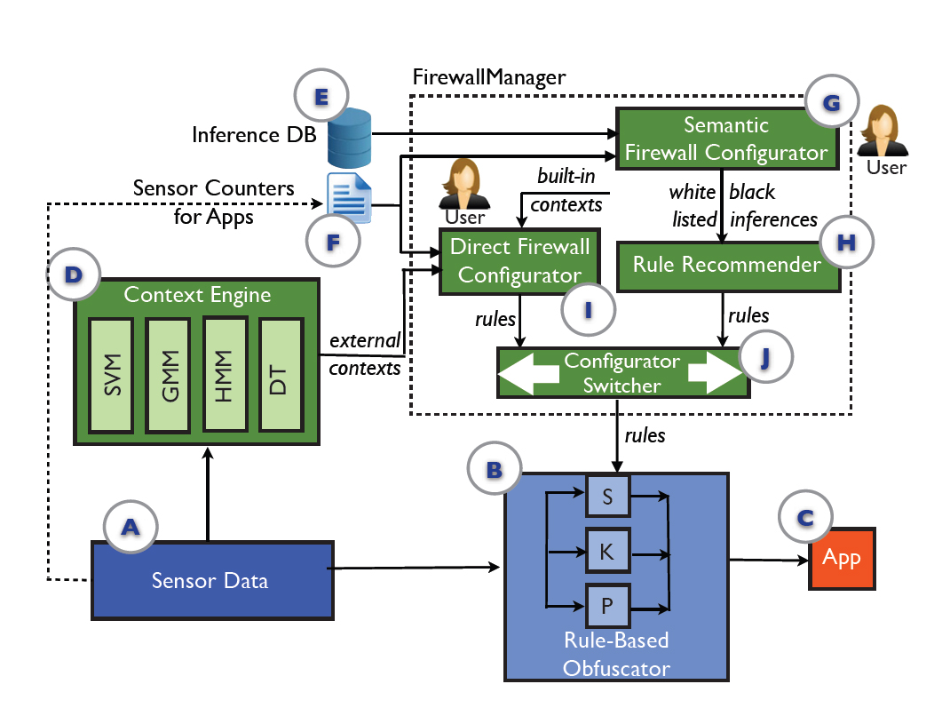
How does it work?
ipShield uses dual mode of Operation:
Built in contexts
User Defined
Image 3: ipShield Data Flow

Slide 8
Open Problems
Doesn’t detect information leakage/misuse.
Users must know the sensors which are used for an app
Uses Android Open Source Project (AOSP) which is used in lesser^{[9]} (about 40%) Android Devices.
Problem of the paper is addressed with Nexus 4 Smartphone running on Android 4.2.2 & doesn’t support forward compatibility.

Slide 9
References
[1] Mobile phones market - February 2015 - http://www.netmarketshare.com/mobile-phones.aspx?qprid=9&qpcustomb=1&qpcustom=iOS,Android
[2] Horyack, P., S., Jung, J., Schechter, S., and Wetherrall, D. - These aren’t the droids you’re looking for: Retrofitting android to protect data from imperious applications.
[3] Pausing Google Play: More than 100,000 Andoid Apps May Pose Security Threats - https://www.bit9.com/download/reports/Pausing-Google-Play-October2012.pdf
[4] Thurm, S., & Kane, Y. Your apps are watching you. The Wall Street Journal, 2012
[5] Supriyo Chakraborty, Chenguang Shen, Kasturi Rangan Raghavan, Yasser Shoukry, Matt Millar and Mani Srivastava - ipShield: A framework for Enforcing Context-Aware Privacy.
[6] Miluzzo, E., Varshavsky, A., Balakrishnan, S., and Choudhary, R. R. Tapprints: Your finger taps have the fingerprints.
[7] Han, J., Owusu, E., Nguyen, L., Perrig, A., and Zhang, J. Accomplice: Location inference using accelerometers on smartphones.
[8] Jeon, J., Micinski, K. K., Vaughan, J. A., Reddy, N., Zhu, Y., Foster, J. S., and Millstein, T. - Dr. Andorid and Mr. Hide: Fine grained security policies on unmodified android.
[9] Android Operating System - Wikipedia.org - http://en.wikipedia.org/wiki/Android_%28operating_system%29
[10] Mingshen Sun , Min Zheng , John C.S. Lui & Xuxian Jiang - Design and Implementation of an Android Host-based Intrusion Prevention System
[11] Market share held by smartphone platforms in the United States from January 2012 to January 2015 – Stastica.com
[12] Did you know how many different kinds of sensors go inside a smartphone? http://www.phonearena.com/news/Did-you-know-how-many-different-kinds-of-sensors-go-inside-a-smartphone_id57885

Slide 10
Comparison of TCP-only and UDP-only setups in terms of throughput and number of dropped packets in wireless multi-hop networks.
Using ns2 simulator

Slide 11
TCP vs UDP
TCP
UDP
TCP is a connection-oriented protocol.
TCP is suited for applications that require high reliability, and transmission time is relatively less critical.
The speed for TCP is slower than UDP.
UDP is a connectionless protocol.
UDP is suitable for applications that need fast, efficient transmission, such as games. UDP's stateless nature is also useful for servers that answer small queries from huge numbers of clients.
UDP is faster because there is no error-checking for packets.

Slide 12
TCP vs UDP (contd.)
TCP
UDP
There is absolute guarantee that the data transferred remains intact and arrives in the same order in which it was sent.
TCP has error checking, Flow control, handshake protocols
Application: Email, Web browsing.
There is no guarantee that the messages or packets sent would reach at all.
UDP does not have error checking, Flow control, handshake protocols
Application: VOIp, FTP.

Slide 13
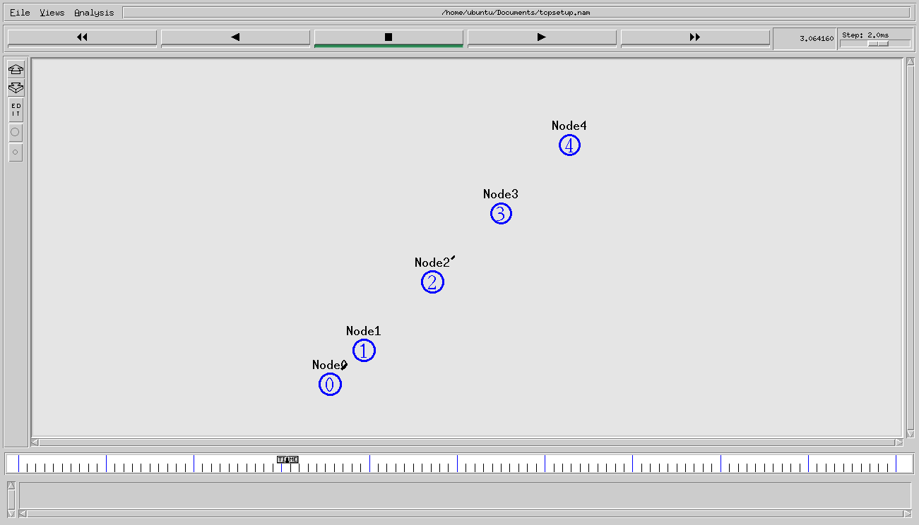
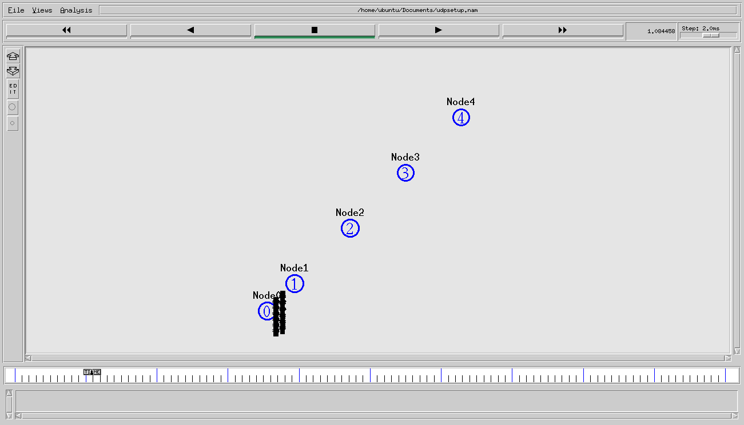
SETUP for project
TCP
UDP

Slide 14
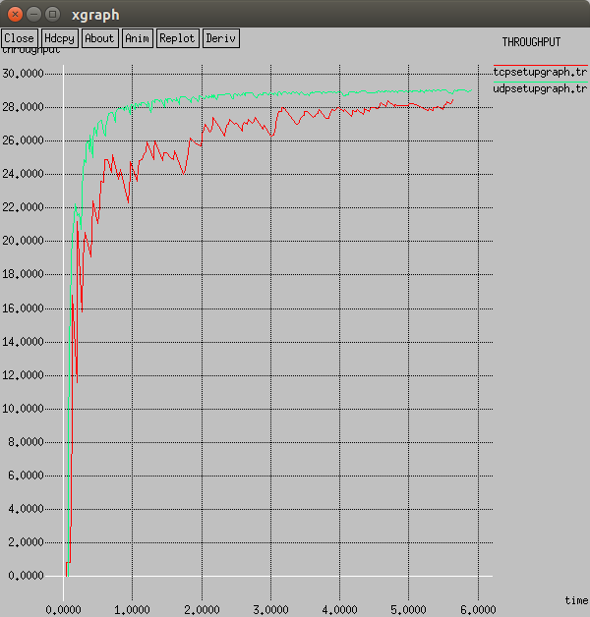
Throughput comparison graph

Slide 15
Observation for Project:
TCP
UDP
Throughput: 28.53 KBps.
Packet loss: 0 packets.
Throughput: 30.47 KBps.
Packet loss:19663 packets .

Slide 16
References
[1] Mobile phones market - February 2015 - http://www.netmarketshare.com/mobile-phones.aspx?qprid=9&qpcustomb=1&qpcustom=iOS,Android
[2] Horyack, P., S., Jung, J., Schechter, S., and Wetherrall, D. - These aren’t the droids you’re looking for: Retrofitting android to protect data from imperious applications.
[3] Pausing Google Play: More than 100,000 Andoid Apps May Pose Security Threats - https://www.bit9.com/download/reports/Pausing-Google-Play-October2012.pdf
[4] Thurm, S., & Kane, Y. Your apps are watching you. The Wall Street Journal, 2012
[5] Supriyo Chakraborty, Chenguang Shen, Kasturi Rangan Raghavan, Yasser Shoukry, Matt Millar and Mani Srivastava - ipShield: A framework for Enforcing Context-Aware Privacy.
[6] Miluzzo, E., Varshavsky, A., Balakrishnan, S., and Choudhary, R. R. Tapprints: Your finger taps have the fingerprints.
[7] Han, J., Owusu, E., Nguyen, L., Perrig, A., and Zhang, J. Accomplice: Location inference using accelerometers on smartphones.
[8] Jeon, J., Micinski, K. K., Vaughan, J. A., Reddy, N., Zhu, Y., Foster, J. S., and Millstein, T. - Dr. Andorid and Mr. Hide: Fine grained security policies on unmodified android.
[9] Android Operating System - Wikipedia.org - http://en.wikipedia.org/wiki/Android_%28operating_system%29
[10] Mingshen Sun , Min Zheng , John C.S. Lui & Xuxian Jiang - Design and Implementation of an Android Host-based Intrusion Prevention System
[11] Market share held by smartphone platforms in the United States from January 2012 to January 2015 – Stastica.com
[12] Did you know how many different kinds of sensors go inside a smartphone? http://www.phonearena.com/news/Did-you-know-how-many-different-kinds-of-sensors-go-inside-a-smartphone_id57885
THANK YOU

