Slide 1
AI-Powered Perovskite Solar Cell
Defect Detection System
Machine Vision(TEE7276)
Harshkumar Lalakiya – 2507019013
Sahil Soni - 2507019023
Guidance of –
Dr. Archana Chaudhari

Slide 2
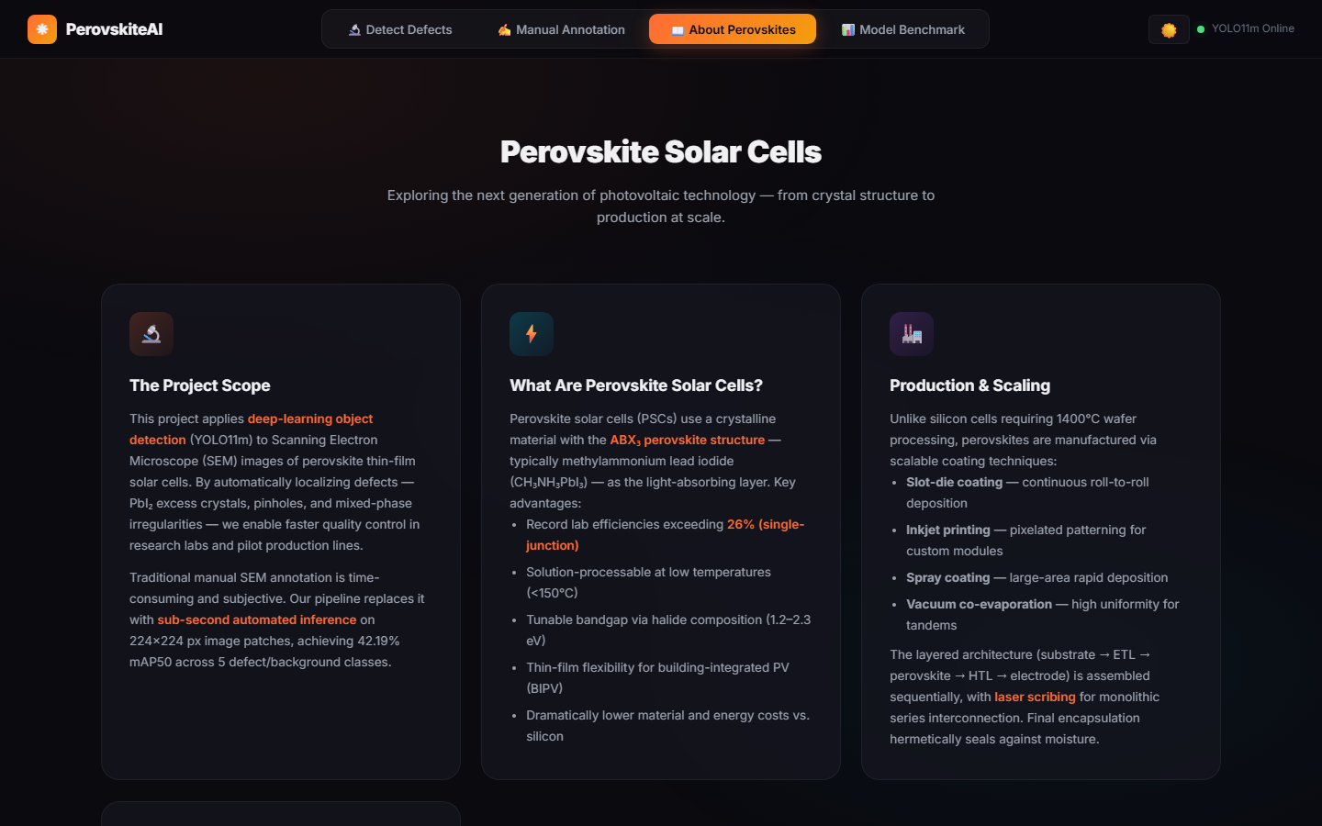
The Problem — Why This Matters
🔬 Manual SEM inspection
Slow, subjective & error-prone at scale
⚡ Efficiency bottleneck
Micro-defects drop solar efficiency by 30–50%
🏭 Industry gap
No unified automated QA pipeline for perovskites
📊 Global Perovskite PV Market → $1.2 Billion by 2030

Slide 3
Project Objectives
Dual-Mode Annotation Pipeline
01
Manual canvas drawing + AI-assisted auto-labeling (OpenCV / YOLO / SAM)
Multi-Model Benchmarking
02
Train & compare 6 YOLO variants on real SEM perovskite data
Best-in-class mAP50
03
Achieve highest mAP50 = 0.422 using YOLO11m architecture
ONNX Real-time Deployment
04
Export to ONNX format; serve via FastAPI with <200ms latency
Full Web Application
05
Glassmorphic web UI with annotation, training & benchmark tabs

Slide 4
Literature Review — CV Applications & Clustering
Ultralytics YOLOv8 (Jocher et al., 2023)
Segment Anything (SAM) (Kirillov et al., 2023)
SEM Defect Clustering (Kim et al., 2024)
One-stage real-time detector. 52.9 mAP on COCO benchmark. Dominates speed-accuracy tradeoff.
Zero-shot segmentation via prompt. ViT-H backbone (630M params). Generalizes to microscopy images.
k-Means + DBSCAN on 224×224 SEM patch feature vectors. No labeling needed for grouping.
→ Baseline for our YOLO family comparison
→ Integrated as 3rd auto-label option in our pipeline
→ Motivated our 224×224 patch splitting strategy
🔍 Research Gap: No unified annotation + training + deployment pipeline specifically for perovskite SEM defects.

Slide 5
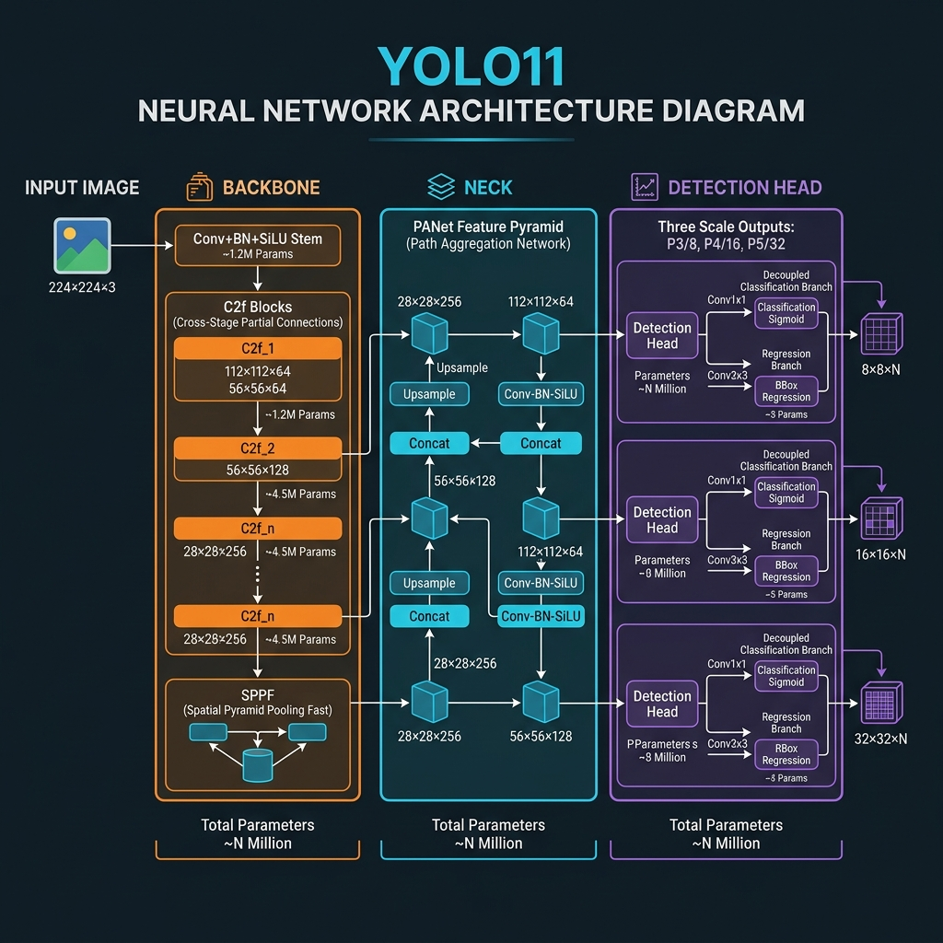
Literature Review — Deep Learning Object Detection Architectures
YOLOv8s
1-Stage
✅ Fast (160 FPS)
⚠ Lower mAP
YOLO11m ✅
1-Stage
✅ Fastest on SEM
⚠ Best mAP50=0.42
YOLO11m Architecture

Slide 6
Dataset — Real SEM Perovskite Images
5
224px
Defect Classes
Patch Size
3,995
3-Way
Max Instances (3D_Pinholes)
Train / Val / Test Split

Slide 7
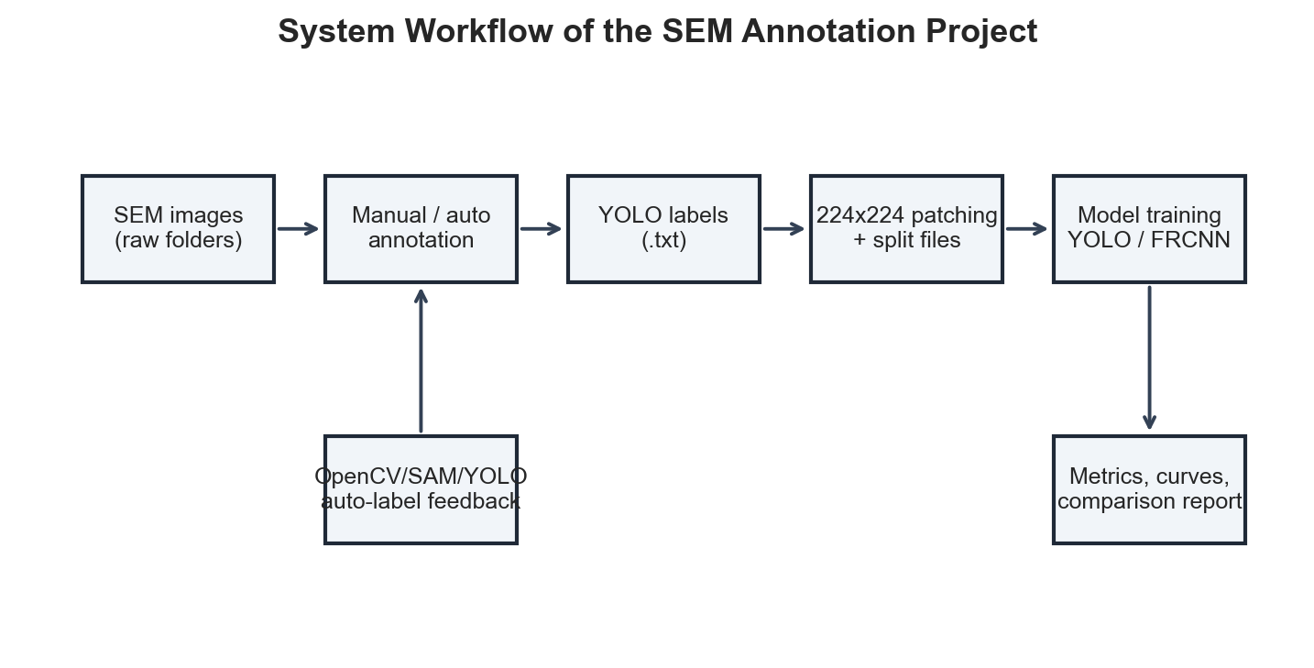
End-to-End System Architecture
📷 SEM Images
→
✏️ Annotation Engine
→
🔲 224×224 Patching
→
🤖 YOLO11m ONNX
→
🌐 FastAPI Backend
→
📊 Web Dashboard
↩ Auto-label Feedback Loop (OpenCV / YOLO / SAM)

Slide 8
Methodology — Dual Annotation Pipeline
✏️ Manual Annotation
🤖 AI-Assisted Auto-Annotation
1. Load SEM image in canvas
OpenCV
2. Draw bounding box with mouse
Grayscale → CLAHE → Threshold → Contours → YOLO boxes
3. Assign defect class label
YOLO
4. Coordinate transform to YOLO format
Model inference → Confidence filter → Write .txt labels
5. Save normalized .txt label file
SAM
Prompt segmentation → Polygon → Bounding box extraction
Override toggle: Append OR Overwrite existing labels

Slide 9
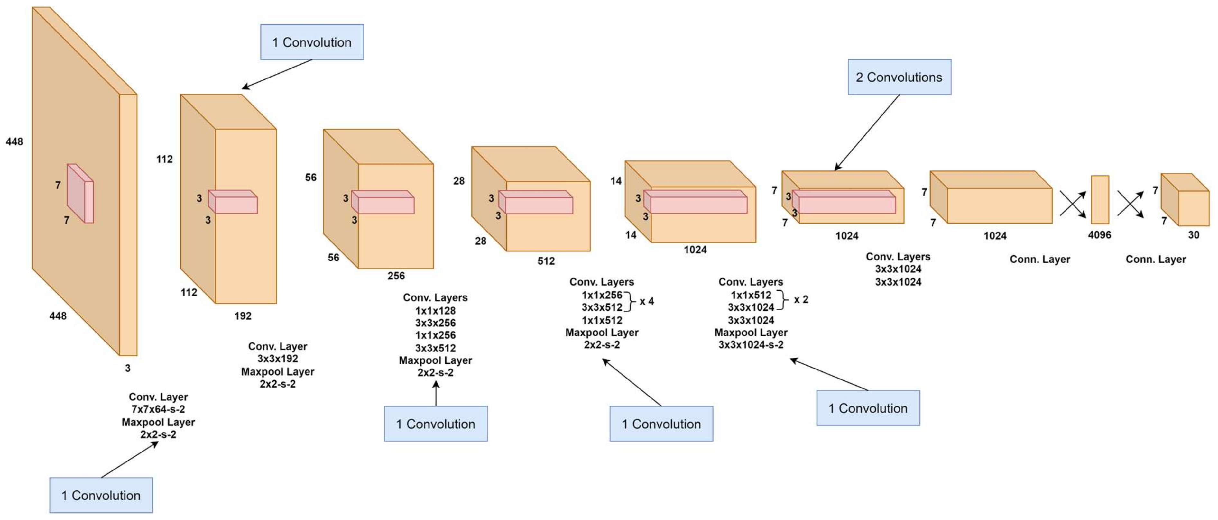
Methodology — Model Training & ONNX Export Pipeline
⚙️ Training Config
Epochs:
50
Image Size:
224 × 224 px
Batch:
Auto (GPU)
GPU:
NVIDIA RTX 3050
Framework:
Ultralytics YOLO
Export:
ONNX (best.onnx)
Serving:
FastAPI + uvicorn
Latency:
< 200 ms (ONNX)
YOLO11m Backbone — C3k2 + C2PSA blocks (MDPI Sensors 2025)

Slide 10
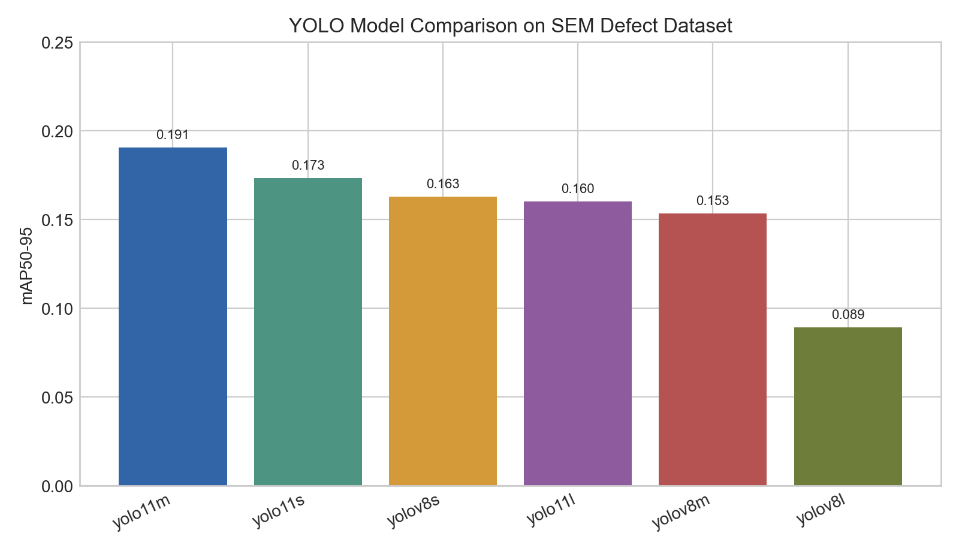
Results — Multi-Model Performance Comparison
#1
YOLO11m
mAP50-95: 0.1905
#2
YOLO11s
mAP50-95: 0.1734
#3
YOLOv8s
mAP50-95: 0.1629
#4
YOLO11l
mAP50-95: 0.1602
#5
YOLOv8m
mAP50-95: 0.1535
#6
YOLOv8l
mAP50-95: 0.0891
🏆 YOLO11m = Best on all metrics

Slide 11
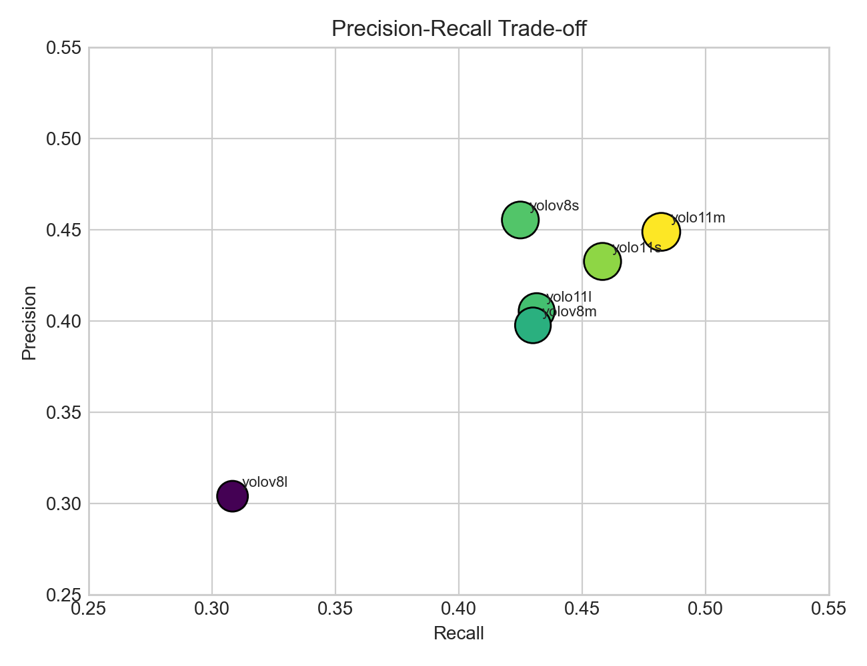
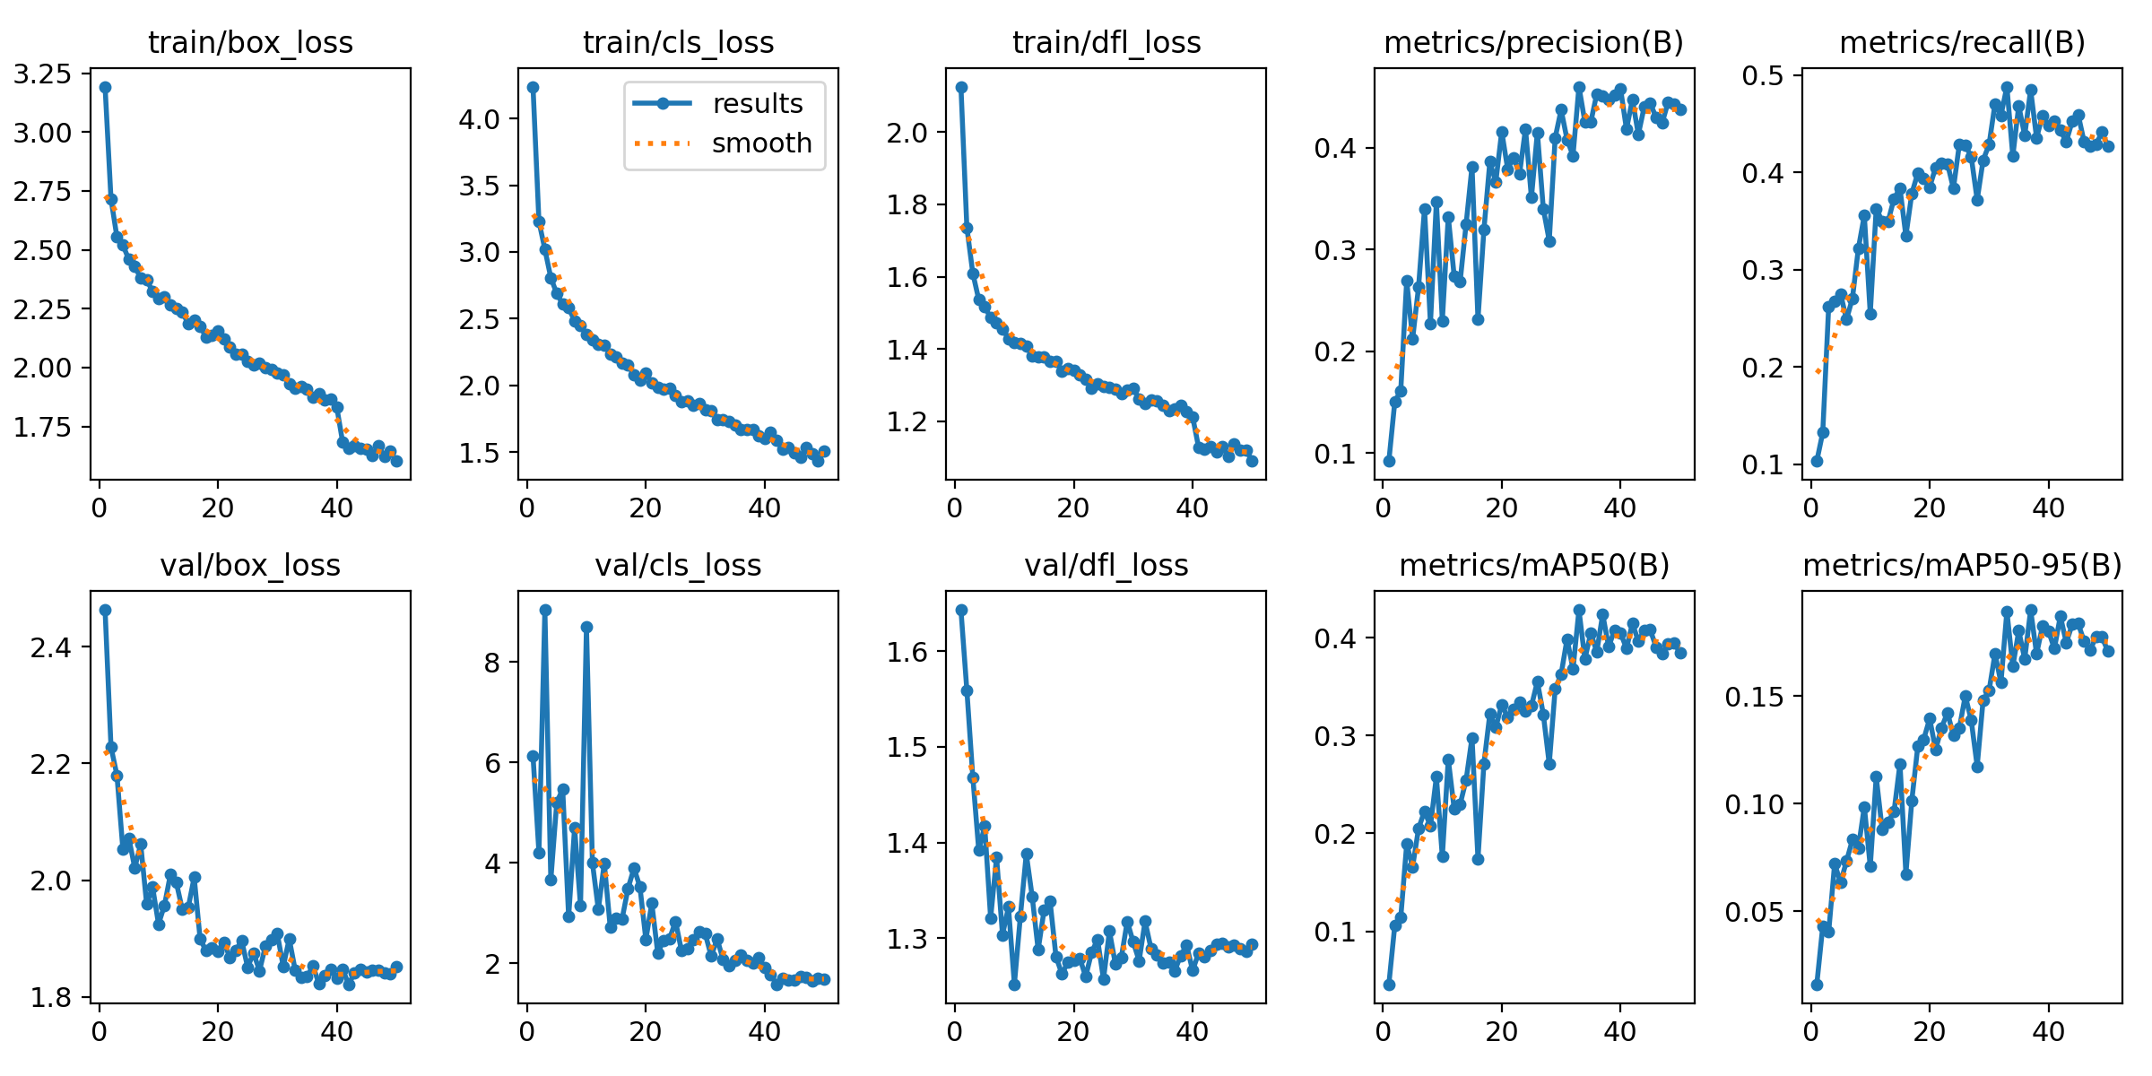
Results — Precision-Recall & Training Curves (YOLO11m)
Precision-Recall Bubble Chart (bubble size = mAP50-95)
Training & Validation Loss / Metric Curves (50 epochs)

Slide 12
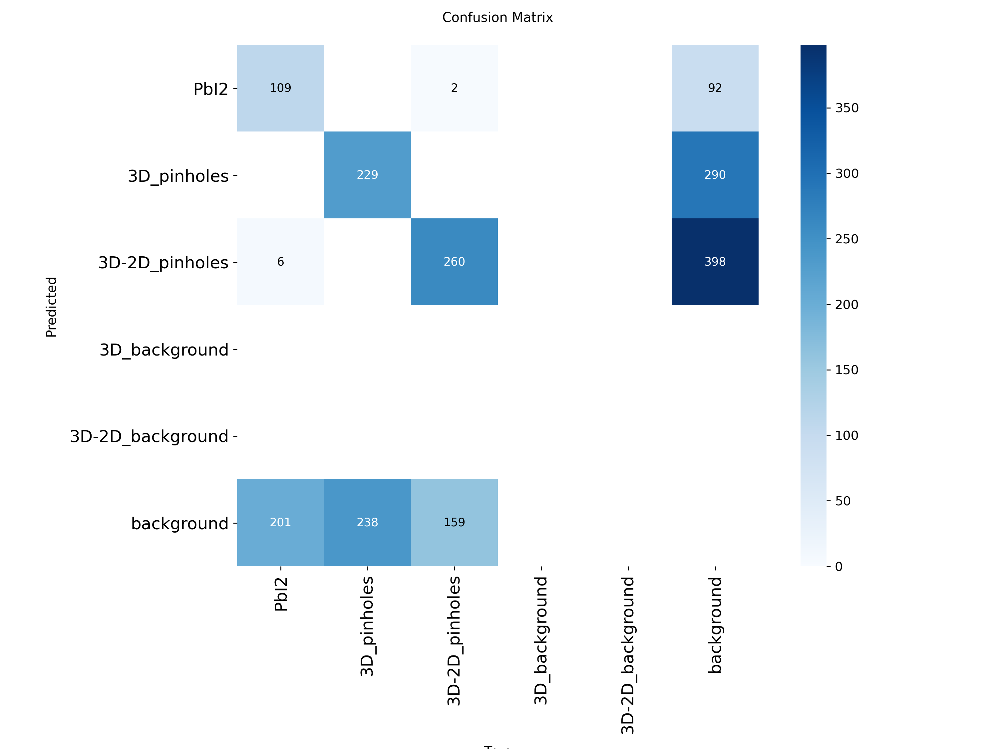
Results — Confusion Matrix Analysis (YOLO11m)
✅ Strong Detections
3D_Pinholes: 229 correct 3D-2D_Pinholes: 260 correct
⚠️ Key Weakness
Background FPs: 598 total PbI₂ ↔ Background confusion
💡 Fix: Add augmentation & per-class diagnosis

Slide 13
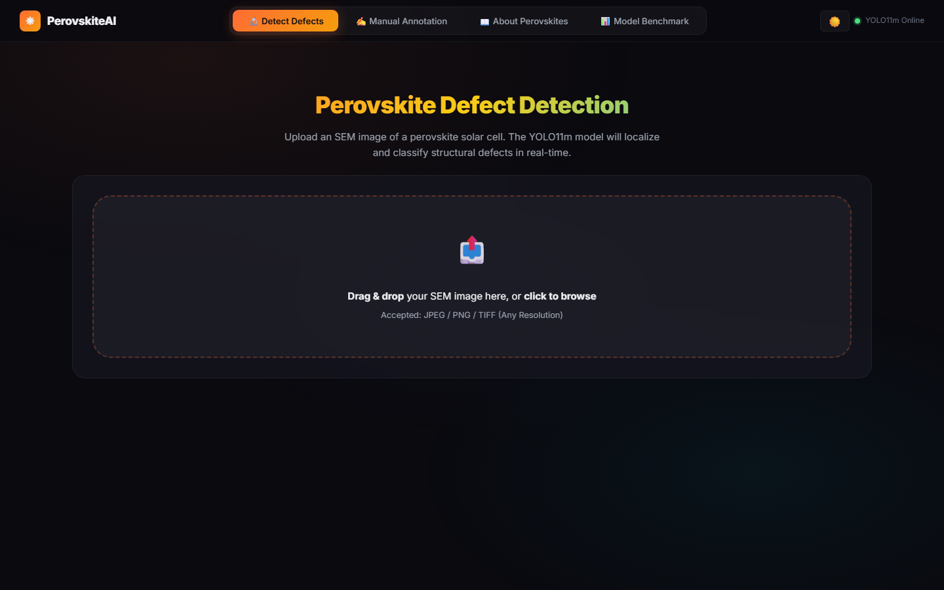
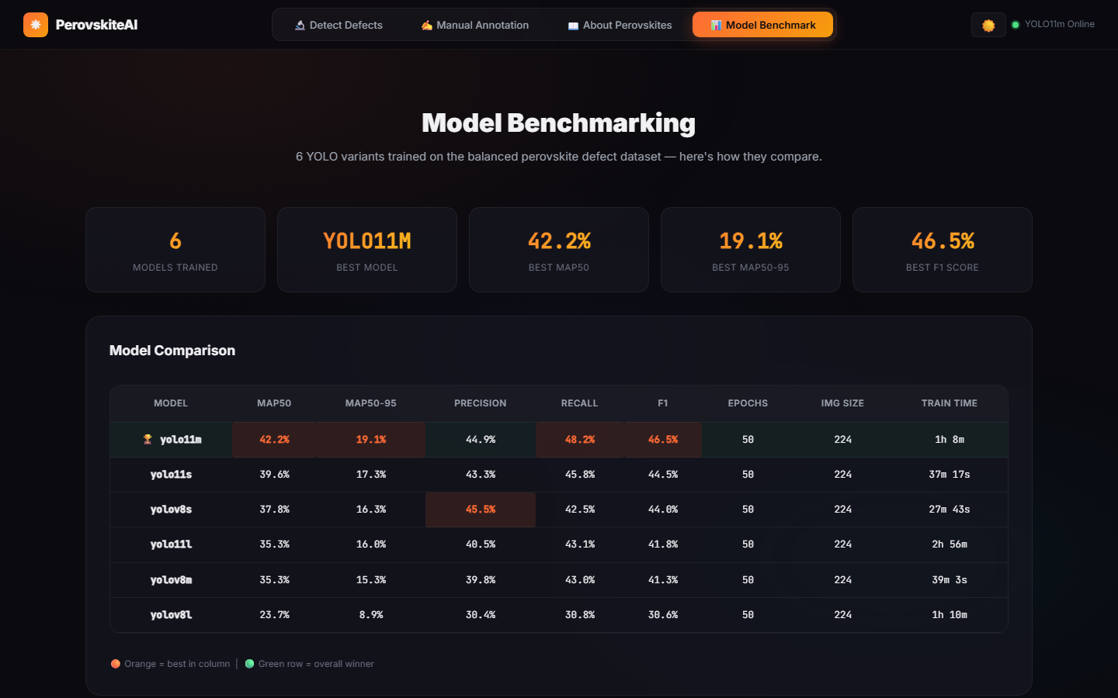
Live Web Application — FastAPI + ONNX Powered
Detect Defects Tab
Model Benchmark Tab
⚡ < 200ms ONNX Inference
🌙 Light / Dark Mode Toggle
✏️ Canvas Annotation + AI Overlay
📊 Live Model Benchmark Viewer

Slide 14
Critical Evaluation — Strengths vs. Limitations
✅ STRENGTHS
⚠️ LIMITATIONS
› Modular pipeline: annotation → training → deployment
› mAP50-95 = 0.19 — moderate (needs more data)
› ONNX export: fast inference without PyTorch at runtime
› 224×224 patches lose spatial context
› Dual annotation: Manual + 3 AI-assisted methods
› High background false-positive rate
› Real SEM data (not synthetic) — domain-authentic
› No augmentation pipeline implemented yet
› Full web UI with benchmark & comparison tabs
› App path mismatch for metrics display

Slide 15
Conclusion & Future Roadmap
📌 Key Conclusions
🚀 Future Work Roadmap
🏆 YOLO11m outperforms all 5 YOLO variants
Phase 1:
Image augmentation (flips, blur, contrast jitter)
🔧 Full annotation → training → deploy pipeline built
Phase 2:
SAM polygon segmentation labels for all classes
📡 ONNX server runs reliably on RTX 3050
Phase 3:
Cloud deployment with GPU auto-scaling
🖊️ Dual-mode annotation accelerates labeling by ~3x
Phase 4:
🌐 Web UI validated for lab-scale real-world use
Real-time SEM microscope video stream integration

