Slide 1

ANALYSIS OF CRIME RATE IN INDIA

Slide 2

Table of Content
Murder rate
Sexual assault
Kidnapping
Theft
Robbery
Dowry death
Women safety
Violence
Findings
Case study

Slide 3

Case study
Dataset
The crime rate of India will be analyzed in this project
Crime includes murder, sexual assault, kidnapping, dowry death, dacoity, robbery, theft and domestic violence against women
The data set contains crime rate of each state in each year
The dataset have the record of total crime in India from 2001 to 2012
Objective
To identify states with highest and lowest crime rate
To observe the change in crime growth rate year over year
To identify the states which are safe for women
To recognize the states which are safe for Indian citizen

Slide 4
Murder Rate-SQL
/*1.State with highest murder rate*/
select state_ut, sum(murder) as total_murder
from district_wise_crimes
Group by state_ut
order by total_murder desc
limit 10;
/*2.State with lowest murder rate*/
select state_ut, sum(murder) as total_murder
from district_wise_crimes
Group by state_ut
order by total_murder asc
limit 10;
3. /*Year-wise murder rate in India*/
select sum(murder) as total_murder, year
from district_wise_crimes
group by year
Order by Year asc;
/*4. Top 5 year with maximum murder rate */
select year, sum(murder) as total_murder
from district_wise_crimes
group by year
Order by total_murder desc
limit 5;
/*Top 5 year with minimum murder rate*/
select year, sum(murder) as total_murder
from district_wise_crimes
group by year
Order by total_murder asc
limit 5;
/*6.state-wise murder rate*/
select state_ut, sum(murder) as total_murderf
rom district_wise_crimes
Group by state_ut;

Slide 5

Murder Rate
Uttar Pradesh has the highest murder rate
Lakshadweep has the lowest murder rate
The total number of murder throughout India was highest in 2001
2007 experienced lowest number of murder in all over India

Slide 6
Sexual Assault-SQL
/*1.State with highest rape rate*/
select state_ut, sum(rape) as total_rape
from district_wise_crimes
Group by state_ut
order by total_rape desc
limit 10;
/*2.State with lowest rape rate*/
select state_ut, sum(rape) as total_rape
from district_wise_crimes
Group by state_ut
order by total_rape asc
limit 10;
3. Year-wise rape rate in India
select sum(rape) as rape, year
from district_wise_crimes
group by year
Order by Year asc;
4. Top 5 year with maximum murder rate
select year, sum(rape) as total_rape
from district_wise_crimes
group by year
Order by total_rape desc
limit 5;
5. Top 5 year with mimimum murder rate
select year, sum(rape) as total_rape
from district_wise_crimes
group by year
Order by total_rape asc
limit 5;
6. /*.State with highest murder rate*/
select state_ut, sum(rape) as total_rape
from district_wise_crimes
Group by state_ut;

Slide 7

Sexual Assault
Madhya Pradesh has the highest record of sexual assault
Lakshadweep has the lowest record of sexual assault
The total number of murder throughout India was highest in 2012
2001 experienced lowest number of murder in all over India
Total number of sexual assault is increasing year over year

Slide 8
Kidnapping-SQL
/*1.State with highest kidnapping rate*/
select state_ut, sum(kidnapping_and_abduction_of_women_and_girls) as total_kidnapping
from district_wise_crimes
Group by state_ut
order by total_kidnapping desc
limit 10;
/*2.State with lowest kidnapping rate*/
select state_ut, sum(kidnapping_and_abduction_of_women_and_girls) as total_kidnapping
from district_wise_crimes
Group by state_ut
order by total_kidnapping asc
limit 10;
/*3. Year-wise kidnapping rate in India*/
select sum(kidnapping_and_abduction_of_women_and_girls) as total_kidnapping, year
from district_wise_crimes
group by year
Order by Year asc;
4. Top 5 year with maximum kidnapping rate
select year, sum(kidnapping_and_abduction_of_women_and_girls) as total_kidnapping
from district_wise_crimes
group by year
Order by total_kidnapping desc
limit 5;

Slide 9
Kidnapping
Uttar Pradesh has the highest Kidnapping rate
Lakshadweep and Mizoram has lowest kidnapping rate
Kidnapping rate is increasing gradually year over year
2003 recorded lowest number of kidnapping

Slide 10

Robbery
Maharashtra has experienced highest number of robbery rate
The robbery rate is expanding with a high growth rate
Sikkim, Lakshadweep, Manipur have the lowest number of robbery rate

Slide 11

Theft
Maharashtra, Uttar Pradesh, and Andhra Pradesh has highest theft rate
Lakshadweep is the safe city with lowest number of theft rate
From 2007, the theft has been surged throughout India

Slide 12

Dowry death
Bihar, Uttar Pradesh, and Madhya Pradesh has highest dowry death rate
Haryana, Mizoram, and Lakshadweep has lowest number of dowry death rate
From 2006, the dowry death rate has been saturated throughout India

Slide 13

Women safety
The women safety has been measured in terms of rape, dowry_deaths, assault_on_women_with_intent_to_outrage_her_modesty, insult_to_modesty_of_women and cruelty_by_husband_or_his_relatives
Andhra Pradesh, Uttar Pradesh, West Bengal and Madhya Pradesh are the unsafe place for women as most of the violence against women has been reported in those sates
Daman & Diu, Lakshadweep and Nagaland are the safest state for women

Slide 14

Violence
Total violence rate has been measured in terms of murder, dacoity, robbery, burglary, theft, and death by neighbors
Maharashtra, Uttar Pradesh, Andhra Pradesh, and Madhya Pradesh are the state with highest number of crimes
Sikkim, Lakshadweep, Nagaland, and Manipur are the state with lowest number of crimes

Slide 15

Findings
Murder rate, and dowry death has been lowered in 2012 compared to 2001
Sexual assault, kidnapping and robbery rate has been increased in 2012 compared to 2001
The Indian government needs to provide more protection to women and improve the national surveillance to decrease kidnapping and robbery rate
Maximum number of crime has been reported in Uttar Pradesh, Maharashtra, Andhra Pradesh, Madhya Pradesh and Bihar
Comparatively, Andaman, Daman & Diu, Lakshadweep, Sikkim, and Nagaland are the safest place to live as these states has recorded minimum number of crime.
The Indian government has performed well in reducing dowry death and murder rate

Slide 16
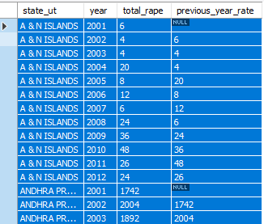
Windows Function
/*1.show the current year and previous year sexual assault rate of each state in each year*/
select state_ut, year, total_rape, lag(total_rape, 1) over(partition by state_ut order by year asc) as previous_year_rate
from (select state_ut, year, sum(rape) as total_rape from district_wise_crimes Group by state_ut, year ) as S;

Slide 17
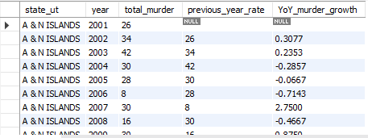
Year of Year growth rate
/*2. Show the year of year murder rate growth in 5 states with highest murder rate*/
It is a combination of sub queries and windows function
select state_ut, year,total_murder,previous_year_rate, (total_murder-previous_year_rate)/ previous_year_rate as YoY_murder_growth
from (select state_ut, year, total_murder, lag(total_murder, 1) over(partition by state_ut order by year asc) as previous_year_rate
from (select state_ut, year, sum(murder) as total_murder from district_wise_crimes Group by state_ut, year ) as S) as S1;

Slide 18
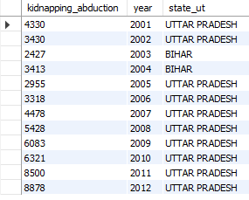
Highest kidnapping rate in each year
/*3. City with highest kidnapping rate in each year*/
select kidnapping_abduction, year, state_ut
from district_wise_crimes
where(year, kidnapping_abduction) in (select year, Max(kidnapping_abduction) as maximum_kidnapping_abduction
from district_wise_crimes group by year);

Slide 19
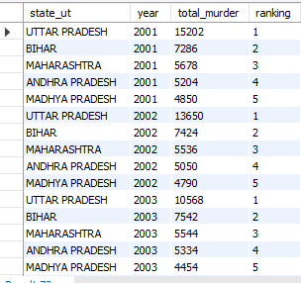
Common table expression
*4. Rank top 5 murder state rate in each year*/
with CTE as (select state_ut, year, total_murder, dense_rank() over (partition by year order by total_murder desc) as ranking
from (select state_ut, sum(Murder) as total_murder, year
from district_wise_crimes
Group by state_ut, year
order by total_murder) as murder_list)
select state_ut, year, total_murder, ranking
from CTE
having ranking<6;

Slide 20


Consecutive Queries
/*5a. identify the year when murder rate has been increased for three years consequetively */
Create view CTE as(select year, total_murder, lag(total_murder, 1) over(order by year asc) as previous_year_rate
from (select year, sum(murder) as total_murder from district_wise_crimes Group by year ) as s)
select M3.year, M2.year, M1.year, M3.total_murder, M2.total_murder, M1.total_murder
From CTE as M1 join CTE as M2 on M1.year=M2.year+1 and M1.total_murder>M2.total_murder
join CTE as M3 on
M2.year=M3.year+1 and M2.total_murder>M3.total_murder;
/*5b. identify the year when murder rate has been decreased for three years consequetively and highlight the year when the rate stats to fall*/
Create view CTE as(select year, total_murder, lag(total_murder, 1) over(order by year asc) as previous_year_rate
from (select year, sum(murder) as total_murder from district_wise_crimes Group by year ) as s)
select M1.year, M2.year, M3.year, M1.total_murder, M2.total_murder, M3.total_murder
From CTE as M1 join CTE as M2on
M1.year+1=M2.year and M1.total_murder>M2.total_murder
join CTE as M3 on M2.year+1=M3.year and M2.total_murder>M3.total_murder;

Slide 21

Second robbery rate
/*6. State with second robbery rate*/
with CTE as (select state_ut, sum(robbery) as total_robbery
from district_wise_crimes
Group by state_ut
order by sum(robbery) desc limit 2)
select state_ut, total_robbery
from CTE
order by total_robbery
limit 1,1;

Slide 22
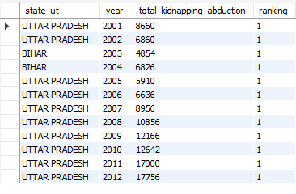
Year wise maximum kidnapping state
/*7.Show year wise maximum Kidnapping city*/
with CTE as (select state_ut, year, total_kidnapping_abduction, dense_rank() over (partition by year order by total_kidnapping_abduction desc) as ranking
from (select state_ut, sum(kidnapping_abduction) as total_kidnapping_abduction, year
from district_wise_crimes
Group by state_ut, year
order by total_kidnapping_abduction) as kidnapping_abduction_list)
select state_ut, year, total_kidnapping_abduction, ranking
from CTE
having ranking<2;

Slide 23

Top 3 murder rate state
/*7. Top 3 murder rate city in 2012*/
with CTE as (select state_ut, total_murder, dense_rank() over (order by total_murder desc) as ranking
from (select state_ut, sum(Murder) as total_murder
from district_wise_crimes
where year= 2012
Group by state_ut
order by total_murder) as murder_list)
select state_ut, total_murder, ranking
from CTE
having ranking<4;

Slide 24
THANK YOU

