Slide 1

Initial Analysis
Open SAE J1939 based

Slide 2
Goal
To enhance Open SAE J1939 protocol to a level where it could be used extensively with full compliance with commercial CAN stacks on automotive systems

Slide 3
System Description
Automotive ECU systems connected over CAN , with SAE J1939, defined CAN frames.
Connected ECU will run Open SAE J1939 stacks to comply with SAE J1939 standards.

Slide 4
High Level Block diagram
Light control
ECU (0x10)
Body control ECU
(0x11)
BMS(battery management system)
(0x17) ECU
ECU X
Note:- All the ECU Names and IDs are representational and not real (assumed)

Slide 5
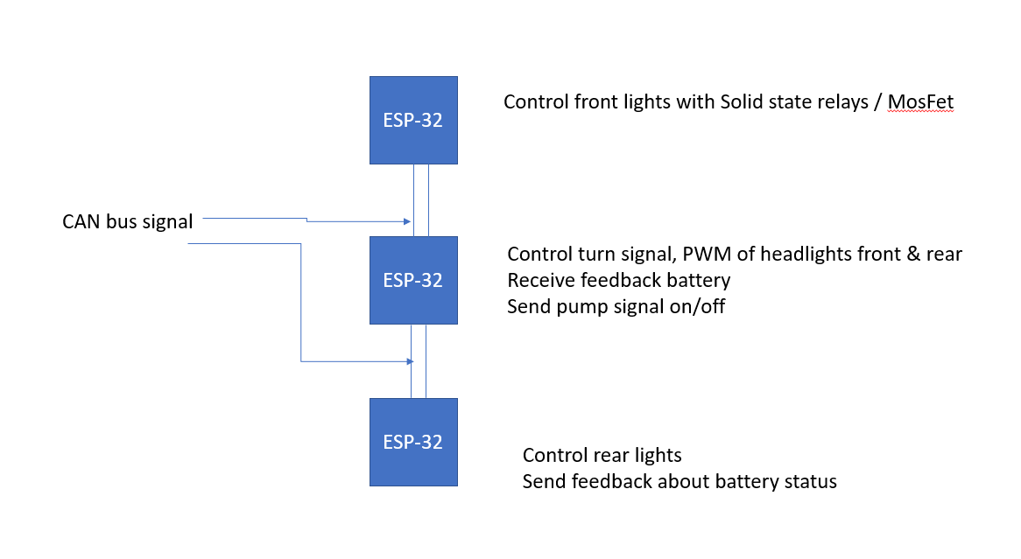
Initial Proof of concept
HW required
ESP32 CAN+SN65HVD230 VP230 CAN transceiver

Slide 6
Detailed Design –Light control ECU
Light Control Application
Open SAE J1939 Message and ECU Management
SAE J1939:71 Application Layer
ISO 11783-7 Application Layer
SAE J1939:73 Diagnostics Layer
SAE J1939:81 Network Layer
Transport Layer( Open SAE J1939)
Hardware Abstraction layer(Drivers ex:-CAN)

Slide 7
Light control Application – Basic functions
Initialize ()
Report current status of light on CAN.
Receive Light ON/OFF command on CAN.
Report DM Message periodically as heart beat to other ECUs .
Control PWM of front lights based on input value over CAN
Memory management .
Note:- All these requirements are conceptual to kickstart the Proof of concept work

Slide 8
Questions
After reviewing the code base you provided I have following questions/assumptions .
The code was done for STM32/Default –No Processer ,Now we need to port it to ESP32 and the rest of variants .
Now that all the messages are predefined should we not have way of storing the message properties like ID ,signals, DLC in a configuration similar to a dbc/look up table or generate c code from database/json file ?
We are not using any scheduling between the application / CAN Tx/Rx ?
Read and write Call backs need to be defined in detail based on the platform and other functional requirement
Need to create application logic for PWM,IO control etc
Memory management need to be handled .

