Slide 1
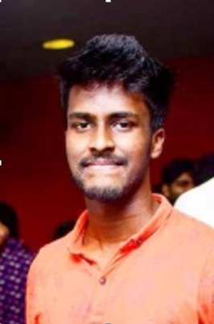
Who Am I ?
Personal Profile
Name : Sahiru Galappaththi
Age : 24 Years
Hometown : Horana
Education
Leeds International School Panadura Ordinary levels
Gateway College Colombo Advanced Levels
Sri Lanka Institute of Information Technology : BSc (Hons) in Information Technology specialising in Software engineering.
Working Experience
Trainee software engineer - Synapse Solutions (Pvt) Ltd.
Associate Software Engineer - CodeGen International (Pvt) Ltd
Software Engineer - CodeGen International (Pvt) Ltd
Sports
-Multiple National Level wins in cricket and badminton.
-University and school colors award and special award holder for cricket and badminton.
-CodeGen badminton team member.

Slide 2

Favorite TV show character
Itachi Uchiha - From Naruto Anime series
-life changing choice.
-always loved his brother.
-well being of the village was priority.
-Every step he takes is a calculated step.

Slide 3

London Stock Exchange Group
-Global financial markets infrastructure and data provider.
-Headquartered in the UK and operated across 70 counties.
-Customers are offered access to capital markets.
-Aiding in capital efficiency.

Slide 4

What are Capital Markets?
-A market where buyers and sellers trade financial securities. eg: shares.
-Primary Market: deals with trade of news issues of stocks and other securities.
-Secondary Market: deals with the exchange of previously issued securities.

Slide 5
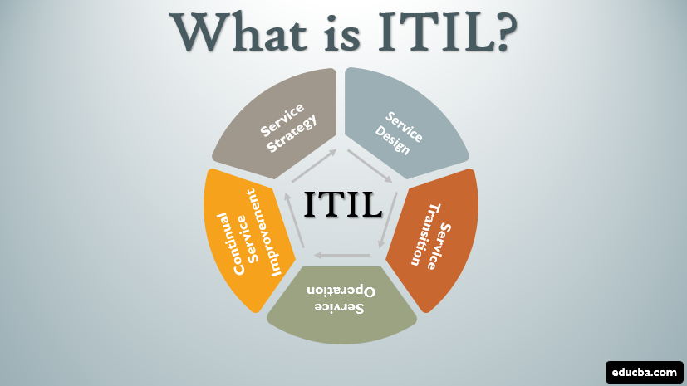
ITIL
Information Technology Infrastructure Library is a framework.
Used to standardize the life cycle of IT services in a business.
Aligning IT services with the needs of business.
enables IT administrators to be business service partners, rather than just back-end support.
The goal is to improve efficiency and achieve predictable service delivery.

Slide 6
Importance of an Application Support Engineer for a Production System.
Ensure the 24 x 7 x 365 availability of the system.
Set up environments for the system to run smoothly.
Provide assistance in emergency situations..
Monitoring, escalation and resolving issues.
Identify and implement operational improvements for processes, performance and reliability.
Working with clients to provide assistance.
Reporting and documentation.
Release management.

Slide 7
Why I want to work as an Application Support Engineer
I have the passion for it.
I have the background knowledge and experience for it.
Interested in self learning new DevOps related technologies.
Passionate about working with releases and deployments.

