Slide 1
DECENTRALIZED P2P LEARNING NETWORK
SkillSwap
Learn what you want by teaching what you know.
Replacing expensive traditional tutors with zero-cash peer knowledge exchange.

Slide 2
THE CORE PARADIGM
Reinventing How We Share Expertise
THE TRADITIONAL PROBLEM
• High Cash Barriers
Traditional private tutors and platforms charge steep recurring fees and subscriptions, creating financial walls to acquiring new skills.
• Passive Learning
Static video tutorials lack dynamic 1-on-1 interaction, direct guidance, and real-time feedback.
• Zero Trust Peer Networks
Basic skill exchanges break down due to unverified skill levels and zero credential proof.
THE SKILLSWAP PARADIGM
✓ Skills as Currency
Trade your existing knowledge directly for new skills without spending a single dollar.
✓ Multi-Hop Graph Matching
Algorithmically routes 3-way circular trades so everyone finds a perfect match.
✓ Proctored Skill Verification
Automated quizzes with tab-blur detection ensure verified expertise before teaching.

Slide 3
SYSTEM INNOVATIONS
Core Features Driving Platform Trust
01
Circular Swaps
Unlocks match liquidity by routing 3-way circular trades (A → B → C → A) when direct 1-on-1 options are unavailable.
02
Proctored Skill Checks
Prevents fake credentials through automated interactive quizzes with real-time window-switch & tab-blur detection.
03
Verified Badges
Establishes long-term network trust through earnable proficiency ratings and verified mentor badges.

Slide 4
ARCHITECTURE & TECH STACK
Built with Modern, Scalable Infrastructure
FRONTEND LAYER
React + Vite Framework — Styled with Tailwind CSS & Lucide Icons for high-performance, responsive UI.
BACKEND & ROUTING
Node.js & Express REST API — Axios client architecture managing real-time graph routing and peer matchmaking.
DATABASE & SECURITY
Supabase PostgreSQL — Row-Level Security (RLS) policies paired with seamless authentication.

Slide 5
HOW IT WORKS
End-to-End User Experience Pipeline
STEP 01
Authenticate
Quick registration with Supabase secure auth.
STEP 02
Verify Skill
Pass a proctored quiz to validate teaching eligibility.
STEP 03
Match Route
Graph algorithms pair direct or multi-hop trade chains.
STEP 04
Start Swap
Connect live 1-on-1 to learn and mentor peers.

Slide 6
COMPETITIVE ADVANTAGE
Unmatched Value Proposition
100%
Free Knowledge Exchange
Completely free to use through a peer skill-based currency model, unlike traditional platforms and private tutors that charge heavy fees.
+30%
Higher Match Rates
Multi-hop graph routing unlocks trades that standard 1-to-1 platforms miss entirely.
100%
Verified Expertise
Built-in proctoring ensures every mentor has proven, verified knowledge.

Slide 7
FUTURE HORIZON
Next-Generation Features & Expansion
AI-Driven Skill Paths
Personalized learning path recommendations generated dynamically based on market demand trends.
Escrow Credit Vaults
Bank earned teaching hours into secure credit vaults to redeem for future learning sessions whenever needed.
Web3 On-Chain Credentials
Mint NFT-backed skill badges providing immutable, globally verifiable proof of technical proficiency.

Slide 8
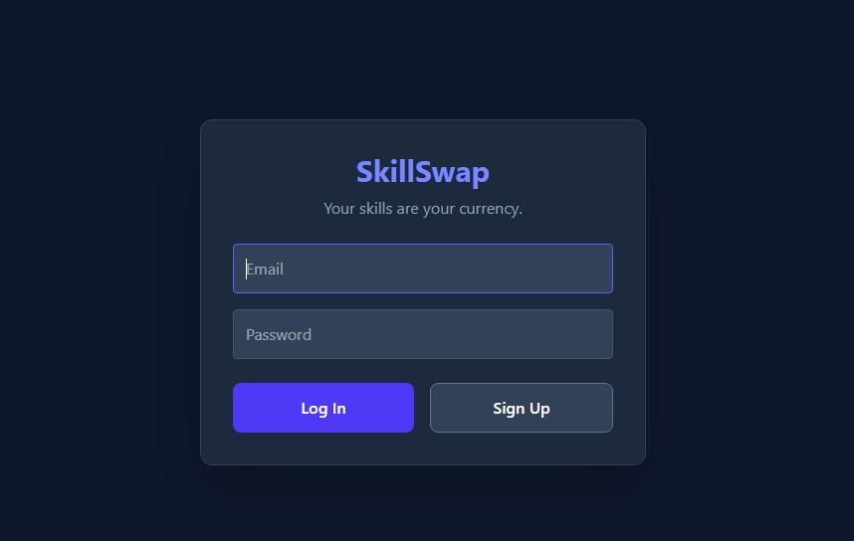
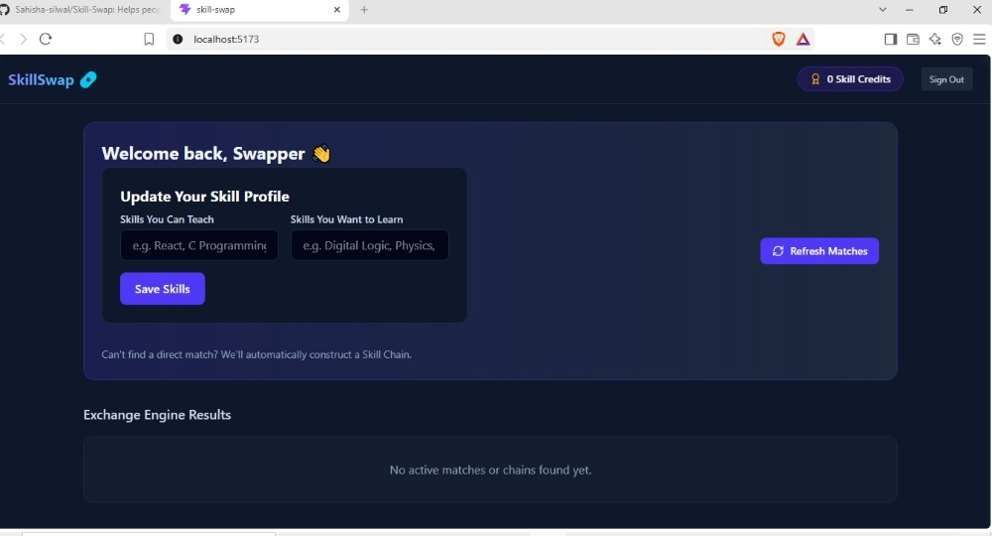
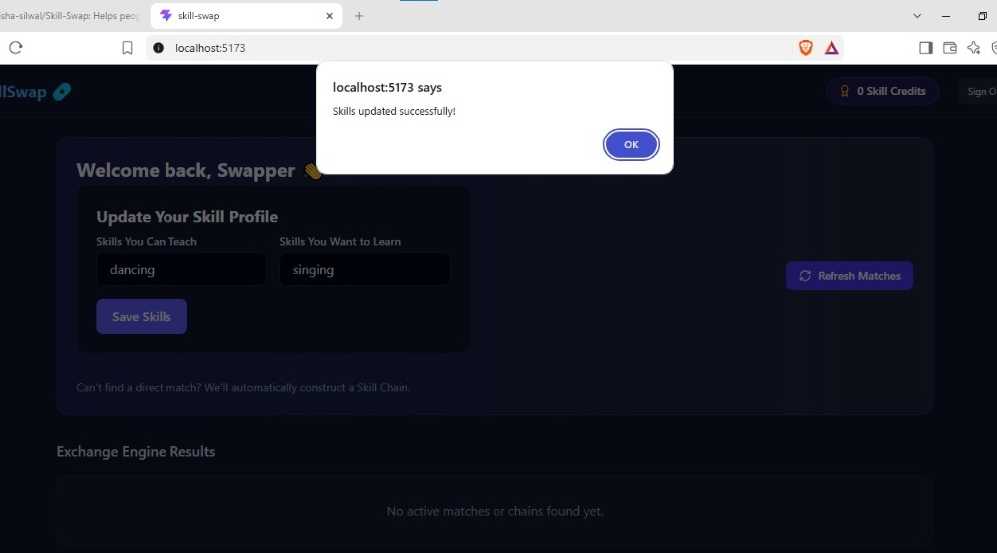
WHY SKILLSWAP BEATS YOUTUBE
Active Peer Mentorship vs. Passive Viewing
01
Interactive Mentorship vs. Passive Viewing
YouTube offers one-way video streaming, while SkillSwap provides live, interactive 1-on-1 instruction where you can ask questions and get real-time feedback.
02
Structured & Verified vs. Unfiltered Content
YouTube content is unverified and fragmented. SkillSwap ensures mentors pass proctored skill checks so you learn accurate, verified information.
03
Accountability & Practice vs. Passive Consumption
SkillSwap creates mutual accountability through live swaps, preventing the 'tutorial hell' common with passive YouTube watching.

Slide 9
PLATFORM INTERFACE SHOWCASE
Seamless Authentication & Match Engine Dashboard

